Slide 1
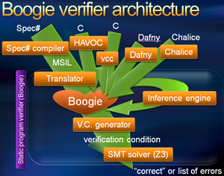
Boogie - Polymorphic Intermediate Verification Language: Design and Logical Encodings
Ido Faran, Verification of Smart Contracts, 14/11/21

Slide 2
Agenda
Boogie IVL - Concept, Frontend, Backend
The Boogie Language
Boogie Types and Expressions
Representation of types as terms for solvers
  Type guards
  Type arguments
Performance
Demo

Slide 3
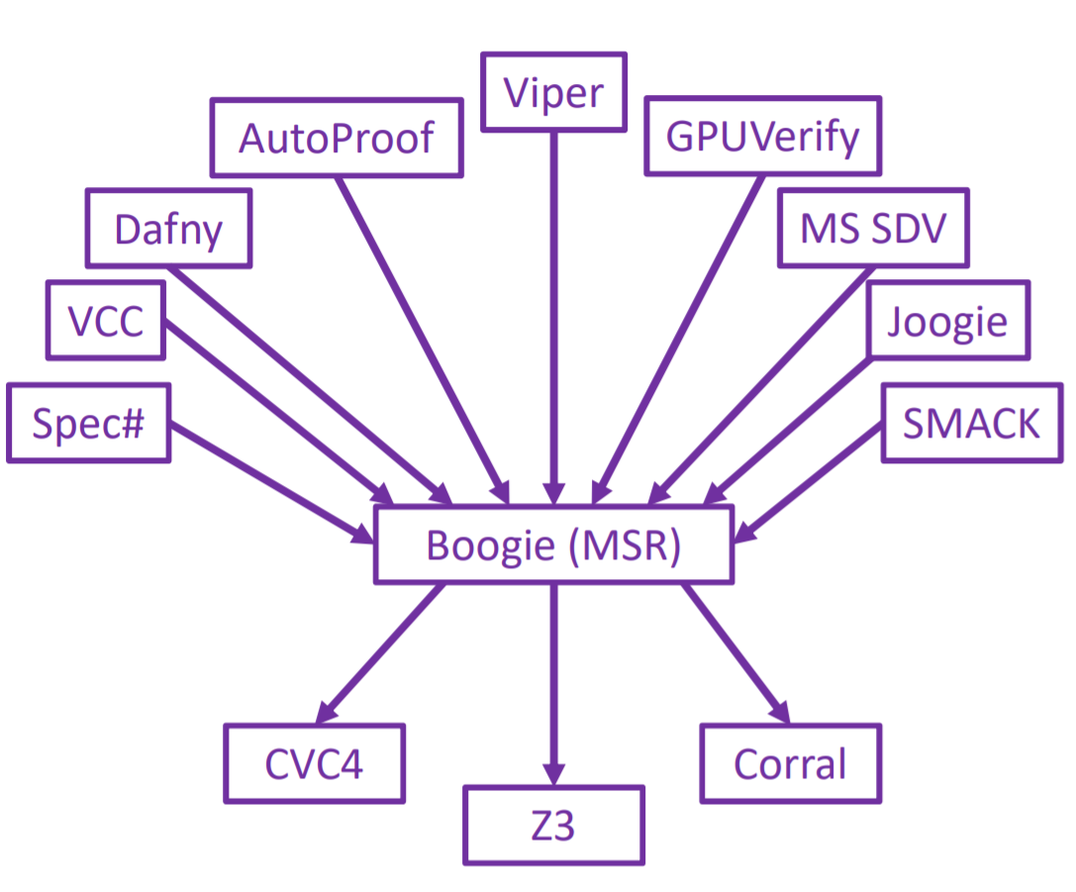
What is Boogie
The Boogie IVL (intermediate verification language) is a simple language designed for verification which was originally created by Microsoft Research.
Intermediate verification language - a layer on which to build program verifiers for other languages
Frontend - translates a program written in some language to the Boogie IVL
  VCC and HAVOC verifiers for C and the verifiers for Dafny, Chalice, and Spec#.
Backend - tries to verify the translated program - SMT Solver
  Z3, CVC5, Yices2, Corral

Slide 4
IVL - Separation of concerns
SoC - Design principle for separating a computer program into distinct sections. Each section addresses a separate concern, a set of information that affects the code of a computer program
The front-end (programing language) does need to care about what method is used to verify the program.
The back-end (verifier) does not need to care about the semantics of several different programming languages. It only needs to care about the Boogie IVL syntax.

Slide 5
Projects over Boogie
Boogie has proven to be a great platform on top of which to implement other verification systems:
Havoc: a tool for checking systems software written in C.
Poirot: a property checker for concurrent programs.
Symdiff: a windiff that shows semantic differences!
VCC: a tool that analyzes concurrent C programs.
Verve: an operating system whose type safety has been verified.

Slide 6
Boogie - Concept and History
Boogie (2005) was developed as an intermediate tool for the Spec# project
  Spec# is an extension of C# with non-null types, preconditions, postconditions, and object invariants.
The Boogie language is designed to provide reusable language features:
  Encoding imperative programing
  Heap-based programs
  Representing verification requirements
  Adding custom types, axioms, assumptions
  Polymorphism

Slide 7
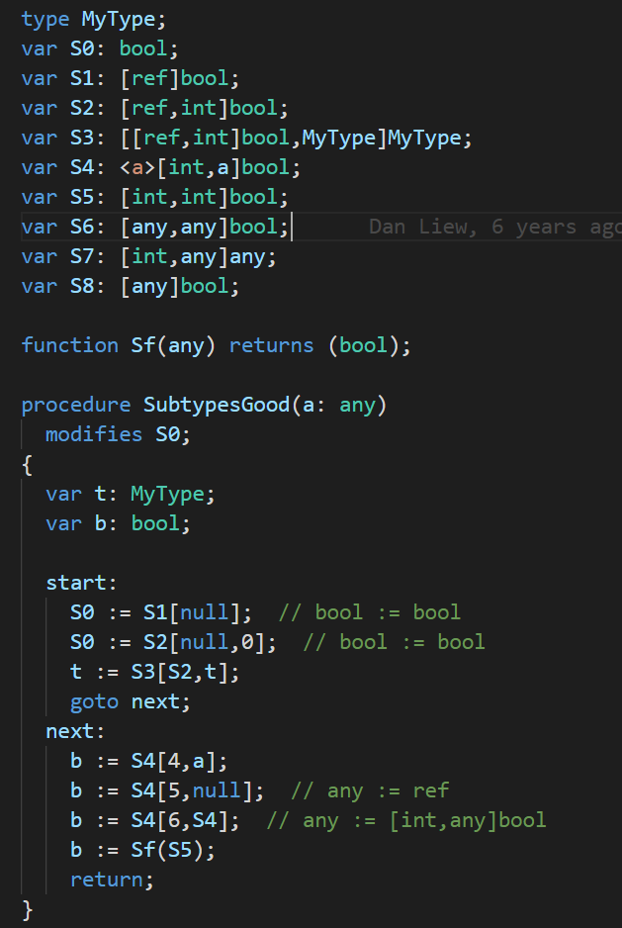
The Boogie Language
Built-in types for integers, booleans, bit-vectors, real numbers and maps
User-defined types and axioms, polymorphism
Standard features such as variables, loops, conditionals, procedure calls
Assume and assert statements, non-deterministic choice

Slide 8
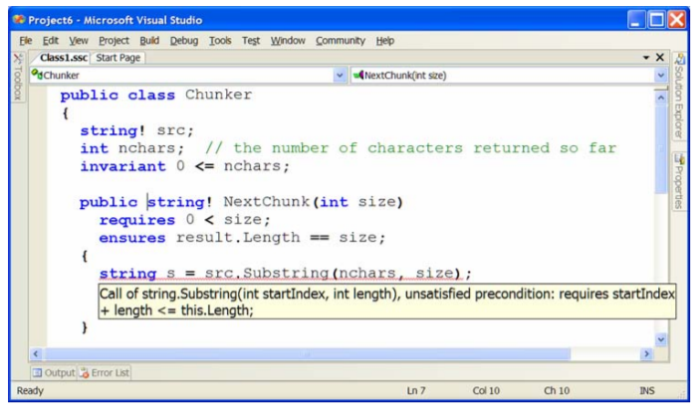
Boogie Verification
Correctness of programs means no failing traces
for each procedure
  procedures can be given preconditions and postconditions
  loops must be provided with invariants
Boogie comes with a verifier to check correctness of Boogie programs
  weakest preconditions are efficiently calculated by the Boogie verifier
  the corresponding entailments are encoded to a backend SMT solver (typically Z3)
  verification by a SMT solver
Boogie Output - localise errors and traces which reach the error locations

Slide 9
Boogie Types and Expressions
Built-in types: bool, integers, bit-vectors, maps
User-defined types (constructors), type synonyms (macros)
  Type - non empty set of individuals
var x:bv8;
x := 0bv8; // 0b00000000
x := 1bv8; // 0b00000001
x := 2bv8; // 0b00000010
x := 3bv8; // 0b00000011
x := 15bv8; // 0b11111111
// Variable x maps integers to boolean values
var x:[int]bool;
// Variable y maps boolean values to boolean values
var y:[bool]bool;
type CustomNum int;
type Pair S T;
type PolyMap = <S>[int]S
// type synonyms
type IntPair = Pair int int
var a:int;
var b:bool;

Slide 10
Const and Variables
Symbolic constants are introduced by constant declarations: const z:bool;
  Value defined by axiom statement
Global variable declarations introduce the state on which all procedure operate - var a:int;
  Restricted by axiom and modify statements
var a:int;
var b:int;
var map:[int]int;
axiom {:some_attribute} a > b;
axiom (forall x:int :: map[x] > a);
// Immutable global variable with idenitifer z.
// Properties on this variable should be set using axiom(s)
const z:bool;
axiom z == 0;

Slide 11
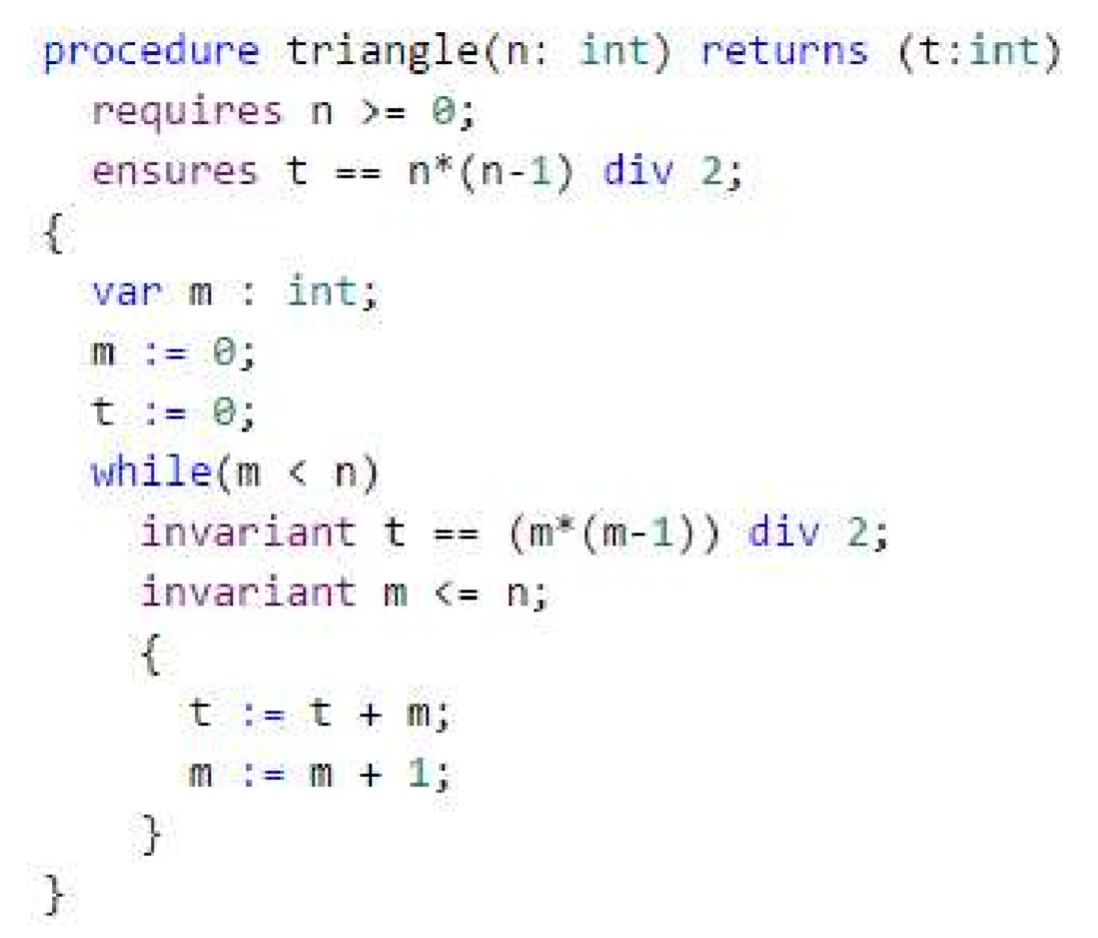
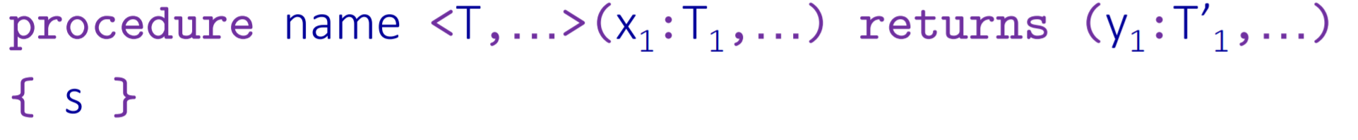
Procedures
Procedure - gives a name to a set of execution traces, which are specified by pre and post conditions.
T - typed parameters
X - input parameters
Y - output parameters
Conditions - requires (precondition), ensures (postcondition)
frame specification modifies
Loop invariant

Slide 12
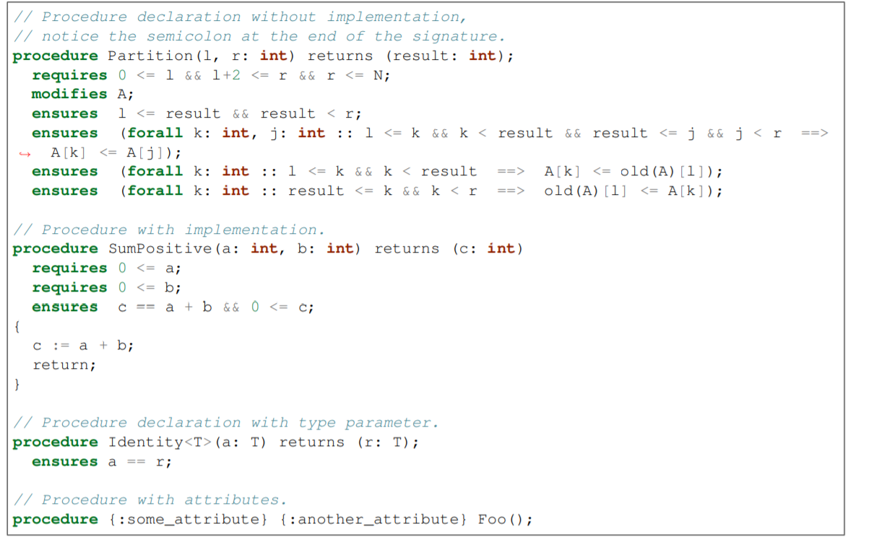
Procedure - Complex

Slide 13
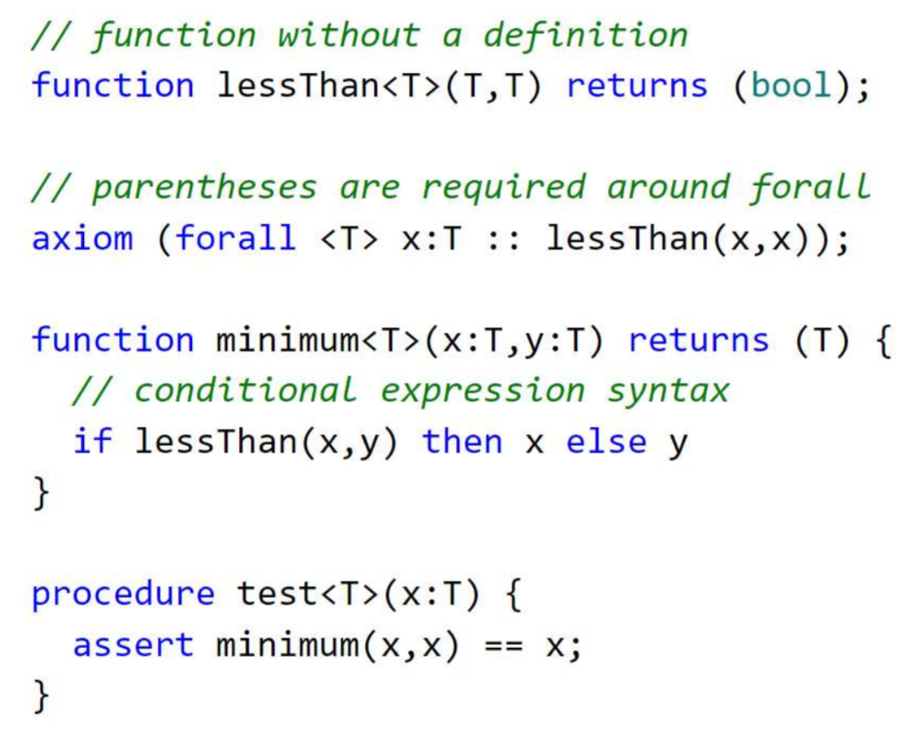
Functions
Function declarations, with or without definitions
  If a definition is provided, the body is an expression, not a statement
Properties of function can be defined by axioms
All declarations can be polymorphic
  type parameters instantiated implicitly
  family of functions
  Type correction expression x:T

Slide 14
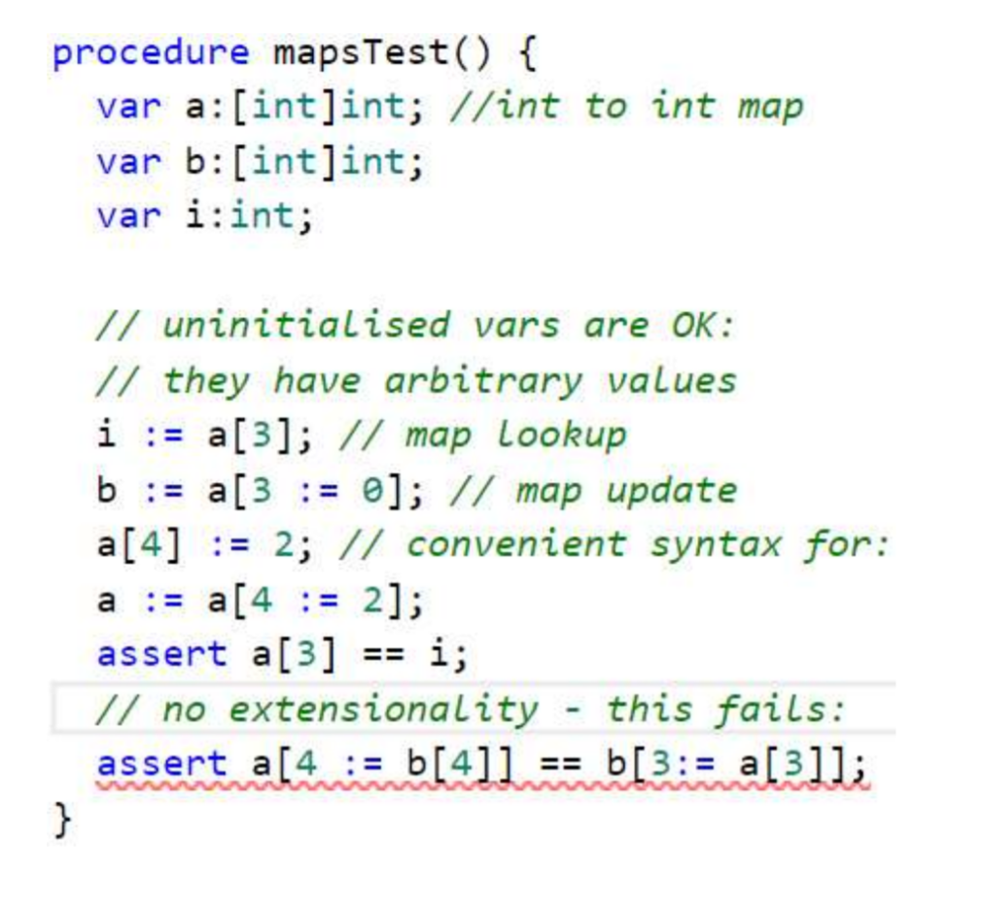
Maps
Mathematical maps are built-in in Boogie
  map types are written [domain]result - e.g. [int]bool and[int,int]int
  map types can also be polymorphic - var a:<T>[int]T
Boogie provides syntax for map lookup and “update” operations
  In practise, maps are immutable values; a - map update defines a new map value
Boogie maps are not extensional -
  two maps can return the same lookup values but not be (known to be) equal

Slide 15
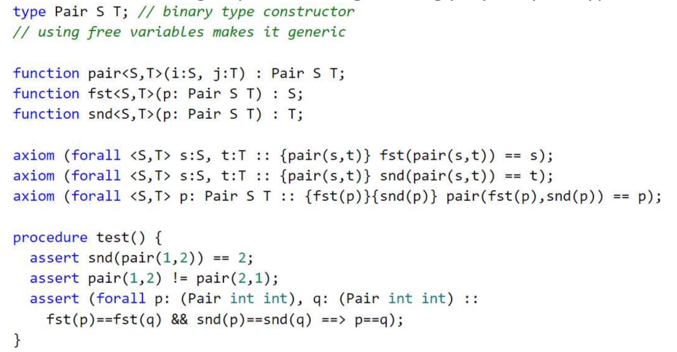
Custom Types - Type Constructor

Slide 16
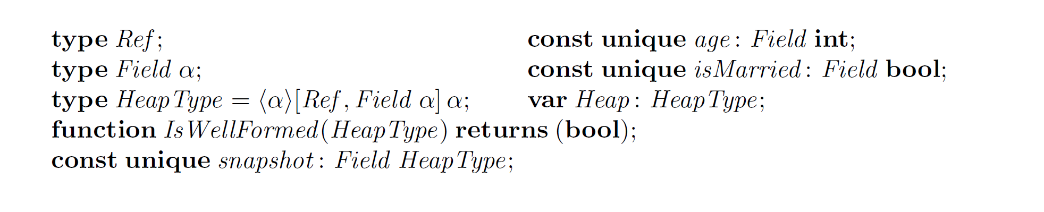
OOP Class Declaration in Boogie

Slide 17
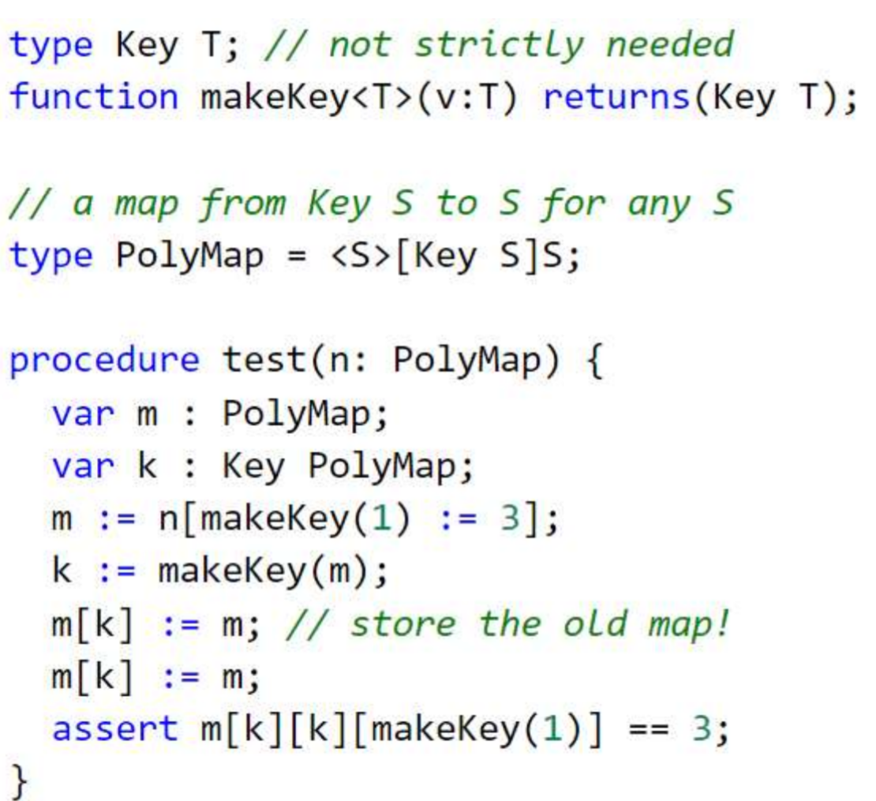
Type Synonyms and Polymorphic Maps
Type synonyms + polymorphic types allows recursive types
For example, we can define a map which contains instances of the same map type to lookup:
  note that none of the following statements require type annotations
Example - test function here

Slide 18
Representation of types as terms
Automated theorem provers and SMT solvers typically accept only untyped logics as their input language
The expressions from the richer language have to be translated into the simpler logic
  Encode Boogie’s types as terms so that typing conditions can be expressed as formulae
Two approaches to this translation:
  Captures type information using logical guards
  Encodes type parameters of polymorphic functions as additional function arguments

Slide 19
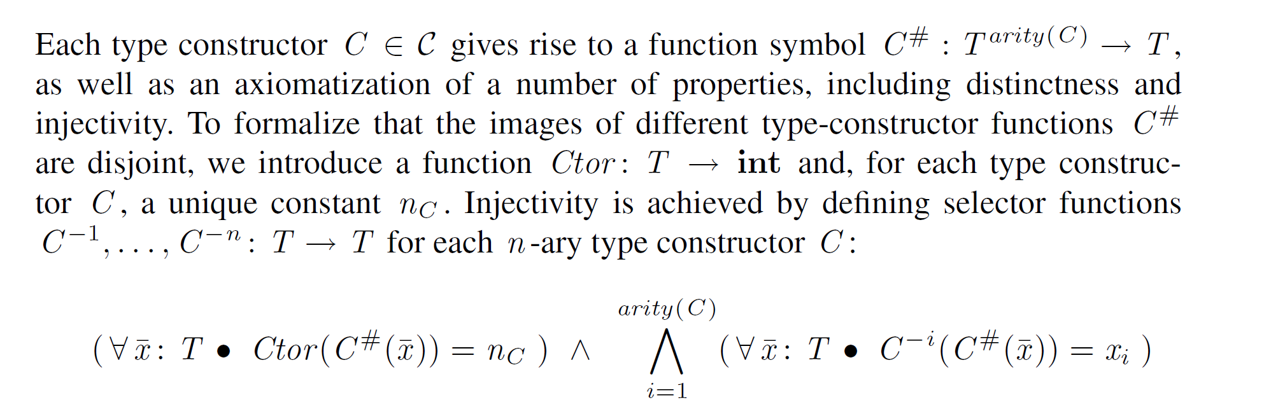
Type Constructor encoding

Slide 20
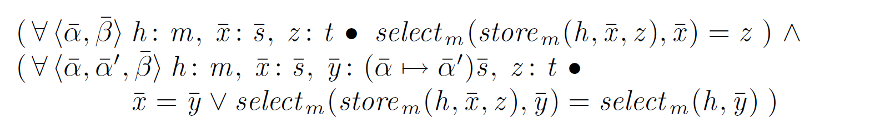

Reduction of Map types to Ordinary Constructors
The encoding of Boogie’s polymorphic map types is done by a reduction to normal type constructor
Access functions (get, set) can be axiomatized as ordinary functions
Problematic - two maps that have common instances, might be represented by a different constructor
  Solution - larger classes of type constructor for map types - define constructor only for the “most general” map type (more details in the paper)
type myMap = <a1, …, an>[int]a1, … an;

Slide 21
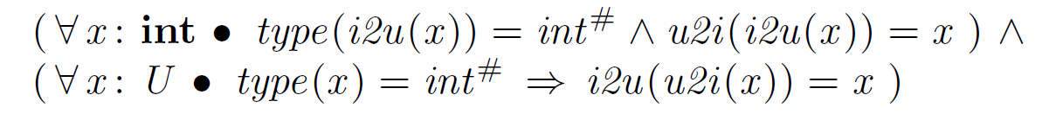
Translation of Expressions - Logical Guards
Encoding type information using type guard
  Axioms about functions variables’ types
Complicating the propositional structures of the formula, performance impact

Slide 22
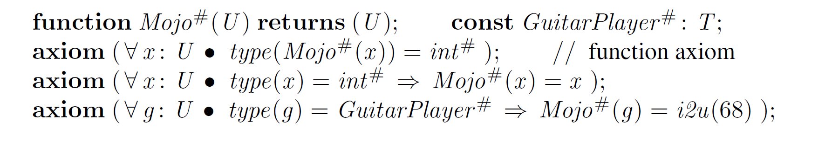
Logical Guards - Example

Slide 23
Translation of Expressions - Type Arguments
Explicitly passing the values of type parameters to functions
Much faster - trades generality for performance

Slide 24
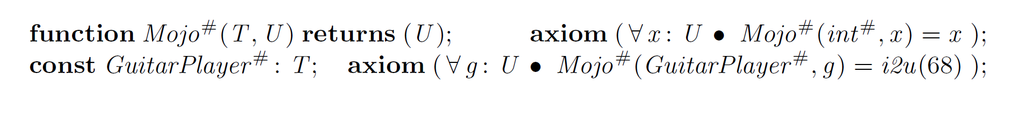
Type Arguments - Example

Slide 25
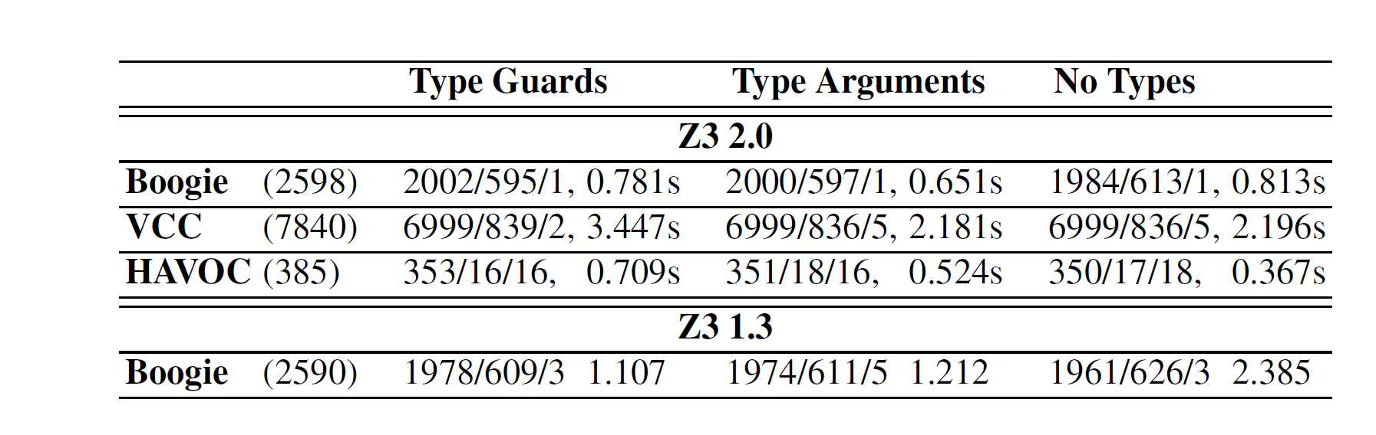
Performance Benchmark
Three types of translations
  Type Guards
  Type Arguments
  No Types - aries all type information
Four boogie programs (last two does not use polymorphism)
Boogie 2 generated verifications conditions, SMT Solver Z3 2.0 verified them
Reports in each cell:
  Number of times for each outcome - valid/invalid/timeout
  Average time needed for proof attempts
Time difference between Type Argument encoding and without types is small, while providing stronger coding for the frontend models

Slide 26
Summary
Boogie - intermediate verification language (Frontend -> Boogie -> Backend)
  Procedural, imperative language with support for specification constructs, maps, and a rich polymorphic type system
Boogie main features:
  variables, consts, procedures, functions, maps, custom types and polymorphism
  axiom, requires , modifies, ensures, loop invariant
Boogie translates expressions and types for verification by SMT solver
  Logical guard, encode type parameters as additional function arguments

Slide 27
Demo
boogie\Test\test1\Arrays.bpl
boogie\Test\test1\Frame0.bpl
boogie\Test\test1\Frame1.bpl
boogie\Test\test15\CaptureState.bpl
boogie\Test\test16
boogie\Test\test17\flpydisk.bpl

