Slide 1
MOVE: A Language With Programmable Resources
Blackshear et al.

Slide 2
Overview
Background – challenges of representing digital assets on a blockchain.
Move design – how the design of move addresses these challenges.
Technical details
Implementation example of peer-to-peer payment
Move interpreter & move verifier
Putting it al together

Slide 3
Background
Why do we need a special programming language for blockchain?
What informs the design of a blockchain programming language?

Slide 4
Background
It is challenging to…
  1. Representing transitions and state that encode ownership of digital asset.
  2. Working in an open software system.
Scarcity
Access control

Slide 5
Background
Move:
  Blockchain high-level programming language for the Diem (Libra) Blockchain.
  Used to implement custom transactions and smart contracts.
  Developed by Meta (Facebook), 2019.
  Values and reference types.
  Executable bytecode language.
  Similar (but different!) to object oriented-programming.
  The key feature: the ability to define custom resource types.

Slide 6
Move Design - Four key goals
  First-class Resources – special characteristics but still an ordinary program value.
  Flexibility – transaction scripts and modules.
  Safety – compile time vs runtime - approach between two extremes; bytecode verifier and bytecode interpreter.
  Verifiability – move is amenable to static verification tools; no dynamic dispatch, limited mutability, modularity.

Slide 7
Move Execution Model
  two different kinds of programs:
    1. Modules
    - long-lived piece of code published it the global state.
    - include struct declarations and procedures declaration.
    - data abstraction.
  2. Transaction scripts
    - the main procedure of the transaction.
    - included procedures of a modules to update the global state.
    - a single-use piece of code.
    - “all or nothing”.

Slide 8
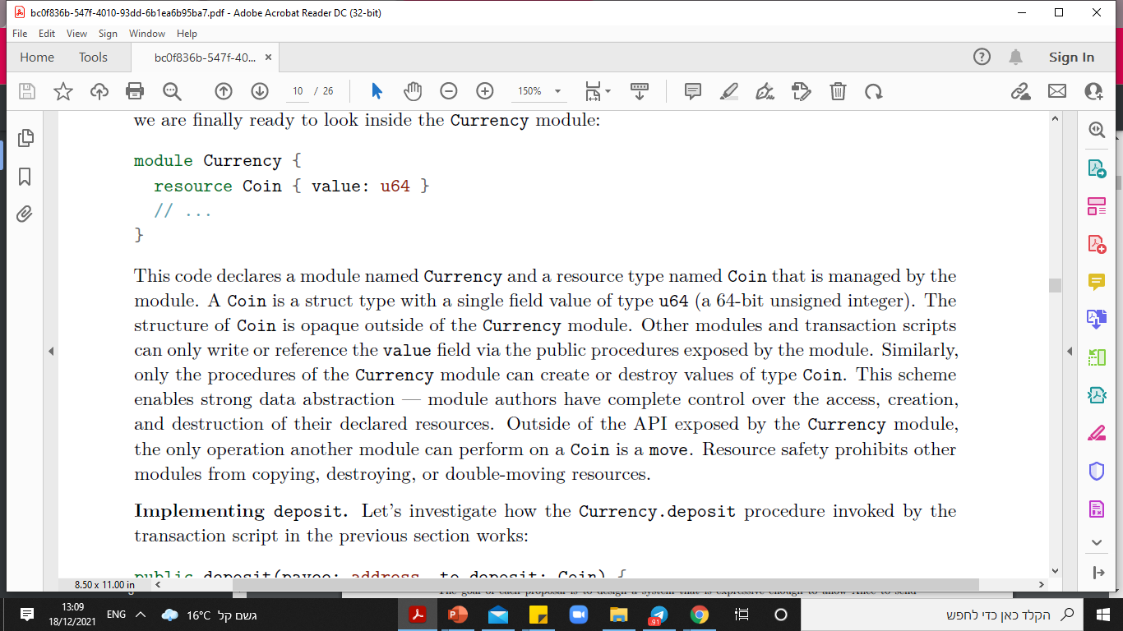
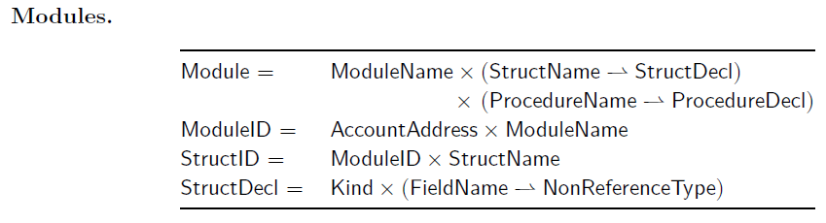
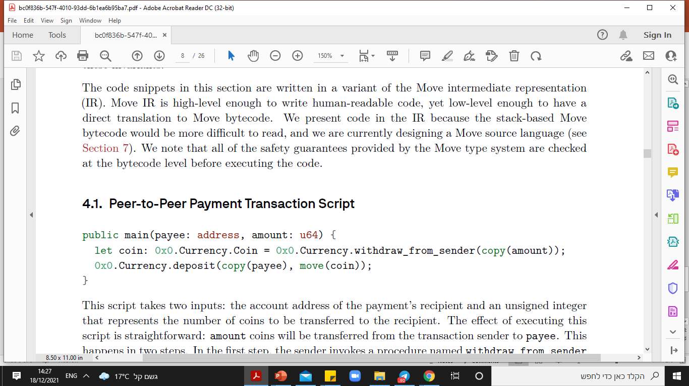
The Move Language
Procedures declarations

Slide 9
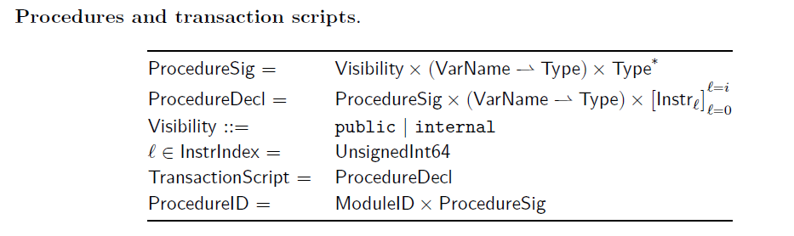
The Move Language

Slide 10
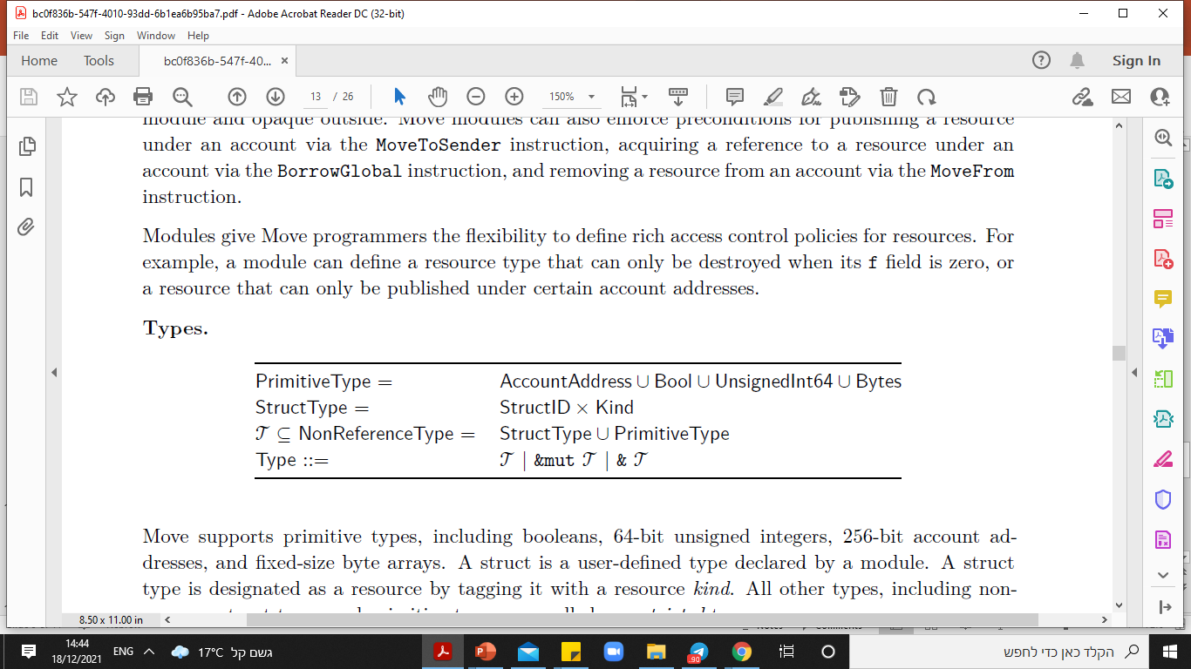
The Move Language

Slide 11
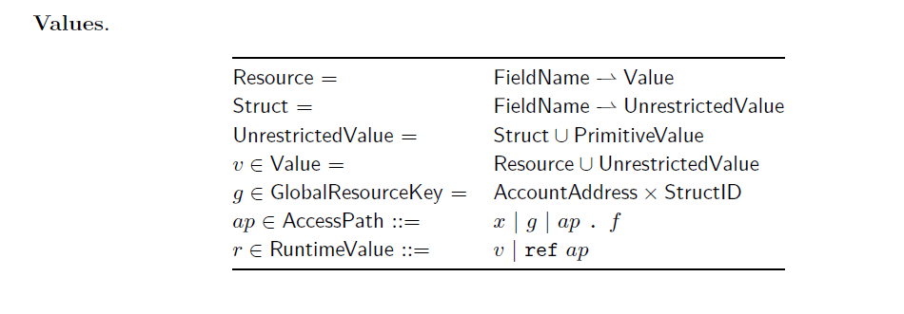
The Move Language

Slide 12
The Move Language
Resource type:
  Restricted type – cannot be copied and must always be moved.
  No reassigned.
  No dereferenced.
  Only moved between storage locations.
  “first-class” – ordinary program value.
  Critical operations on a resource type T will only be performed inside the module that defines T.

Slide 13
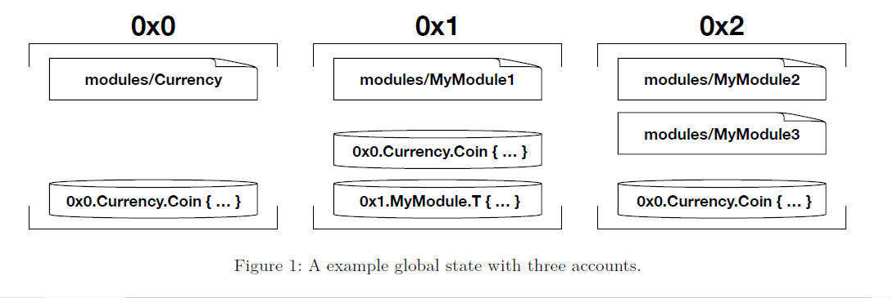
The Move Language
The global state:
  Structures as a map from account addresses to accounts
  Each account can contain zero or more modules.
  Each account can contain one or more resource value.

Slide 14
Peer-to-Peer Payment implementation example

Slide 15
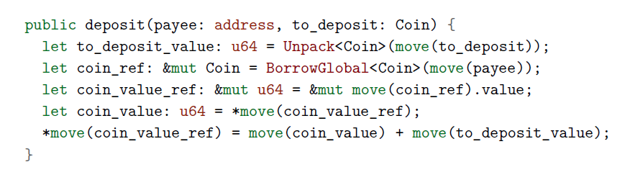
Peer-to-Peer Payment implementation example

Slide 16
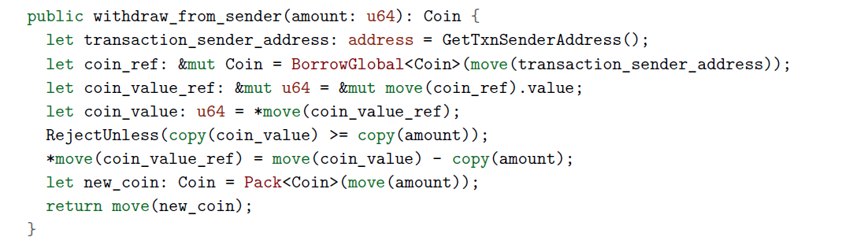
Peer-to-Peer Payment implementation example

Slide 17
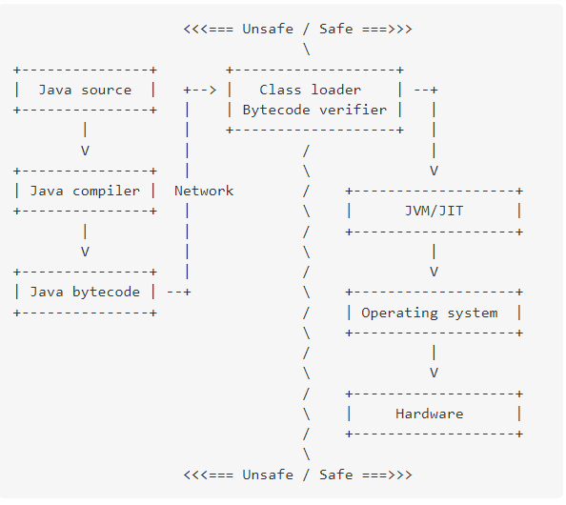
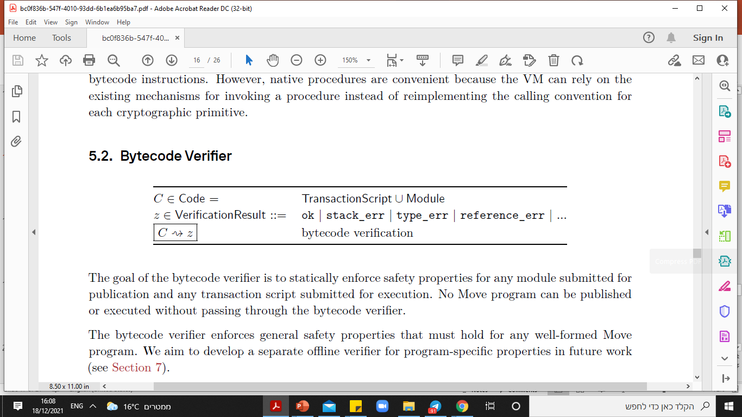
Bytecode Interpreter & Bytecode verifier
compile time vs runtime - approach between two extremes
Bytecode Interpreter:
  Stack-based interpreter.
  Gas unit budget to each transaction (similar to EVM).
Bytecode Verifier:
  Enforce safety properties for any module publication
  and transaction script execution.
  Structural, semantic and linking checks.

Slide 18
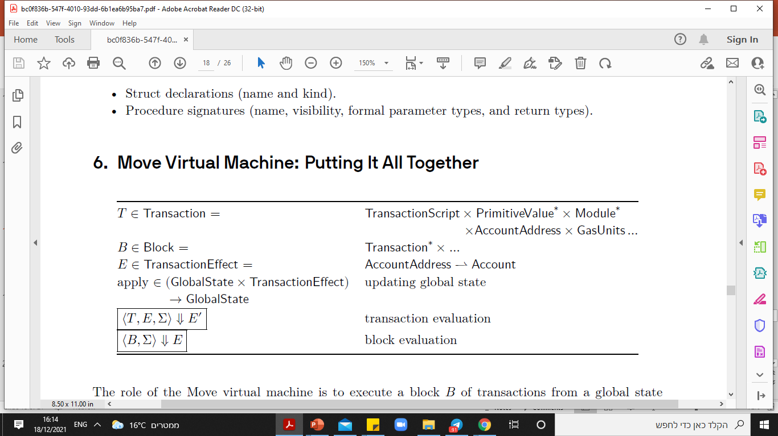
Putting it all together
∑
Block M
Fetch transaction i
Execute transaction i
Produce an effect Ei
Apply Ei to
∑
‘∑ Get
Transaction 1
...
...
Transaction n

Slide 19
Conclusion
Two main challenges in the blockchain system: representing transitions and state and working in an open system.
Move design addresses the challenges: first-class resources, safety, flexibility and vulnerability.
The key feature of Move: the ability to define custom resource types.
Types and values: primitives, structs, resources, references, mutable, immutable…
Code example that expressed the main components in the language.
Safety-check: compile time vs runtime - approach between two extremes.
Update global state process.

Slide 20
QUESTIONS?

Slide 21
THANK YOU!

