Slide 1
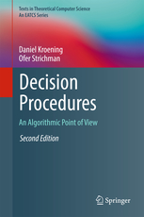
Program Verification
Chapters 12.1 - 12.3 in “Decision Procedures: An Algorithmic Point of View“, by Daniel Kroening and Ofer Strichman.
Presenting: Yuval Tal

Slide 2
Agenda
Introduction of Software Verification.
  How it is possible?
Verification of bounded program
  For program’s single execution and for any execution
Verification of unbounded program
  Techniques of dealing with loops

Slide 3
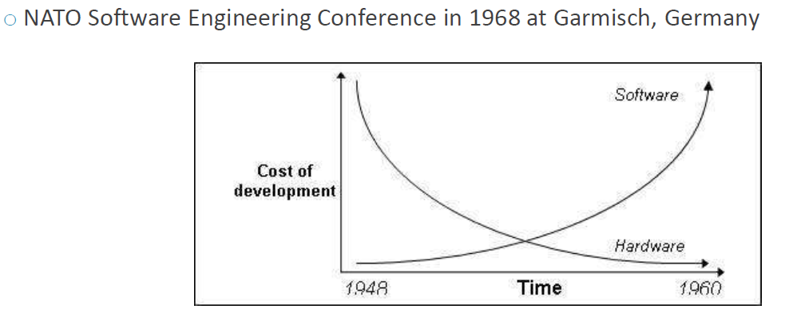

Coping with program ‘bugs’
Tests
The traditional method to detect bugs.
executing the program using a limited set of inputs.
Tests cannot guarantee the complete absence of errors.
Program Verification
Decides whether for all possible inputs a given specification is satisfied by the program.
100% correctness.

Slide 4
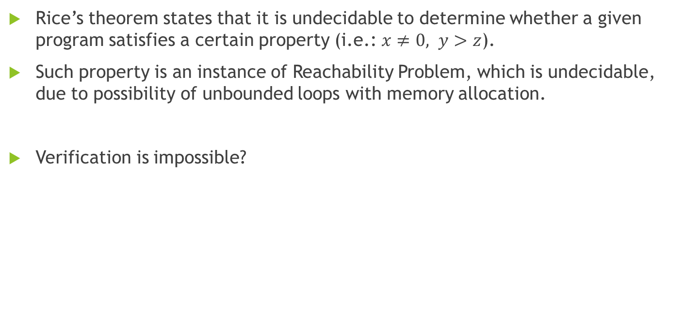
Rice’s Theorem
Rice’s theorem states that it is undecidable to determine whether a given program satisfies a certain property (i.e.: $x≠0, y>z$).
Such property is an instance of Reachability Problem, which is undecidable, due to possibility of unbounded loops with memory allocation.
Verification is impossible?

Slide 5
Verification Despite Rice’s Theorem
Core Technique: Translating programs into a logical formula
SMT (Satisfiability modulo theories) - generalizes SAT to more complex formulas involving real numbers, integers, and various data structures.
SMT-solvers - general-purpose logical solvers (e.g. CVC4)
Check satisfiability program’s generated logical formula using SMT-solver.
Translating program into logical formula is not trivial (especially with loops!) as we’ll see next.

Slide 6
Bounded Program Analysis

Slide 7
Checking Feasibility of a Single Path
Definitions:
Execution path – sequence of program instructions
Execution trace – sequence of states that are observed along an execution path. (changed by different inputs)
For each path we can build a formula that represents it: the satisfying assignments to this formula correspond to traces along this path.
Assertion verification - proving that for all inputs the condition of the assertion evaluates to true.

Slide 8
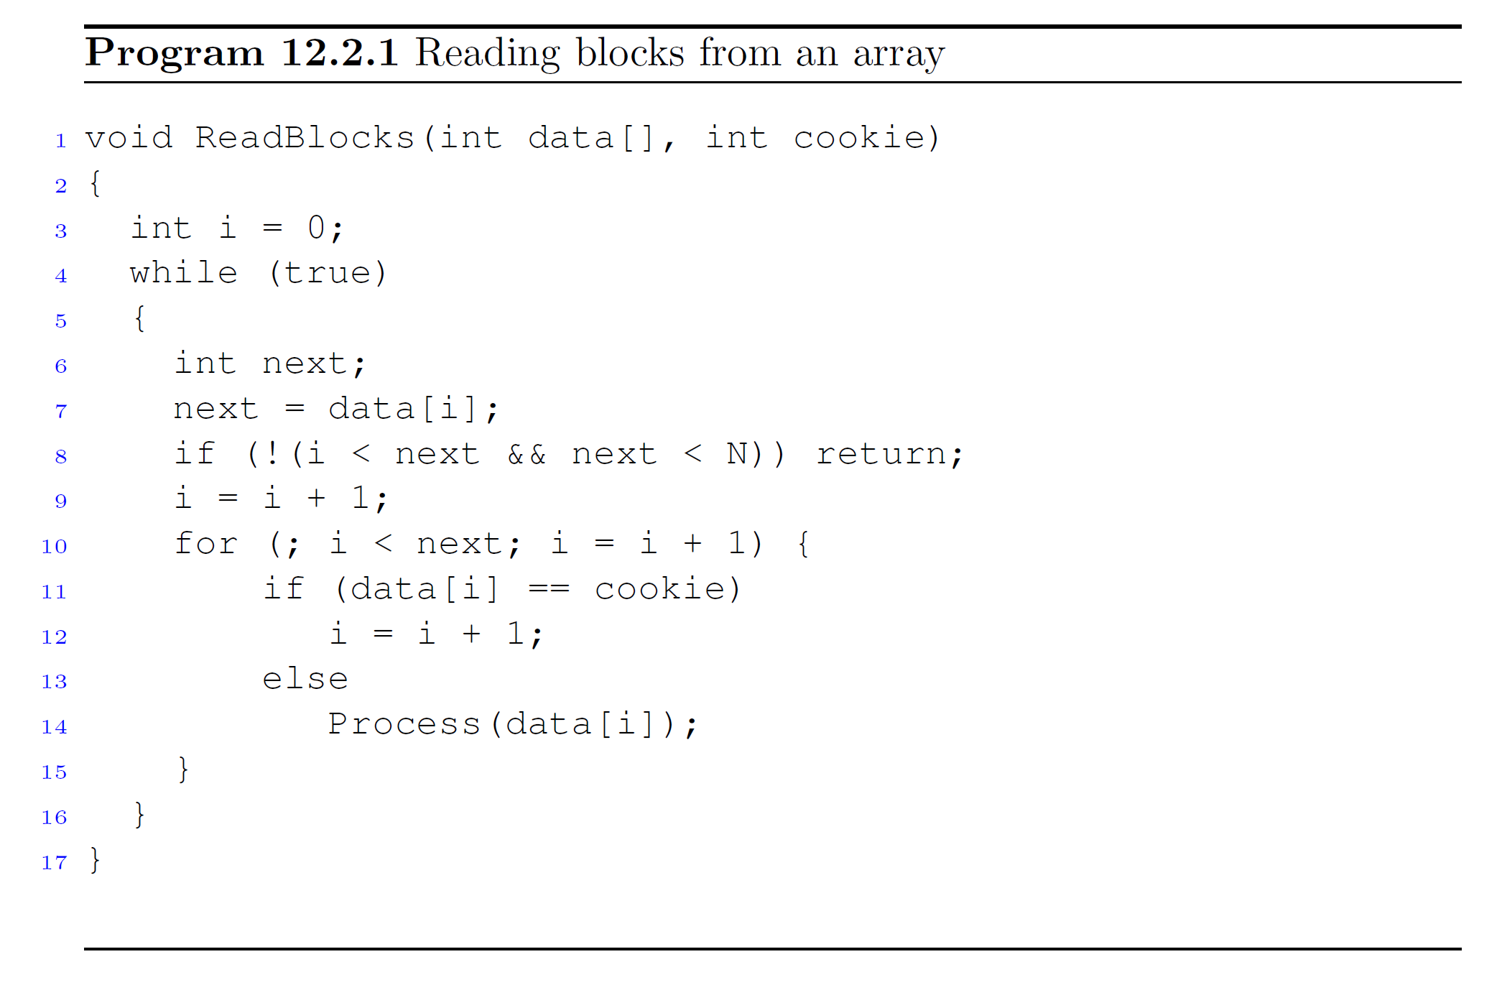
The first element of each block contains the index of the next block.
ReadBlocks is supposed to process all the data in these blocks, while skipping data that is equal to the input parameter cookie.
N is array’s length.

Slide 9
Execution path example
Consider the next possible execution path:
  Begin at Line 3.
  Run through the for loop once, take the else branch, and then exit the for loop.
  Exit the while loop during the second iteration in Line 8.
The next slide shows the sequence of instructions that corresponds to this execution.

Slide 10
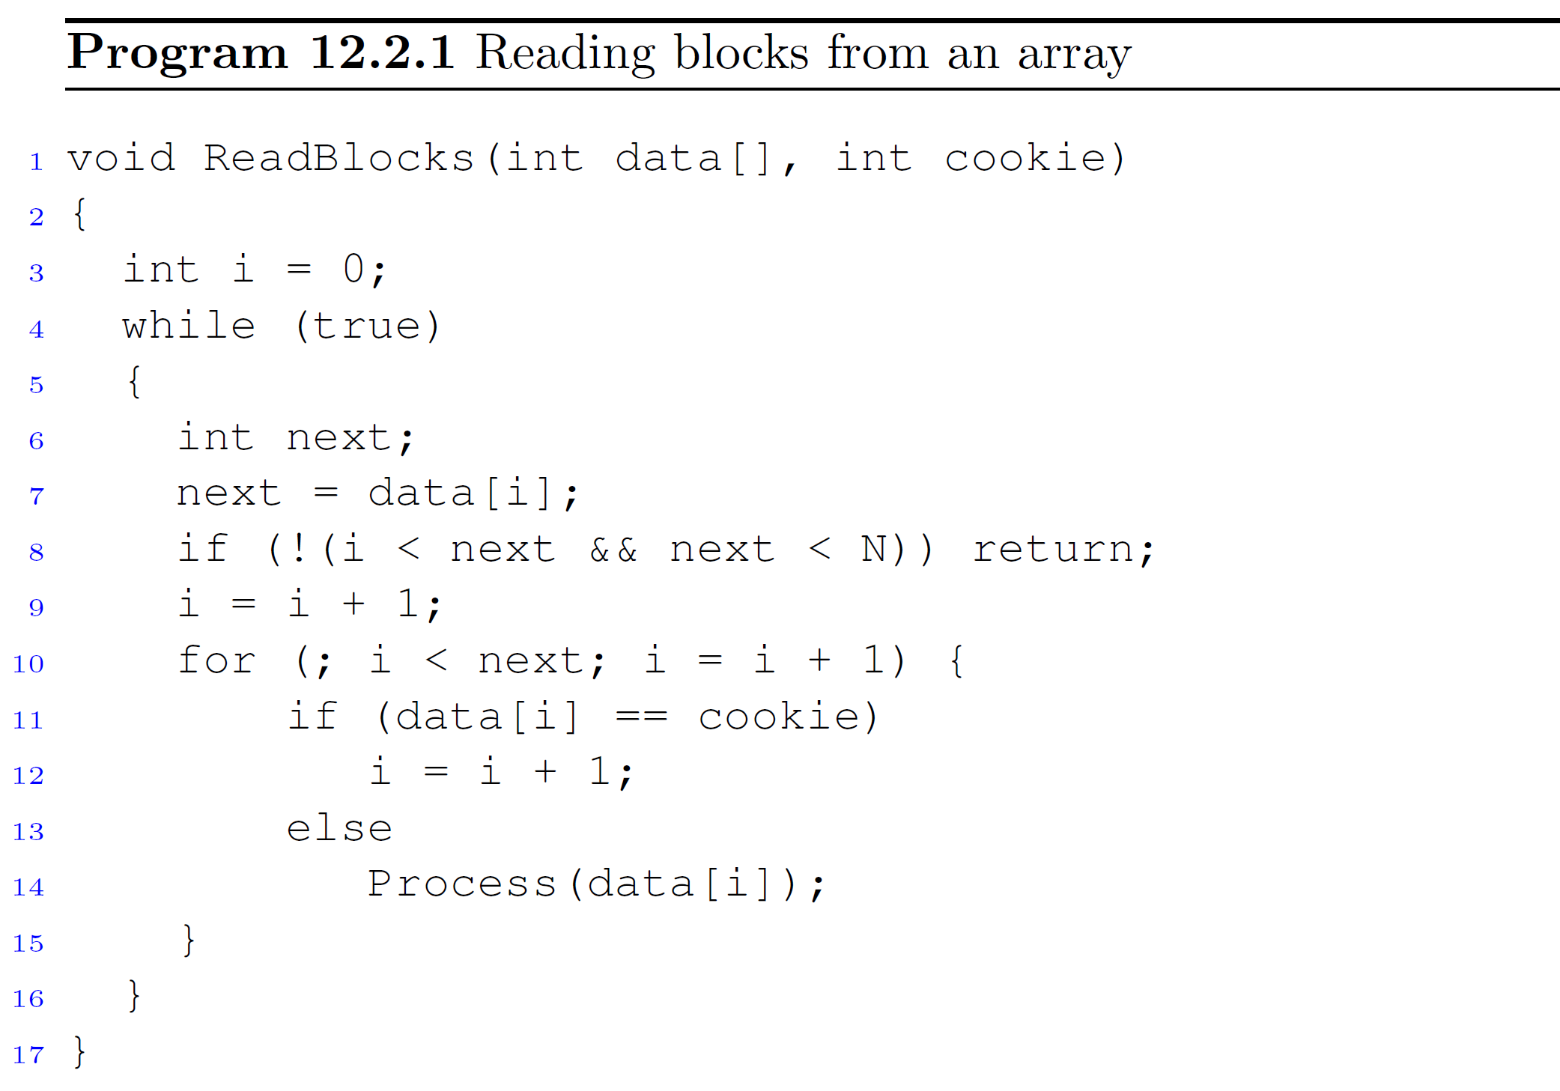
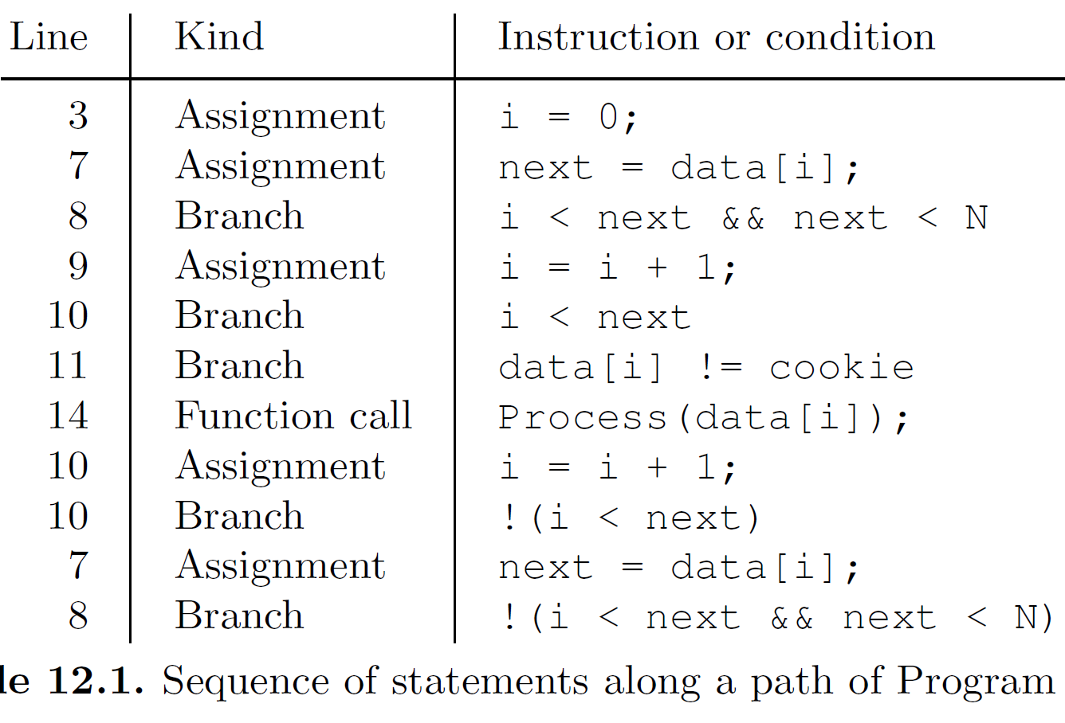

Slide 11
SSA representation
SSA = Static Single Assignment
Create a “time stamped version” of the program variables
Every time a variable is written – a new symbol (=‘time stamp’) is introduced for it.
Values of inputs time stamped with 0 (data and cookie in the example)

Slide 12
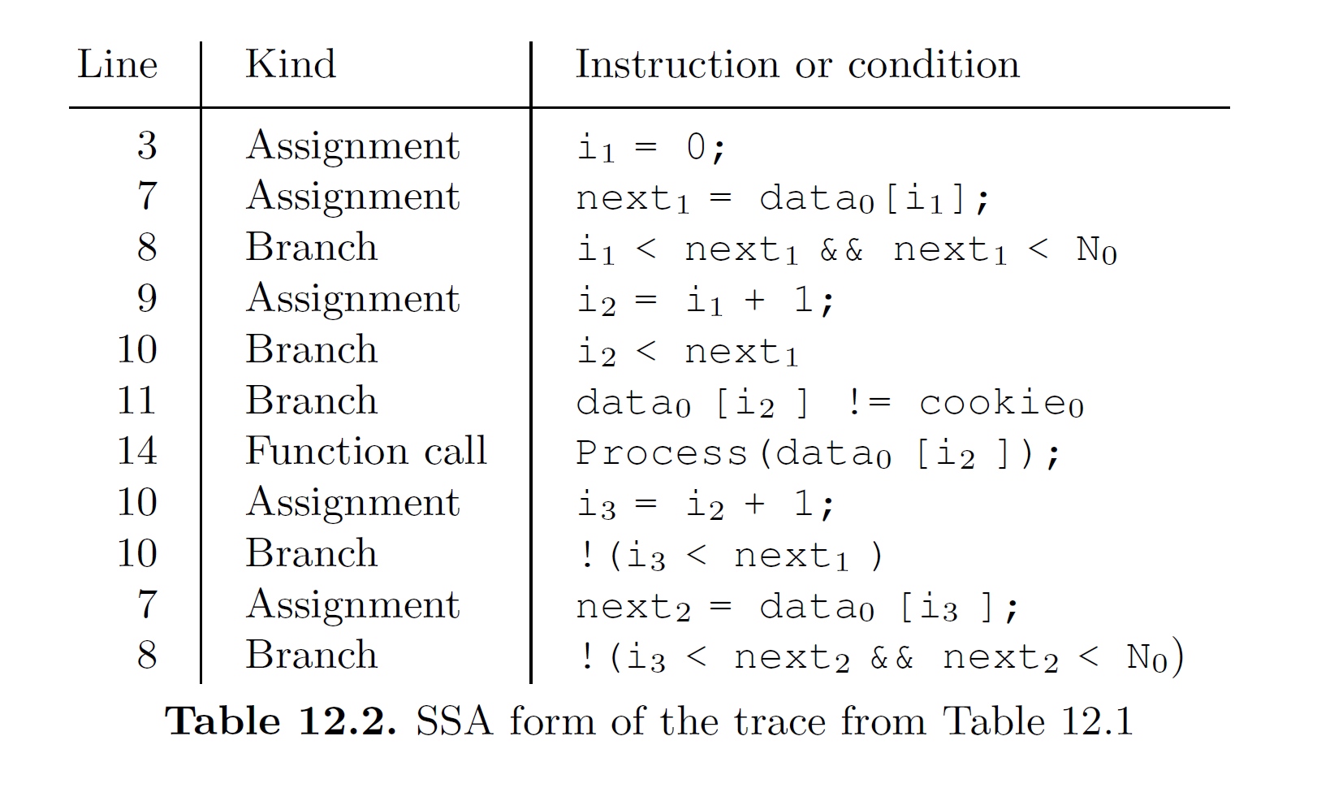

Slide 13
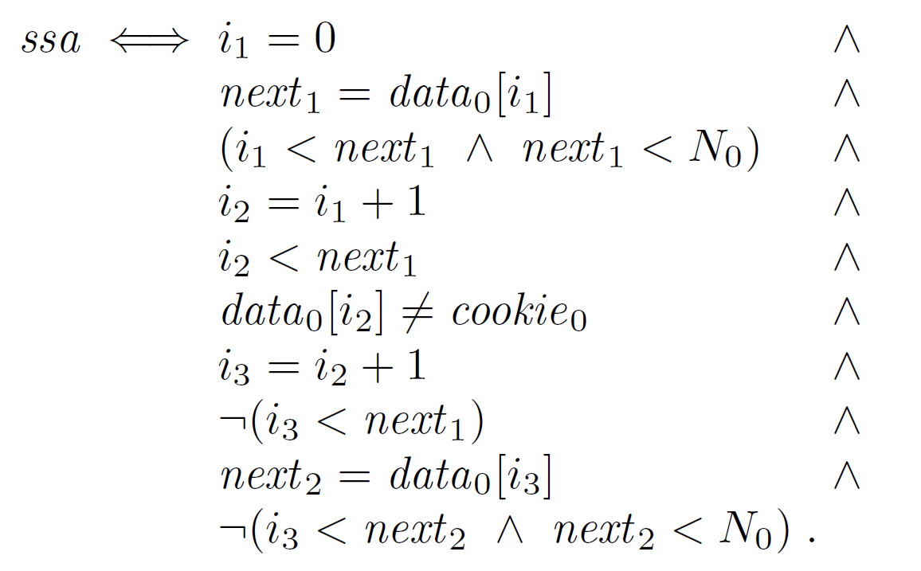
The SSA form can now be translated into a logical formula:
Note that the equality symbol in the formula denotes mathematical equality, whereas it denotes an assignment in Table 12.2.

Slide 14
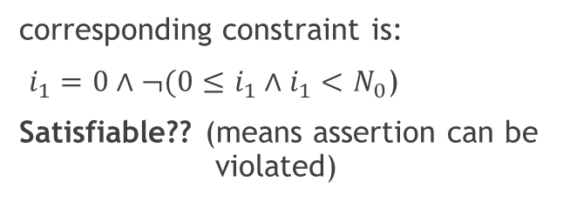
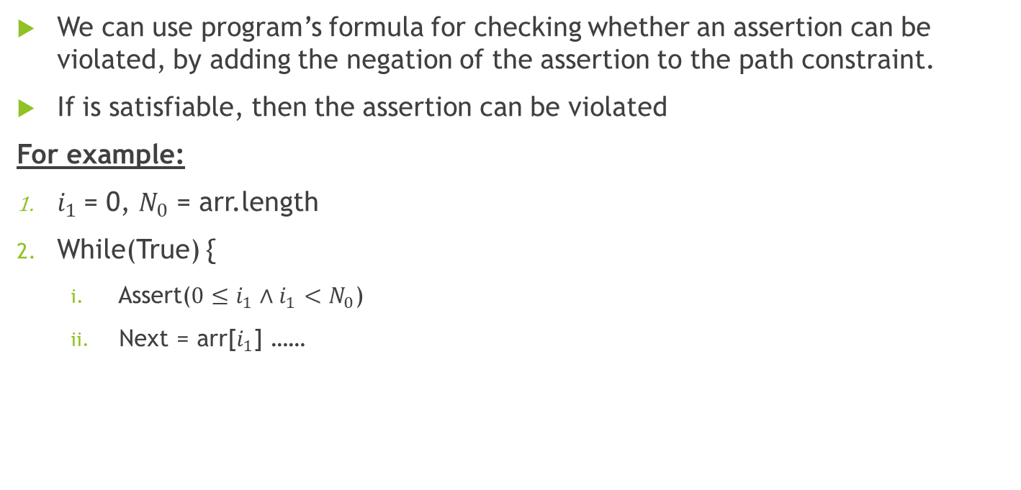
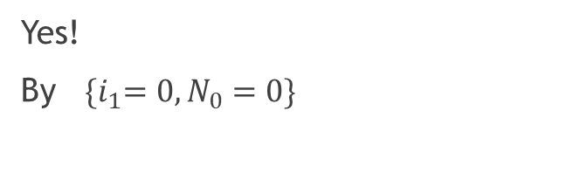
Assertion Checking
We can use program’s formula for checking whether an assertion can be violated, by adding the negation of the assertion to the path constraint.
If is satisfiable, then the assertion can be violated
For example:
$i_{1}$= 0, $N_{0}$ = arr.length
While(True) {
  Assert($0≤i_{1}∧i_{1}<N_{0}$)
  Next = arr[$i_{1}$] ……
corresponding constraint is:
$i_{1}=0∧¬(0≤i_{1}∧i_{1}<N_{0}$)
Satisfiable?? (means assertion can be violated)
Yes!
By ${\{i}_{1}=0,N_{0}=0\}$

Slide 15
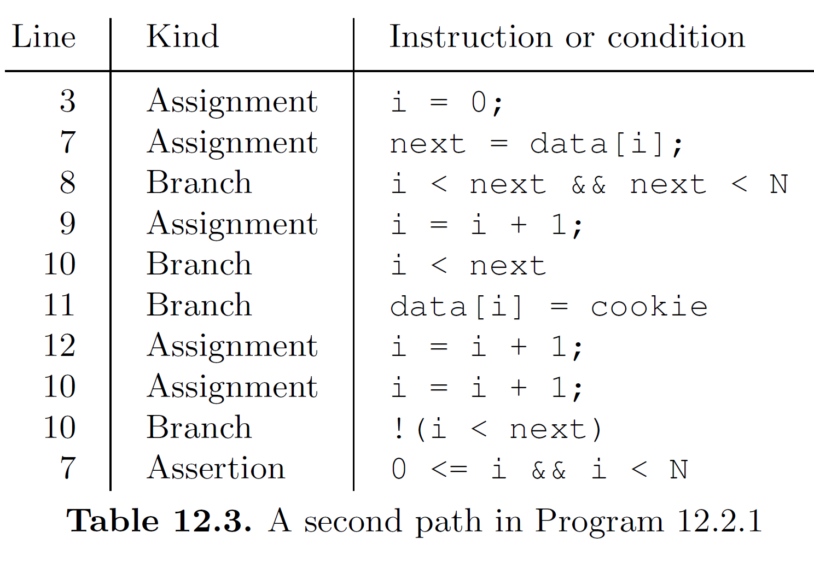
Path leading to previous violation

Slide 16
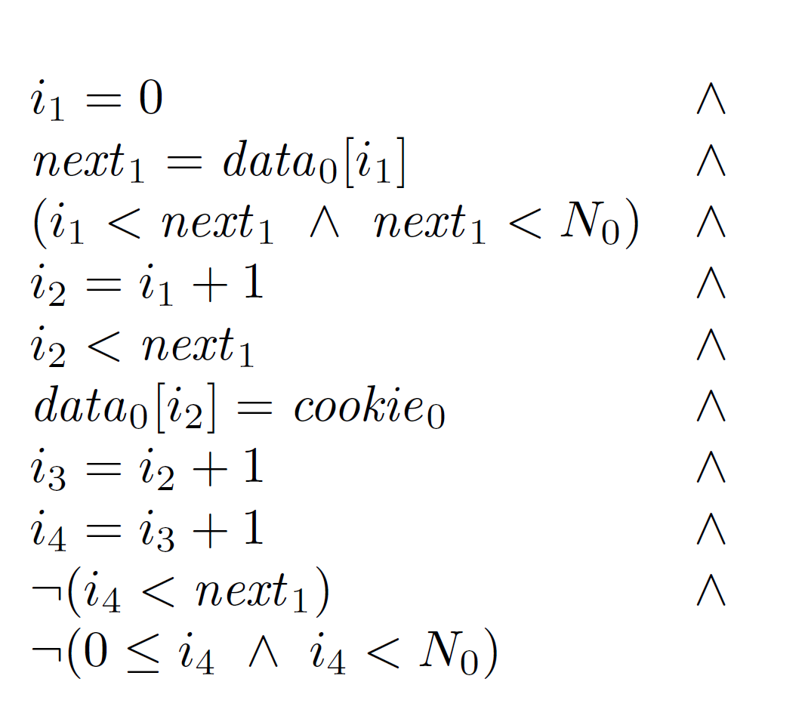
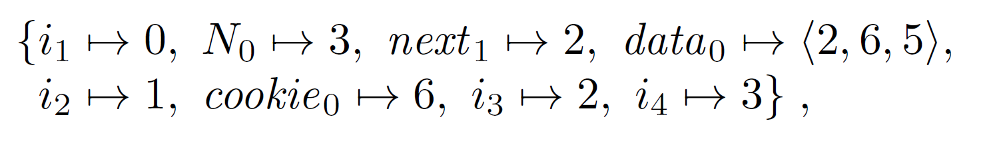
Formula can be SAT by:
To summarize, we reduced the problem of verifying the correctness of a path in a program to a problem of checking the satisfiability of a formula.

Slide 17
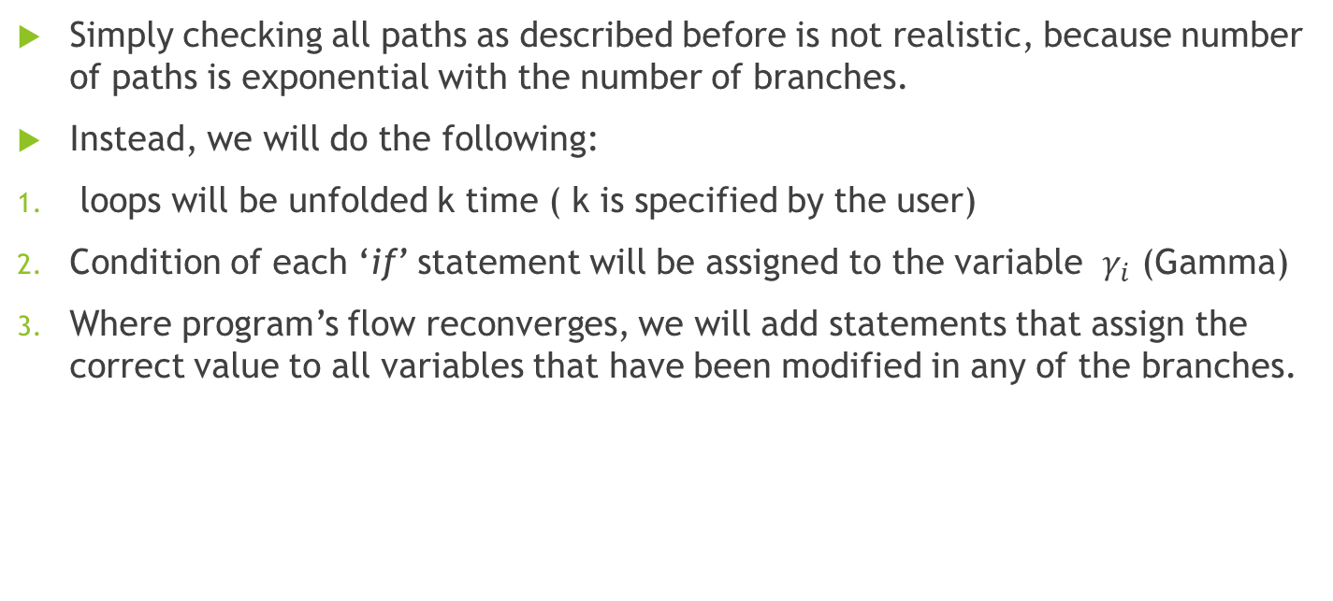
Checking Feasibility of all Paths
(Bounded program)
Simply checking all paths as described before is not realistic, because number of paths is exponential with the number of branches.
Instead, we will do the following:
loops will be unfolded k time ( k is specified by the user)
Condition of each ‘if’ statement will be assigned to the variable $γ_{i}$ (Gamma)
Where program’s flow reconverges, we will add statements that assign the correct value to all variables that have been modified in any of the branches.

Slide 18
We will illustrate with the for loop on previous code, unfolding this loop twice ( k = 2 )

Slide 19
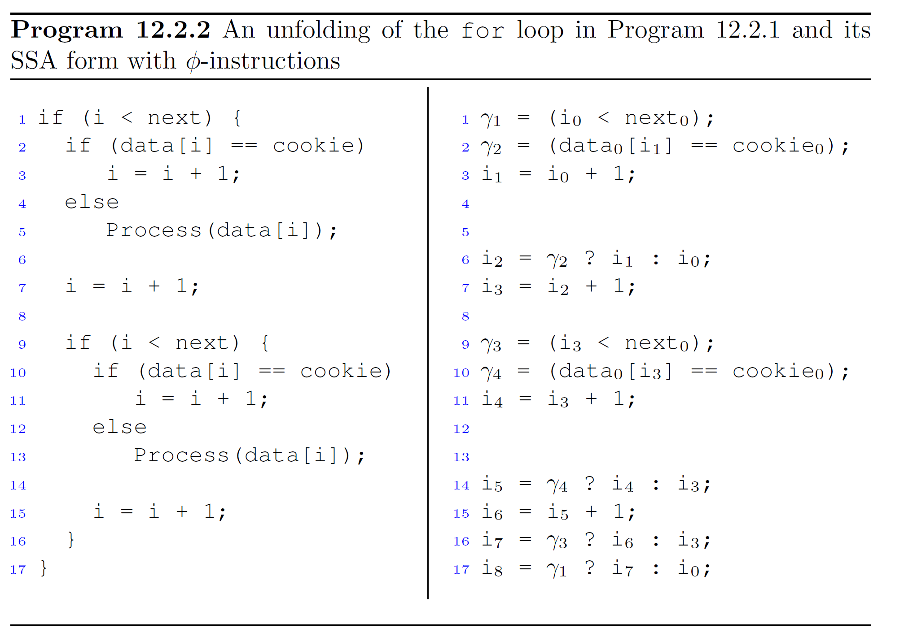
Flow reconverges
Flow reconverges

Slide 20
summary
Given the SSA form of the (unfolded) program, we can construct a formula that captures exactly all the possible traces that it can execute.
As before, in order to check an assertion in the program, we need to add its negation to the formula.
The resulting formula is then finally given to a suitable decision procedure. (Such as CVC5)

Slide 21
Unbounded Program Analysis

Slide 22
Overapproximation with Nondeterministic Assignments
Limiting the number of iterations will underapproximate the behavior of the program. (bugs in further iterations may be not detected)
We now introduce a program transformation that turns a program with loops into a program that is loop-free but overapproximates the original behavior.

Slide 23
Transform program into loop-free one
1. For each loop and variable that is modified by the loop, add a nondeterministic assignment at the beginning of the loop to the variable.
2. After each loop, add an assumption that the negation of the loop condition holds.
3. Replace each while loop with an if statement.

Slide 24
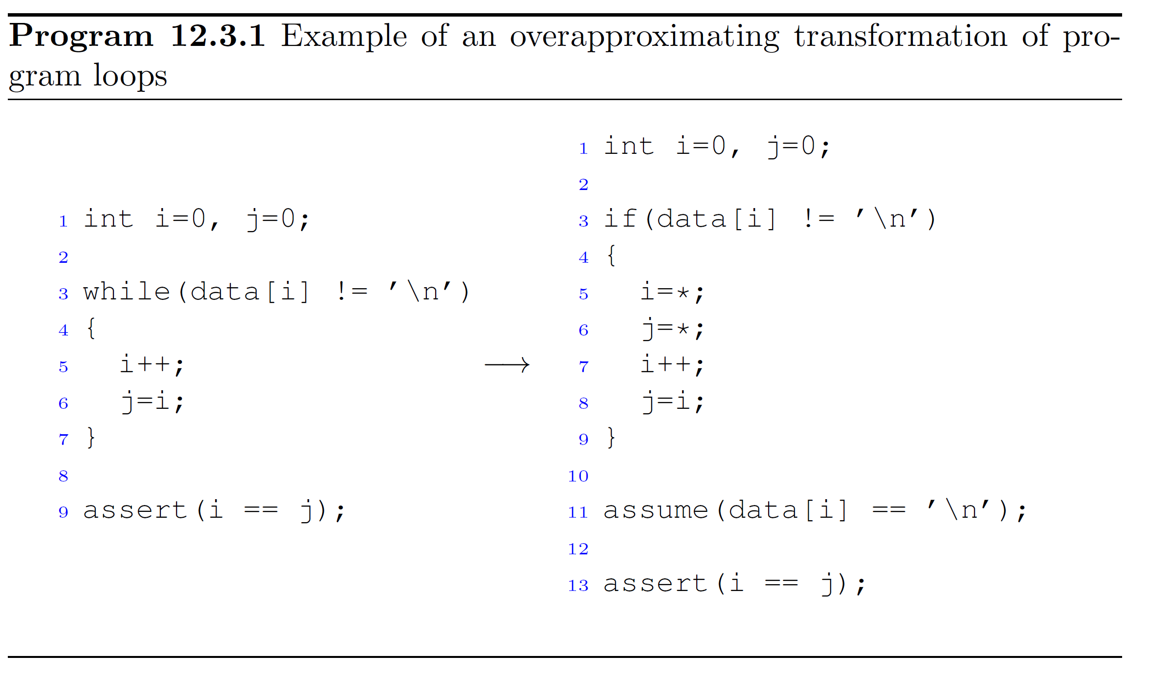

Slide 25
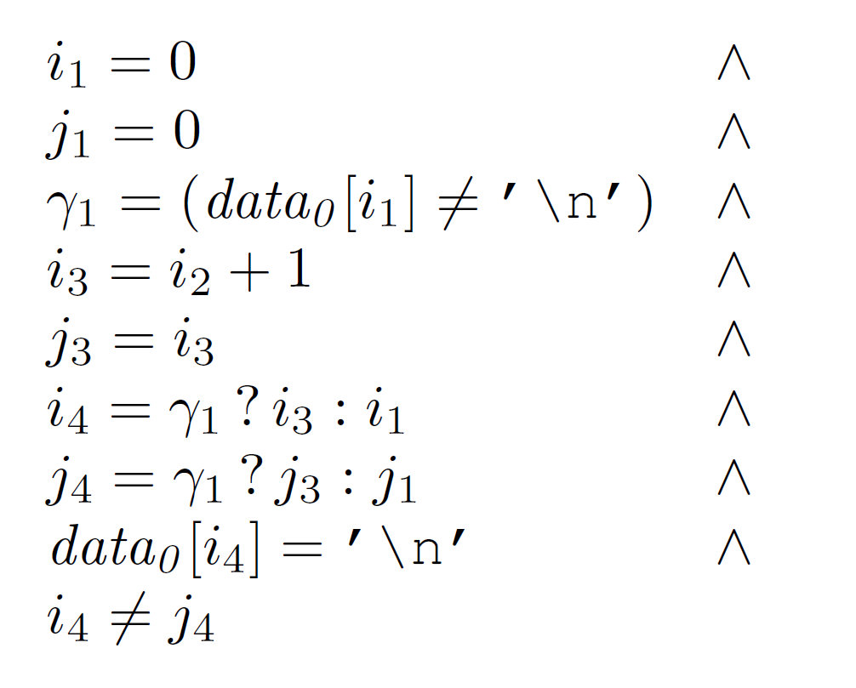
Translation into SSA constraint
Satisfiable??
No! (assertion holds for every number of iterations)
It worked because the correctness of the assertion does not depend on the previous iterations of the loop.
We’ll next see a program for which the abstraction is too coarse
(Non-deterministic assignment)

Slide 26
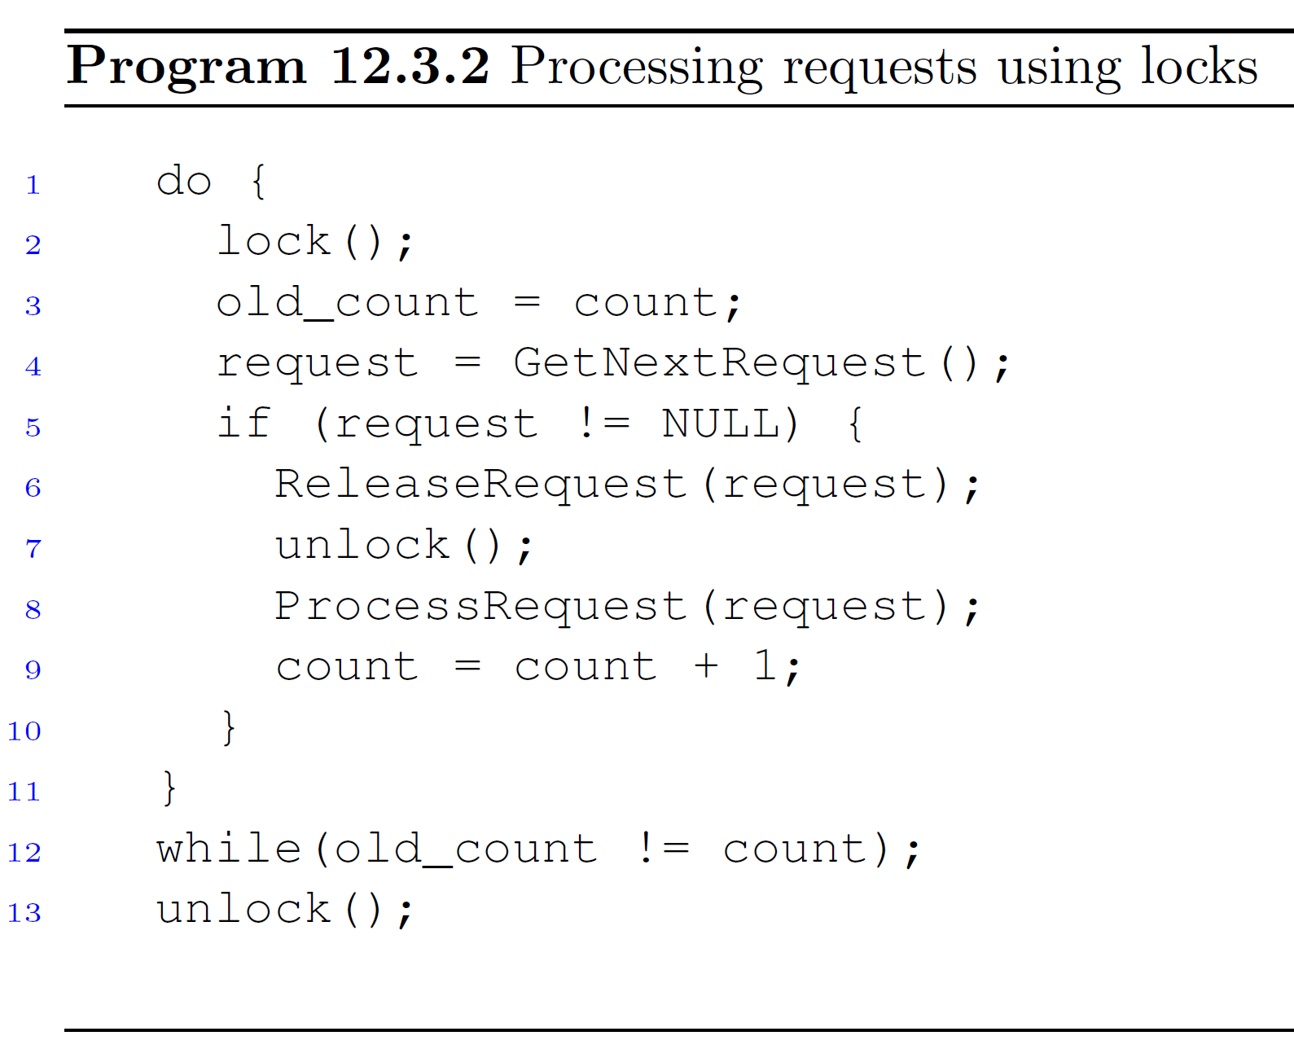
Example of too coarse Overapproximation

Slide 27
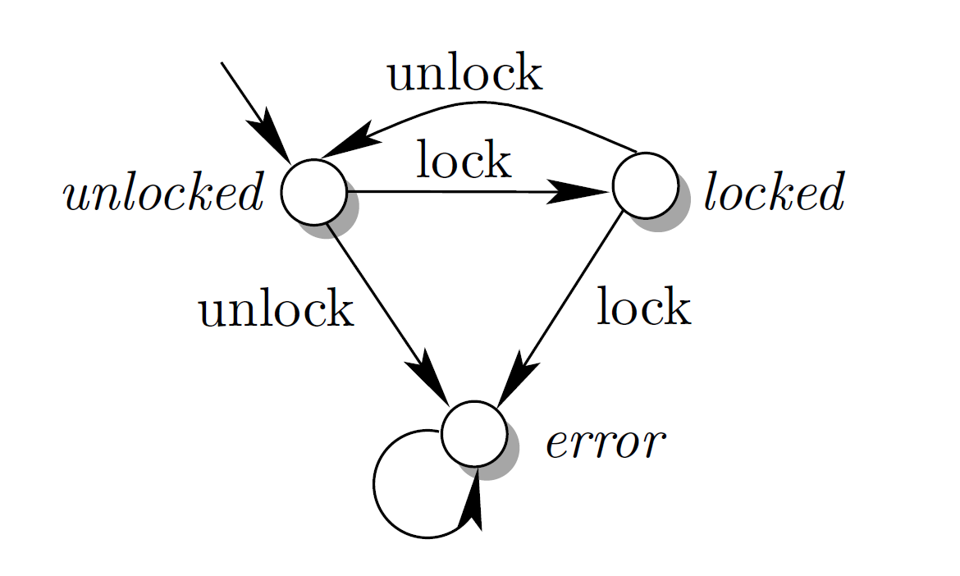
The specification of the lock mechanism given as a state machine
We add a variable state_of_lock, which reflects the state of the state machine.

Slide 28
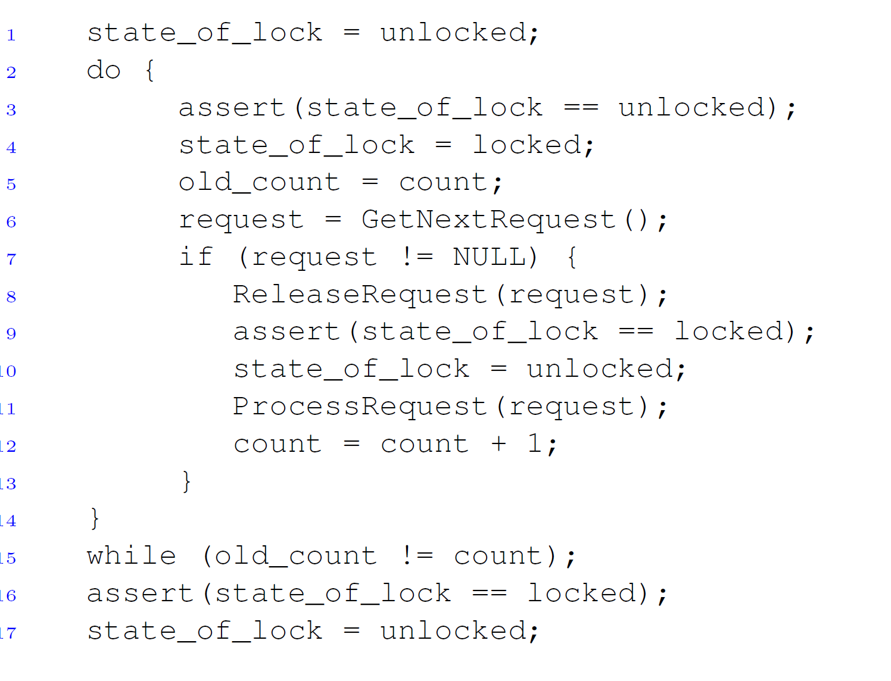
Locking specification is modeled with assertions

Slide 29
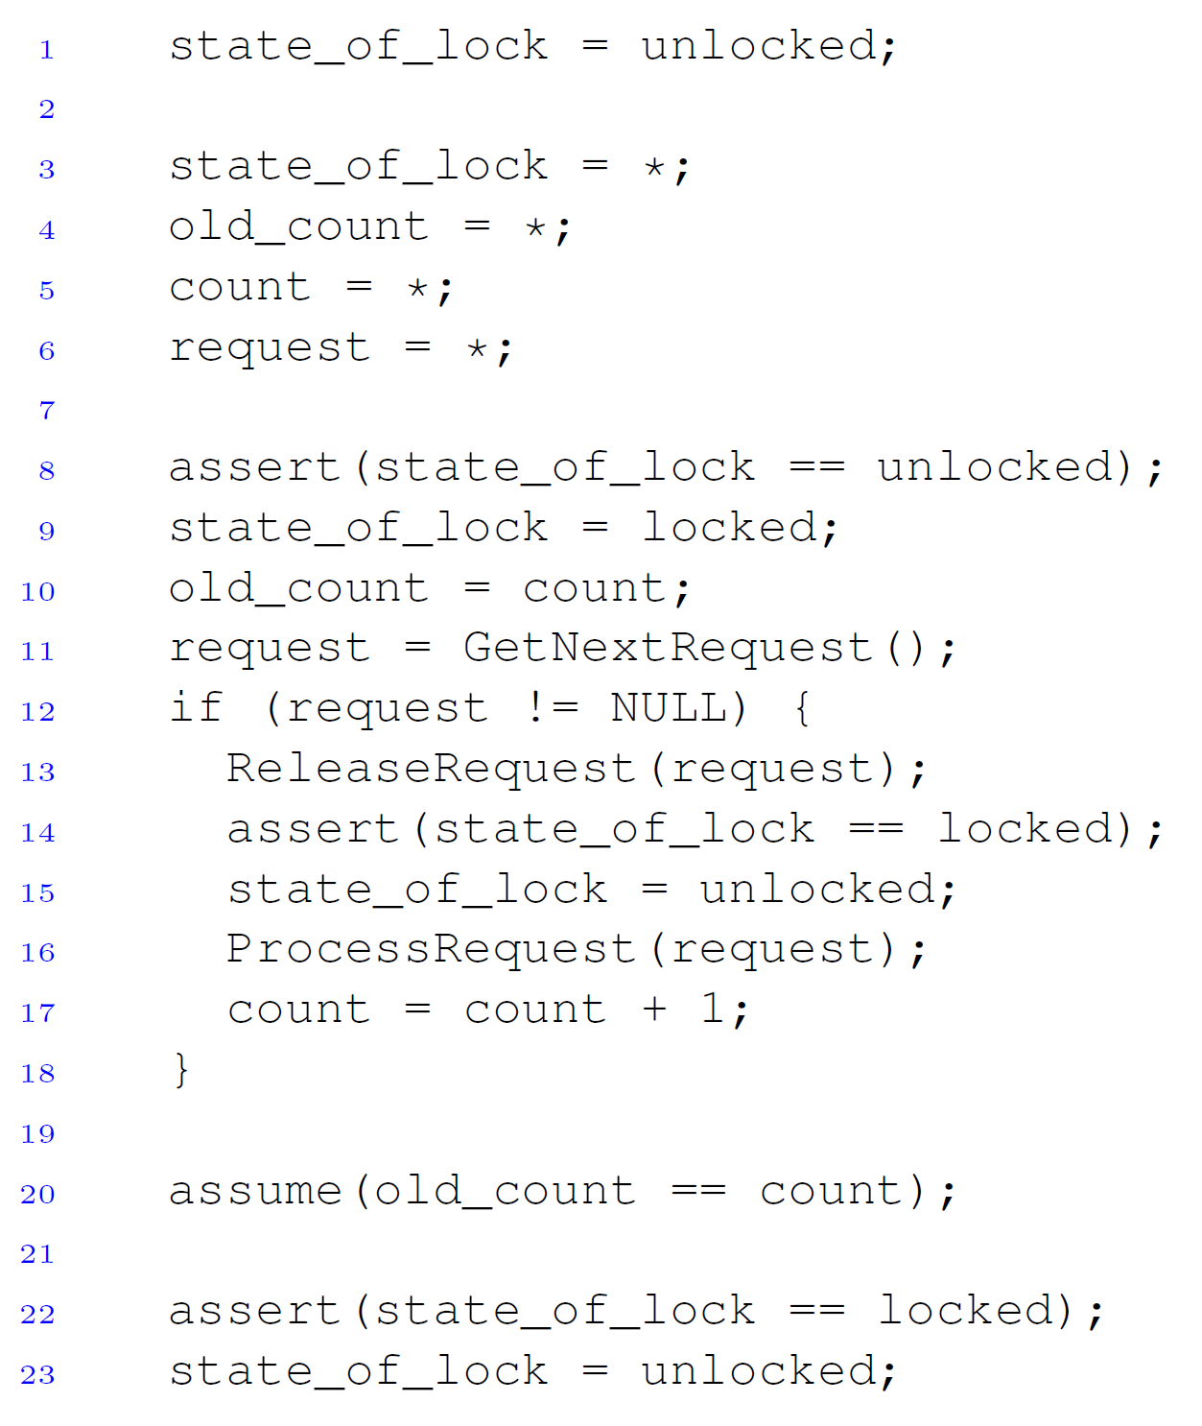
After application of the overapproximating transformation
Generated formula is sat, meaning an assertion can be violated.
E.G.: in Line 3 the variable state_of_lock is assigned the value locked and in Line 8 the assertion will fail.
The state cannot be locked in the beginning of the loop in the concrete program.
This abstraction can cause proof to fail because of non existing states. (false alarms)
We need to refine this abstraction

Slide 30
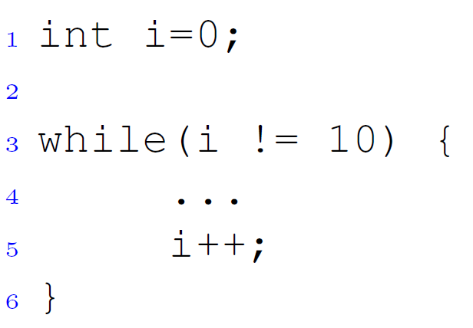
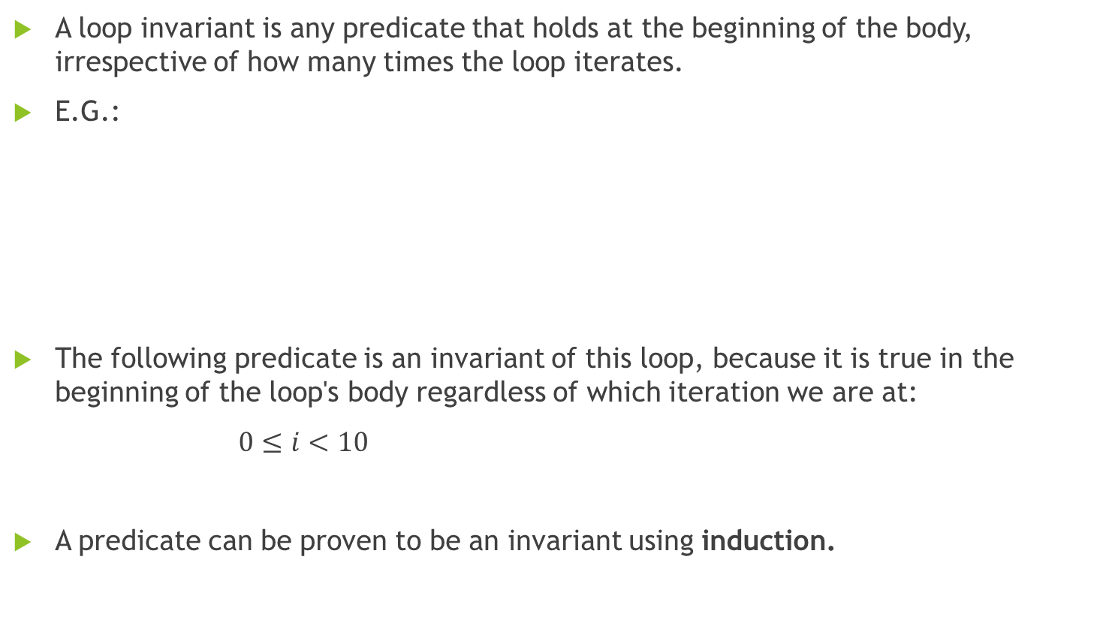
Loop Invariants
A loop invariant is any predicate that holds at the beginning of the body, irrespective of how many times the loop iterates.
E.G.:
The following predicate is an invariant of this loop, because it is true in the beginning of the loop's body regardless of which iteration we are at:
$0≤i<10$
A predicate can be proven to be an invariant using induction.

Slide 31
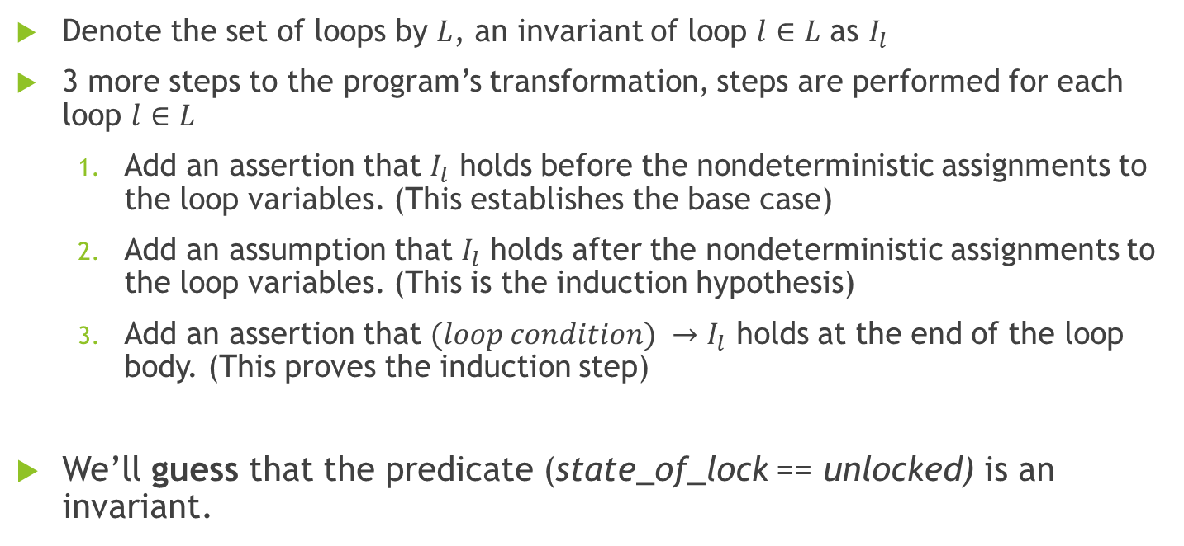
Refining the Abstraction with Loop Invariants
Denote the set of loops by $L$, an invariant of loop $l∈L$ as $I_{l}$
3 more steps to the program’s transformation, steps are performed for each loop $l∈L$
  Add an assertion that $I_{l}$ holds before the nondeterministic assignments to the loop variables. (This establishes the base case)
  Add an assumption that $I_{l}$ holds after the nondeterministic assignments to the loop variables. (This is the induction hypothesis)
  Add an assertion that $(loop condition) →I_{l}$ holds at the end of the loop body. (This proves the induction step)
We’ll guess that the predicate (state_of_lock == unlocked) is an invariant.

Slide 32
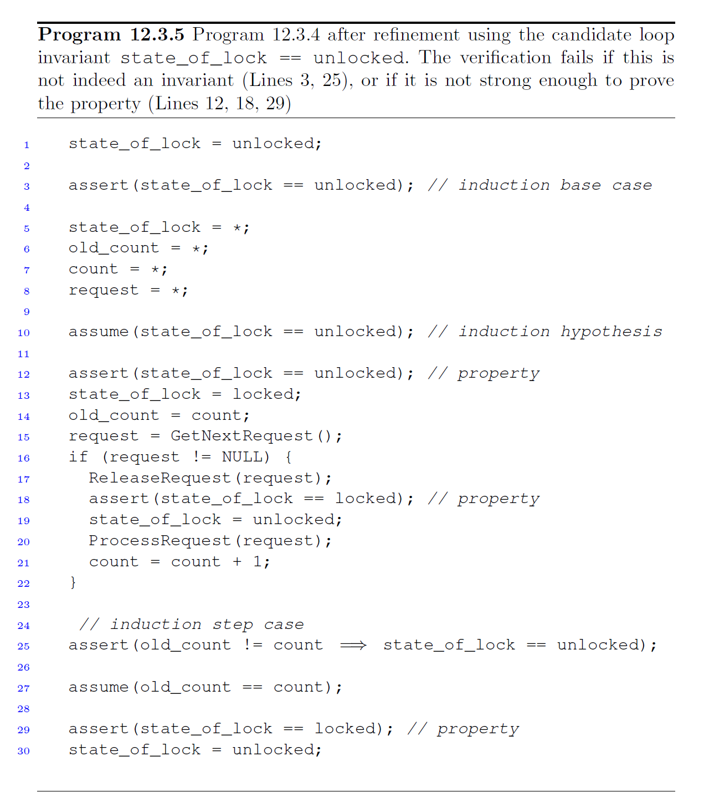



Passes
Passes
Passes
Passes. Why?
Passes. Why?

Slide 33
Choosing Loop Invariant
The challenge is to find an invariant that is strong enough to prove the desired property.
Finding such loop invariant is an area of active research.
In general, there is no algorithm that always finds an invariant that is strong enough to prove a given property.

Slide 34
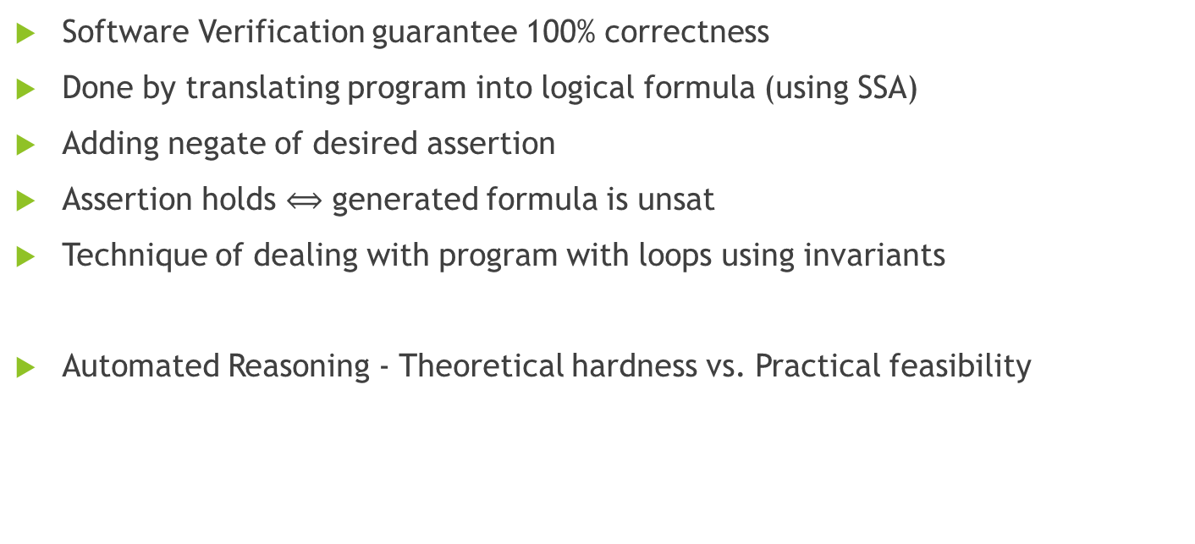
Summary
Software Verification guarantee 100% correctness
Done by translating program into logical formula (using SSA)
Adding negate of desired assertion
Assertion holds $⟺$ generated formula is unsat
Technique of dealing with program with loops using invariants
Automated Reasoning - Theoretical hardness vs. Practical feasibility

Slide 35
Questions?
Thank you for listening!

