Slide 1


Formal Verification of Workflow Policies for Smart Contracts in Azure Blockchain
Yuepeng Wang
University of Texas at Austin ypwang@cs.utexas.edu
Shuvendu K. Lahiri Microsoft Research shuvendu@microsoft.com
Shuo Chen
Microsoft Research shuochen@microsoft.com
Rong Pan
University of Texas at Austin rpan@cs.utexas.edu
Isil Dillig
University of Texas at Austin isil@cs.utexas.edu
Cody Born
Microsoft Azure
coborn@microsoft.com
Immad Naseer
Microsoft Azure imnaseer@microsoft.com
Presenter: Saar Cohen

Slide 2
Motivation
Saar Cohen | Formal Verification of Workflow Policies for Smart Contracts in Azure Blockchain | November 28, 2021

Slide 3
Blockchain-as-a-Service (BaaS)
Major cloud platform companies (e.g., Microsoft, IBM, Amazon, SAP, and Oracle) are offering Blockchain-as-a-Service (BaaS) solutions
  The business value-add of the blockchain has the potential to exceed $3.1 trillion by 2030
    https://www.gartner.com/en/documents/3627117
Saar Cohen | Formal Verification of Workflow Policies for Smart Contracts in Azure Blockchain | November 28, 2021

Slide 4
The Financial Impact of Bugs in Smart Contracts
Bugs and vulnerabilities in smart contract code have resulted in several high-profile exploits that undermine trust in the underlying blockchain technology
  The TheDAO exploit resulted in the loss of almost $60 million worth of Ether
    https://medium.com/@MyPaoG/explaining-the-dao-exploit-for-beginners-in-solidity-80ee84f0d470
  The Parity Wallet bug caused 169 million USD worth of ether to be locked forever
    https://www.theregister.co.uk/2017/11/16/parity_flaw_not_fixed
Saar Cohen | Formal Verification of Workflow Policies for Smart Contracts in Azure Blockchain | November 28, 2021

Slide 5
The Purpose of the Paper
The Goal: Studying the safety and security of smart contracts present in Azure Blockchain Workbench (or Workbench for short)
A first attempt: Hard-fork the blockchain and revert one of the forks back to the state before the incident
  Problem: Defeats the core values of blockchain, such as immutability and decentralized trust
Saar Cohen | Formal Verification of Workflow Policies for Smart Contracts in Azure Blockchain | November 28, 2021

Slide 6
Talk Outline
Overview of the Approach
  Azure Blockchain Workbench Application Policy
  Azure Blockchain Workbench Smart Contract
  Semantic Conformance Verification
Semantic Conformance Checking
Formal Verification using VeriSol
Saar Cohen | Formal Verification of Workflow Policies for Smart Contracts in Azure Blockchain | November 28, 2021

Slide 7
Overview of the Approach
Saar Cohen | Formal Verification of Workflow Policies for Smart Contracts in Azure Blockchain | November 28, 2021

Slide 8
Workbench Application Policy
Azure Blockchain Workbench applications are multi-party workflows defined by configuration metadata and smart contract code.
Configuration metadata defines:
  Name and description of the blockchain application
  Unique roles for users who can act or participate within the blockchain application
  One or more workflows.
    Act as a finite state machine (FSM) to control the flow of the business logic
    Can be independent or interact with one another
Saar Cohen | Formal Verification of Workflow Policies for Smart Contracts in Azure Blockchain | November 28, 2021

Slide 9
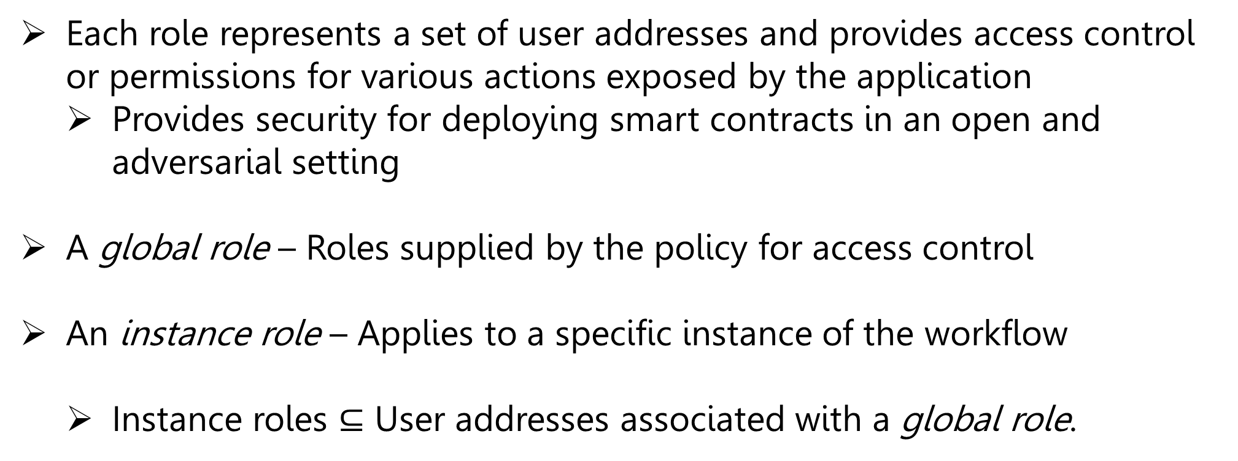
Role-based Access Control
Each role represents a set of user addresses and provides access control or permissions for various actions exposed by the application
  Provides security for deploying smart contracts in an open and adversarial setting
A global role – Roles supplied by the policy for access control
An instance role – Applies to a specific instance of the workflow
  Instance roles $⊆$ User addresses associated with a global role.
Saar Cohen | Formal Verification of Workflow Policies for Smart Contracts in Azure Blockchain | November 28, 2021

Slide 10
Workflows
Each workflow acts as a finite state machine (FSM) to control the flow of the business logic
Workflows can be independent or interact with one another.
The workflow describes:
  Roles
  States of a contract
  The set of enabled actions (or functions) at each state restricted to each role
  Initiator roles permitted to initiate each action
  Smart contracts that represent business logic in code files
Saar Cohen | Formal Verification of Workflow Policies for Smart Contracts in Azure Blockchain | November 28, 2021

Slide 11
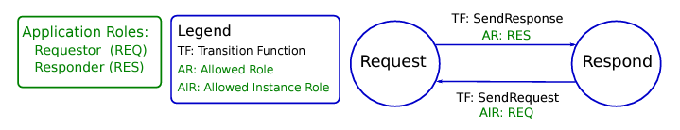
Example: HelloBlockchain
A workflow between a person sending a request and a person responding to the request
States
Global Roles
Initiator Role
Actions
Saar Cohen | Formal Verification of Workflow Policies for Smart Contracts in Azure Blockchain | November 28, 2021

Slide 12
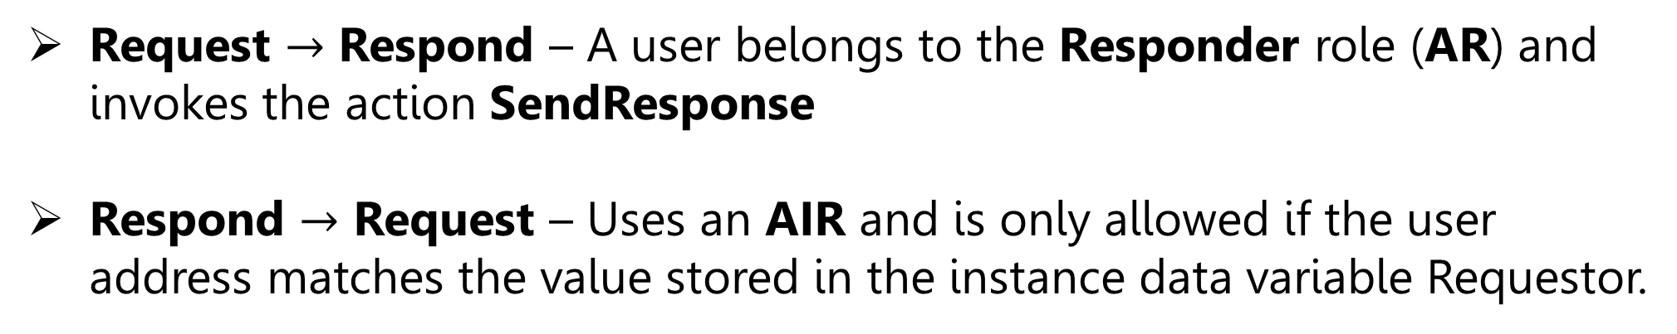
Example (Transitions): HelloBlockchain
Request $→$ Respond – A user belongs to the Responder role (AR) and invokes the action SendResponse
Respond $→$ Request – Uses an AIR and is only allowed if the user address matches the value stored in the instance data variable Requestor.
Saar Cohen | Formal Verification of Workflow Policies for Smart Contracts in Azure Blockchain | November 28, 2021

Slide 13
Workbench Application Smart Contract
After specifying the application policy, a user provides a smart contract written in Solidity to implement the workflow
  Workbench supports the popular language Solidity for targeting applications on Ethereum
Saar Cohen | Formal Verification of Workflow Policies for Smart Contracts in Azure Blockchain | November 28, 2021

Slide 14
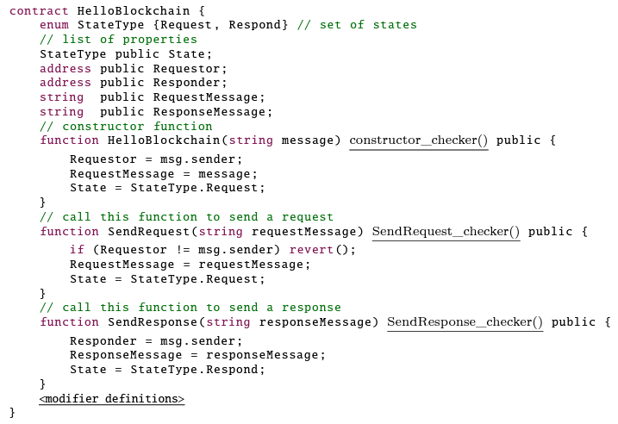
Example: Solidity contract for HelloBlockchain
Tracks the current state of a workflow
Saar Cohen | Formal Verification of Workflow Policies for Smart Contracts in Azure Blockchain | November 28, 2021

Slide 15
Example: Solidity contract for HelloBlockchain
Composition of the contract:
  A constructor
  Functions defined in the policy, with matching signatures
    Reflect the state transitions
Saar Cohen | Formal Verification of Workflow Policies for Smart Contracts in Azure Blockchain | November 28, 2021

Slide 16
Semantic Conformance Verification
Policy
Exposes the set of enabled actions at each state for a given user
Smart Contract
Drives the application
Inconsistencies can lead to unexpected state transitions
Saar Cohen | Formal Verification of Workflow Policies for Smart Contracts in Azure Blockchain | November 28, 2021

Slide 17
Semantic Conformance Verification
Semantic conformance ensures the smart contract respects the policy
  Reduced to checking assertions on an instrumented Solidity program
  Provided by adding modifier invocations
      A modifier – a Solidity construct that allows wrapping a function invocation with code that executes before and after the function body
Saar Cohen | Formal Verification of Workflow Policies for Smart Contracts in Azure Blockchain | November 28, 2021

Slide 18
Example: Modifiers for HelloBlockchain
Saar Cohen | Formal Verification of Workflow Policies for Smart Contracts in Azure Blockchain | November 28, 2021

Slide 19
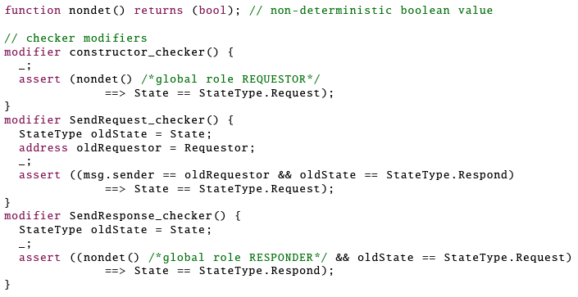
Example: Modifiers for HelloBlockchain
For instance, SendRequest_checker ensures that any execution starting in Respond with instance role Requestor should transition to Request
Saar Cohen | Formal Verification of Workflow Policies for Smart Contracts in Azure Blockchain | November 28, 2021

Slide 20
VeriSol
A formal verifier for checking safety of Solidity smart contracts
  Applies to the instrumented Solidity program
  Can find counterexamples (in the form of a sequence of transactions)
  Can automatically construct proofs of semantic conformance
Saar Cohen | Formal Verification of Workflow Policies for Smart Contracts in Azure Blockchain | November 28, 2021

Slide 21
Semantic Conformance Checking
Saar Cohen | Formal Verification of Workflow Policies for Smart Contracts in Azure Blockchain | November 28, 2021

Slide 22
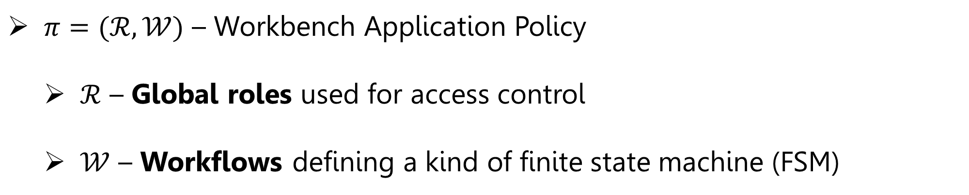
Formalization of Workbench Application Policies
$π=(ℛ,𝒲)$ – Workbench Application Policy
  $ℛ$ – Global roles used for access control
  $𝒲$ – Workflows defining a kind of finite state machine (FSM)
Saar Cohen | Formal Verification of Workflow Policies for Smart Contracts in Azure Blockchain | November 28, 2021

Slide 23
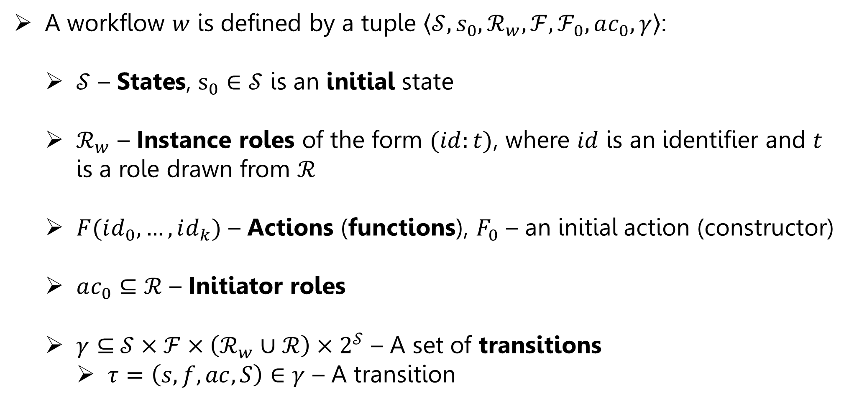
Formalization of Workbench Application Workflows
A workflow $w$ is defined by a tuple $⟨𝒮,s_{0},ℛ_{w},ℱ,ℱ_{0},ac_{0},γ〉$:
  $𝒮$ – States, $s_{0}∈𝒮$ is an initial state
  $ℛ_{w}$ – Instance roles of the form $(id:t)$, where $id$ is an identifier and $t$ is a role drawn from $ℛ$
  $F(id_{0},…,id_{k})$ – Actions (functions), $F_{0}$ – an initial action (constructor)
  $ac_{0}⊆ℛ$ – Initiator roles
  $γ⊆$ $𝒮×ℱ×\left(ℛ_{w}∪ℛ\right)×2^{𝒮}$ – A set of transitions
    $τ=\left(s,f,ac,S\right)∈γ$ – A transition
Saar Cohen | Formal Verification of Workflow Policies for Smart Contracts in Azure Blockchain | November 28, 2021

Slide 24
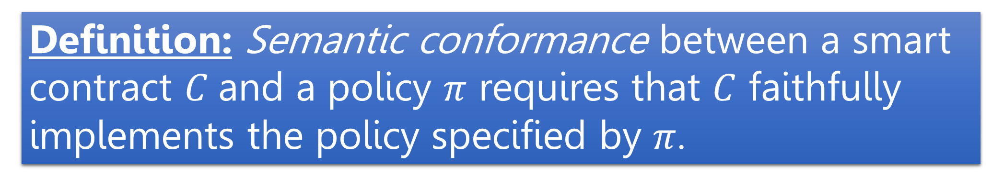
Semantic Conformance – Definition
Definition: Semantic conformance between a smart contract $C$ and a policy $π$ requires that $C$ faithfully implements the policy specified by $π$.
Saar Cohen | Formal Verification of Workflow Policies for Smart Contracts in Azure Blockchain | November 28, 2021

Slide 25
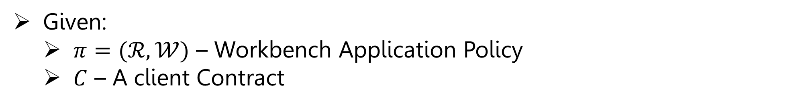
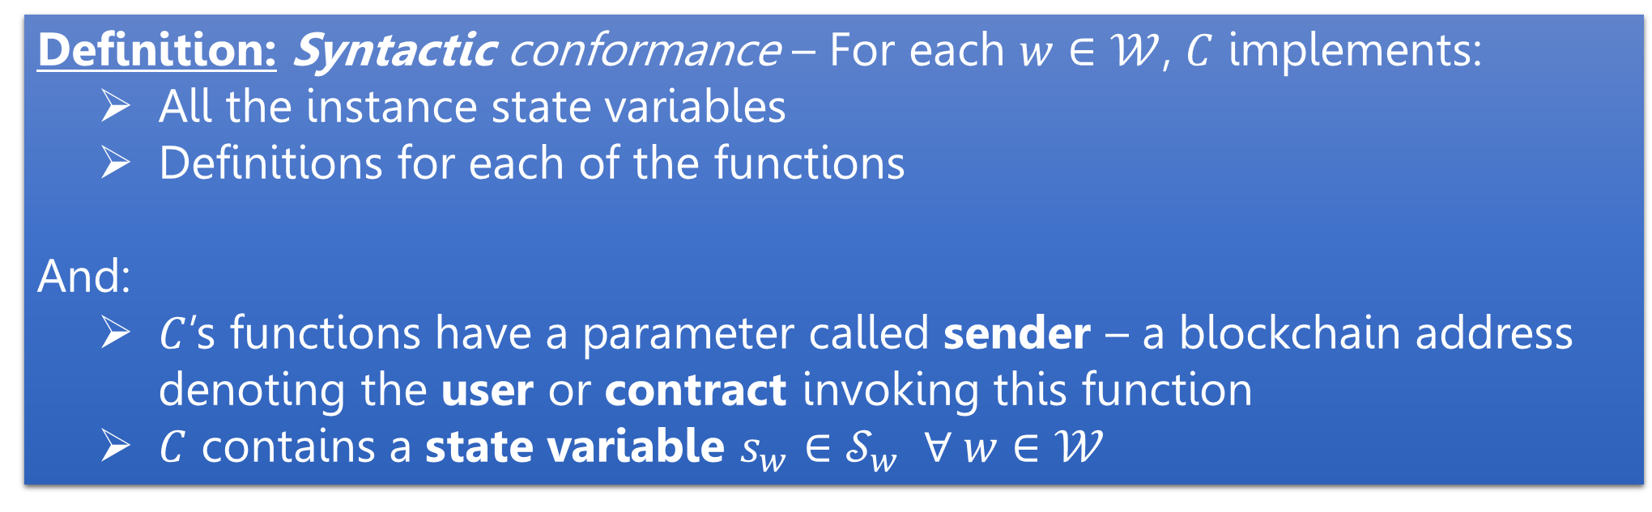
Syntactic Conformance
Given:
  $π=(ℛ,𝒲)$ – Workbench Application Policy
  $C$ – A client Contract
Definition: Syntactic conformance – For each $w∈𝒲$, $C$ implements:
  All the instance state variables
  Definitions for each of the functions
And:
  $C$’s functions have a parameter called sender – a blockchain address denoting the user or contract invoking this function
  $C$ contains a state variable $s_{w}∈𝒮_{w} ∀ w∈𝒲$
Saar Cohen | Formal Verification of Workflow Policies for Smart Contracts in Azure Blockchain | November 28, 2021

Slide 26
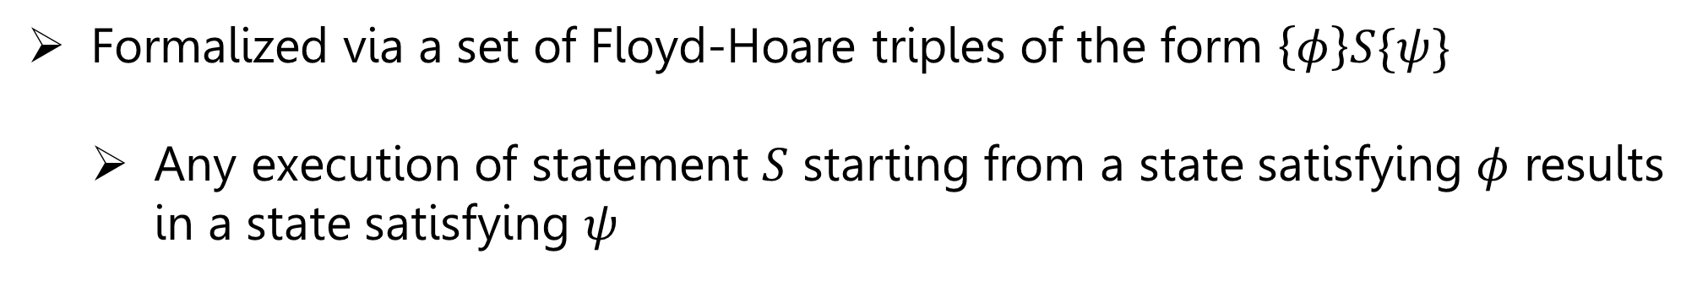
Semantic Conformance
Formalized via a set of Floyd-Hoare triples of the form $\left\{φ\right\}S\{ψ\}$
  Any execution of statement $S$ starting from a state satisfying $φ$ results in a state satisfying $ψ$
Saar Cohen | Formal Verification of Workflow Policies for Smart Contracts in Azure Blockchain | November 28, 2021

Slide 27
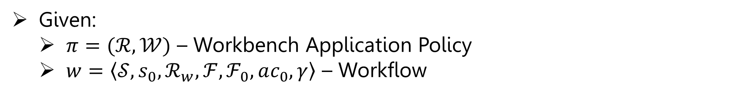
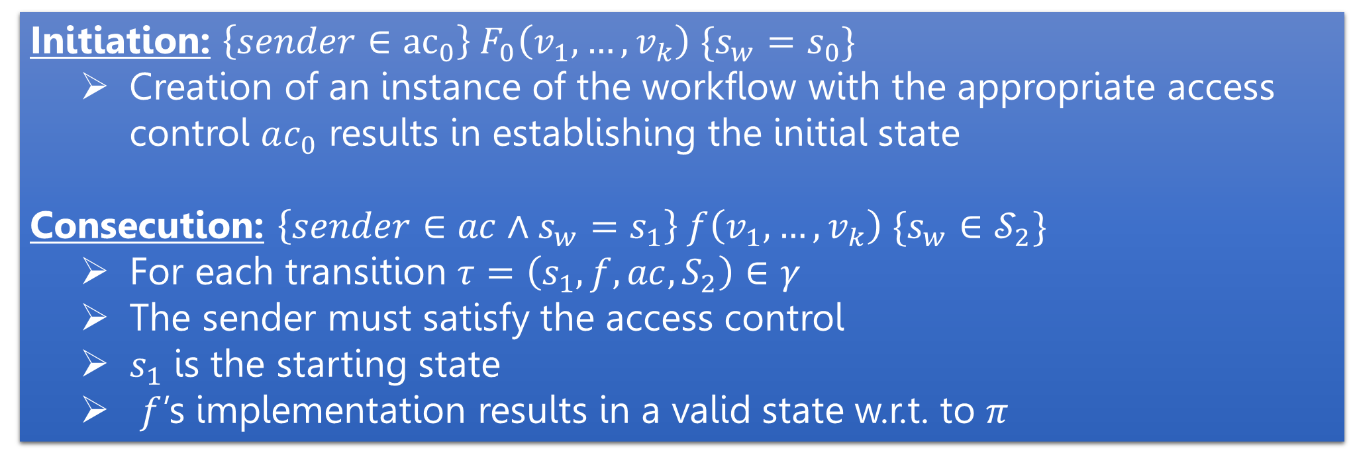
Semantic Conformance
Given:
  $π=(ℛ,𝒲)$ – Workbench Application Policy
  $w=⟨𝒮,s_{0},ℛ_{w},ℱ,ℱ_{0},ac_{0},γ〉$ – Workflow
Initiation: $\left\{sender∈{ac}_{0}\right\} F_{0}\left(v_{1},…,v_{k}\right) \{s_{w}=s_{0}\}$
  Creation of an instance of the workflow with the appropriate access control $ac_{0}$ results in establishing the initial state
Consecution: $\left\{sender∈ac∧s_{w}=s_{1}\right\} f\left(v_{1},…,v_{k}\right) \{s_{w}∈𝒮_{2}\}$
  For each transition $τ=\left(s_{1},f,ac,S_{2}\right)∈γ$
  The sender must satisfy the access control
  $s_{1}$ is the starting state
  $f$’s implementation results in a valid state w.r.t. to $π$
Saar Cohen | Formal Verification of Workflow Policies for Smart Contracts in Azure Blockchain | November 28, 2021

Slide 28
Modifiers Constructs for Instrumentation
Modifier invocations are generally depicted as follows:
  The Solidity compiler transforms the body of Bar to execute pre-stmt (resp. post-stmt) before (resp. after) Bar-stmt.
Saar Cohen | Formal Verification of Workflow Policies for Smart Contracts in Azure Blockchain | November 28, 2021

Slide 29
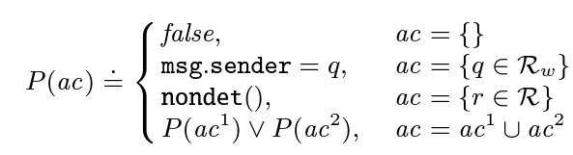
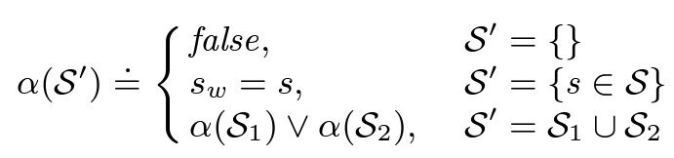
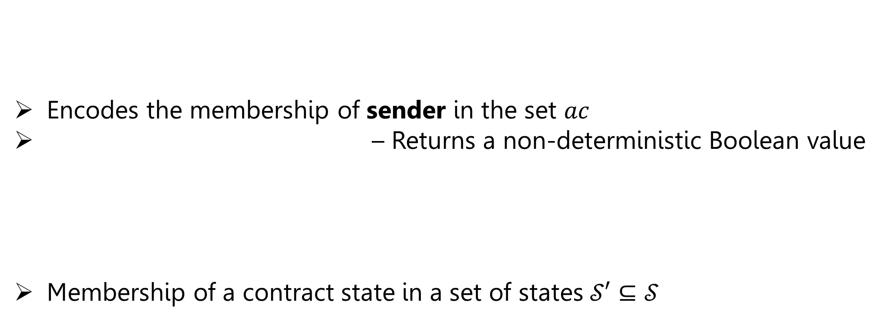
Helper Predicates
Encodes the membership of sender in the set $ac$
– Returns a non-deterministic Boolean value
Membership of a contract state in a set of states $𝒮′⊆𝒮$
Saar Cohen | Formal Verification of Workflow Policies for Smart Contracts in Azure Blockchain | November 28, 2021

Slide 30
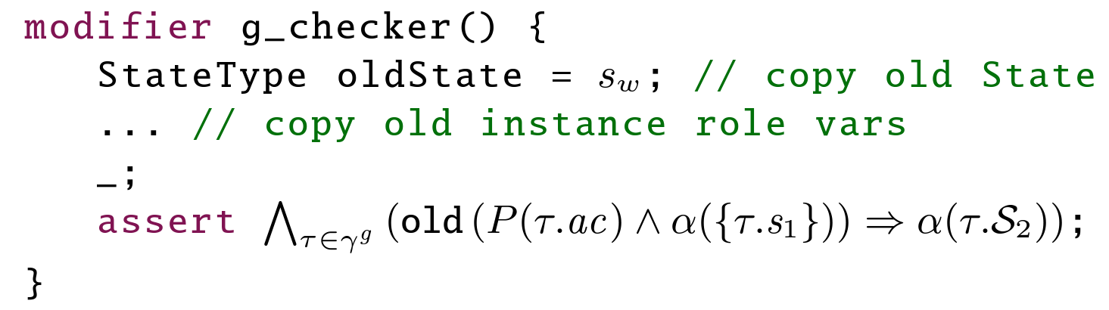
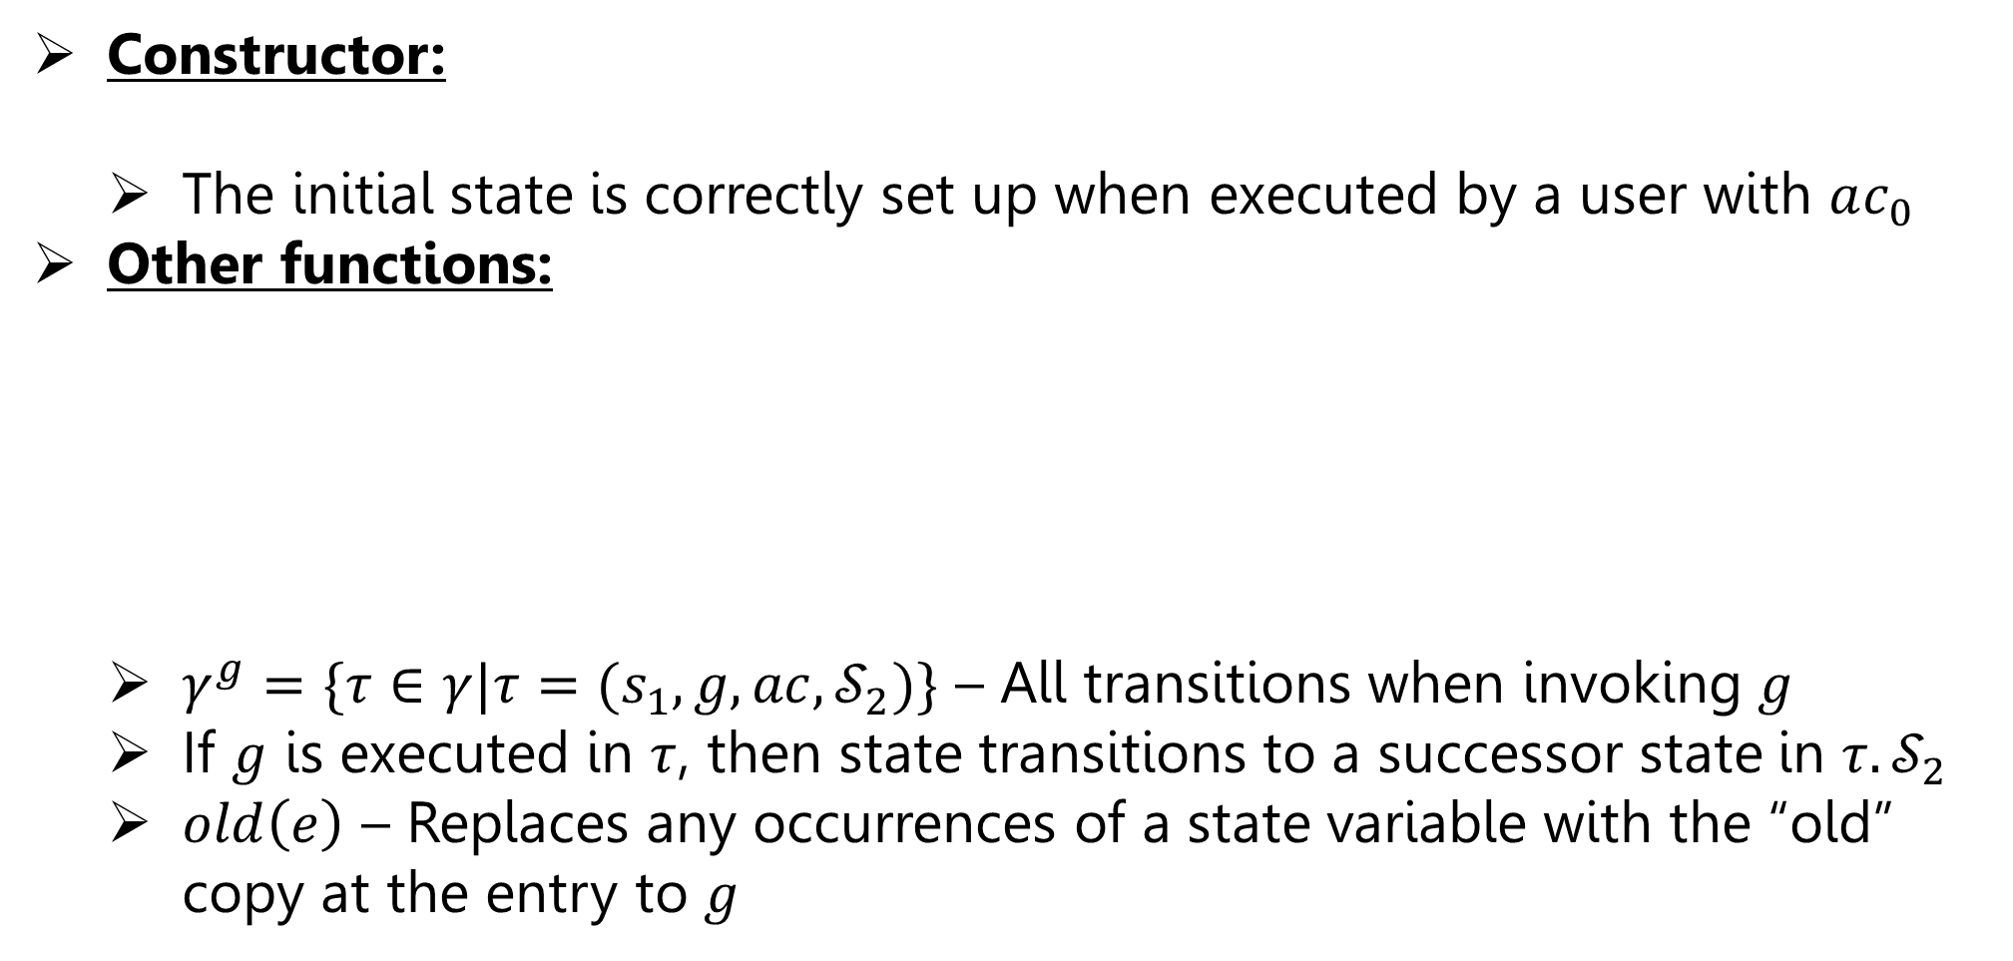

Instrumentation for Semantic Conformance Checking
Constructor:
  The initial state is correctly set up when executed by a user with $ac_{0}$
Other functions:
  $γ^{g}=\{τ∈γ|τ=(s_{1},g,ac,𝒮_{2})\}$ – All transitions when invoking $g$
  If $g$ is executed in $τ$, then state transitions to a successor state in $τ.𝒮_{2}$
  $old\left(e\right)$ – Replaces any occurrences of a state variable with the “old” copy at the entry to $g$
In $ℛ_{w}$
Saar Cohen | Formal Verification of Workflow Policies for Smart Contracts in Azure Blockchain | November 28, 2021

Slide 31
Formal Verification using VeriSol
Saar Cohen | Formal Verification of Workflow Policies for Smart Contracts in Azure Blockchain | November 28, 2021

Slide 32
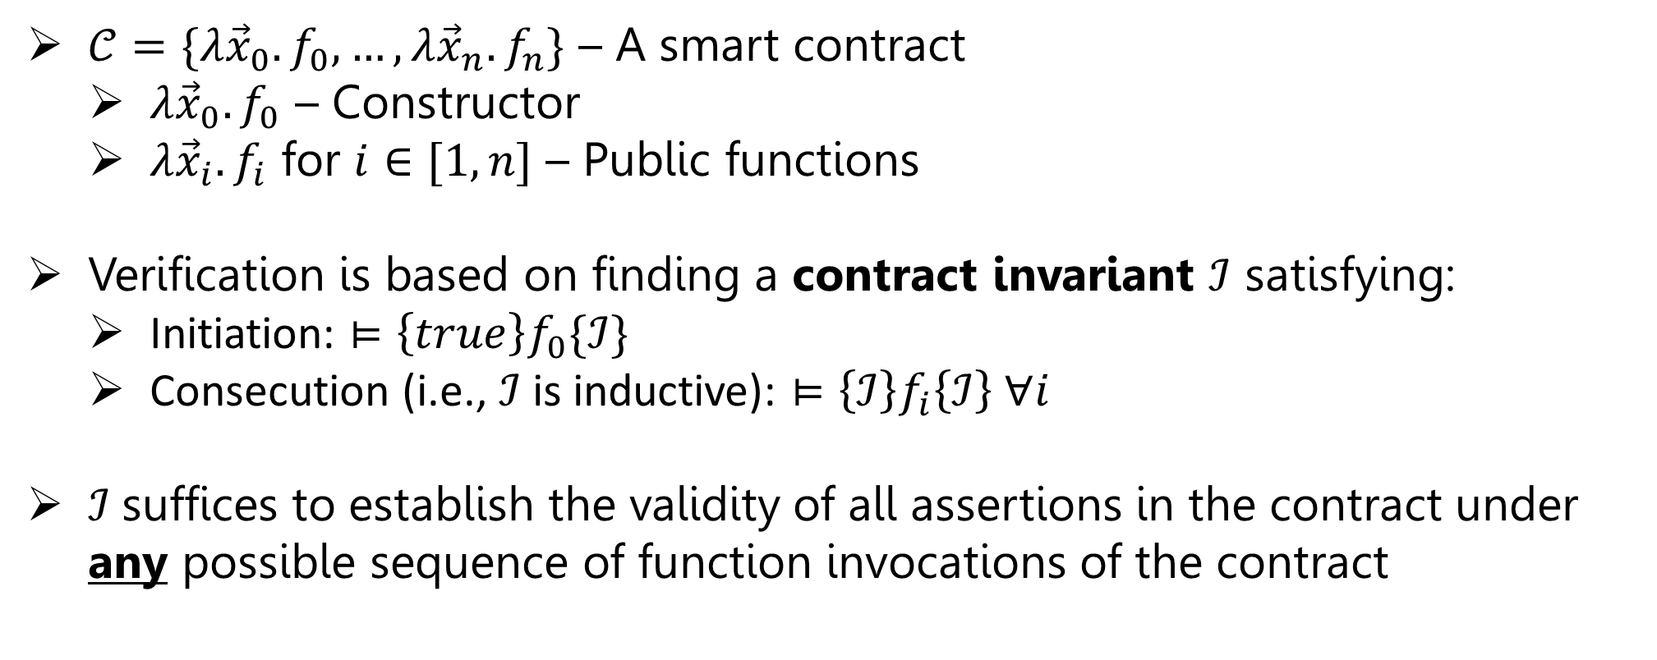
Contract Invariants
$𝒞=\{λ{\vec{x}}_{0}.f_{0},…,λ{\vec{x}}_{n}.f_{n}\}$ – A smart contract
  $λ{\vec{x}}_{0}.f_{0}$ – Constructor
  $λ{\vec{x}}_{i}.f_{i}$ for $i∈[1,n]$ – Public functions
Verification is based on finding a contract invariant $ℐ$ satisfying:
  Initiation: $⊨\left\{true\right\}f_{0}\{ℐ\}$
  Consecution (i.e., $ℐ$ is inductive): $⊨\left\{ℐ\right\}f_{i}\left\{ℐ\right\} ∀i$
$ℐ$suffices to establish the validity of all assertions in the contract under any possible sequence of function invocations of the contract
Saar Cohen | Formal Verification of Workflow Policies for Smart Contracts in Azure Blockchain | November 28, 2021

Slide 33
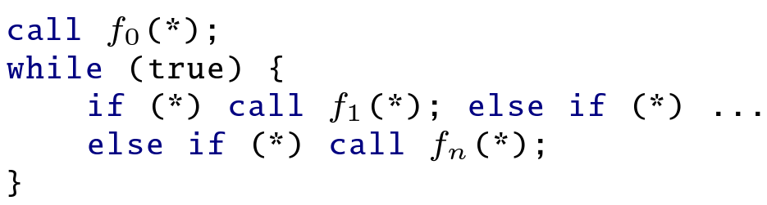
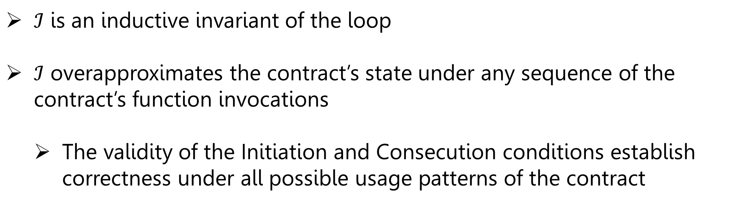
Harness for Solidity Contracts
Constructor
Non-deterministic Invocation
$ℐ$ is an inductive invariant of the loop
$ℐ$ overapproximates the contract’s state under any sequence of the contract’s function invocations
  The validity of the Initiation and Consecution conditions establish correctness under all possible usage patterns of the contract
Saar Cohen | Formal Verification of Workflow Policies for Smart Contracts in Azure Blockchain | November 28, 2021

Slide 34
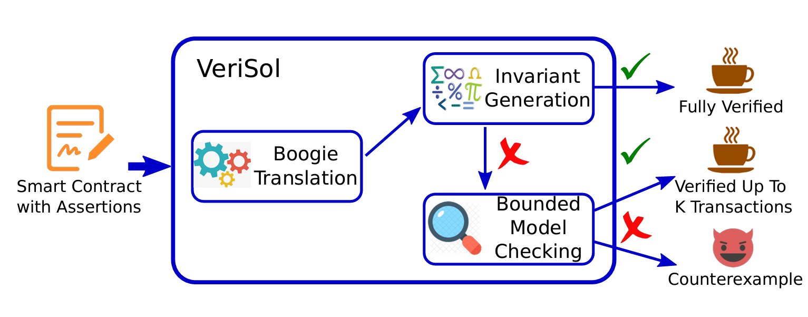
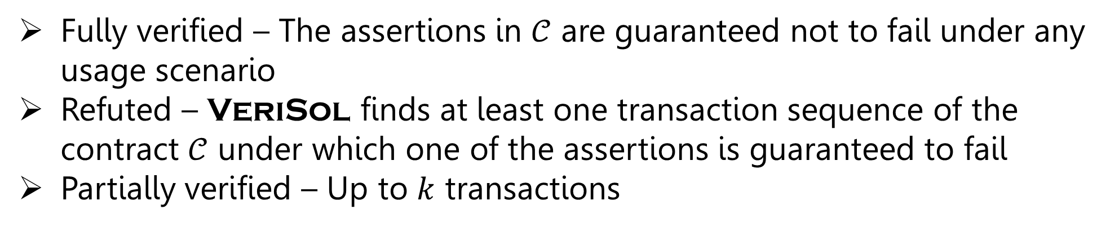
Overview of VeriSol
Fully verified – The assertions in $𝒞$ are guaranteed not to fail under any usage scenario
Refuted – VeriSol finds at least one transaction sequence of the contract $𝒞$ under which one of the assertions is guaranteed to fail
Partially verified – Up to $k$ transactions
Saar Cohen | Formal Verification of Workflow Policies for Smart Contracts in Azure Blockchain | November 28, 2021

Slide 35
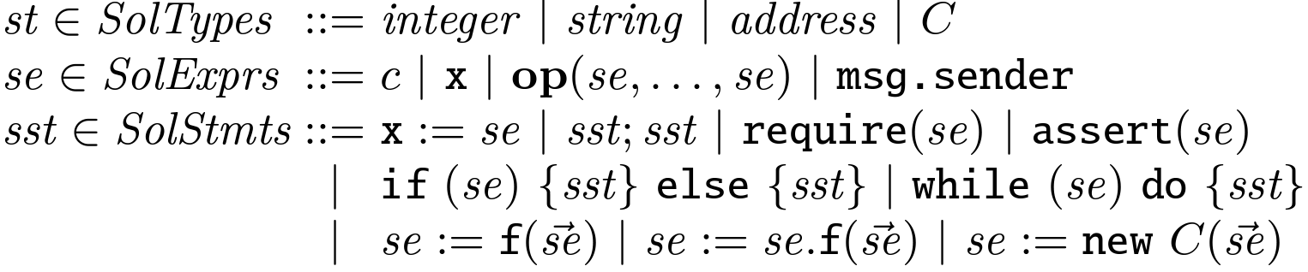
Solidity Language
* Arrays and mappings for clarity of the discussion.
Types – integers, strings, addresses, and contracts
Expressions – constants, local variables, state variables, unary/binary operators (denoted op), and msg.sender that yields the address of the contract or user that initiates the current function invocation
Statements – assignments, conditionals, loops, requires, assertions, internal and external function calls, and contract instance creation
Saar Cohen | Formal Verification of Workflow Policies for Smart Contracts in Azure Blockchain | November 28, 2021
Notes:
state variables - fields in standard object-oriented language terminology

Slide 36
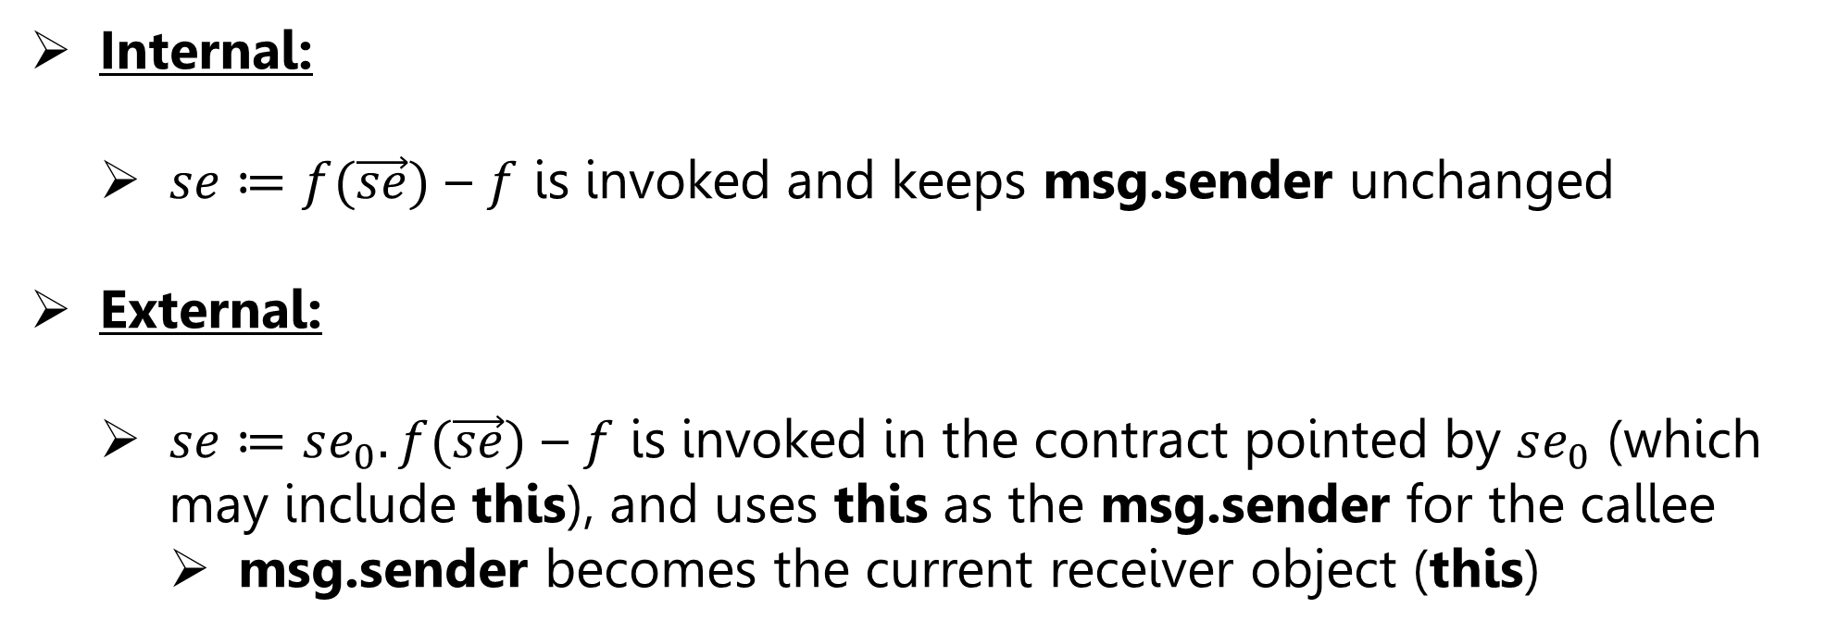
Internal and External Function Calls
Internal:
  $se≔f(\vec{se})$ – $f$ is invoked and keeps msg.sender unchanged
External:
  $se≔se_{0}.f(\vec{se})$ – $f$ is invoked in the contract pointed by $se_{0}$ (which may include this), and uses this as the msg.sender for the callee
    msg.sender becomes the current receiver object (this)
Saar Cohen | Formal Verification of Workflow Policies for Smart Contracts in Azure Blockchain | November 28, 2021
Notes:
Functions in Solidity have two implicit parameters, namely this for the receiver object and msg.sender for the Blockchain address of the caller

Slide 37
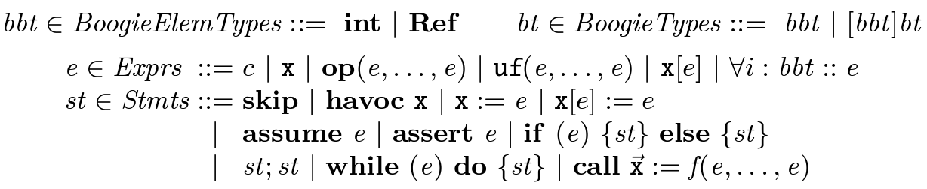
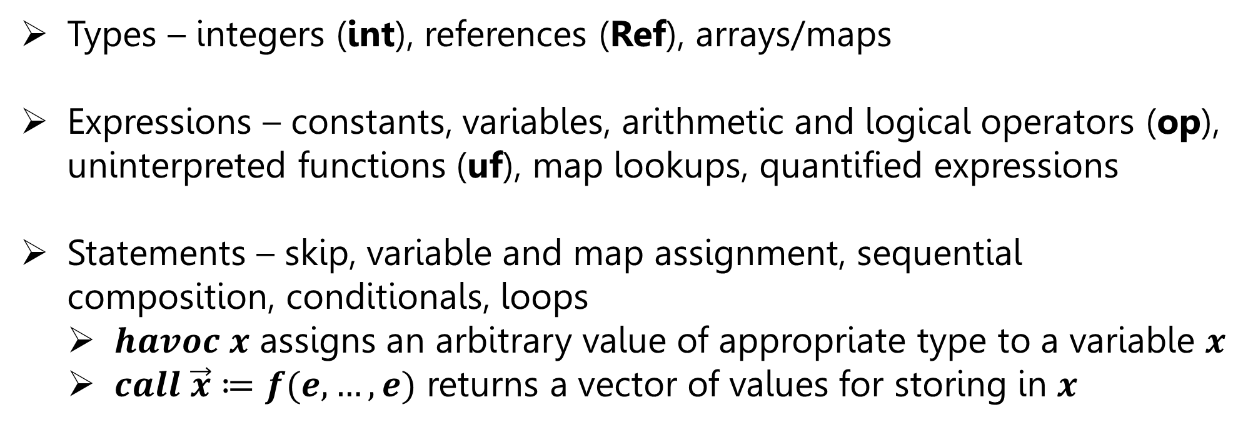
Boogie Language
Types – integers (int), references (Ref), arrays/maps
Expressions – constants, variables, arithmetic and logical operators (op), uninterpreted functions (uf), map lookups, quantified expressions
Statements – skip, variable and map assignment, sequential composition, conditionals, loops
  $havoc x$ assigns an arbitrary value of appropriate type to a variable $x$
  $call \vec{x}≔f(e,…,e)$ returns a vector of values for storing in $x$
Saar Cohen | Formal Verification of Workflow Policies for Smart Contracts in Azure Blockchain | November 28, 2021

Slide 38

From Solidity to Boogie Types
We translate:
  Solidity integers and strings to Boogie integers
  Addresses and contract names to Boogie references
Saar Cohen | Formal Verification of Workflow Policies for Smart Contracts in Azure Blockchain | November 28, 2021

Slide 39
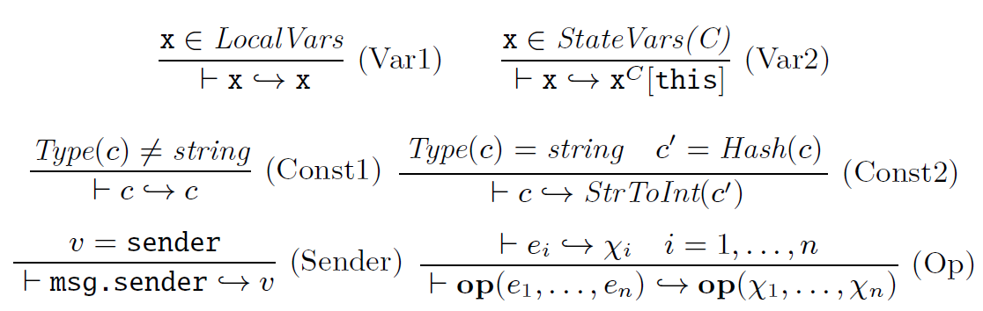
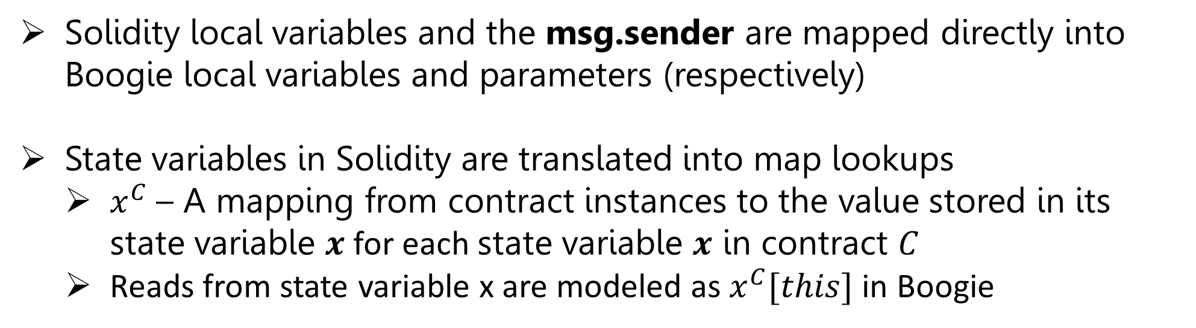
From Solidity to Boogie Expressions
Solidity local variables and the msg.sender are mapped directly into Boogie local variables and parameters (respectively)
State variables in Solidity are translated into map lookups
  $x^{C}$ – A mapping from contract instances to the value stored in its state variable $x$ for each state variable $x$ in contract $C$
  Reads from state variable x are modeled as $x^{C}[this]$ in Boogie
Saar Cohen | Formal Verification of Workflow Policies for Smart Contracts in Azure Blockchain | November 28, 2021

Slide 40
From Solidity to Boogie Expressions
StrToInt – An uninterpreted function applied to a hash of the string
  The hash function is collision-free
Saar Cohen | Formal Verification of Workflow Policies for Smart Contracts in Azure Blockchain | November 28, 2021
Notes:
keeping a mapping from each string constant to a counter

Slide 41
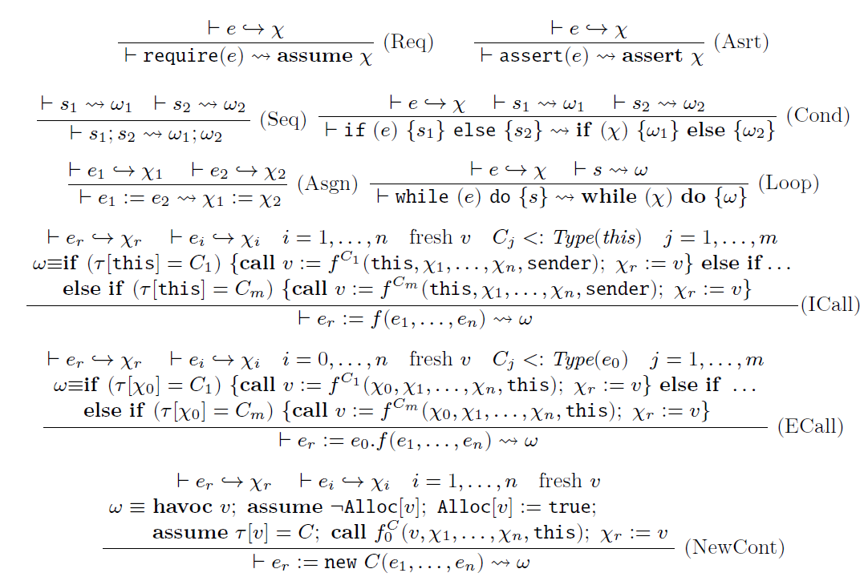
From Solidity to Boogie Statements
Saar Cohen | Formal Verification of Workflow Policies for Smart Contracts in Azure Blockchain | November 28, 2021

Slide 42
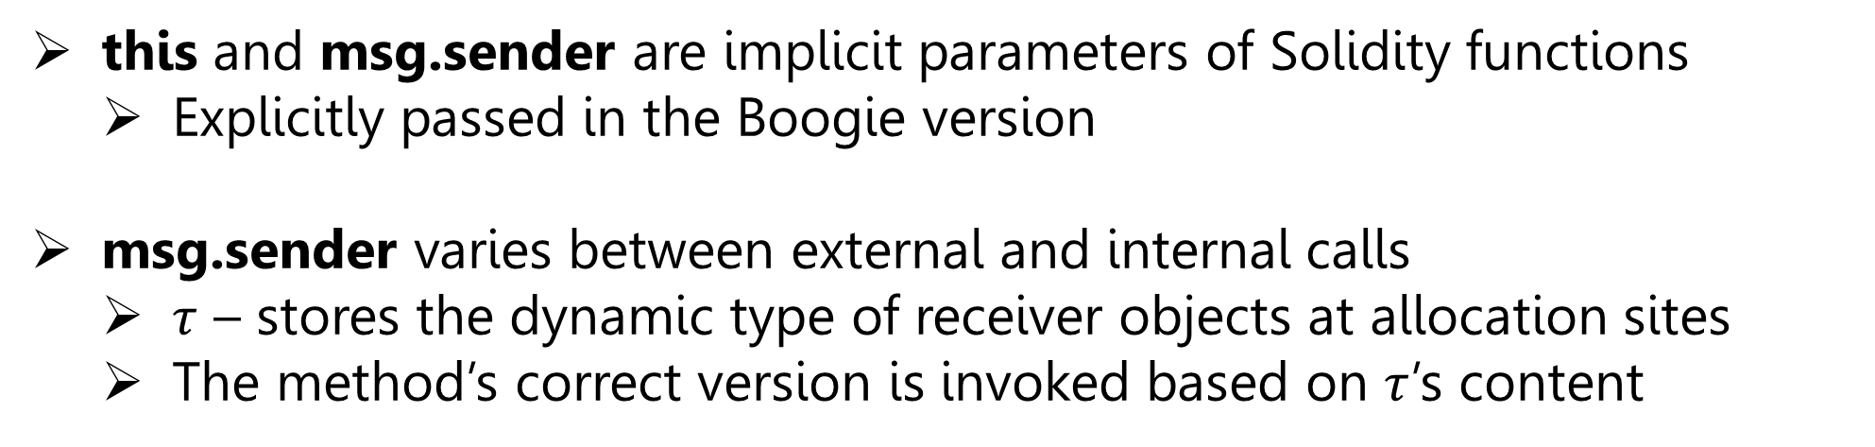
From Solidity to Boogie Statements – Function Calls
this and msg.sender are implicit parameters of Solidity functions
  Explicitly passed in the Boogie version
msg.sender varies between external and internal calls
  $τ$ – stores the dynamic type of receiver objects at allocation sites
  The method’s correct version is invoked based on $τ$’s content
Saar Cohen | Formal Verification of Workflow Policies for Smart Contracts in Azure Blockchain | November 28, 2021
Notes:
Type(e) is a function that returns the static type of Solidity expression e.
Symbol $f^{C}$ denotes the function f in contract C, and $f_{0}^{C}$ denotes the constructor of contract C.
The <: relation represents the sub-typing relationship.

Slide 43
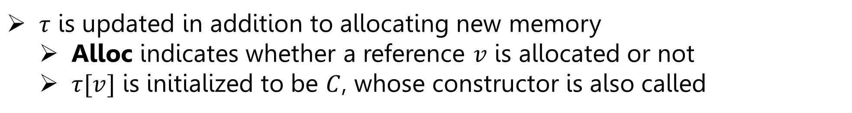
From Solidity to Boogie Statements – Contract Creation
$τ$ is updated in addition to allocating new memory
  Alloc indicates whether a reference $v$ is allocated or not
  $τ[v]$ is initialized to be $C$, whose constructor is also called
Saar Cohen | Formal Verification of Workflow Policies for Smart Contracts in Azure Blockchain | November 28, 2021
Notes:
Type(e) is a function that returns the static type of Solidity expression e.
Symbol $f^{C}$ denotes the function f in contract C, and $f_{0}^{C}$ denotes the constructor of contract C.
The <: relation represents the sub-typing relationship.

Slide 44
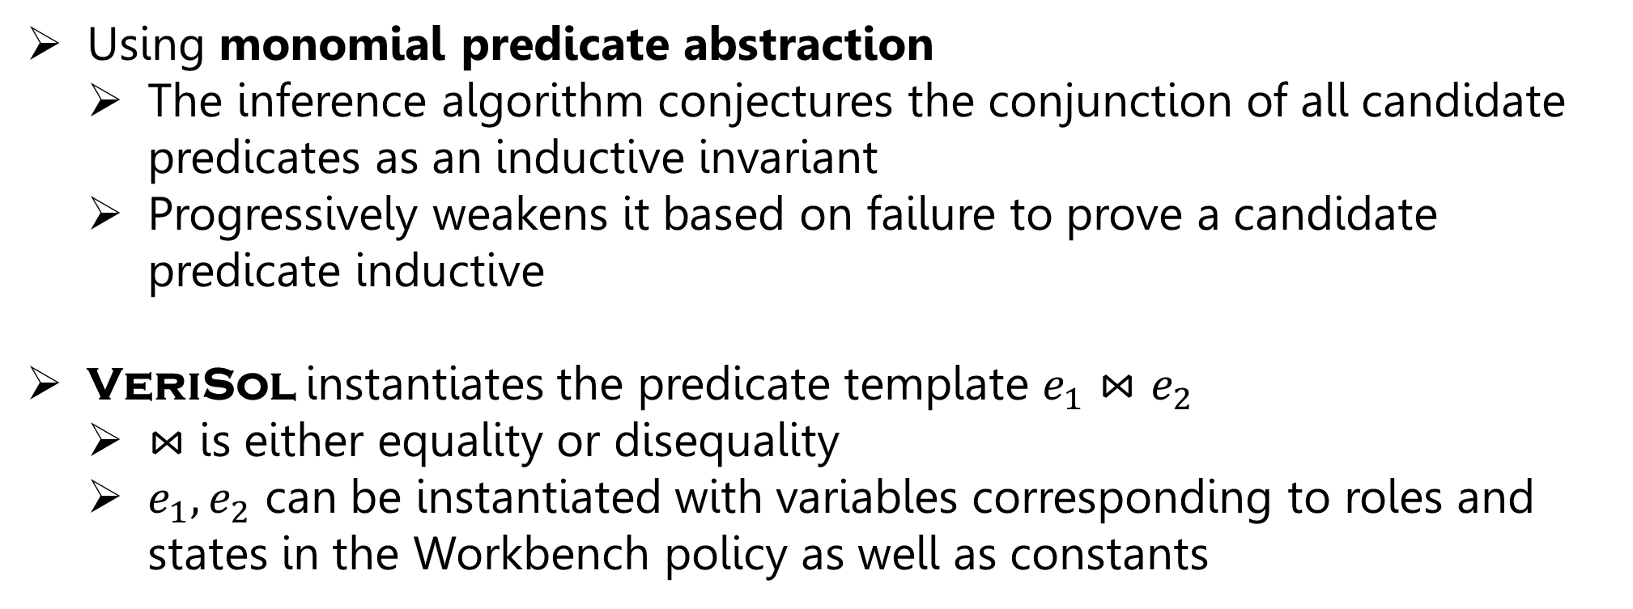
Invariant Generation
Using monomial predicate abstraction
  The inference algorithm conjectures the conjunction of all candidate predicates as an inductive invariant
  Progressively weakens it based on failure to prove a candidate predicate inductive
VeriSol instantiates the predicate template $e_{1}⋈e_{2}$
  $⋈$ is either equality or disequality
  $e_{1},e_{2}$ can be instantiated with variables corresponding to roles and states in the Workbench policy as well as constants
Saar Cohen | Formal Verification of Workflow Policies for Smart Contracts in Azure Blockchain | November 28, 2021
Notes:
We have found these candidate predicates to be sufficiently general for automatically verifying semantic conformance of Workbench contracts; however, additional predicates may be required for other types of contracts.

Slide 45
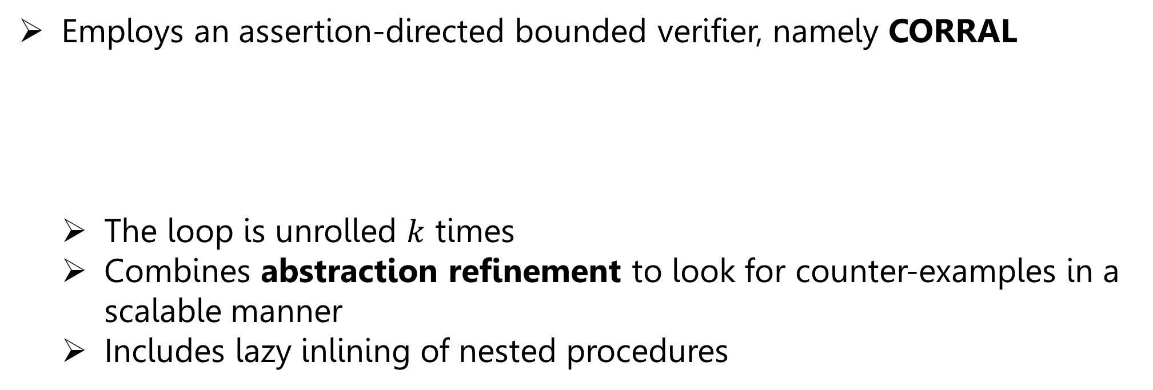
Bounded Model Checking
Employs an assertion-directed bounded verifier, namely CORRAL
  The loop is unrolled $k$ times
  Combines abstraction refinement to look for counter-examples in a scalable manner
  Includes lazy inlining of nested procedures
Saar Cohen | Formal Verification of Workflow Policies for Smart Contracts in Azure Blockchain | November 28, 2021

Slide 46
Abstraction Refinement
Variable Abstraction:
  Global variables retained by the abstraction are tracked variables
  Assignments to variables that are not tracked are completely removed
  Expressions that have an untracked global variable are assumed to evaluate to any value
Refinement:
  The goal: Figure out a minimal set of variables to track that rule out the forged counterexample
Saar Cohen | Formal Verification of Workflow Policies for Smart Contracts in Azure Blockchain | November 28, 2021

Slide 47
Evaluation
Saar Cohen | Formal Verification of Workflow Policies for Smart Contracts in Azure Blockchain | November 28, 2021

Slide 48
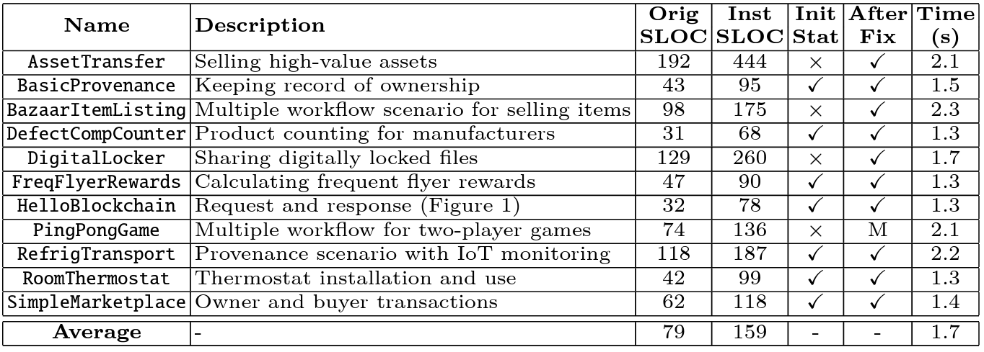
Main Results
Init Stat – The result of applying VeriSol on the original smart contract
After Fix – After we manually fix the bug (if any)
Saar Cohen | Formal Verification of Workflow Policies for Smart Contracts in Azure Blockchain | November 28, 2021

Slide 49
Bug Analysis
Incorrect state transition – AssetTransfer (Selling high-value assets):
  The transition from state BuyerAccepted to state Accepted in the Accept function had no matching transitions in the policy.
    Policy: allows a transition from BuyerAccepted to SellerAccepted when invoking the function Accept and msg.sender equals the instance role variable InstanceOwner
    Implementation: Accept transitions to the state Accepted instead of SellerAccepted
Incorrect initial state – DigitalLocker (Sharing digitally locked files):
  Policy: requires the initial state to be Requested
  Implementation: incorrectly sets the initial state to DocumentReview
Saar Cohen | Formal Verification of Workflow Policies for Smart Contracts in Azure Blockchain | November 28, 2021

Slide 50
Questions?
Saar Cohen | Formal Verification of Workflow Policies for Smart Contracts in Azure Blockchain | November 28, 2021

