Slide 1
ZEUS: Analyzing Safety of Smart Contracts
Sukrit Kalra, Seep Goel, Mohan Dhawan, Subodh Sharma
Presenting: Daniel Kaganovich

Slide 2
ZEUS: Analyzing Safety of Smart Contracts
INTRODUCTION
MOTIVATION
ZEUS
IMPLEMENTATION
EVALUATION
CONCLUSION

Slide 3
INTRODUCTION
Correctness: Syntactic implementation follows the best practices
Fairness: The code adheres to the agreed upon higher-level business logic for interaction

Slide 4
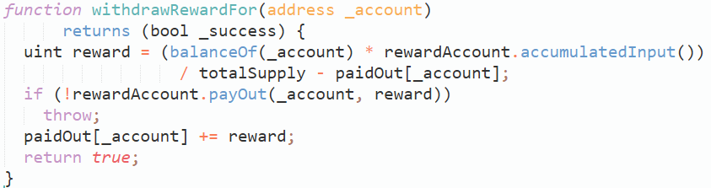
The DAO Attack
Investors in TheDAO lost cryptocurrency worth around $50 million!
Notes:
The attacker use recursive call to the function and drain the money of The DAO

Slide 5

Example
Notes:
Example of Incorrect Contracts, Integer overflow

Slide 6
Example
Notes:
Example of Incorrect Contracts, Integer overflow

Slide 7
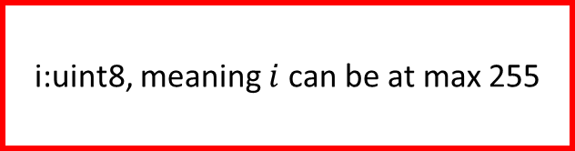
Example
i:uint8, meaning $i$ can be at max 255
Notes:
Example of Incorrect Contracts, if there is more than 255 participants only the first 256 participants will get the money

Slide 8
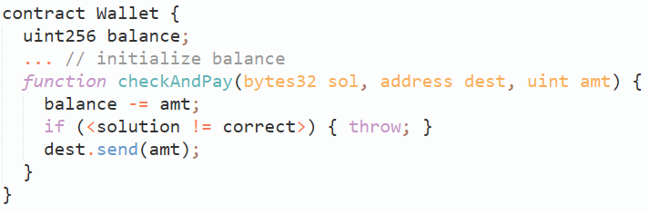
Example
Notes:
Example of unfair contract

Slide 9
Example

Slide 10
Example
If balance < amt so send() will fail
Notes:
In this case the owner of the contract will get the solution to his puzzle and not pay anything to the winner

Slide 11
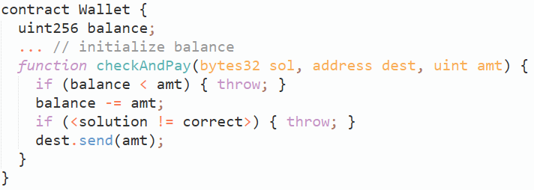
Example - Fix

Slide 12
Auction House
With reserve: The seller is allowed to bid
Without reserve: The seller is not allowed to bid
By law, the auction must announce if it is “with reserve” or “without reserve”
Notes:
Fairness example

Slide 13
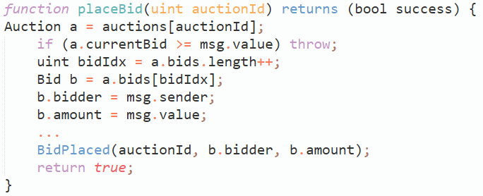

Unfair Auction House Contract

Slide 14
Unfair Auction House Contract
The seller can participate in the auction house
Notes:
The contract did not publish the terms of the auctions

Slide 15
ZEUS
Policy
Source Code
Intermediate Language
Verifier

Slide 16


ZEUS
Policy
Source Code
Intermediate Language
Verifier

Slide 17


ZEUS
Policy
Source Code
Intermediate Language
Verifier

Slide 18

ZEUS
Policy
Source Code
Intermediate Language
Verifier

Slide 19



ZEUS
Policy
Source Code
Intermediate Language
Verifier

Slide 20
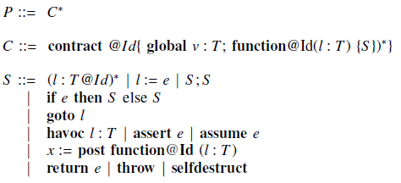
Formalizing Solidity Semantics

Slide 21
Formalizing Solidity Semantics
A program consists of a sequence of contract declarations

Slide 22
Formalizing Solidity Semantics
Each contract is abstractly viewed as a sequence of one or more method definitions.
Persistent storage private to a contract, denoted by the keyword global.
Notes:
We have methods with a single input variable of type T that is global to the contract’s functions. Since T is generic, we lose no generality with single local and global variables

Slide 23
Formalizing Solidity Semantics
The body of a contract method is inductively defined by S.
goto: Internal and external invocations or are inlined
post: call() invocations (send with argument)
havoc: asigns a non-deterministic value
assume: blocks until the supplied
expression becomes true
assert: check of truth value of predicates
Notes:
The body of a contract method is inductively defined by S.

Slide 24


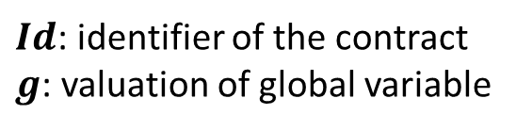

LANGUAGE SEMANTICS
$$\left\langle \left\langle 𝓣,σ\right\rangle ,BC\right\rangle : The blockchain state$$
$$\left\langle 𝓣,σ\right\rangle : The block B being currently mined$$
$σ:Id→g$, $g∈Vals$
$$σ: The global state of the system after executing 𝒯$$
$Id$: identifier of the contract
$g$: valuation of global variable
$$𝓣: The completed transactions that are not commited$$
$$BC: The list of committed blocks$$
$$Vlas: Set of values that expressions can take after evaluetion$$
$$Vals⊆ℕ$$
Notes:
Sigma maps contract identifiers to a valuation of the global variables.
Finally, each miner will add B to their respective copies of blockchain once it is validated.

Slide 25



LANGUAGE SEMANTICS
$$γ: A transaction, defined as a stuck of frames f$$
$$f≔\left\langle ℓ, id, M, pc, v\right\rangle : A frame$$
$$ℓ∈Vals: The valuation of the method−local variables l$$
$$M: The code of the contract with identidier id$$
$$pc: The program counter$$
$$v≔\left\langle i,o\right\rangle :Auxiliary memory for storing input and output$$
$$ε:empty frame$$
Notes:
The top frame of gama is the frame under active execution and is relevant to the currently executing transaction

Slide 26


LANGUAGE SEMANTICS
$$c≔\left\langle γ,σ\right\rangle : The configuration, capture the state of the transaction$$
$$⇝: Small step operation$$
$$→: Transition relation for globals and blockchain state$$
$$←:Assignment$$

Slide 27
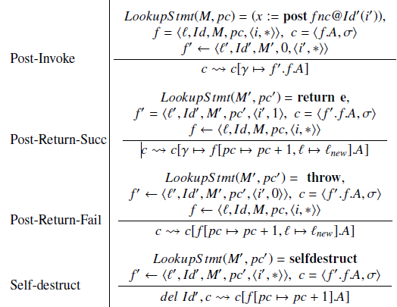
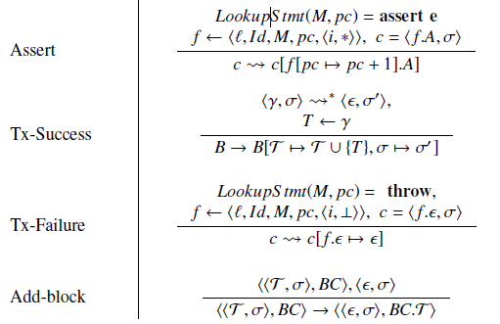
LANGUAGE SEMANTICS

Slide 28
Formalizing the Policy Language
$$PVars:\text{the} \text{set} \text{of} \text{program} \text{variables}$$
Notes:
The body of a contract method is inductively defined by S.

Slide 29
Formalizing the Policy Language
$$PVars:\text{the} \text{set} \text{of} \text{program} \text{variables}$$
$$Func:\text{the} \text{set} \text{of} \text{function} \text{names} \text{in} \text{a} \text{contract}$$
Notes:
The body of a contract method is inductively defined by S.

Slide 30
Formalizing the Policy Language
$$PVars:\text{the} \text{set} \text{of} \text{program} \text{variables}$$
$$Func:\text{the} \text{set} \text{of} \text{function} \text{names} \text{in} \text{a} \text{contract}$$
$$Expr:\text{the} \text{set} \text{of} \text{conditional} \text{expressions}$$
Notes:
The body of a contract method is inductively defined by S.

Slide 31

Formalizing the Policy Language
$$PVars:\text{the} \text{set} \text{of} \text{program} \text{variables}$$
$$Func:\text{the} \text{set} \text{of} \text{function} \text{names} \text{in} \text{a} \text{contract}$$
$$Expr:\text{the} \text{set} \text{of} \text{conditional} \text{expressions}$$
Policy specification:
$$\left\langle Sub,Obj,Op,Cond,Res\right\rangle$$
Notes:
XACML-styled five tuple policy specification

Slide 32

Formalizing the Policy Language
$$PVars:\text{the} \text{set} \text{of} \text{program} \text{variables}$$
$$Func:\text{the} \text{set} \text{of} \text{function} \text{names} \text{in} \text{a} \text{contract}$$
$$Expr:\text{the} \text{set} \text{of} \text{conditional} \text{expressions}$$
Policy specification:
$$\left\langle Sub,Obj,Op,Cond,Res\right\rangle$$
$$Subject Sub∈PVar$$
The set of source variables (one or more) that need to be tracked

Slide 33

Formalizing the Policy Language
$$PVars:\text{the} \text{set} \text{of} \text{program} \text{variables}$$
$$Func:\text{the} \text{set} \text{of} \text{function} \text{names} \text{in} \text{a} \text{contract}$$
$$Expr:\text{the} \text{set} \text{of} \text{conditional} \text{expressions}$$
Policy specification:
$$\left\langle Sub,Obj,Op,Cond,Res\right\rangle$$
$$Subject Sub∈PVar$$
The set of variables representing entities with which the subject interacts
$$Object Obj∈PVar$$

Slide 34
Formalizing the Policy Language
$$PVars:\text{the} \text{set} \text{of} \text{program} \text{variables}$$
$$Func:\text{the} \text{set} \text{of} \text{function} \text{names} \text{in} \text{a} \text{contract}$$
$$Expr:\text{the} \text{set} \text{of} \text{conditional} \text{expressions}$$
Policy specification:
$$\left\langle Sub,Obj,Op,Cond,Res\right\rangle$$
$$Subject Sub∈PVar$$
The set of side-affecting invocations that capture the effects of interaction between the subject and the object
$$Object Obj∈PVar$$
$$Operation Op≔\left\langle f, trig\right\rangle , f∈Func, trig∈\left\{pre, post\right\}$$

Slide 35

Formalizing the Policy Language
$$PVars:\text{the} \text{set} \text{of} \text{program} \text{variables}$$
$$Func:\text{the} \text{set} \text{of} \text{function} \text{names} \text{in} \text{a} \text{contract}$$
$$Expr:\text{the} \text{set} \text{of} \text{conditional} \text{expressions}$$
Policy specification:
$$\left\langle Sub,Obj,Op,Cond,Res\right\rangle$$
$$Subject Sub∈PVar$$
The set of predicates that govern this interaction leading to the operation
$$Object Obj∈PVar$$
$$Operation Op≔\left\langle f, trig\right\rangle , f∈Func, trig∈\left\{pre, post\right\}$$
$$Condition Cond∈Expr$$

Slide 36

Formalizing the Policy Language
$$PVars:\text{the} \text{set} \text{of} \text{program} \text{variables}$$
$$Func:\text{the} \text{set} \text{of} \text{function} \text{names} \text{in} \text{a} \text{contract}$$
$$Expr:\text{the} \text{set} \text{of} \text{conditional} \text{expressions}$$
Policy specification:
$$\left\langle Sub,Obj,Op,Cond,Res\right\rangle$$
Indicates whether the interaction between the subject and operation as governed by the predicates is permitted or constitutes a violation
$$Subject Sub∈PVar$$
$$Object Obj∈PVar$$
$$Operation Op≔\left\langle f, trig\right\rangle , f∈Func, trig∈\left\{pre, post\right\}$$
$$Condition Cond∈Expr$$
$$Res∈\left\{T,F\right\}$$

Slide 37
Soundness - proof
Transformation from Solidity to abstract language
Effect of Taint analysis on soundness
Semantic interpretation of Policy Confirmation
Assertion Safety in a program implies Policy Confirmation
Soundness via over-approximation
Soundness of methodology

Slide 38
Transformation from Solidity to abstract
Solidity maps semantically to the abstract language that was presented.
The translation preserves the semantic behavior.

Slide 39
Effect of Taint Analysis on soundness
The Taint Analysis determine the location to put asserts in the code.
Put these asserts may introduce False Positive, but not False Negative
Notes:
Note that taint-analysis, which is required to determine the locations at which to assert the predicates, is conservative.

Slide 40
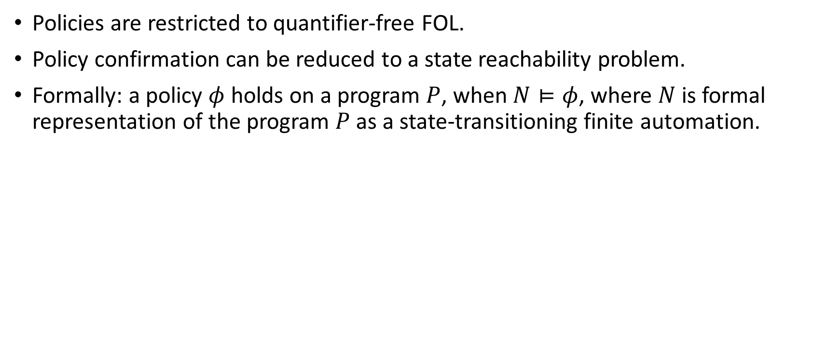
Semantic interpretation of Policy Confirmation
Policies are restricted to quantifier-free FOL.
Policy confirmation can be reduced to a state reachability problem.
Formally: a policy $φ$ holds on a program $P$, when $N⊨φ$, where $N$ is formal representation of the program $P$ as a state-transitioning finite automation.

Slide 41
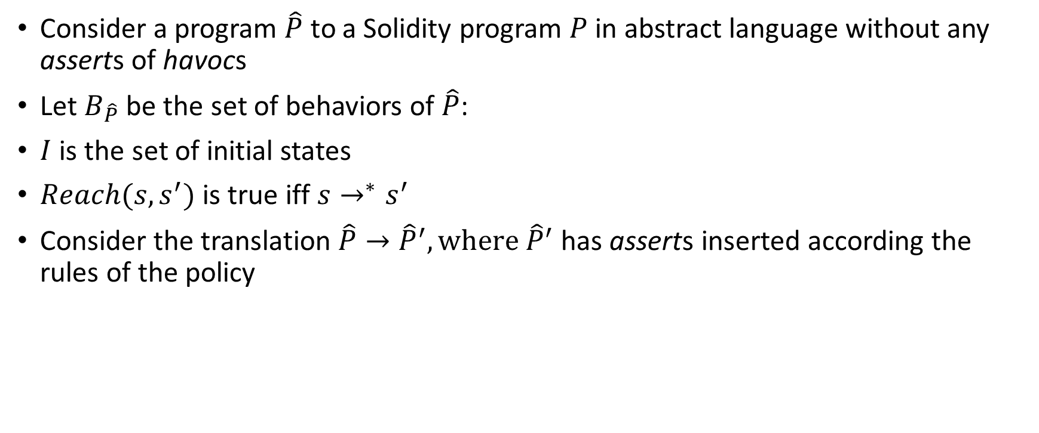
Assertion Safety in a program implies Policy Confirmation
Consider a program $\hat{P}$ to a Solidity program $P$ in abstract language without any asserts of havocs
Let $B_{\hat{P}}$ be the set of behaviors of $\hat{P}$:
$I$ is the set of initial states
$Reach(s,s^{′})$ is true iff $s→^{∗}s^{′}$
Consider the translation $\hat{P}→{\hat{P}}^{′}, where {\hat{P}}^{′}$ has asserts inserted according the rules of the policy

Slide 42
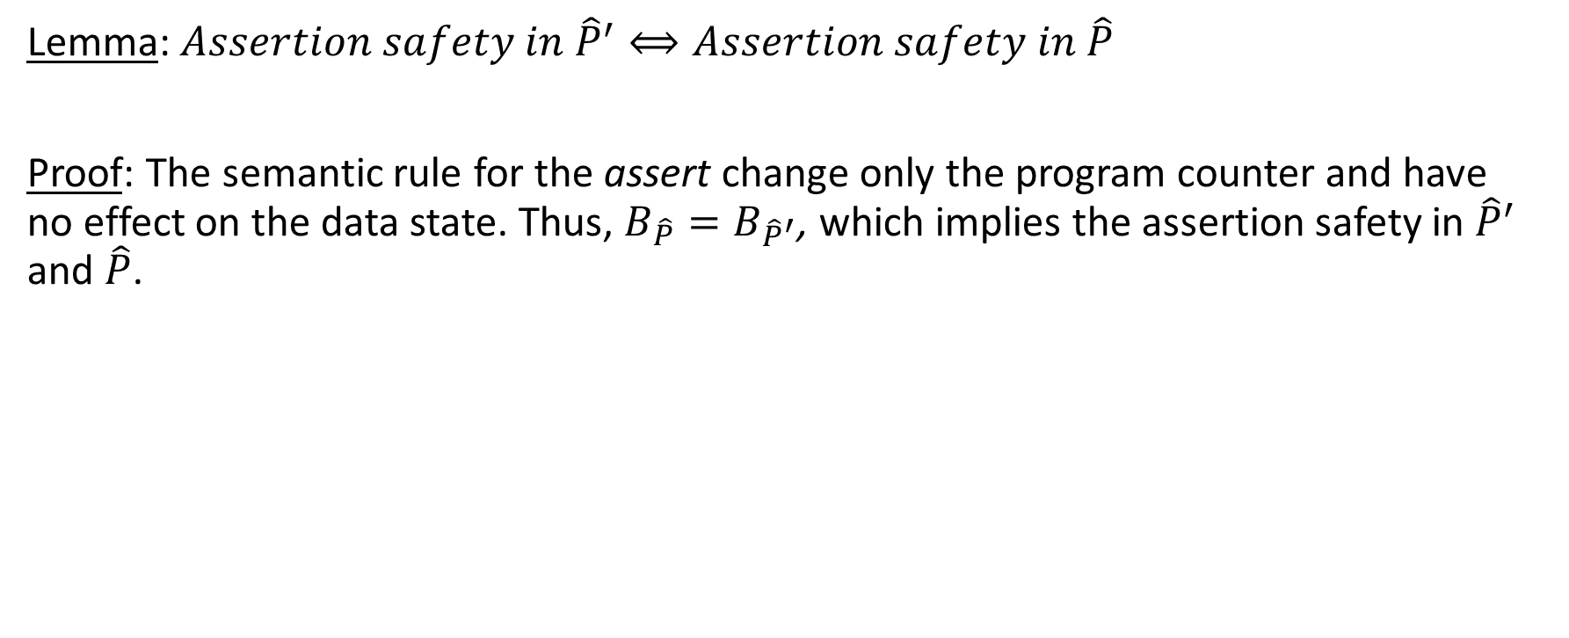
Assertion Safety in a program implies Policy Confirmation
Lemma: $Assertion safety in {\hat{P}}^{′}⟺Assertion safety in \hat{P}$
Proof: The semantic rule for the assert change only the program counter and have no effect on the data state. Thus, $B_{\hat{P}}=B_{{\hat{P}}^{′}}$, which implies the assertion safety in ${\hat{P}}^{′}$ and $\hat{P}$.

Slide 43
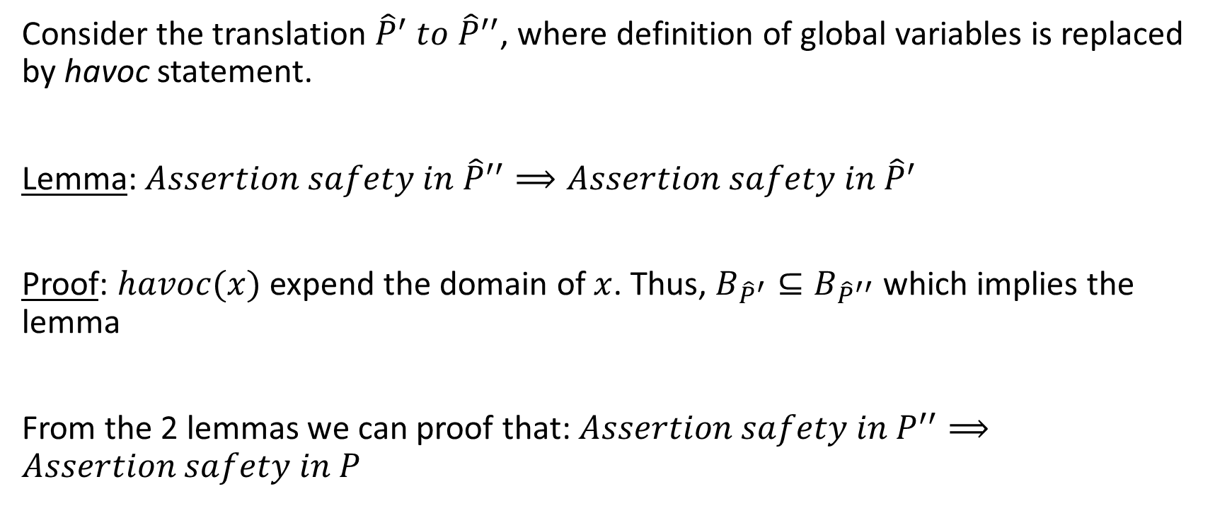
Soundness via over-approximation
Consider the translation ${\hat{P}}^{′} to {\hat{P}}^{′′}$, where definition of global variables is replaced by havoc statement.
Lemma: $Assertion safety in {\hat{P}}^{′′}⟹Assertion safety in {\hat{P}}^{′}$
Proof: $havoc(x)$ expend the domain of $x$. Thus, $B_{{\hat{P}}^{′}}⊆B_{{\hat{P}}^{′′}}$ which implies the lemma
From the 2 lemmas we can proof that: $Assertion safety in P^{′′}⟹Assertion safety in P$

Slide 44
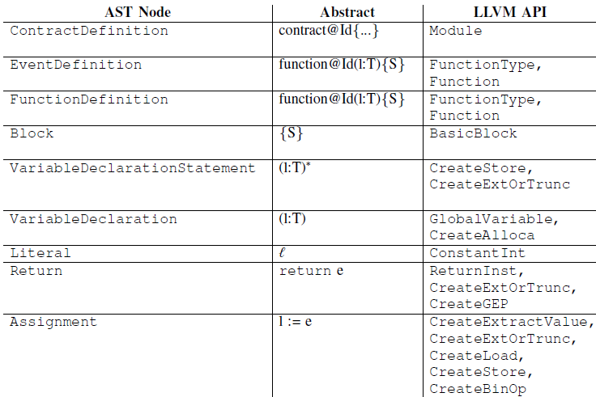
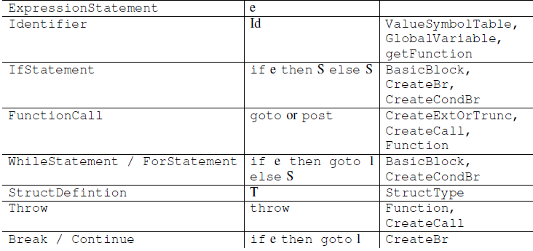
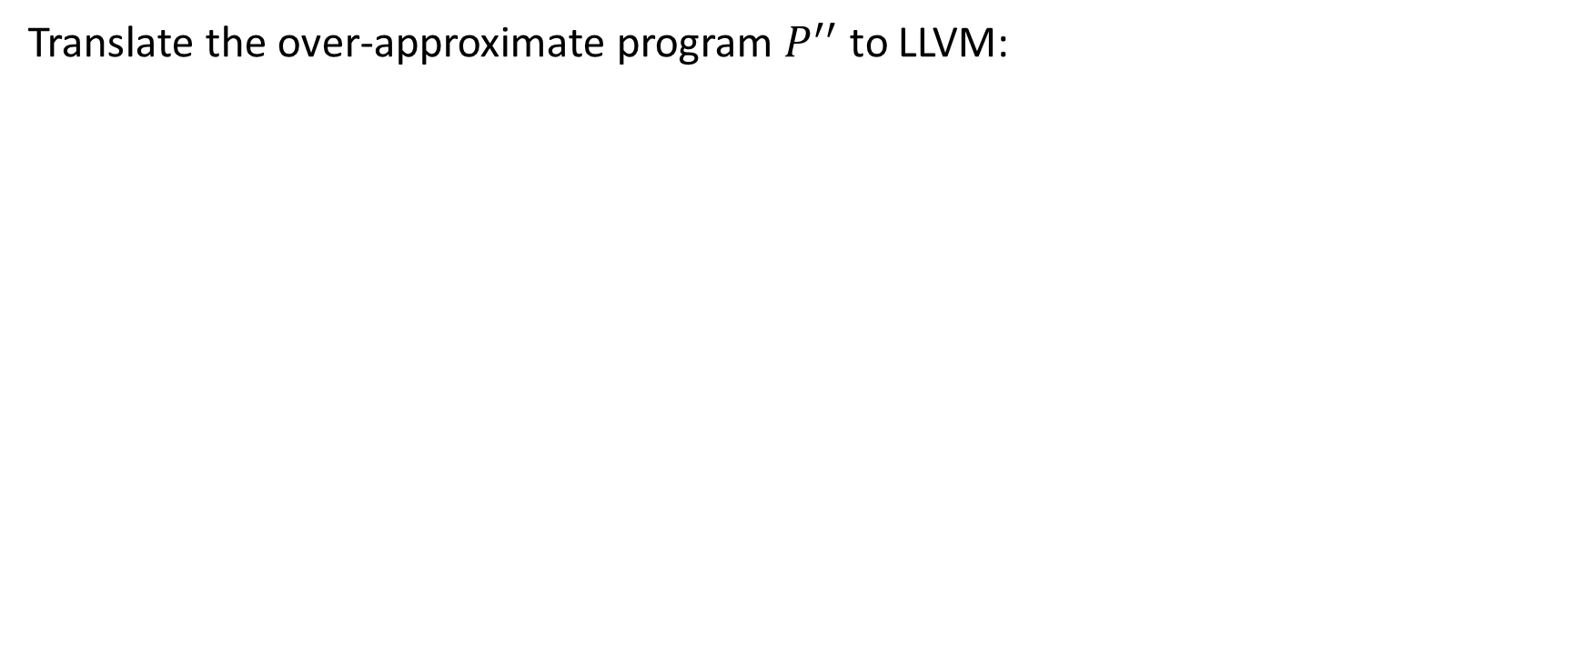
Soundness of methodology
Translate the over-approximate program $P^{′′}$ to LLVM:

Slide 45
IMPLEMENTATION
The policy builder: 500 Lines Of Code
The translator from Solidity to LLVM: 3000 Lines Of Code
The code was written on C++ using the Abstract Syntax Tree (AST) derived from the Solidity compiler solc
Verifier: Verifiers that are already work with LLVM like SMACK, Seahorn

Slide 46
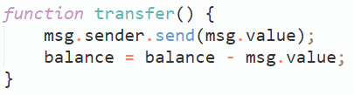
End-to-End Example
Notes:
The solidity code

Slide 47
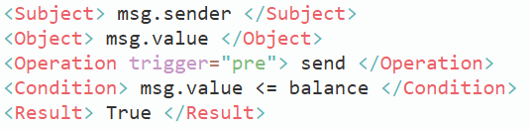
End-to-End Example
Notes:
The solidity code + The policy (XACML)

Slide 48
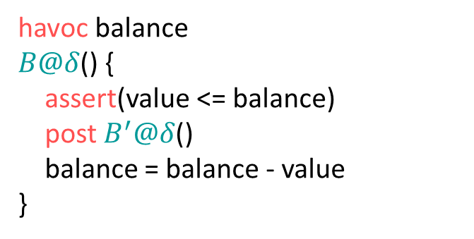
End-to-End Example
havoc balance
$B@δ$() {
assert(value <= balance)
post $B^{′}@δ$()
balance = balance - value
}
Notes:
Abstract Program

Slide 49
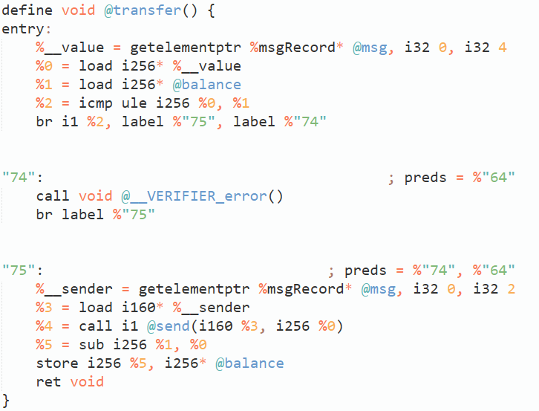
End-to-End Example
Notes:
LLVM bitcode

Slide 50
End-to-End Example
Check if msg.value <= balance
Notes:
LLVM bitcode

Slide 51
End-to-End Example
Assert call failure is make a call to the verifier error function
Notes:
LLVM bitcode

Slide 52
LIMITATIONS

Slide 53
LIMITATIONS
Fairness properties involving mathematical formulae are harder to check
  ZEUS depends on the user to give appropriate policy

Slide 54
LIMITATIONS
Fairness properties involving mathematical formulae are harder to check
  ZEUS depends on the user to give appropriate policy
Zeus is not faithful exactly to Solidity syntax
  throw and selfdestruct are modeled as program exit
Notes:
Because they have no LLVM transformation

Slide 55
LIMITATIONS
Fairness properties involving mathematical formulae are harder to check
  ZEUS depends on the user to give appropriate policy
Zeus is not faithful exactly to Solidity syntax
  throw and selfdestruct are modeled as program exit
Zeus does not explicitly account for runtime EVM parameters such as gas

Slide 56
LIMITATIONS
Fairness properties involving mathematical formulae are harder to check
  ZEUS depends on the user to give appropriate policy
Zeus is not faithful exactly to Solidity syntax
  throw and selfdestruct are modeled as program exit
Zeus does not explicitly account for runtime EVM parameters such as gas
Zeus does not support virtual functions in contract hierarchy (super keyword)

Slide 57
LIMITATIONS
Fairness properties involving mathematical formulae are harder to check
  ZEUS depends on the user to give appropriate policy
Zeus is not faithful exactly to Solidity syntax
  throw and selfdestruct are modeled as program exit
Zeus does not explicitly account for runtime EVM parameters such as gas
Zeus does not support virtual functions in contract hierarchy (super keyword)
Zeus does not analyze contracts with an assembly block

Slide 58
LIMITATIONS
Fairness properties involving mathematical formulae are harder to check
  ZEUS depends on the user to give appropriate policy
Zeus is not faithful exactly to Solidity syntax
  throw and selfdestruct are modeled as program exit
Zeus does not explicitly account for runtime EVM parameters such as gas
Zeus does not support virtual functions in contract hierarchy (super keyword)
Zeus does not analyze contracts with an assembly block
ZEUS supports verification of safety properties
  Quantifier-free logic with integer linear arithmetic
Notes:
State reachability expressible via quantifier-free logic with integer linear arithmetic.
Verification of liveness (i.e., something good must eventually happen) does not supported.

Slide 59
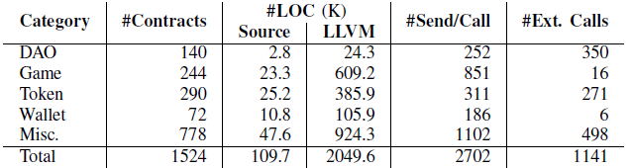
EVALUATION
1524 unique contracts (out of 22,493 contracts)
Classified Contract: DAO, Game, Token, Wallet, Misc

Slide 60
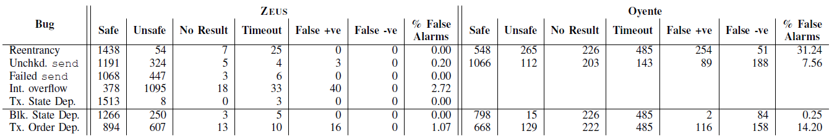
EVALUATION

Slide 61
EVALUATION

Slide 62
EVALUATION

Slide 63
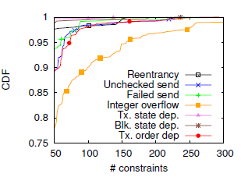
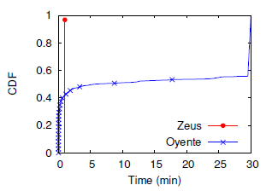
EVALUATION

Slide 64
CONCLUSION
94.6% of 22.4K contracts are vulnerable
ZEUS is sound (zero false negative)
Low false positive rate
ZEUS is fast (less than 1 min to verify 97% of the contracts)

Slide 65
Thanks For Listening

