Slide 1
Demystifying loops in smart contracts
Benjamin Mariano, Yanju Chen, Yu Feng, Shuvendu K. Lahiri, and Isil Dillig
Presented by Yosef Zumer and Yossi Weizman

Slide 2
Agenda
Intro
Loops analysis in Solidity
Loops – main patterns
Summarizing solidity loops in CONSUL, evaluation and results
Wrap-up

Slide 3
Intro
Smart contracts are a hot topic.
Security plays a crucial role in smart contracts.
Therefore, it’s important to analyze the contracts to ensure an expected behavior.

Slide 4
Intro
Solidity is the main language for developing smart contracts.
A common assumption: Loops aren’t common in Solidity.
The researcher have found this is inaccurate.
The paper aims to understand the behavior of loops in smart contracts,
to enhance security of contracts.

Slide 5
Zoom-out
The researchers collected smart contracts. Many contracts with loops were found.
The researchers analyzed the loops to find common patterns.
A DSL (domain-specific language), CONSUL, was developed that fits most patterns.
The tool SOLIS was developed, which translates Solidity loops to CONSUL.

Slide 6
Loops prevalence is smart contracts
Over 20K smart contracts were analyzed, using Slither.
20% of the contracts contain loops.
50% of contracts with >200 lines of code contain loops.

Slide 7
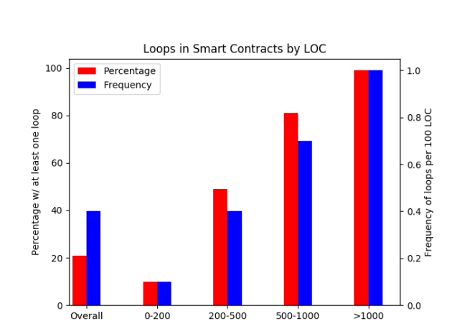
Loops prevalence is smart contracts

Slide 8
Syntactic analysis of loops
Loops are usually small, ~2 lines of code in average.
Nested loops are very rare (<5% of all loops).
Loops have 5 variables in average.
The length of the loop doesn’t significantly affect those proprieties.

Slide 9
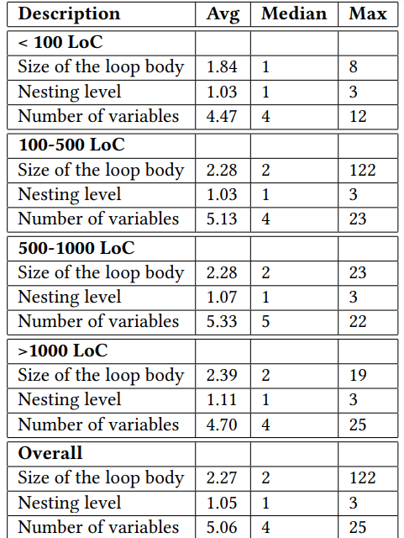
Syntactic analysis of loops

Slide 10
Syntactic analysis of loops
88% of loops contains collections.
75% of loops have a side-affect on contract state (i.e. involve writes).
33% of loops have control-flow (e.g. if statements).
80% of loops don’t have a constant bound.
13% of loops contains require statement.

Slide 11
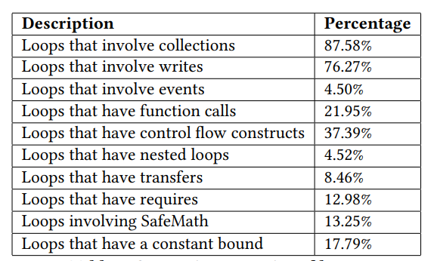
Syntactic analysis of loops

Slide 12
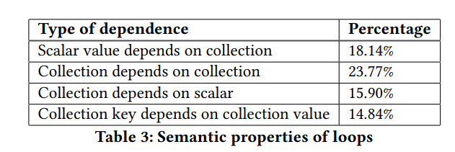
Semantic analysis of loops
There are four types of data dependencies in loops.
For example: Aggregate array values is covered by the first row in the table.
4 properties aren’t specific enough to find patterns in loops

Slide 13
Semantic analysis of loops
To better characterize loops, k-means with 6 clusters was used.
For clustering, only 1-sized loops were used.
Loops were converted to dependency graph with 37 features.
From each cluster, 10 samples were manually investigated.
4 main patterns were found.

Slide 14
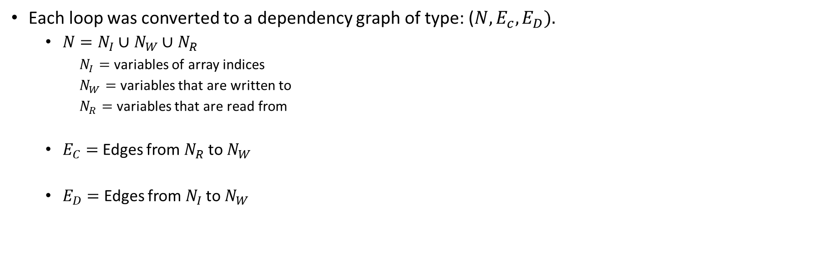
Semantic analysis of loops
K-means
Each loop was converted to a dependency graph of type: ($N, E_{c},E_{D}).$
  $N=N_{I}∪$ $N_{W}$ $∪$ $N_{R}$
    $N_{I}=$ variables of array indices
    $N_{W}=$ variables that are written to
    $N_{R}=$ variables that are read from
  $E_{C}=$ Edges from $N_{R}$ to $N_{W}$
  $E_{D}=$ Edges from $N_{I}$ to $N_{W}$

Slide 15
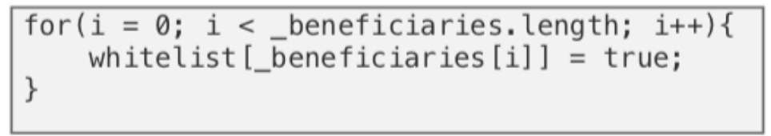
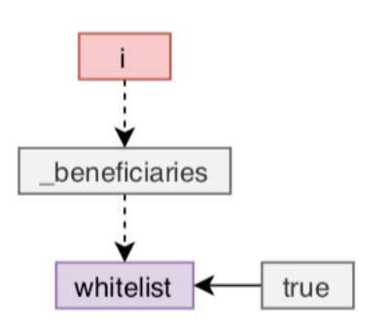
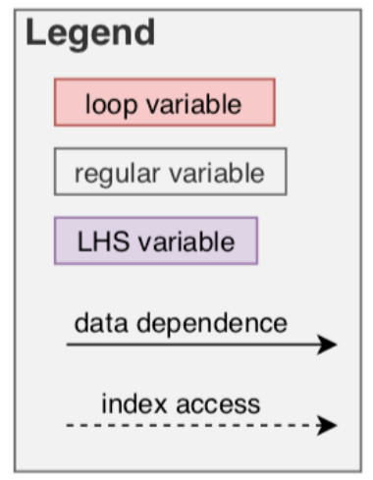
Semantic analysis of loops
K-means
Each loop was converted to a dependency graph of type: ($N, E_{c},E_{D}).$
  $N=N_{I}∪$ $N_{W}$ $∪$ $N_{R}$
    $N_{I}=$ variables of array indices
    $N_{W}=$ variables that are written to
    $N_{R}=$ variables that are read from
  $E_{C}=$ Edges from $N_{R}$ to $N_{W}$
  $E_{D}=$ Edges from $N_{I}$ to $N_{W}$

Slide 16
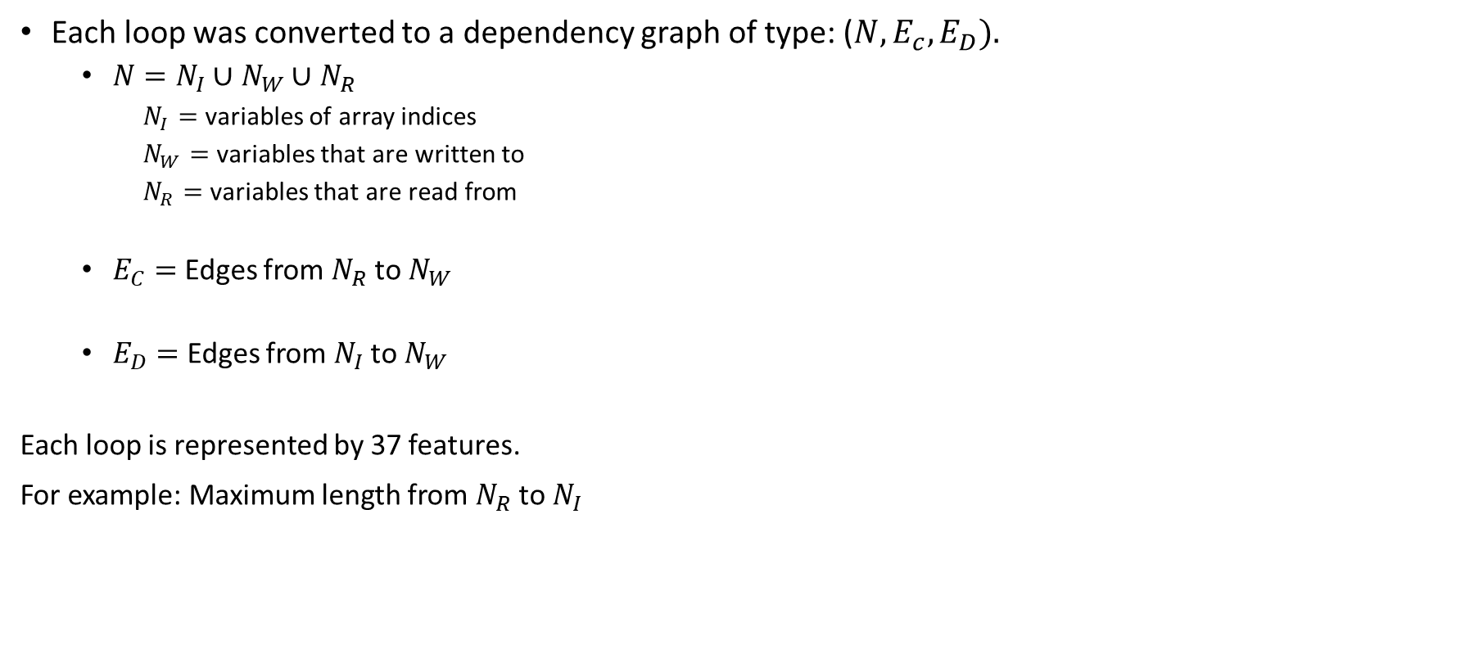
Semantic analysis of loops
K-means
Each loop was converted to a dependency graph of type: ($N, E_{c},E_{D}).$
  $N=N_{I}∪$ $N_{W}$ $∪$ $N_{R}$
    $N_{I}=$ variables of array indices
    $N_{W}=$ variables that are written to
    $N_{R}=$ variables that are read from
  $E_{C}=$ Edges from $N_{R}$ to $N_{W}$
  $E_{D}=$ Edges from $N_{I}$ to $N_{W}$
Each loop is represented by 37 features.
For example: Maximum length from $N_{R}$ to $N_{I}$

Slide 17
Semantic analysis of loops
Patterns
After manually examine each of k-mean’s clusters, 4 main patterns were found:
Fold – Perform an accumulation over a collection
Map - Apply a function to elements of a collection
Require – Enforce a predicate over a collection
Zip – Pairwise aggregate collection

Slide 18
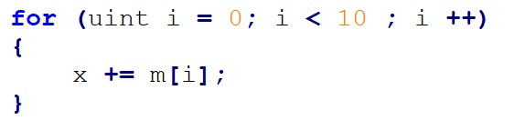
Semantic analysis of loops
Patterns
After manually examine each of k-mean’s clusters, 4 main patterns were found:
Fold – Perform an accumulation over a collection
Map - Apply a function to elements of a collection
Require – Enforce a predicate over a collection
Zip – Pairwise aggregate collection

Slide 19
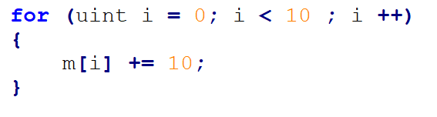
Semantic analysis of loops
Patterns
After manually examine each of k-mean’s clusters, 4 main patterns were found:
Fold – Perform an accumulation over a collection
Map - Apply a function to elements of a collection
Require – Enforce a predicate over a collection
Zip – Pairwise aggregate collection

Slide 20
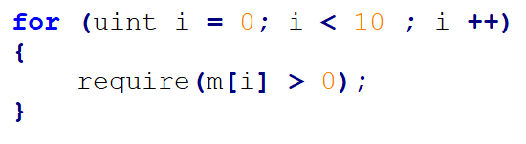
Semantic analysis of loops
Patterns
After manually examine each of k-mean’s clusters, 4 main patterns were found:
Fold – Perform an accumulation over a collection
Map - Apply a function to elements of a collection
Require – Enforce a predicate over a collection
Zip – Pairwise aggregate collection

Slide 21
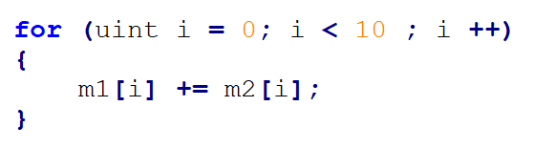
Semantic analysis of loops
Patterns
After manually examine each of k-mean’s clusters, 4 main patterns were found:
Fold – Perform an accumulation over a collection
Map - Apply a function to elements of a collection
Require – Enforce a predicate over a collection
Zip – Pairwise aggregate collection
* Additionally, an arithmetic pattern was found. But it’s rare

Slide 22
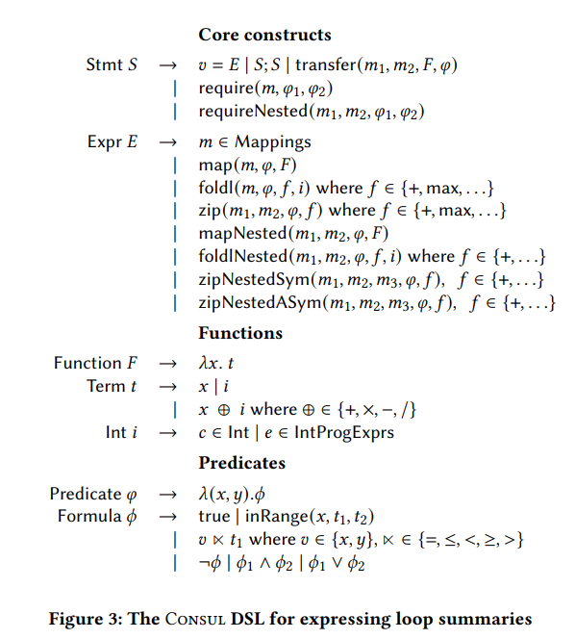
CONSUL DSL

Slide 23
CONSUL DSL
Transfer of amount 𝑚2 [𝑖] from the receiver object to address 𝑚1 [𝑖] for all keys 𝑖 satisfying predicate φ

Slide 24

CONSUL DSL

Slide 25
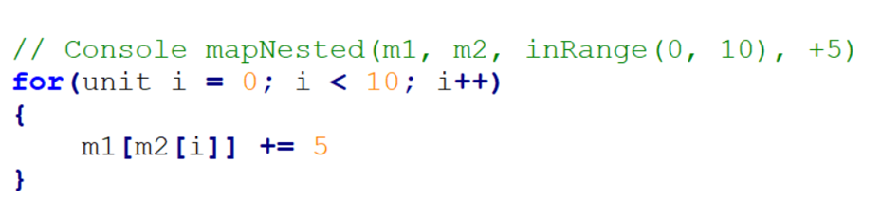
CONSUL - Nested
Nested behavior is a common pattern in loops.
It uses values of one map as indexes of another map:

Slide 26
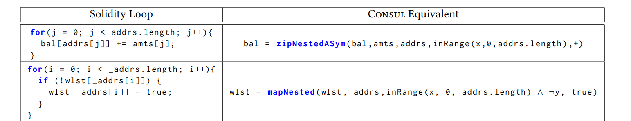
CONSUL DSL - Examples

Slide 27
SOLIS
SOLIS is a tool for automatically synthesizing loop summaries.
It converts Solidity loops into CONSUL summaries.
For each loop, SOLIS searches candidate patterns for conversion.
It performs pruning based on pre-conditions.
Executes the converted code and the original code (bounded).
Compares the output state.

Slide 28
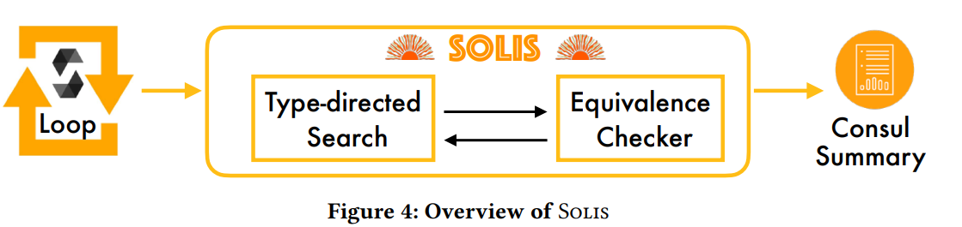
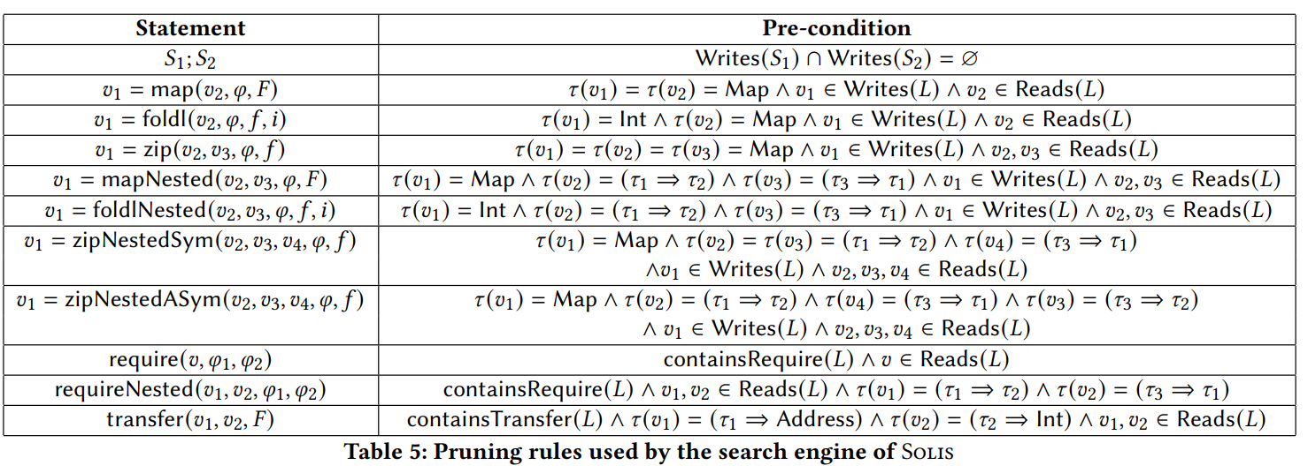
SOLIS

Slide 29
SOLIS equivalency check
Lastly, SOLIS check the equivalency of a candidate summary (in CONSUL) to the original loop.
SOLIS converts the CONSUL summary back to Solidity.
SOLIS runs both the original loop and the new one k times (both start with the same initial state).
SOLIS compares the state of the original code and the new translated code.
If both states equivalent, then the CONSUL summary is correct.

Slide 30
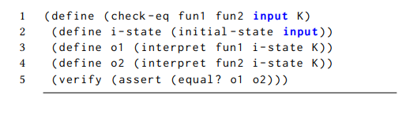
SOLIS equivalency check

Slide 31


SOLIS
Compositional Synthesis
The search space of candidates is exponentially in the number of statements.
Therefore, instead of converting the whole loop, we’ll have partial summaries, and then sequence them.
The summary is for each variable which is written in the loop.
Compose together

Slide 32
SOLIS
Compositional Synthesis
Advantages
Saves runtime
Keeps the soundness of the algorithm
Disadvantages
Incomplete:
  For P = S1;S2
  If S2 depends on S1 (variables read in S2 are written in S1) → partial summary isn’t possible

Slide 33
SOLIS
Which loops cannot be summarized?
Group 1: The semantics of the loop aren’t supported by CONSUL
For example: nested loops
Group 2: Summary fails due to the incomplete decomposition heuristics employed by SOLIS

Slide 34
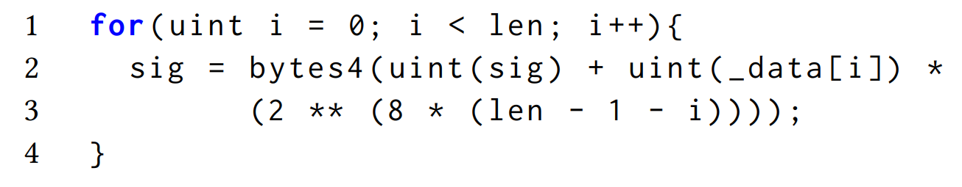
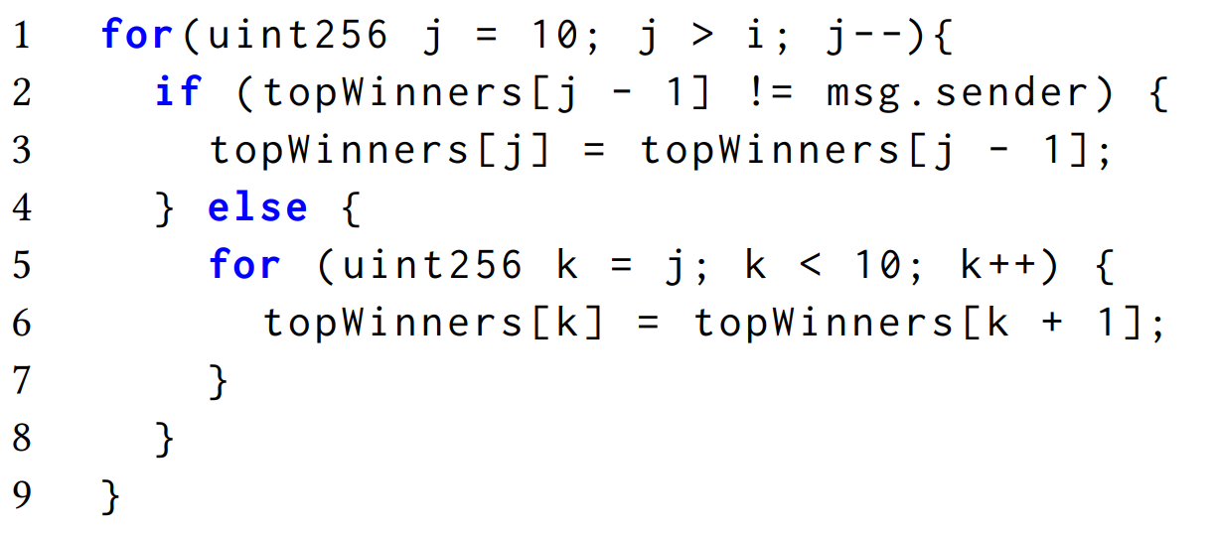
SOLIS
Which loops cannot be summarized?

Slide 35
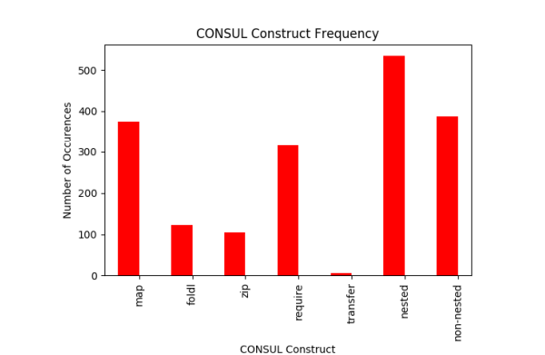
Results
56% of loops can be expressed by CONSUL summary.
81% of these summaries are equivalent to the original loop.
The most common summary of a loop is to map operator

Slide 36
Wrap-up
What did we see?
Analyzing patterns in loop using static analysis and k-means clustering.
CONSUL – a DSL for loops summary in smart contracts.
SOLIS – a tool for creating CONSUL summaries from Solidity code.
Key take-aways
Loops are common in Solidity and should be considered when analyzing smart contracts.
Tools like SOLIS can give better visibility to smart contracts, thus improving security.

Slide 37
Thank You!

