Slide 1
Introduction
A survey of attacks on Ethereum smart contracts
Paper overview
Mr. Dor Huri,
Mr. Itay Etelis
March 26, 2023

Slide 2
Basics of Ethereum - Recap
Bitcoin allows scripting
  e.g., escrow, micro-payments.
  however, very limited and not Turing-complete.
Ethereum is a Turing-complete altcoin that aims to support any future application on top of it
  The scripts used in Ethereum are “smart contacts.”
  Namely, the contract (script) resides in the blockchain as a transaction, can perform operations (API), and send/receive money.

Slide 3
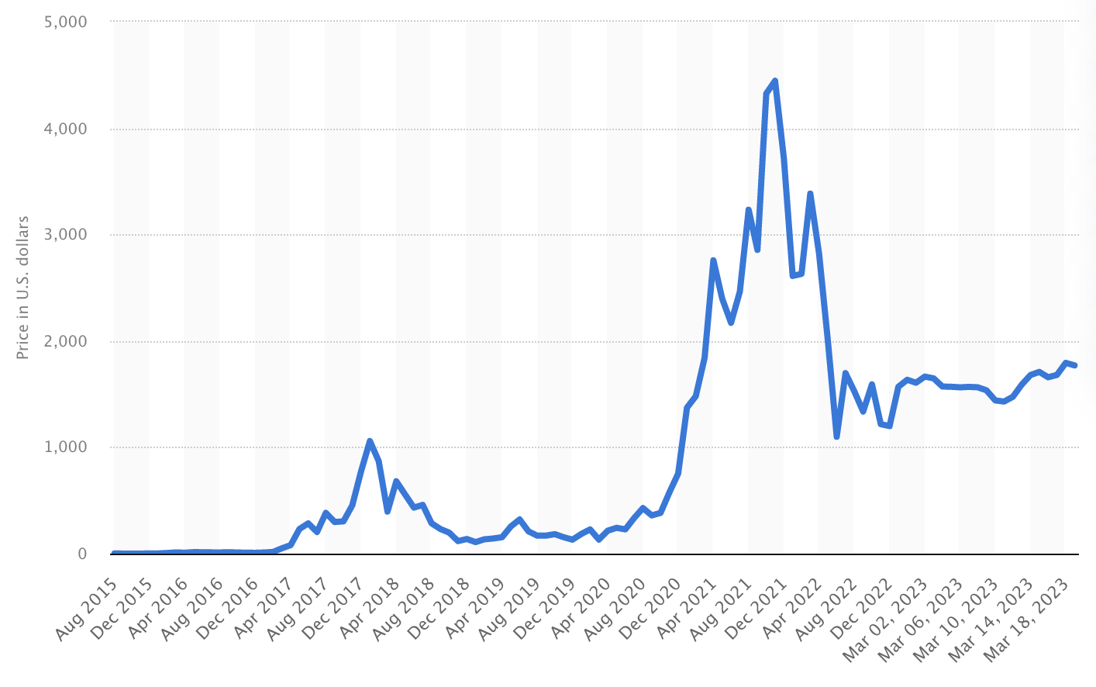
Ethereum value over the years
Ethereum Value

Slide 4
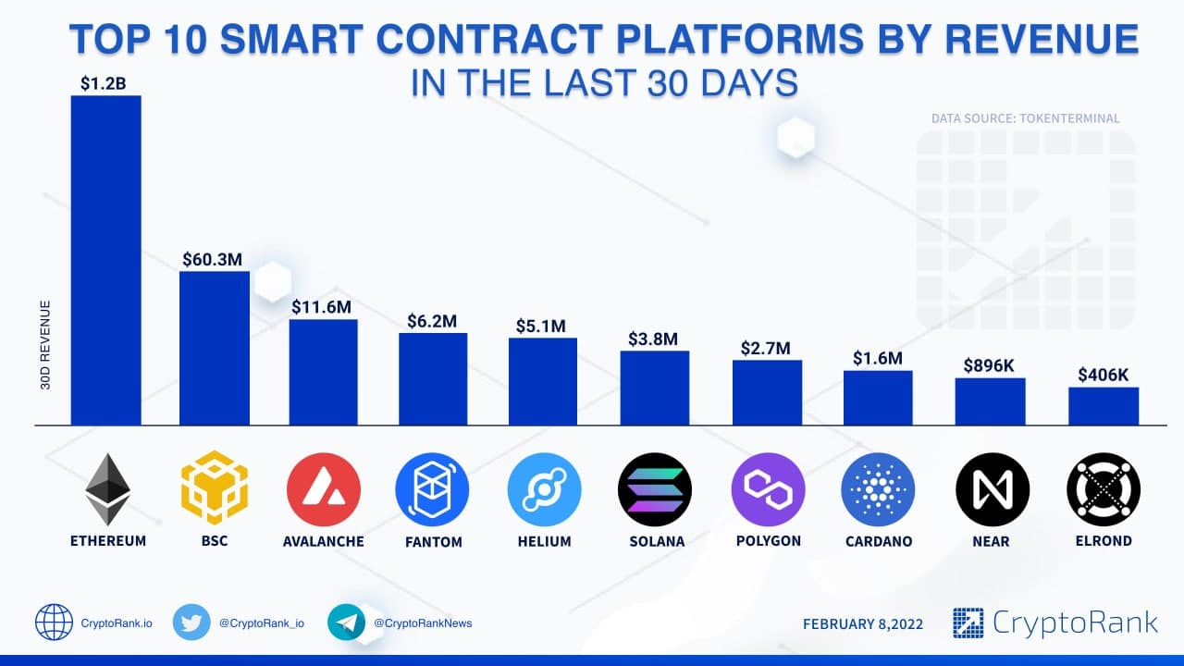
Top Smart Contracts
Smart Contracts Revenue

Slide 5
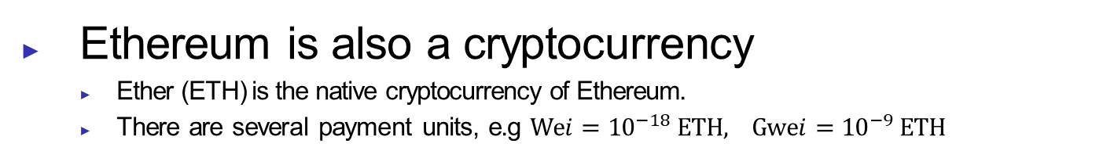
Basics of Ethereum - Recap
Basics of Ethereum - Recap
Ethereum Virtual Machine (EVM)
  The runtime environment that executes smart contracts on the Ethereum blockchain
Nodes
  The real-life machines which are storing the EVM state.
  Nodes communicate with each other to propagate information about the EVM state and new state changes
GAS
  refers to the unit that measures the computational effort required to execute specific operations on the network.

Slide 6
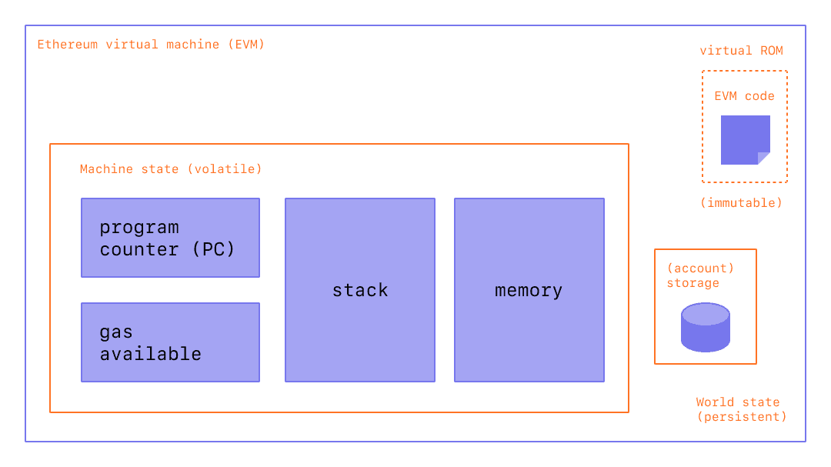
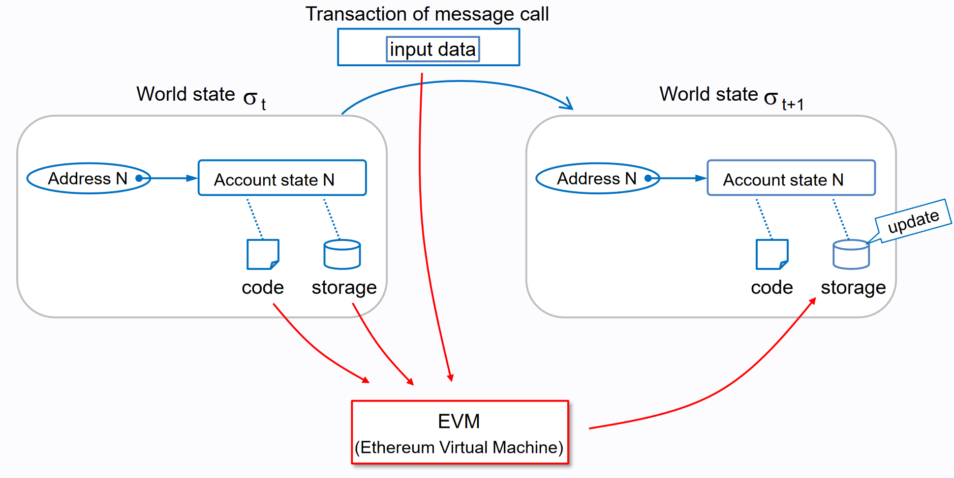
Ethereum Stack
Ethereum Stack
Ethereum stack consists of several layers.
There are core components of Ethereum that help provide a mental model for how software applications interact with the Ethereum blockchain.
  Level 1: EVM
  Level 2: Smart Contracts
  Not in our scope:
  Level 3: Ethereum Nodes
  Level 4: Ethereum Client APIs
  Level 5: End-User Applications

Slide 7
Ethereum Smart Contracts
Ethereum Smart Contracts
Smart Contract is just an agreement
  One of the biggest problems with a traditional contract is the need for trusted individuals to follow through with the contract's outcomes.
  Smart contracts digitize agreements by turning the terms of an agreement into computer code that automatically executes when the contract terms are met.
A smart contract is a program running on the Ethereum blockchain.
  Contract is a set of functions defined by a sequence of bytecode instructions.
  Written in a Turing-complete bytecode language called EVM bytecode.
  A remarkable feature of contracts is that they can transfer ETH.

Slide 8

Ethereum Smart Contracts
Ethereum Smart Contracts
Intuitive Example:
Alice and Bob have a bicycle race.
Let's say Alice bets Bob $10 that she will win the race.
Bob is confident he'll be the winner and agrees to the bet.
Ultimately, Alice finishes the race well ahead of Bob and wins.
But Bob refuses to pay out on the bet, claiming Alice must have cheated.
This silly example illustrates the problem with any non-smart agreement.
  Even if the conditions of the agreement get, you must still trust another person to fulfill the agreement
.

Slide 9
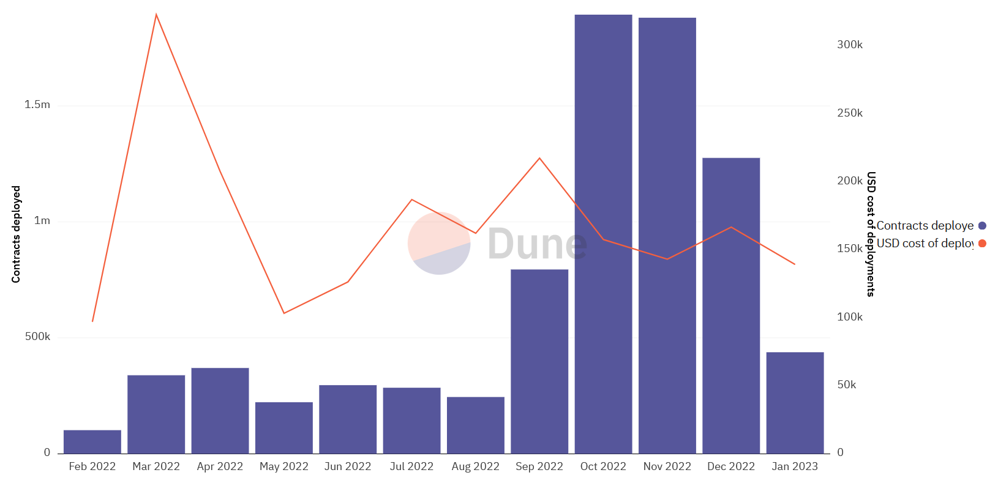
Smart Contract deployment
Smart Contracts Deployment

Slide 10
Ethereum Smart Contracts
Ethereum Smart Contracts
Smart Contracts have an economic value.
  Can be used to transfer equity from one user to another
  Can enable the tokenization of assets
  Can be used to create NFTs, which are unique digital assets that represent ownership of specific items
  And much more!
So, How can the network enforce a contract?
  The consensus mechanism is used to enforce contracts.
  An extensive network of mutually untrusted peers – miners - process transactions.
  Rationally, it is more convenient for a miner to follow the protocol than to attack it.

Slide 11
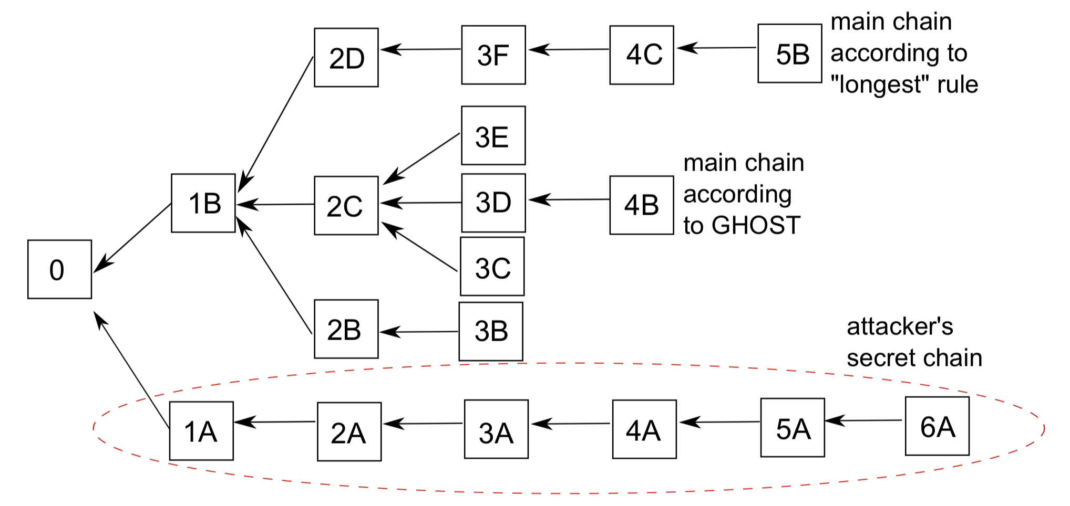
Ethereum Smart Contracts
Ethereum Smart Contracts
GHOST Protocol
  Blocks are mined every 12 seconds.
  Short time intervals in Ethereum could harm the network.
  The heaviest chain is selected rather than the longest one.

Slide 12



Ethereum Smart Contracts
Ethereum Smart Contracts
How can a user interact with a contract?
  User sends transactions to the Ethereum network to
Create New Contract
Invoke a function
Transfer Ether to contract
or to others
But! executing a contract requires a fee
  To make the consensus work, miners receive economic incentives (execution fees)
  Execution fees are defined in terms of gas and gas price.
  The overall fee depends on the whole sequence of operations executed.
  These fees bound the execution steps of a transaction (prevention DOS attacks)

Slide 13
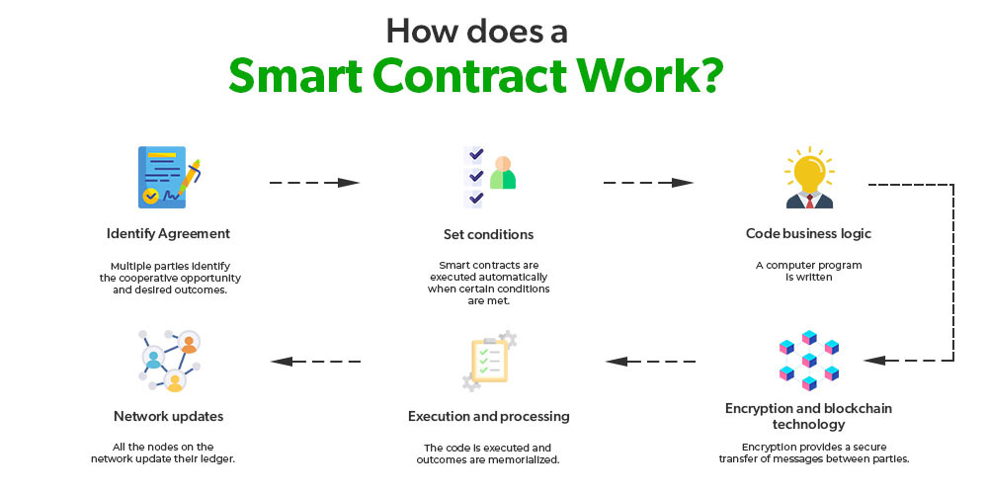
How Smart Contract Works
Ethereum Smart Contracts

Slide 14
Solidity
Solidity
Solidity is a JavaScript-like programming language
  Rather than programming directly in EVM bytecode.
  Statically typed language.
  It compiles to EVM bytecode.
  There are other programming languages as well, e.g …
EVM bytecode has no support for functions
  Therefore, the solidity compiler translates functions into a unique four-byte "function selector“ signature.
  Upon function invocation, this signature is passed as input to the called contract.

Slide 15
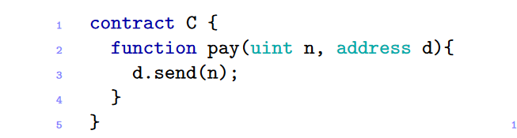
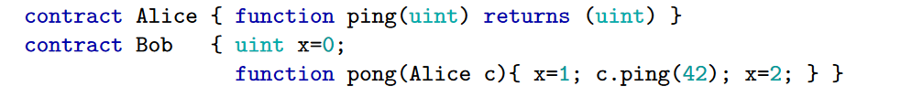
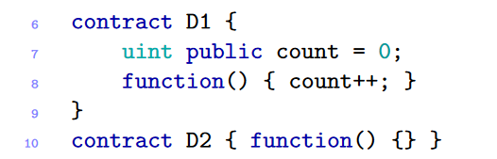
Solidity
Solidity
  Contracts are just like classes.
  Address are sequences of 160 bits that uniquely identify contracts and users,
  Interfaces can also be declared when the original contract is referred.
  Fallback function is a function with no name and no arguments.
  It can either have an implementation or not.

Slide 16
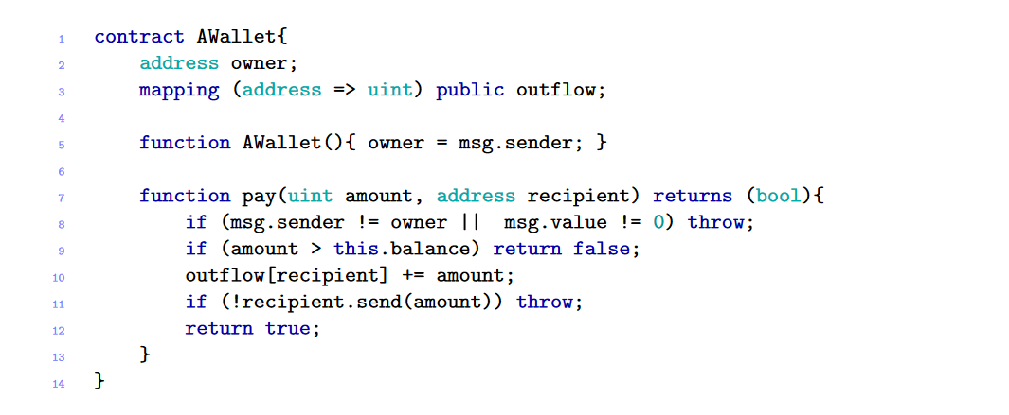
Solidity
Solidity
It’s easy to write contracts
A contract encompasses a long-lived state that lives in the EVM’s storage.
A constructor runs only once when the contract is created.
Exceptions cannot be caught; once raised, the execution stops.
But it’s hard to ensure they are secure

Slide 17
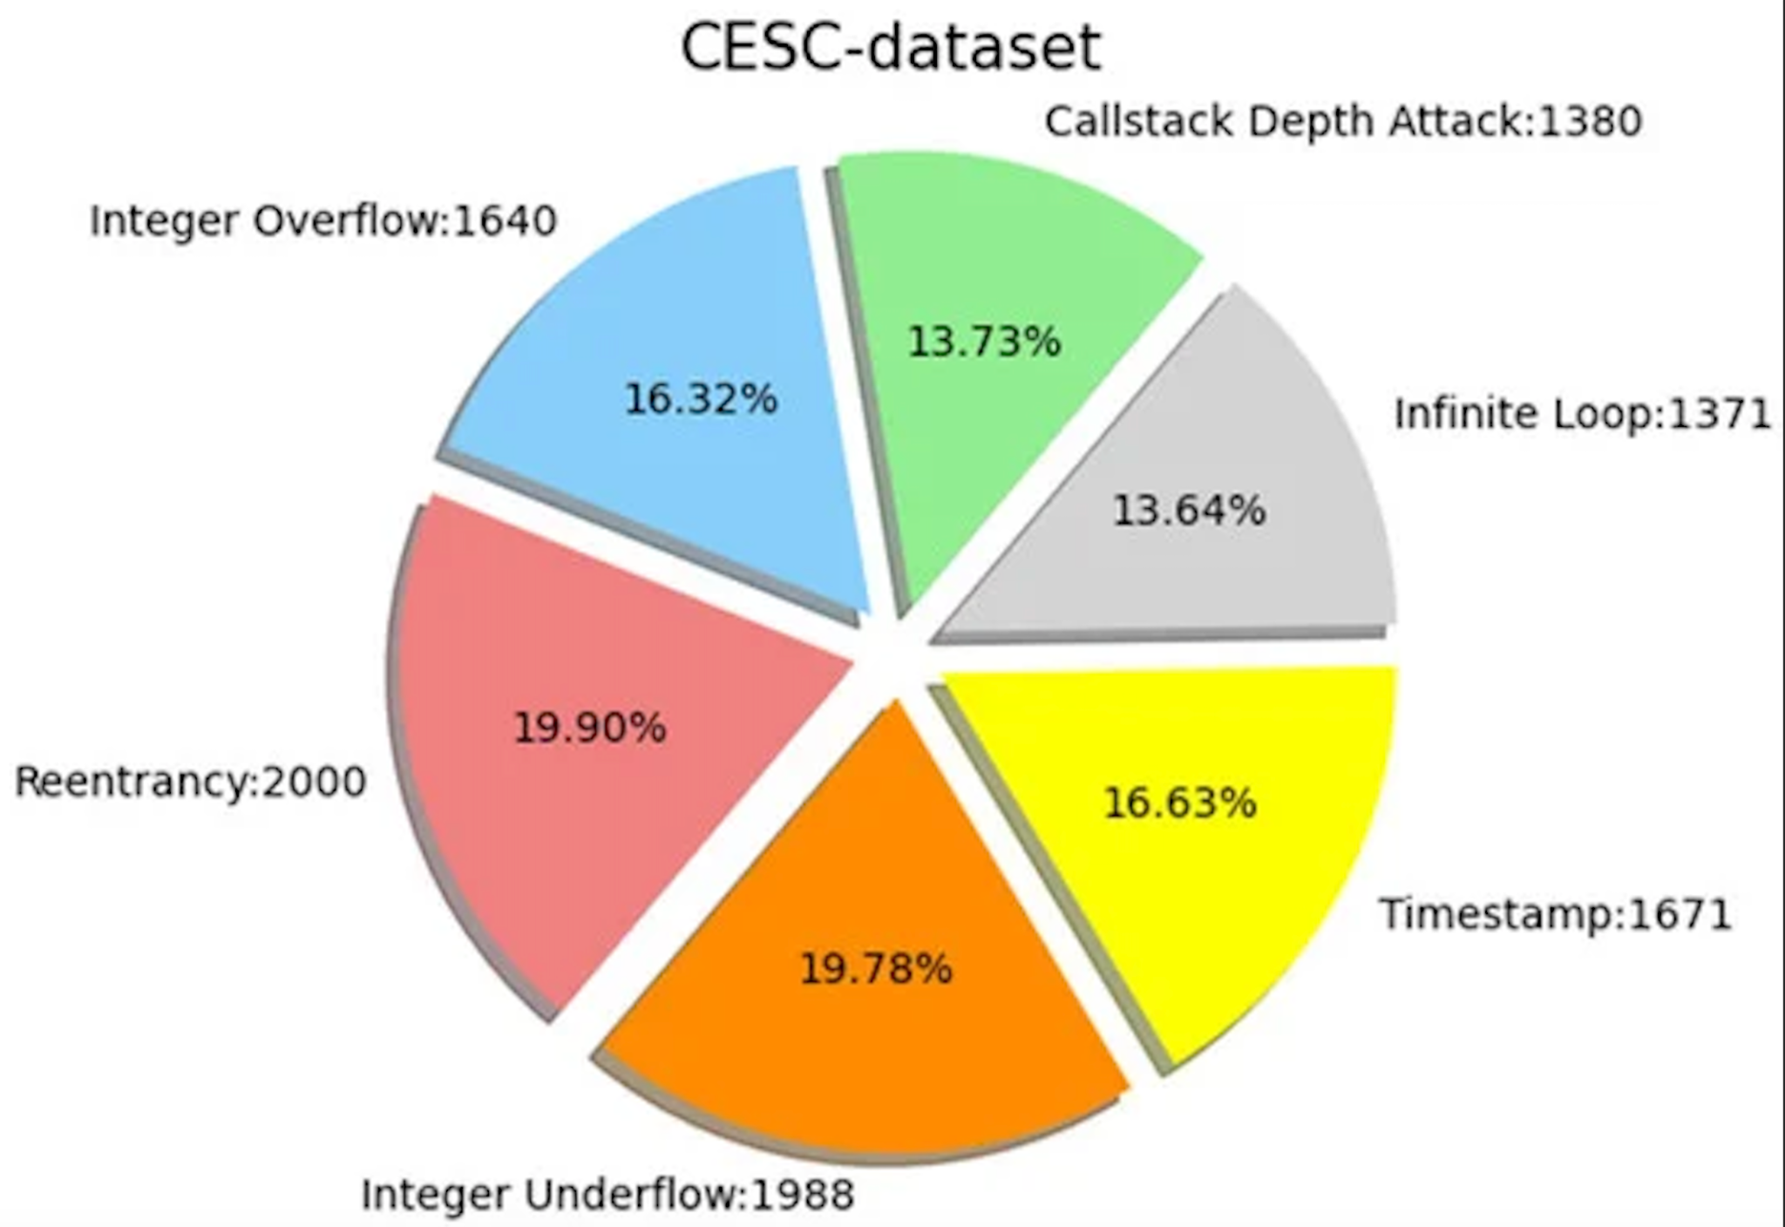
Vulnerabilities chart
Vulnerability Chart

Slide 18
Basics of Ethereum - Recap
Table of Content
Vulnerabilities Ahead:
Attacks Ahead:
  Call to the Unknown
  Reentrancy
  Exception Disorders
  Gasless send
  Type Casts
  Keeping Secrets
  Stack Size Limit
  Unpredictable States
  The DAO attack
  The King of The Ether Throne
  Multiplayer Games
  Dynamic Libraries

Slide 19

Call to the unknown
Call to The Unknown
Call Function
  invokes a function of another contract or of itself.
  transfers ether to the callee.
  Transfer ‘amount’ wei to ‘c’
  Activate function ‘ping’ with parameter ‘n’
Solidity Compiler
Dynamic types and lack of type safety
  If c has no function with the matching signature, the fallback function activates.
  No exception propagation.

Slide 20
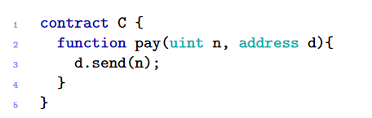
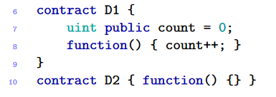
Call to the unknown
Call to The Unknown
Send Function
  is used to transfer ether from the running contract to some recipient r.
  After the ether transfer send executes the recipient’s fallback.
  Transfer ‘n’ wei to address ‘d’
  Activates the fallback function of ‘d’

Slide 21
Call to the unknown
Call to The Unknown
Delegatecall Function
  Invocation of the called function is run in the caller environment
  Same effects as the call function
c.delegatecall(bytes4(sha3("ping(uint256)")),n)
  Activate the function ‘ping’ with parameter ‘n’
  With the environment of the callee

Slide 22
Call to the unknown
Call to The Unknown
Direct Call
  Instead of all the previous functions, we can use direct call as well:
  the first line declares the interface of Alice’s contract
  the line below defines bob’s contract and invokes the function ‘ping’ via ‘pong’
  If there is a mismatch in the declared interface, the call will activate the fallback function instead.

Slide 23
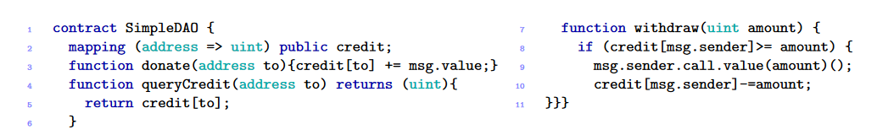
The DAO attack
The DAO attack
DAO
  A DAO is a Decentralized Autonomous Organization
  A group of people writes the smart contracts (programs) that will run the organization
  There is an initial funding period in which people add funds to the Dao
  attacker managed to drain more than 3.6m ether
Find the vulnerability
Hints: Can you enter twice to the withdraw
Can you cause an underflow?

Slide 24
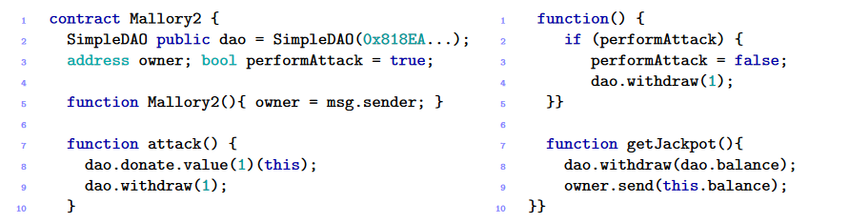
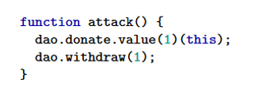

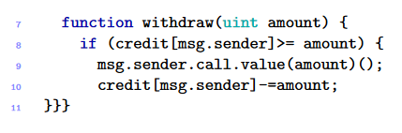
The DAO attack
The DAO attack
  First post ‘Mallory2’ providing it with a small amount of ETH
  Activate function attack, Which donates and withdraws the payment back to the attacker.
  After the if statement, the call function sends the payment and activates the fallback of ‘Mallory2’

Slide 25
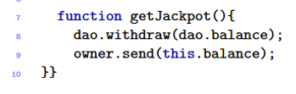
The DAO attack
The DAO attack
  The fallback is activated, calling withdraw again.
  Will the if statement stop it from re-withdrawing?
  What will happened to the balance?
  Call getJackpot for profit.

Slide 26
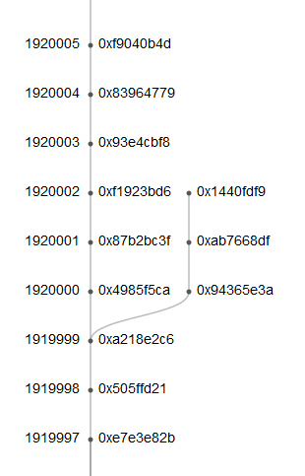
Fork of DAO attack
The DAO attack

Slide 27
Fork of DAO attack
The DAO attack
===== BEGIN SIGNED MESSAGE =====
To the DAO and the Ethereum community,
I have carefully examined the code of The DAO and decided to participate after finding the feature where splitting is rewarded with additional ether. I have made use of this feature and have rightfully claimed 3,641,694 ether, and would like to thank the DAO for this reward. It is my understanding that the DAO code contains this feature to promote decentralization and encourage the creation of "child DAOs".
I am disappointed by those who are characterizing the use of this intentional feature as "theft". I am making use of this explicitly coded feature as per the smart contract terms and my law firm has advised me that my action is fully compliant with United States criminal and tort law. For reference please review the terms of the DAO:
"The terms of The DAO Creation are set forth in the smart contract code existing on the Ethereum blockchain at 0xbb9bc244d798123fde783fcc1c72d3bb8c189413. Nothing in this explanation of terms or in any other document or communication may modify or add any additional obligations or guarantees beyond those set forth in The DAO’s code. Any and all explanatory terms or descriptions are merely offered for educational purposes and do not supercede or modify the express terms of The DAO’s code set forth on the blockchain; to the extent you believe there to be any conflict or discrepancy between the descriptions offered here and the functionality of The DAO’s code at 0xbb9bc244d798123fde783fcc1c72d3bb8c189413, The DAO’s code controls and sets forth all terms of The DAO Creation."
A soft or hard fork would amount to seizure of my legitimate and rightful ether, claimed legally through the terms of a smart contract. Such fork would permanently and irrevocably ruin all confidence in not only Ethereum but also the in the field of smart contracts and blockchain technology. Many large Ethereum holders will dump their ether, and developers, researchers, and companies will leave Ethereum. Make no mistake: any fork, soft or hard, will further damage Ethereum and destroy its reputation and appeal.
I reserve all rights to take any and all legal action against any accomplices of illegitimate theft, freezing, or seizure of my legitimate ether, and am actively working with my law firm. Those accomplices will be receiving Cease and Desist notices in the mail shortly.
I hope this event becomes an valuable learning experience for the Ethereum community and wish you all the best of luck.
Yours truly,
"The Attacker"
===== END SIGNED MESSAGE =====
Message Hash (Keccak): 0xaf9e302a664122389d17ee0fa4394d0c24c33236143c1f26faed97ebbd017d0e
Signature: 0x5f91152a2382b4acfdbfe8ad3c6c8cde45f73f6147d39b072c81637fe81006061603908f692dc15a1b6ead217785cf5e07fb496708d129645f3370a28922136a32

Slide 28
Basics of Ethereum - Recap
Table of Content
Vulnerabilities Ahead:
Attacks Ahead:
  Call to the Unknown
  Reentrancy
  Exception Disorders
  Gasless Send
  Type Casts
  Keeping Secrets
  Stack Size Limit
  Unpredictable States
  The DAO attack
  The King of The Ether Throne
  Multiplayer Games
  The GovernMental
  Dynamic Libraries

Slide 29
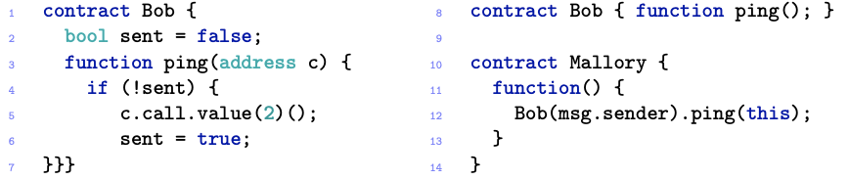
Reentrancy
Reentrancy
Atomicity of transactions
  It might seem that a non-recursive function cannot be re-entered before termination
  However, an attacker can re-enter the caller function with the fallback.
  This may result in unexpected behaviors, and possibly also in loops of invocations.
  The function ‘ping’ meant to send exactly 2$wei$ to some address ‘c’
Hints: What is the vulnerability here?

Slide 30
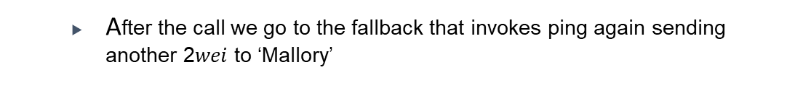
Reentrancy
Reentrancy
  Assume that ‘ping’ is invoked with ‘Mallory’’s address.
  After the call we go to the fallback that invokes ping again sending another 2$wei$ to ‘Mallory’
  This eventually will cause an out-of-gas exception or a stack-limit exception
  Since `call` does not propagate the exception, only the effects of the last call are reverted

Slide 31
The DAO attack
The DAO attack
Back to DAO, Find Another vulnerability
Hints: Reentrancy?
Would a fallback function help?

Slide 32
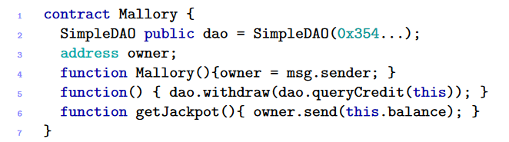
The DAO attack
The DAO attack
  First post ‘Mallory’ and donate some amount to it.
  Donating would activate the fallback function
  After the if statement, the call function sends the payment and activates the fallback of ‘Mallory’
  again, and again.

Slide 33
Basics of Ethereum - Recap
Table of Content
Vulnerabilities Ahead:
Attacks Ahead:
  Call to the Unknown
  Reentrancy
  Exception Disorders
  Gasless Send
  Type Casts
  Keeping Secrets
  Stack Size Limit
  Unpredictable States
  The DAO attack
  The King of The Ether Throne
  Multiplayer Games
  The GovernMental
  Dynamic Libraries

Slide 34

Exception Disorders
Exception Disorders
Exception may occur in several cases
  The execution runs out of gas.
  The call stack reaches its limit.
  The command ‘throw’ is executed.
  If an exception is invoked in Alice’s ping, all changes are reverted.
  But invoking with ‘call’ is different; the exception won’t propagate.

Slide 35
Exception Disorders
Exception Disorders
What if an exception occurs in a chain of calls?
  If every chain element is a direct call, the execution stops, and every side effect is reverted.
  If at least one element of the chain is a ‘call,’ then all the side effects until the call are reverted.

Slide 36
Exception Disorders
Exception Disorders
  One can also bound the limit of a call function
  At a time of an exception, only ‘g’ gas will be lost.
  If no limit was specified, the whole gas allocated to the contract will be lost.
  28% of contracts do not control the return value of call/send.

Slide 37
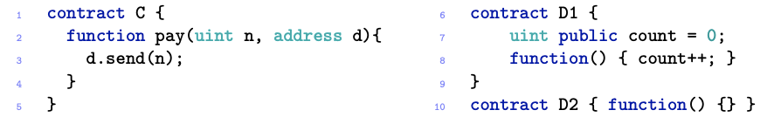
Gasless Send
Gasless Send
The send function requires gas
  Invoking the send function automatically allocates 2,300 wei of gas.
  But 2,300 wei will allow executing a limited set of bytecode instructions.
  Invoking such instructions will raise an out-of-gas exception.
An expensive fallback
A cheap fallback
There are three scenarios possible
  n ≠ 0 and d = D1, the send in ‘c’ fails because not enough gas for D1’s fallback
  n ≠ 0 and d = D2, the send in ‘c’ succeeds, enough gas for D2’s fallback
  n = 0 compiler dependent.

Slide 38




King Of The Ether Throne
King of the Ether Throne
King of the Ether Throne
  A KOTET is a game where players compete to acquire the title “KOTE”
There are a few rules
  Suppose - for example - the current throne claim price is 10 ETH
Bob
  Alice acquires the title for 10 ETH by paying the contract.
10
  The contract pays Bob 10 ETH minus a commission.
Alice
Contract
~13 - $ε$
Bob
~13
10
Alice
13.33

Slide 39
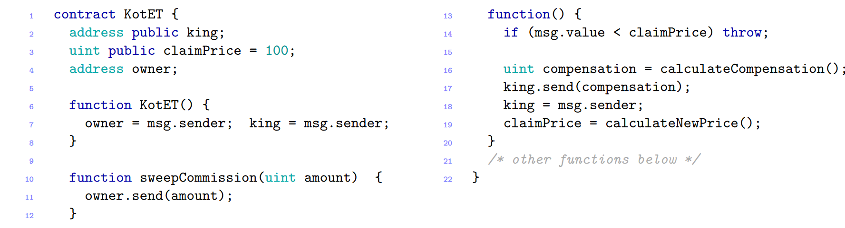

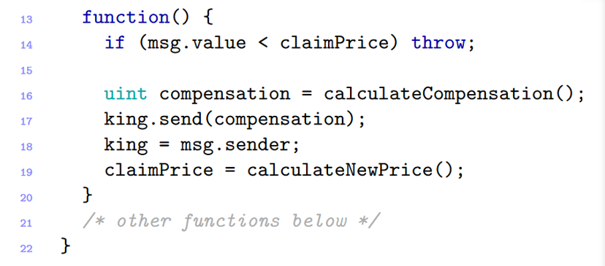
King Of The Ether Throne
King of the Ether Throne
  Whenever a client sends ETH to the contract, the fallback function is activated.
  The fallback first checks if the amount send satisfies the rule.
Then, the contract sends the compensation to the previous monarch
Keeping a small fee to itself.
  This code is not honest, Can you figure out why?
Hints: What will happen if the current monarch has an expensive fallback?

Slide 40
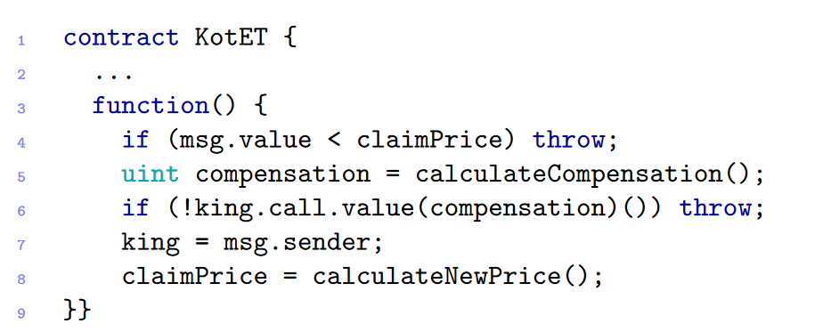
King Of The Ether Throne
King of the Ether Throne
Another yet more trustworthy implementation
Is it?
Hints: Can you perform a Denial-of-Service attack?

Slide 41
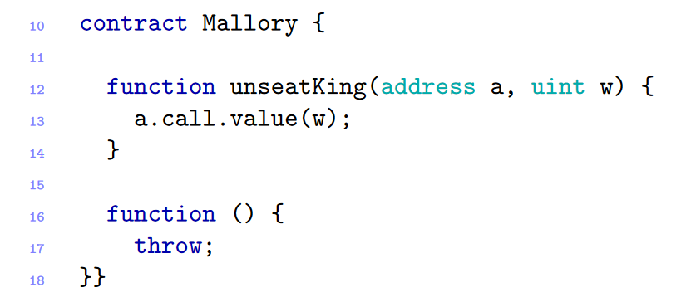
King Of The Ether Throne
King of the Ether Throne
  Mallory will apply for the King’s title.
  But when a future King will apply for the monarch, the contract will fail!

Slide 42
Basics of Ethereum - Recap
Table of Content
Vulnerabilities Ahead:
Attacks Ahead:
  Call to the Unknown
  Reentrancy
  Exception Disorders
  Gasless Send
  Type Casts
  Keeping Secrets
  Stack Size Limit
  Unpredictable States
  The DAO attack
  The King of The Ether Throne
  Multiplayer Games
  The GovernMental
  Dynamic Libraries

Slide 43

Type Casts
Type Casts
Solidity compiler can detect only some errors
  For example, assigning an int value to a variable of type string.
  The caller must declare the callee’s interface and cast to it the callee’s address.
  the compiler only checks whether the interface declares the function ‘ping’
  It will not check where is c is the address of the contract Alice
  It will not check if the interface declared by Bob matches Alice’s actual interface
  Same applies to explicit type casts.

Slide 44
Type Casts
Type Casts
  Type-check may deceive programmers
  Making them believe that any error in checks and is detected
Solidity Compiler
Direct calls are compiled in the same EVM bytecode as call
Differs only in the exception management.
In mismatch, several things may happen in run-time
  If ‘c’ is not a contract address, the call returns without execution of code.
  If ‘c’ is the address of another contract having same function, it will be executed.
  If ‘c’ is a contract with no matching function, then ‘c’’s fallback is executed.
  In all cases, no exception is thrown, and the caller is unaware of the error.

Slide 45
Keeping Secrets
Keeping Secrets
Private fields do not guarantee secrecy
  Fields in contracts can be public or private.
  Declaring a field as private does not guarantee its secrecy
  To set a value to a private field, a user must include the contract in a transaction
  Since the blockchain is public, everyone can inspect the contents of the transaction, and infer the new value of the field
So, how can we keep a value private?
  to make the field remains secret until a certain event occurs the contract needs to use cryptographic techniques.

Slide 46
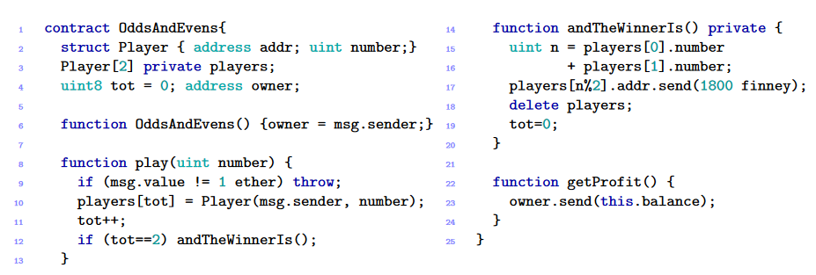
Multiplayer Games
Multiplayer Games
TMG
  Multiplayer games are a common thing using Smart Contracts.
  Consider a contract that implements a simple “odds and evens” game.
Can you spot the vulnerability?
Hints: Can one player see the choice of the other?

Slide 47
Multiplayer Games
Multiplayer Games
  An adversary impersonates the second player and waits for the first
  player makes his bet.
  The adversary can infer the first player’s bet by inspecting the blockchain transaction where he joined the game
  The adversary can win the game by invoking ‘play’ with a suitable bet

Slide 48
Basics of Ethereum - Recap
Table of Content
Vulnerabilities Ahead:
Attacks Ahead:
  Call to the Unknown
  Reentrancy
  Exception Disorders
  Gasless Send
  Type Casts
  Keeping Secrets
  Stack Size Limit
  Unpredictable States
  The DAO attack
  The King of The Ether Throne
  Multiplayer Games
  The GovernMental
  Dynamic Libraries

Slide 49
Stack Size Limit
Stack Size Limit
Solidity Compiler
Stack Size is limited to 1024 calls.
Stack size is limited
  Each invocation of a function the call stack associated with the transaction grows.
  If the call stack limit is reached, an exception is thrown.
  An adversary can generate an almost victim’s contract that does not properly handle the exceptions
  If the victim’s contract does not properly handle the exception, the adversary could manage to succeed in his attack.

Slide 50


The GovernMental
The GovernMental
GovernMental
  The GovernMental is a Ponzi scheme.
  To join the scheme, a participant must send a certain amount of ether to the contract.
  If there are no new arrivals for 12 hours, the last participant gets all the ether (minus a fee)
Alice
Jackpot = 1
  Alice joins the game by paying the current fee, one ETH.
Jackpot += ½
Contract
  The entrance fee doubles in price, standing on two ETH
1
Bob
Jackpot += 1
  Bob joins the game and pays two ETH.
2.5
  No new member in the last 12 hours; Bob wins the jackpot.
2

Slide 51
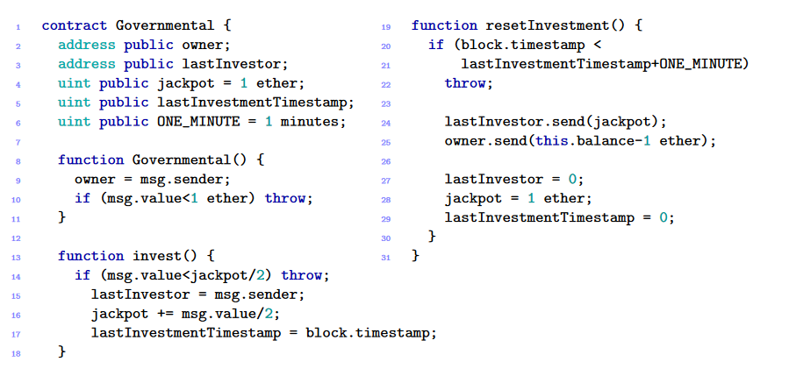
The GovernMental
The GovernMental
  Anyone can invoke ‘resetInvestment’ function
  Once the time limit has passed, invoking the function would result in sending the payment.
Find the vulnerability
Hints: Can the contract owner not pay his debt?
Stack-Limit to the rescue!

Slide 52
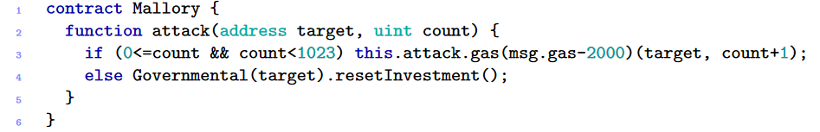

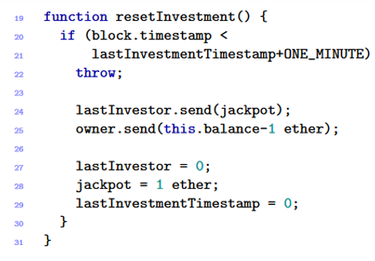
The GovernMental
The GovernMental
Stack
  In this exploit, the owner makes a profit.
  For the owner to profit, he should make the send call fail.
Attack(…)
Attack(…)
1023
.
.
.
  The owner first publishes the ‘Mallory’ contract.
  The owner invokes the attack function, which fills the stack.
  The function then invokes the GoverMental contract reaching the send function.
  The send fails, leaving the balance in the contract.
  The owner withdraws the balance on the next round.
Attack(…)

Slide 53
Basics of Ethereum - Recap
Table of Content
Vulnerabilities Ahead:
Attacks Ahead:
  Call to the Unknown
  Reentrancy
  Exception Disorders
  Gasless Send
  Type Casts
  Keeping Secrets
  Stack Size Limit
  Unpredictable States
  The DAO attack
  The King of The Ether Throne
  Multiplayer Games
  The GovernMental
  Dynamic Libraries

Slide 54
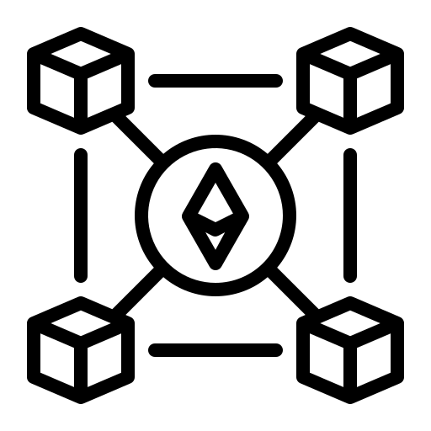



Vulnerabilities in Blockchain
Unpredictable State
Contract States
Transaction
Mine Block
Creation
Execution
Active
Terminated
Self Destruct
Command
Self-Destructed
Terminated
  State is determined by the value of its fields and balance.
  Contract code can’t be altered after got to the blockchain.
  When invoking a contract, we cannot be sure the state is as sent.

Slide 55
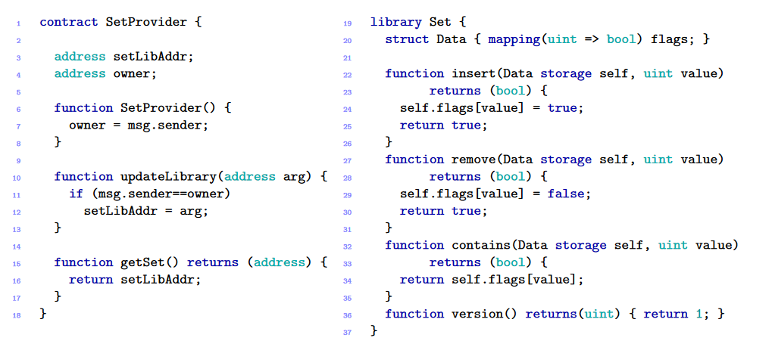
Dynamic Libraries
Dynamic Libraries
Dynamic Libraries
  As discussed, contracts are immutable.
  But sometimes a bug occurs which needs to be fixed.
  Libraries are introduced to handle this issue.
All calls are done via delegatecall
Arguments tagged as storage are passed by reference.
  The owner of contract ‘SetProvider’ can update the library address with a new one
  Any user can obtain the address of the lib by the ‘getSet’ function.

Slide 56
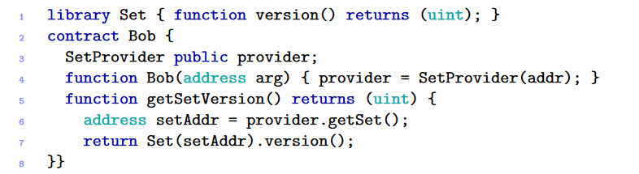
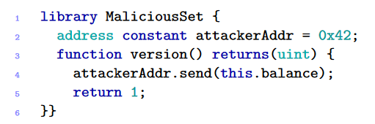
Dynamic Libraries
Dynamic Libraries
Dynamic Libraries might be malicious
  Assume that Bob is an honest contract, it is using the library and checks the version of it.
  The owner might public the library to a malicious one.
  Bob prompts the library for the version.
  Resulting in a send function invocation.
  But, every invocation inside the library is delegated.
  Bob loses all his money.

Slide 57
Immutable Bugs
Immutable bugs
  Once a contract is published on the blockchain, it can no longer be altered.
  if a contract contains a bug, there is no direct way to patch it
  So, programmers have to anticipate ways to alter or terminate a contract in its implementation
  The immutability of bugs has been exploited in various attacks:
    steal ether
    make it unredeemable by any user
  the only time that was a recovery was in the “DAO attack”
  eventually there was a consequence part of the miners refused to fork on the block with the dao attack, and created an alternative blockchain

Slide 58
Vulnerabilities in EVM
Ether lost in transfer
  when sending ether we need to specify the recipient address, which a sequence of 160 bits.
  However, many of these addresses are orphan
    , i.e. they are not associated to any user or contract.
  If some ether is sent to an orphan address, it is lost forever
    there is no way to detect whether an address is orphan
  programmers have to manually ensure the correctness of the recipient addresses.

Slide 59
Vulnerabilities in Blockchain
Generating randomness
  The execution of EVM bytecode is deterministic.
  Hence, to simulate non-deterministic choices we use pseudo-random numbers.
    e.g. for games lotteries
  the initialization seed is chosen uniquely for all miners.
  common choice for this seed is the hash or the timestamp of a block that will appear at the blockchain in the future.
  at run-time this value will be the same for everyone.
  this thought to be a safe way to generate random number, future block are considered to be unpredictable.
  malicious miner could attempt to craft his block to bias the pseudo-random generator.
  analysis in randomness of the Bitcoin blockchain show that 50 bitcoins can significantly bias the outcome.
  Alternative solutions to this based on timed commitment protocols
  each participant chooses a secret, and then communicates to the others a digest of it, paying a deposit as a guarantee
  participants must either reveal their secrets, or lose their deposits.

Slide 60
Vulnerabilities in Blockchain
  The pseudo-random number computed by combining the secrets.
  adversary could bias the outcome by not revealing her secret
  doing so would result in losing her deposit.
  The protocol set the deposit making not revealing the secret an irrational strategy.

Slide 61
Vulnerabilities in Blockchain
Time constraints
  A wide range of applications use time constraints in order to determine which actions are permitted in the current state.
  Typically, time constraints are implemented by using block timestamps, which are agreed upon by all the miners..
  Contracts can retrieve the timestamp in which the block was mined.
  all the transactions within a block share the same timestamp.
  it may expose a contract to attacks.
  since the miner who creates the new block can choose the timestamp with a certain degree of arbitrariness.
  If a miner holds a stake on a contract, he could gain an advantage by choosing a suitable timestamp for a block he is mining.

