Slide 1

The Calculus of Computation
BEN ELI
Gal Giladi

Slide 2

Introduction
“The Calculus of Computation”
by Araon R.Bradley and Zohar Manna, 2007
From Stanford University, USA
Sections:1.1—1.3, 2.1-2.3 , 3.1 –3.3
Notes:
זה הספר שממנו עשינו את המצגת, שכתבו את הספר הם כתבו אותו עבור סטודנטים כך שהוא מאוד מובן וזה רק חלק קטן ממנו.

Slide 3
Introduction
What Will we talk about today?
Propositional Logic – Syntax, Semantics, Satisfiability and Validity.
First Order Logic – Syntax , Semantics , Satisfiability and Validity.
First Order Theories – Theories, Theory of Equality, Theories of Natural Numbers and Integers.
Notes:
אז על מה נדבר היום? נדבר על PL תחשיב פסוקים, על הסינטקס והסמנטיקה שלה ועל סיפוק וואלידיות בה.
נדבר גם על לוגיקה מסדר ראשון ועל תאוריות מסדר ראשון.

Slide 4

Propositional Logic (PL)

Slide 5
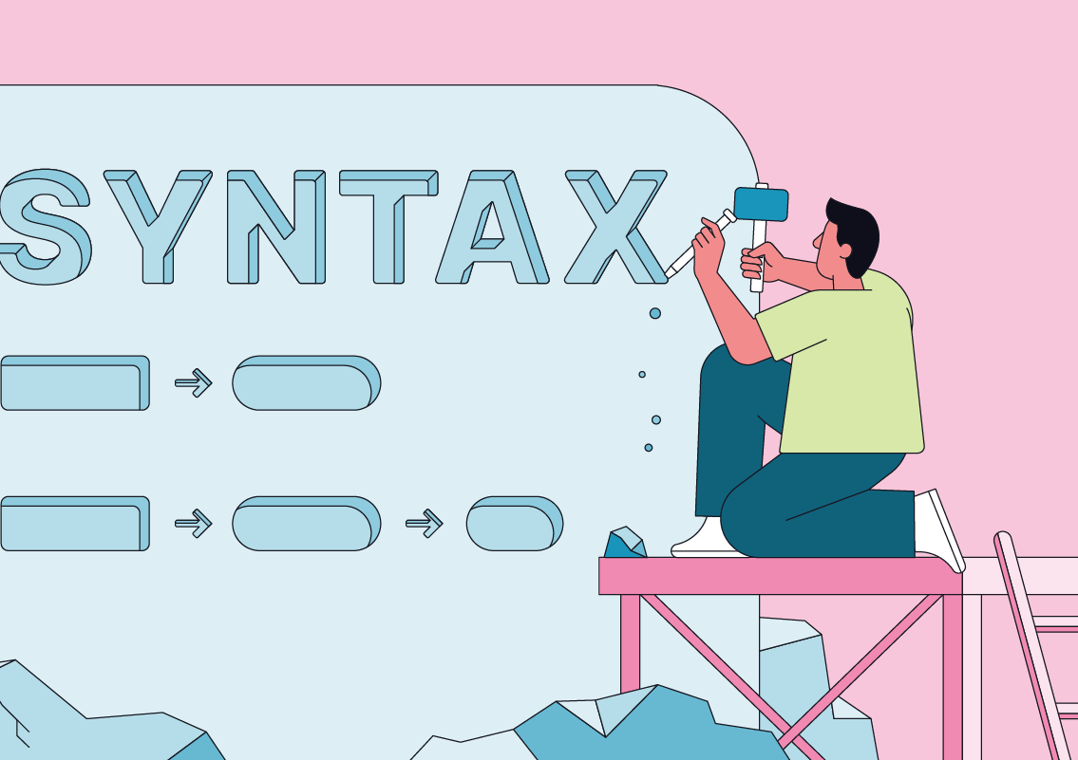
PL- Syntax
We will introduce the Syntax of PL (Propositional Logic):
Truth symbol :⊤ (“true”) , ⊥ (“false”)
Boolean variable: denoted by P, Q, R, P1, P2, . . ..
Logical connective: ￢, ∧, ∨, → , ↔
Notes:
הדרך להסביר מהי לוגיקה היא על ידי הצגת הסינטקס והסמנטיקה שלה
סינטקס הוא סט של חוקים/ עקרונות שנותנים למשהו משמעות ומבניות
סימן אמת – כלומר true/false
משתנה בוליאני – מסומן על ידי אות לדוגמה P
תזכורת קלה מבדידה – אלה הקשרים הלוגים – או/וגם/גרירה חד כיוונית דו כיוונית והנה הטבלאות אמת שלהם

Slide 6
Logical Connectives
F | ￢F
F | T
T | F
F1 | F2 | F1∨F2
F | F | F
F | T | T
T | F | T
T | T | T
F1 | F2 | F1∧F2
F | F | F
F | T | F
T | F | F
T | T | T
Notes:
כאן יש תזכורת של טבלאות אמת לקשרים הלוגים מהשקופית הקודמת

Slide 7
Logical Connectives
F1 | F2 | F1→F2
F | F | T
F | T | T
T | F | F
T | T | T
F1 | F2 | F1↔F2
F | F | T
F | T | F
T | F | F
T | T | T
Notes:
כאן יש תזכורת של טבלאות אמת לקשרים הלוגים מהשקופית הקודמת

Slide 8

Atom , Literal and Formula
Atom: truth symbol (⊤, ⊥) or Boolean variable (P)
Literal: is an atom α or its negation ¬α
Formula: is a literal or the application of a logical connective to a formula or formulae.
For example : P, ￢P, P ∧ Q , P ∧ (Q → R)
Notes:
אטום זה סימן אמת או משתנה בוליאני
ליטרל זה אטום או שלילת אטום
נוסחה היא ליטרל או הפעלת קשר לוגי על נוסחה/נוסחאות

Slide 9
Subformula
Subformula: Formula G is a subformula of formula F if it occurs within G.
the only subformula of P is P;
the subformulae of ￢F are ￢F and the subformulae of F;
and the subformulae of F1∧F2, F1∨F2, F1 → F2, F1 ↔ F2 are the formula itself and the subformulae of F1 and F2.
For Example :The subformulae of P ∧ Q are P ∧ Q , Q , P
Notes:
תת נוסחה היא נוסחה שמופיעה סינטטית בנוסחה אחרת, ישנם 3 כללים (אחד למשתנה כללי, אחד לקשר אונרי NOT ואחד לקשרים בינאריים)
תת נוסחה מחמירה/מקפידה

Slide 10
Strict Subformula
The strict subformulae of a formula are all its subformulae except itself.
For example: the strict subformulae of P ∧ Q are just P and Q .
Notes:
תת נוסחה היא נוסחה שמופיעה סינטטית בנוסחה אחרת, ישנם 3 כללים (אחד למשתנה כללי, אחד לקשר אונרי NOT ואחד לקשרים בינאריים)
תת נוסחה מחמירה/מקפידה

Slide 11
Atoms & Literals Example
F : (P ∧ Q) → (P ∨ ¬Q)
What are the atoms and literals?

Slide 12
Atoms & Literals Example
F : (P ∧ Q) → (P ∨ ¬Q)
What are the atoms and literals?
P, Q are atoms and literals. ¬Q is a literal but not an atom!

Slide 13
Subformula Example
F : (P ∧ Q) → (P ∨ ¬Q)
What is the subformula of F?
Notes:
לשאול גם מה הstrict

Slide 14
Subformula Example
F : (P ∧ Q) → (P ∨ ¬Q)
What is the subformula of F?
Answer: F , P ∨ ¬Q , ¬Q , P ∧ Q , P , Q .
Notes:
לשאול גם מה הstrict

Slide 15
Parentheses precedence
We define the relative precedence of the logical connectives from highest to lowest as follows: ¬, ∧, ∨, →, ↔.
For example :P1 ∧ ¬P2 ∧ ⊤ ∨ ¬P1 ∧ P2 stands for
P1 ∧ (¬P2) ∧ ⊤ ∨ (¬P1) ∧ P2 -> (P1 ∧ ((¬P2) ∧ ⊤)) ∨ ((¬P1) ∧ P2)
Additionally, let → and ↔ associate to the right, so that P → Q →R is the same formula as P → (Q → R).

Slide 16
Example
F: P ∨ Q ∧ R → ¬ P ∧ Q
How would we define the parentheses F?
Notes:
איך נגדיר את הסוגריים על הביטוי הבא?

Slide 17
Example
F: P ∨ Q ∧ R → ¬ P ∧ Q
How would we define the parentheses F?
Answer:
(P ∨ (Q ∧ R)) → ((¬ P) ∧ Q)
*the order is red , green , blue

Slide 18
PL - Semantics
An interpretation I assigns to every Boolean variable exactly one truth value. For example - I:{P → true, Q → false, . . .}.
Now given a PL formula F and an interpretation I we can compute the truth value of F.
F: P ∧ Q → P ∨ ￢Q
I: {P → true, Q → false}
P | Q | ￢Q | P ∧ Q | P∨￢Q | F
1 | 0 | 1 | 0 | 1 | 1
Notes:
אינטרפטציה I זאת השמה לכל משתנה בוליאני לtrue/false
עכשיו בהינתן נוסחה והשמה למשתנים עבור אותה נוסחה לחשב את ערך האמת של שלה.
להלן דוגמה עם טבלת אמת.

Slide 19
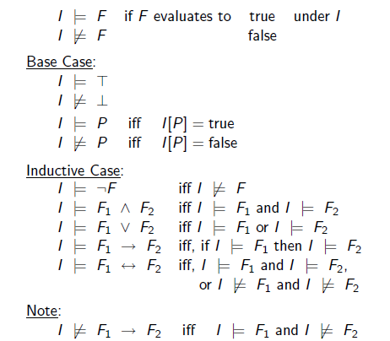
Inductive definition
Notes:
הגדרה אינדוקטיבית
כלומר F הוא אמת תחת I אם ורק אם F נובע מI אחרת F לא נובע מI

Slide 20
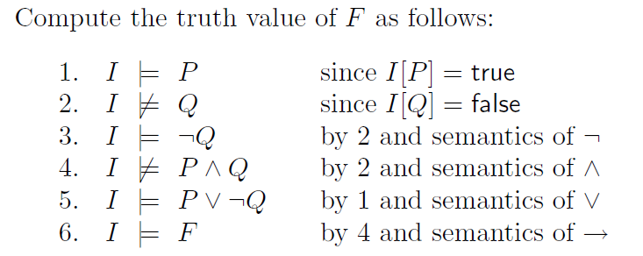
Example
Consider the formula F and interpretation I :
F : P ∧ Q → P ∨ ￢Q
I : {P → true, Q → false}
Notes:
בעזרתה אפשר לקבוע אם F נובעת מI

Slide 21

PL- Satisfiability and Validity
F is valid iff ¬F is unsatisfiable
Notes:
F ואלידית(תקפה) אם ורק אם NOT F היא לא ניתנת לסיפוק
ולמה זה? כי אם not f לא ניתנת לסיפוק זה אומר שאין השמה למשתנים כך ש not f מקבלת ערך true כלומר ש f יקבל false.
fa

Slide 22
Validity Check
Consider the formula
F : P ∧ Q → P ∨ ¬Q
Is it valid?
Notes:
איך ניתן לדעת אם נוסחה היא ואלידית?

Slide 23
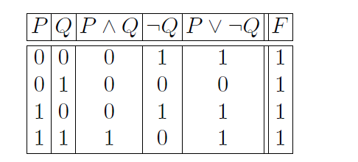
Validity Check - Truth Table
Consider the formula
F : P ∧ Q → P ∨ ¬Q
Thus F is valid!
Notes:
טבלת אמת

Slide 24

Another Example
Notes:
דוגמה נוספת שהיא לא ואלידית אבל כן ניתנת לסיפוק!

Slide 25

Another Example
Notes:
דוגמה נוספת שהיא לא ואלידית אבל כן ניתנת לסיפוק!

Slide 26
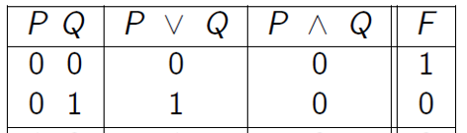
Another Example
Notes:
דוגמה נוספת שהיא לא ואלידית אבל כן ניתנת לסיפוק!

Slide 27
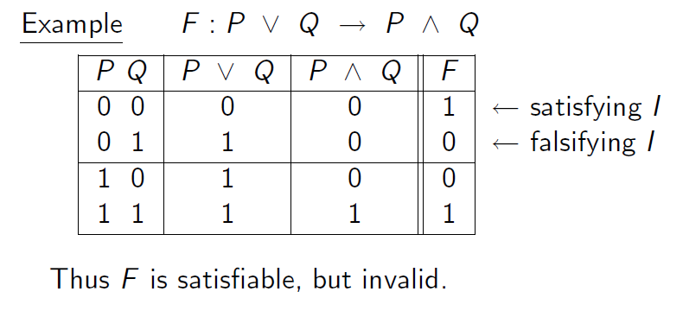
Another Example
Notes:
דוגמה נוספת שהיא לא ואלידית אבל כן ניתנת לסיפוק!

Slide 28
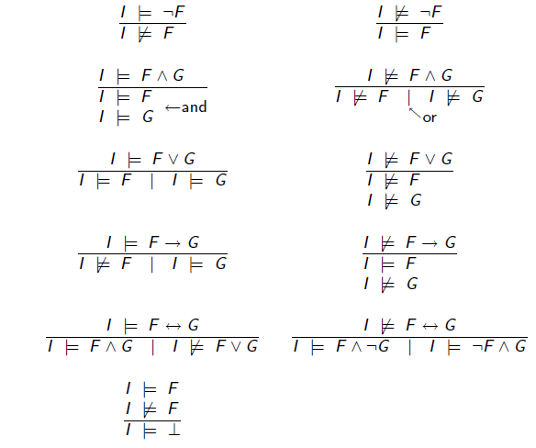
Validity Check - Semantic Arguments
A proof begins by assuming that the given formula F is invalid.
We will use the following proof rules in order to decide whether a formula F is valid or not.
We can end the proof as soon as we have a contradiction
Notes:
הוכחה מתחילה בכך שמניחים בשלילה שהנוסחה לא ואלידית כלומר שקיימת השמה שפוסלת אותה (מביאה לה את הערך false )
והמטרה לקבל סתירה להנחה.

Slide 29
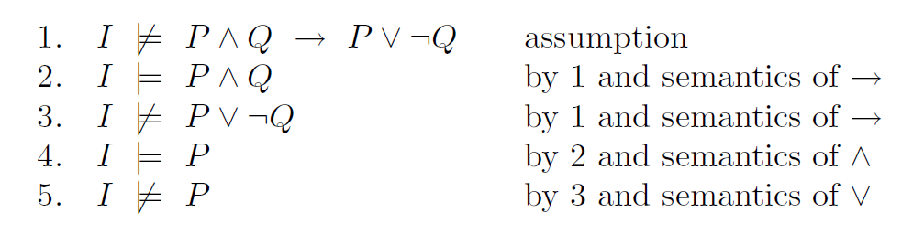

Example
Consider the formula
F : P ∧ Q → P ∨ ¬Q
Notes:
לדוגמה הנוסחה ממוקדם שהראנו שהיא ואלידית , אנחנו מניחים שהיא לא ואלידית לכן אם היא לא ואלידית אז זה אומר שצד שמאל היה true וצד ימין false ולפי סמנטיקה של וגם ואו מקבלים סתירה וסיימנו.

Slide 30

Exercise
Consider the formula
F : P ∧ Q → P → Q
I P ∧ Q → (P → Q) assumption

Slide 31

Exercise
Consider the formula
F : P ∧ Q → P → Q
I P ∧ Q → (P → Q) assumption
I P ∧ Q by 1 and semantics of →
I (P → Q) by 1 and semantics of →

Slide 32
Exercise
Consider the formula
F : P ∧ Q → P → Q
I P ∧ Q → (P → Q) assumption
I P ∧ Q by 1 and semantics of →
I (P → Q) by 1 and semantics of →
I P by 2 and semantics of ∧
I Q by 2 and semantics of ∧

Slide 33
Exercise
Consider the formula
F : P ∧ Q → P → Q
I P ∧ Q → (P → Q) assumption
I P ∧ Q by 1 and semantics of →
I (P → Q) by 1 and semantics of →
I P by 2 and semantics of ∧
I Q by 2 and semantics of ∧
I Q by 3 and semantics of →

Slide 34

Exercise
F : P ∧ Q → P → Q
I P ∧ Q → (P → Q) assumption
I P ∧ Q by 1 and semantics of →
I (P → Q) by 1 and semantics of →
I P by 2 and semantics of ∧
I Q by 2 and semantics of ∧
I Q by 3 and semantics of →
5 and 6 are contradictory!

Slide 35

First Order Logic (FOL)

Slide 36
FOL )First Order Logic)
FOL extends PL with predicates, functions, and quantifiers.
All formulae of PL evaluate to true or false.
FOL is not so simple.
In FOL, terms evaluate to values other than truth values such as integers, people, or cards of a deck.

Slide 37
FOL Syntax
The most basic terms are variables x, y, z, x1, x2, . . .
and constants a, b, c, a1, a2, . . ..
More complicated terms are constructed using functions.
An n-ary function f takes n terms as arguments.
Notationally, we represent generic FOL functions by symbols f, g, h, f1, f2, . . ..
A constant can also be viewed as a 0-ary function.

Slide 38
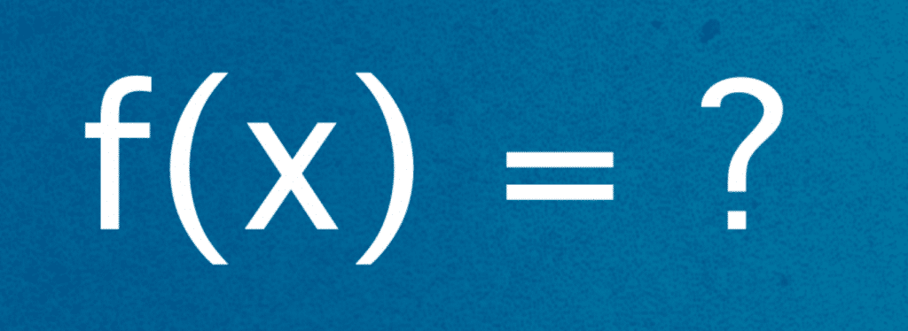
Examples of terms
(constants, variables, functions)
a, a constant (or 0-ary function);
x, a variable;
f(a), an unary function f applied to a constant;
g(x, b), a binary function g applied to a variable x and a constant b;
f(g(x, f(b))). Who tells me what it is?

Slide 39
FOL Syntax
The propositional variables of PL are generalized to predicates, denoted
p, q, r, p1, p2, . . ..
An n-ary predicate takes n terms as arguments.
A FOL propositional variable is a 0-ary predicate, which we write P, Q, R, P1, P2, . . ..
An atom is ⊤, ⊥, or an n-ary predicate applied to n terms.
A literal is an atom or its negation.

Slide 40
Example of Literals
P, a propositional variable (or 0-ary predicate).
p(f(x), g(x, f(x))), a binary predicate applied to two terms.
￢p(f(x), g(x, f(x))).
The first two literals are also atoms!

Slide 41

Quantifiers
A FOL formula is a literal, the application of a logical connective ￢, ∧, ∨, →, or ↔ to a formula or the application of a quantifier to a formula, is a formula.
There are two FOL quantifiers:
• the existential quantifier ∃x. F[x], read “there exists an x such that F[x]”;
• and the universal quantifier ∀x. F[x], read “for all x, F[x]”.
In ∀x. F[x], x is the quantified variable, and F[x] is the scope of the quantifier ∀x.
The case is similar for ∃x. F[x].
Also, x in F[x] is bound (by the quantifier).

Slide 42

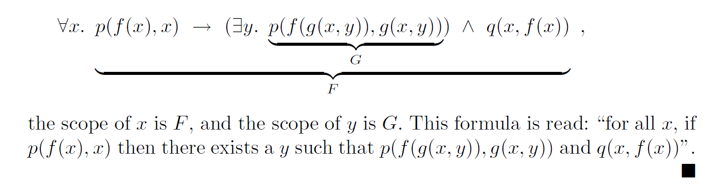
Example of scopes

Slide 43

Free & Bound
A variable is free in formula F[x] if there is an occurrence of x that is not bound by any quantifier. Denote by free(F) the set of free variables of a formula F.
A variable is bound in formula F[x] if there is an occurrence of x in the scope of a binding quantifier ∀x or ∃x. Denote by bound(F) the set of bound variables of a formula F.
In general, it is possible that free(F) ∩ bound(F) != ∅, as a variable x can have both free and bound occurrences.
A formula F is closed if it does not contain any free variables (all variables are bounded).

Slide 44
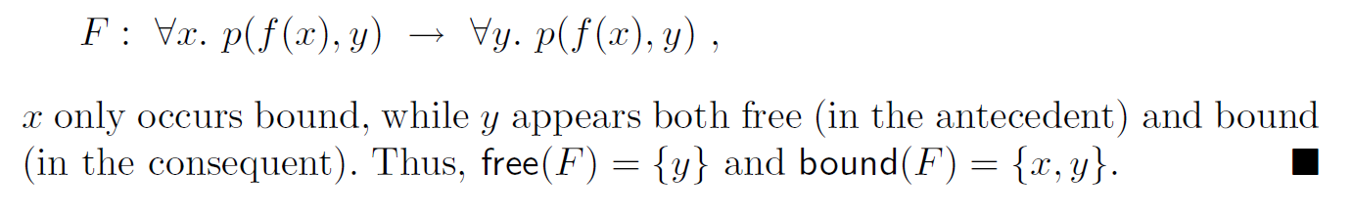
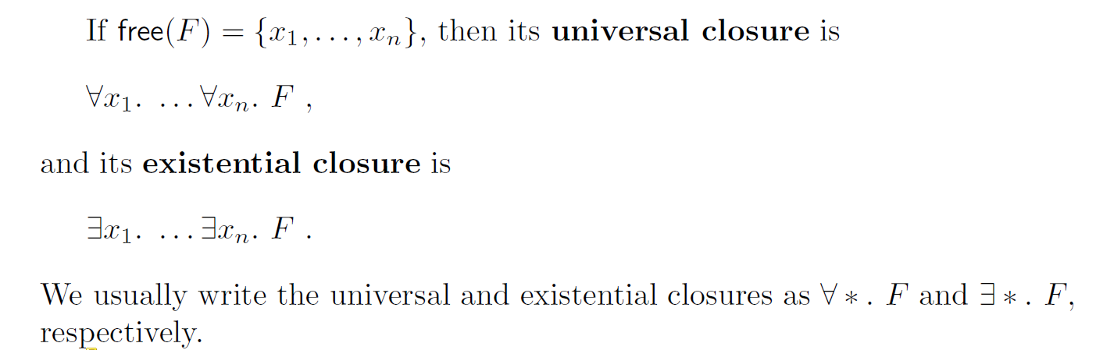
Free & Bound
In
And

Slide 45
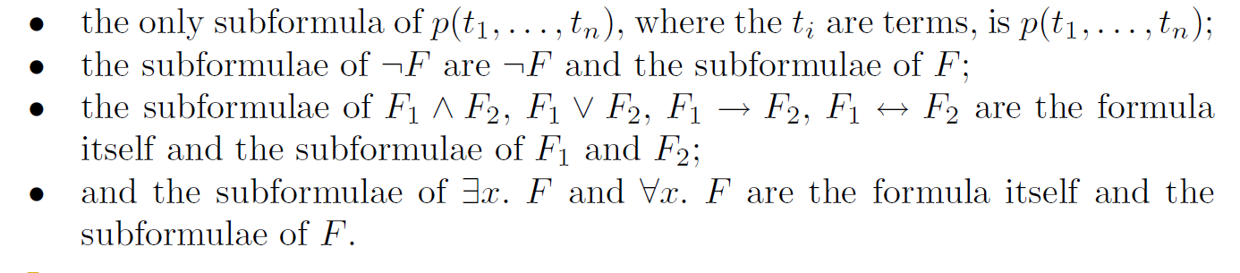
Subformulae
The subformulae of a FOL formula are defined according to an extension of the PL definition of subformula:

Slide 46
Strict Subformulae
The strict subformulae of a formula excludes the formula itself.
The subterms of a FOL term are defined as follows:
• the only subterm of constant a or variable x is a or x itself, respectively;
• and the subterms of f(t1, . . . , tn) are the term itself and the subterms of t1, . . . , tn.
The strict subterms of a term excludes the term itself.

Slide 47
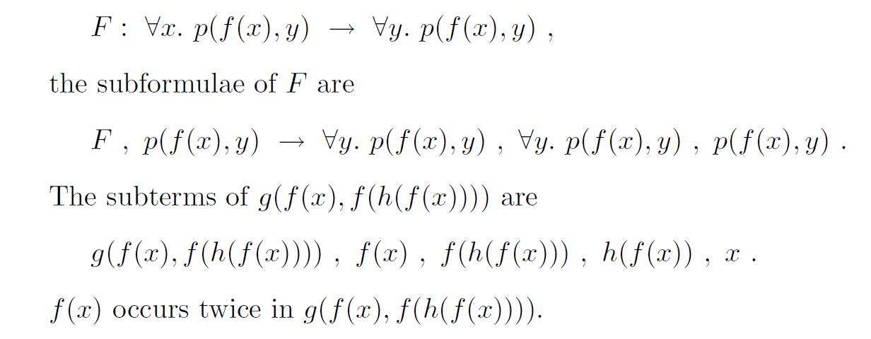
Examples of Subformulas
In formula:

Slide 48
Examples
Before discussing the formal semantics for FOL, let’s have a translations of English sentences into FOL:
1. Some dogs have more days than others.

Slide 49
Examples
Before discussing the formal semantics for FOL, let’s have a translations of English sentences into FOL:
1. Some dogs have more days than others.

Slide 50
Examples
Before discussing the formal semantics for FOL, let’s have a translations of English sentences into FOL:
2. All cats have more days than dogs.

Slide 51
Examples
Before discussing the formal semantics for FOL, let’s have a translations of English sentences into FOL:
2. All cats have more days than dogs.

Slide 52
Examples
Before discussing the formal semantics for FOL, let’s have a translations of English sentences into FOL:
3. The length of one side of a triangle is less than the sum of the lengths of the other two sides.

Slide 53
Examples
Before discussing the formal semantics for FOL, let’s have a translations of English sentences into FOL:
3. The length of one side of a triangle is less than the sum of the lengths of the other two sides.

Slide 54
FOL Semantics – Interpretation and Domain
Having defined the syntax of FOL, we now define its semantics. Formulae of FOL evaluate to the truth values true and false as in PL. However, terms of FOL formulae evaluate to values from a specified domain.
First, we define a FOL interpretation I.
The domain DI of an interpretation I is a nonempty set of values or objects, such as integers, real numbers, dogs, people, or merely abstract objects.
Domains can be finite, such as the 52 cards of a deck of cards;
countably infinite, such as the integers; or uncountably infinite, such as the
reals. But all domains are nonempty.

Slide 55
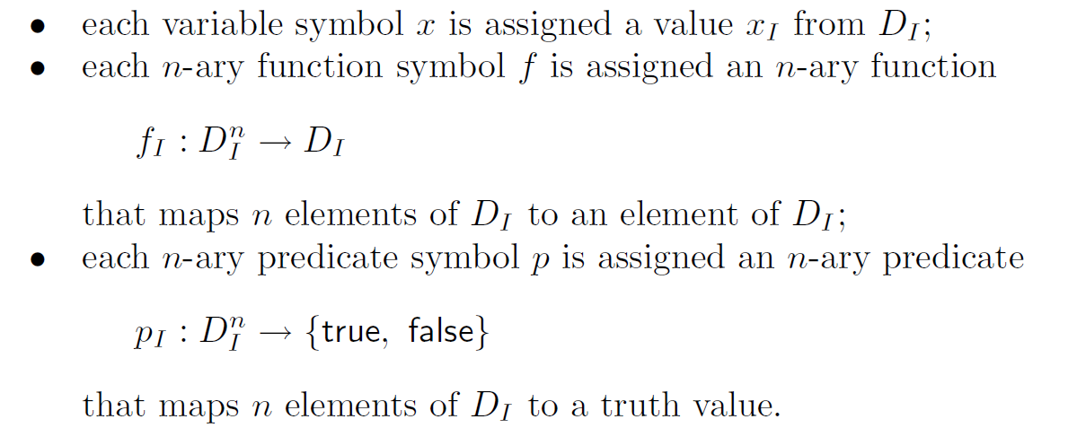
Assignment
The assignment αI of interpretation I maps constant, function, and predicate symbols to elements, functions, and predicates over DI .

Slide 56



Example of “standard” Interpretation
The formula:
contains the binary function symbols + and −, the binary predicate symbol >, and the variables x, y, and z.
+, −, and > are just symbols: we choose these names to provide intuition for the intended meaning of the formulae.
We could just as easily have written:
We construct a “standard” interpretation. The domain is the integers, Z:

Slide 57
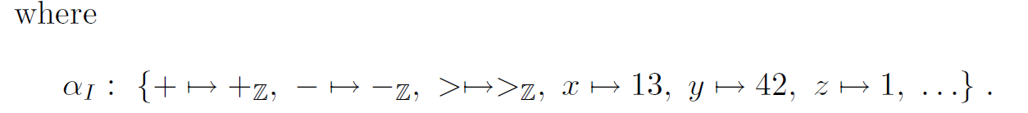
Example of “standard” Interpretation

Slide 58
And a bit of a “non-standard” Interpretation
Let’s take the formula F: x+y
The formula contains the binary function symbol +, and the variables x, y.
As mentioned before: + is just a symbol.
This time, the + symbol won’t have the intuitive meaning it always does.
Let’s assign + to be maxHeight.
This time, the domain is D={all the people in the world}.

Slide 59
And a bit of a “non-standard” Interpretation
We construct a “ non-standard” interpretation I: (D, αI) where:
αI: {+ → maxHeight (returns the taller between x or y) , x → person, y → person}.
So, by now we can see that we don’t have to use the regular symbols we are used to, nor the “standard” domain.

Slide 60
Another Interpretation
Let’s take the formula F: ∀x. f(x)%g(x)
The formula contains the binary function symbol %, the quantifier ∀x, and the variables f(x), g(x).
As mentioned before: % is just a symbol.
This time, the % symbol won’t have the intuitive meaning it always does.
Let’s assign % to be !=.
This time, the domain is D={◦, •}.

Slide 61
Another Interpretation
We construct a “ non-standard” interpretation I: (D, αI) where:
αI: {+= !=, f(◦) → ◦, f(•) → •, g(◦) → •, g(•) → ◦}.
So, by now we can see that we don’t have to use the regular symbols we are used to, nor the “standard” domain.

Slide 62
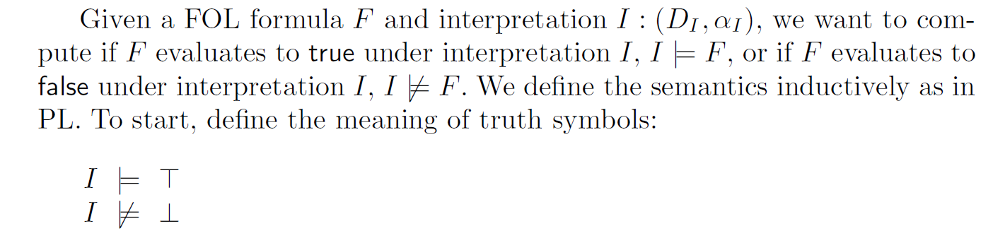
F under interpretation

Slide 63
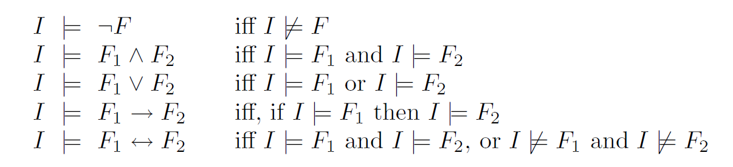
F under interpretation
Assume that formulae F1 and F2 have fixed truth values.
From these formulae, evaluate the semantics of more complex formulae. The logical connectives are handled in FOL in precisely the same way as in PL:

Slide 64

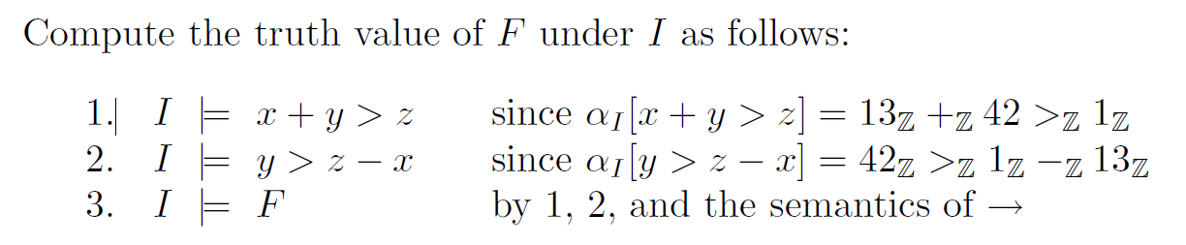
Back to the last example
Recall the formula:

Slide 65
Satisfiability and Validity
A formula F is said to be satisfiable iff there exists an interpretation I such that I |= F.
A formula F is said to be valid iff for all interpretations I, I |= F.
Recall that satisfiability and validity are dual:
F is valid iff ￢F is unsatisfiable.
Who Exaplains Why?

Slide 66

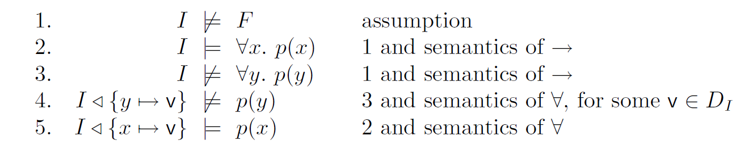
Example
Let’s prove that is valid.
under I, p(v) is false by 4 and true by 5. Thus, F is valid.

Slide 67

First Order Theories

Slide 68

First-Order Theories
A first-order theory T is defined by the following components:
  Its signature Σ is a set of constant, function, and predicate symbols.
  Its set of axioms A is a set of closed (no free variables) FOL formulae in which only constant, function, and predicate symbols of Σ appear.
A Σ-formula is constructed from constant, function, and predicate symbols of Σ, as well as variables, logical connectives, and quantifiers
Notes:
The symbols of are just symbols without prior meaning — the
axioms of T provide their meaning

Slide 69
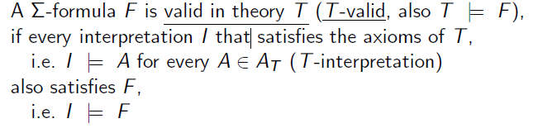

Satisfiability and Validity

Slide 70

First-Order Theories

Slide 71
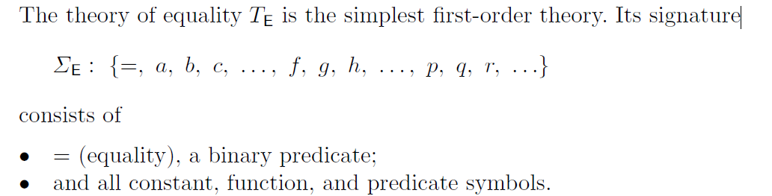
Theory of Equality

Slide 72
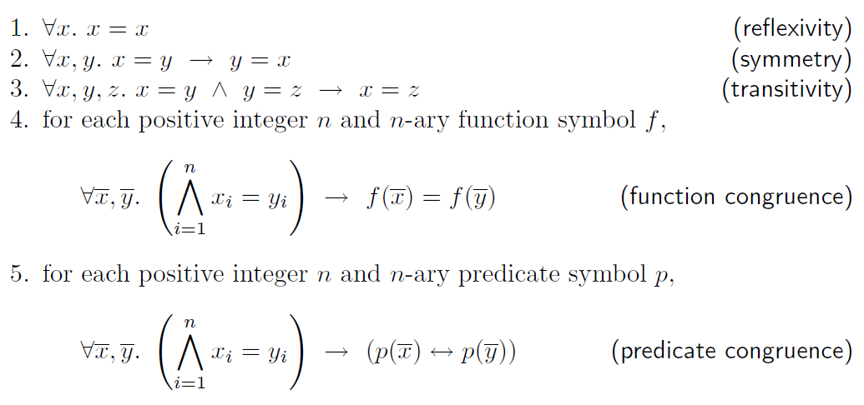
Theory of Equality - Axioms

Slide 73
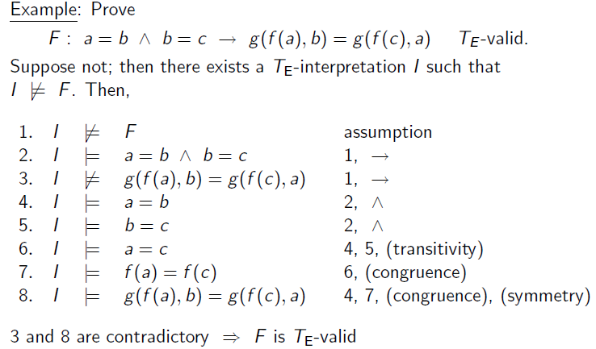
Example

Slide 74
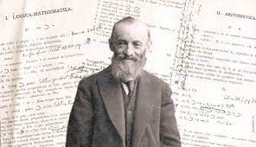
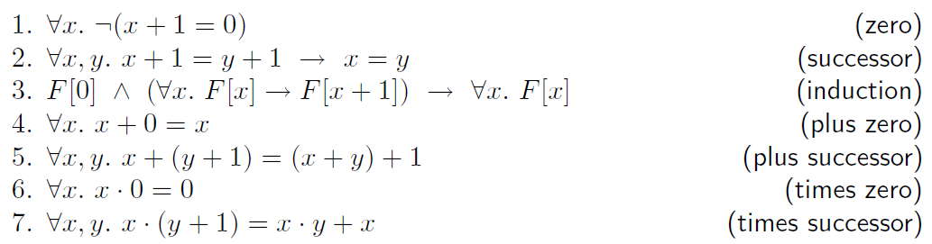
Peano arithmetic
Signature ΣPA : {0, 1, +,*, =}
Axioms :
Satisfiability and validity in TPA is undecidable
Notes:
• 0 and 1 are constants;
• + (addition) and · (multiplication) are binary functions;
• and = (equality) is a binary predicate.
Giuseppe Peano – Italian Mathematician
1889

Slide 75
Example
The formula 3x + 5 = 2y can be written using the signature ΣPA as:
x + x + x + 1 + 1 + 1 + 1 + 1 = y + y
or as :
(1 + 1 + 1) · x + 1 + 1 + 1 + 1 + 1 = (1 + 1) · y
In practice, we use the abbreviated notation 3x + 5 = 2y.

Slide 76
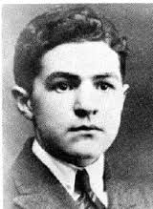
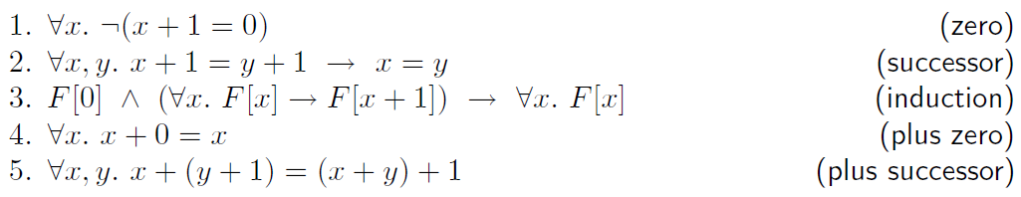
Presburger Arithmetic
Signature ΣN : {0, 1, +, =}
Axioms :
Satisfiability and validity in TN is decidable
Notes:
• 0 and 1 are constants;
• + (addition) and · (multiplication) are binary functions;
• and = (equality) is a binary predicate.
Giuseppe Peano – Italian Mathematician
1889

Slide 77
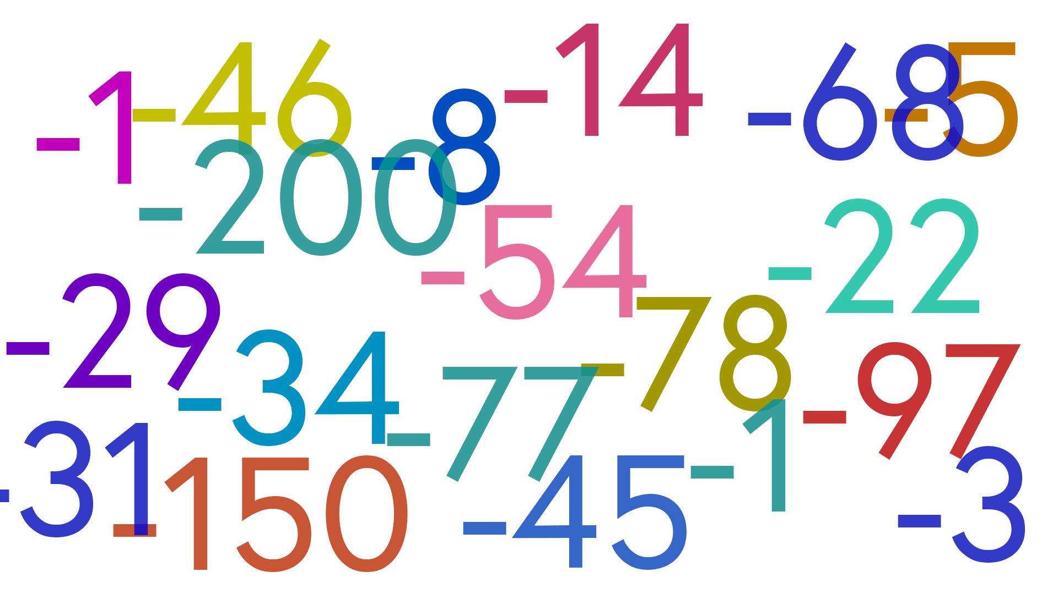
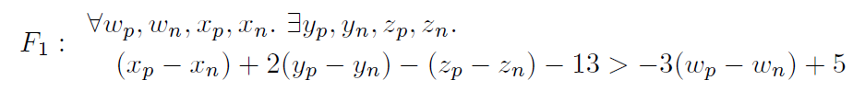
What about negative numbers?
Consider the formula
introduces two variables, vp and vn, for each variable v of F0.
While each of vp and vn can only range over N, vp−vn should range over the integers.

Slide 78

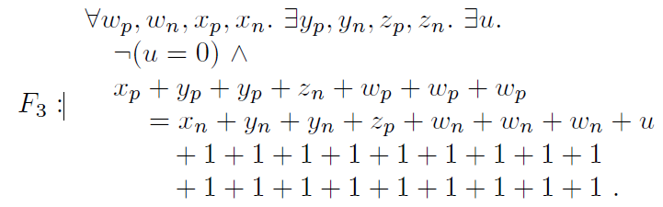
Negative Numbers
Moving negated terms to the other side of the inequality eliminates −:
The final transformation eliminates constant coefficients and strict inequality:

Slide 79

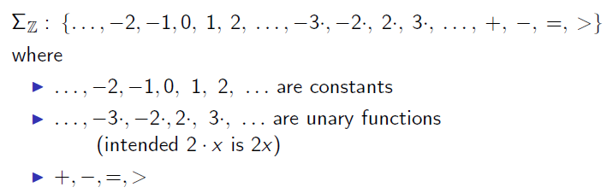
Theory of Integers

Slide 80
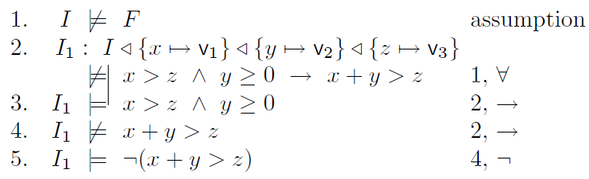

Example
Prove that ΣZ-formula F : ∀x, y, z. x > z ∧ y ≥ 0 → x + y > z is TZ-valid
Proof:

Slide 81

Thank you for listening

