Slide 1
A Polymorphic Intermediate Verification Language: Design and Logical Encoding
K. Rustan M. Leino, Microsoft Research
Philipp Rümmer, Oxford University Computing Laboratory

Slide 2
What are we going to talk about?
Introduction - The Program Verification process
Boogie 2 types and expressions
  Type declarations
  Expressions
  Formalization of the Type System and Type
  Checking
Representation of types as terms
Translation of Expressions
Code example
Summary

Slide 3
1.
The Program Verification Process

Slide 4
The Program Verification Process
The program verification procedure is not an easy task(as we know, it’s not a decideable task). It involves knowledge in various topics.
In order to make this task more feasable, it breaked into smaller pieces, each of which is simpler to understand.
The first task is to translate a program written in a specific, regular programming language to an Intermidiate Verification language.
A program that doing such translation is called “front-end IVL”.

Slide 5
The Program Verification Process
The second task is to verify an IVL program. A program that doing such verification is called “back-end IVL”.
This provides “Seperation of concerns”, as:
  The front-end does not need to care about what method is used to verify the program.
  The back-end does not need to care about the semantics of several different programming languages. It only needs to care about the IVL.
Today, we are going to talk about a specific Intermediate verification language called Boogie 2. It’s an improvement of another IVL called Boogie.

Slide 6
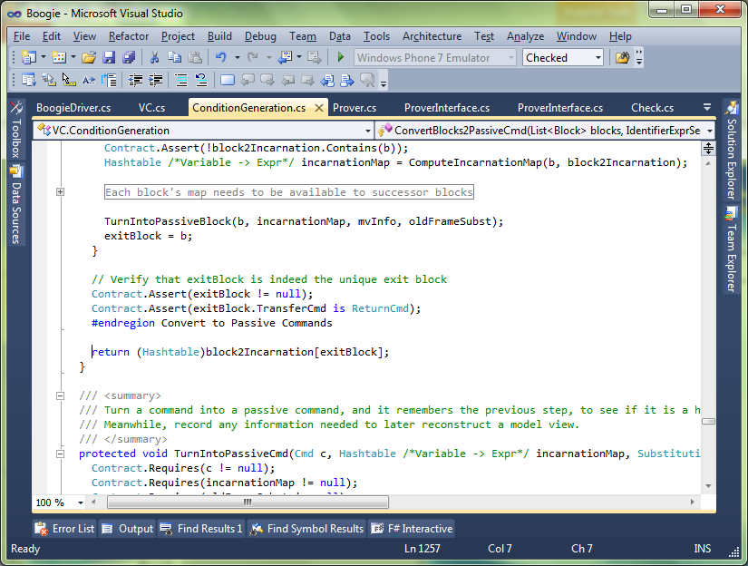
C#
Intermediate verification language
SMT solver

Slide 7
Boogie 2 front-ends and back-ends
Front-ends that emits Boogie IVL:
Dafny
Joogie
GPUVerify
SMACK
VCC
Back-ends that consume Boogie IVL:
Boogie
Boogaloo
Corral
Duality
Symbooglix
Whoop

Slide 8
2.
Boogie 2 types and expressions

Slide 9
Boogie 2 Type declarations
A Boogie program consists of a set of mathematical and imperative declarations that define set of execution sequences.
The boogie program is correct if none of these execution sequences contains an error state.
The built-in types of Boogie are:
Booleans(bool)
Mathematical intergers(int)
Bit-vector types of every size(bv1, bv2,…)
A program can also declare parametrized type synonyms(helps only for syntactic convenience, does not add to the expressiveness of the type system)
In addition, there are:
Maps
User-defined type constructors

Slide 10
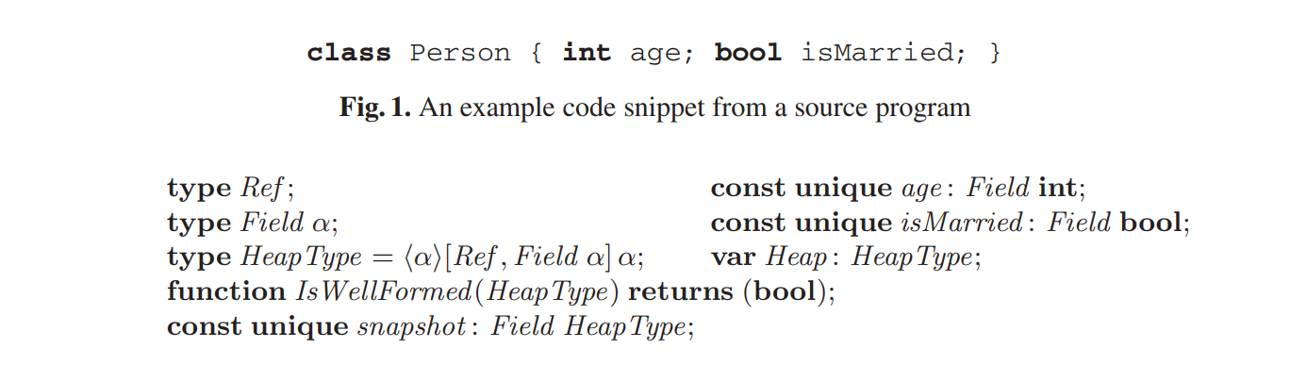
Boogie 2 Type declarations
An example of how object-oriented program features can be modeled in Boogie.
Ref is a nullary type constructor, and Field is a unary type constructor.
The modifier unique is used to say that the constant declared has different value than all other unique constants.
The HeapType is a polymorphic map that represents the heap.

Slide 11
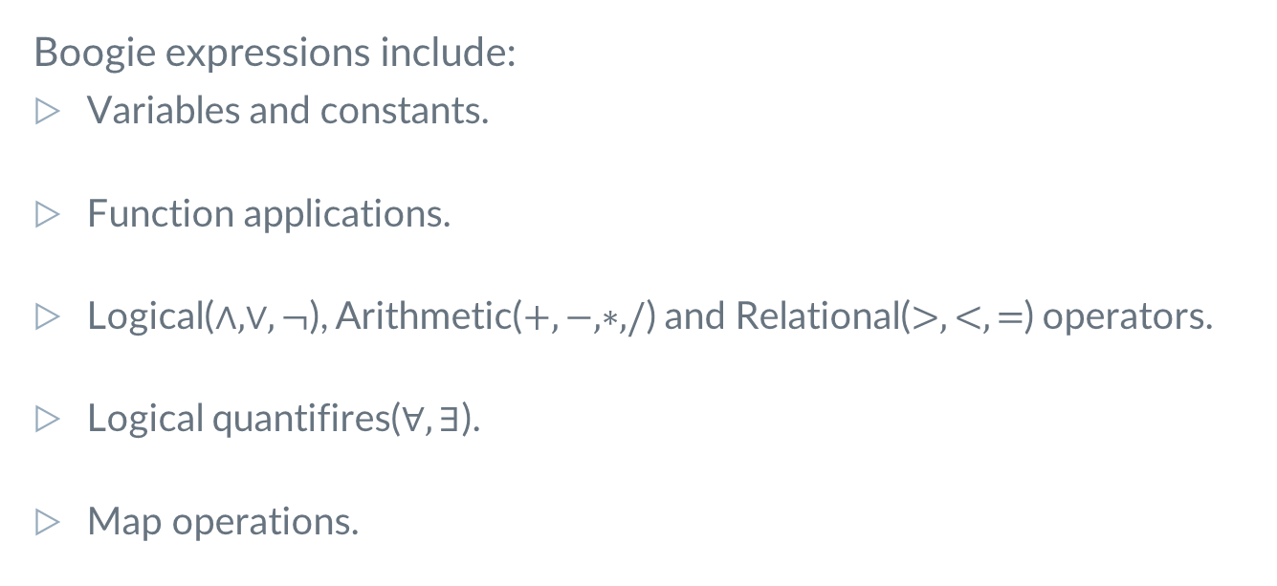
Boogie 2 Expressions
Boogie expressions include:
Variables and constants.
Function applications.
Logical($∧, ∨,¬$), Arithmetic($+,−,∗,/$) and Relational($>,<,=$) operators.
Logical quantifires($∀,∃$).
Map operations.

Slide 12
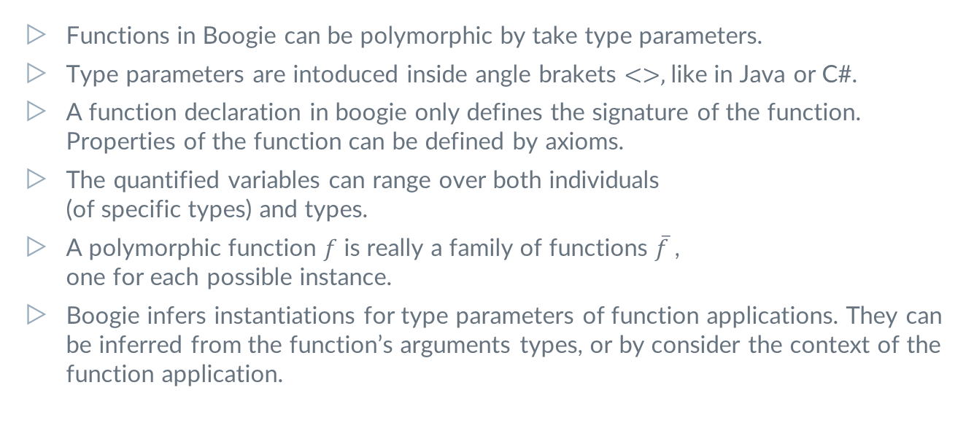
Boogie 2 Expressions
Functions in Boogie can be polymorphic by take type parameters.
Type parameters are intoduced inside angle brakets $<>,$like in Java or C#.
A function declaration in boogie only defines the signature of the function. Properties of the function can be defined by axioms.
The quantified variables can range over both individuals
(of specific types) and types.
A polymorphic function $f$ is really a family of functions $\overline{f}$ ,
one for each possible instance.
Boogie infers instantiations for type parameters of function applications. They can be inferred from the function’s arguments types, or by consider the context of the function application.

Slide 13
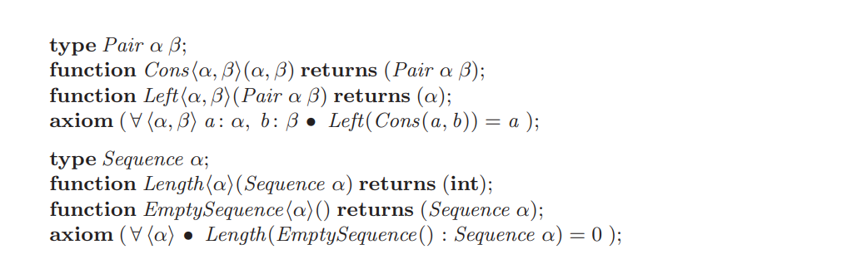
Boogie 2 Expressions

Slide 14
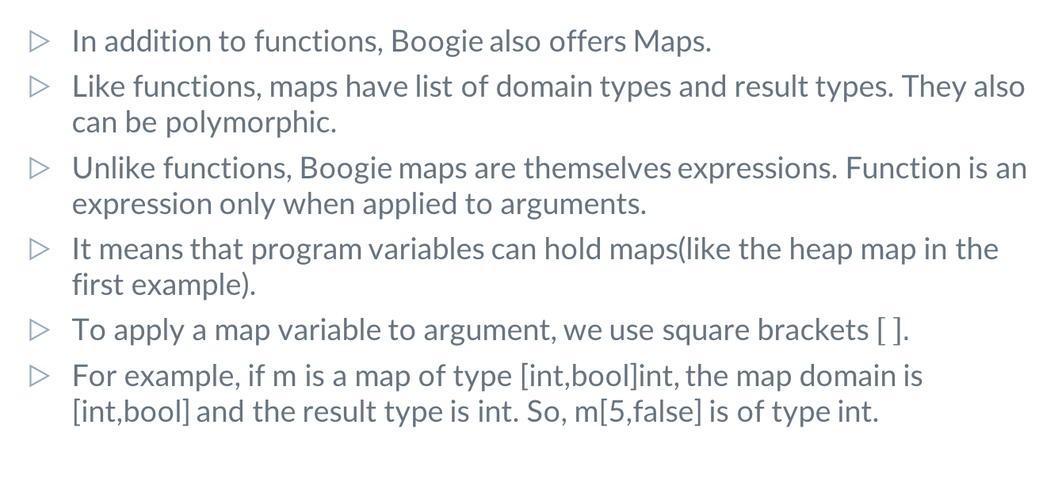
Boogie 2 Expressions
In addition to functions, Boogie also offers Maps.
Like functions, maps have list of domain types and result types. They also can be polymorphic.
Unlike functions, Boogie maps are themselves expressions. Function is an expression only when applied to arguments.
It means that program variables can hold maps(like the heap map in the first example).
To apply a map variable to argument, we use square brackets $\left[ \right].$
For example, if m is a map of type [int,bool]int, the map domain is [int,bool] and the result type is int. So, m[5,false] is of type int.

Slide 15
Boogie 2 Expressions
If m is a map, E is a list of expressions that corresponds to the m’s domain, and x is an expression of the result type of m, then the map m[E:=x] is the same map as m except that m[E:=x] maps E to x.
To update m itself, we can use m[E]:=x, instead of m:=m[E:=x]
As mentioned earlier, Boogie maps can be polymorphic. This feature helps us to model the memory of the program.
For example, one can demonstrate the heap by declaring a two-dimensional map: from object references and field names to values.
Since the result type of such a map is depends on the selected field name, it is natural to declare such heap as a map with a polymorphic map.

Slide 16
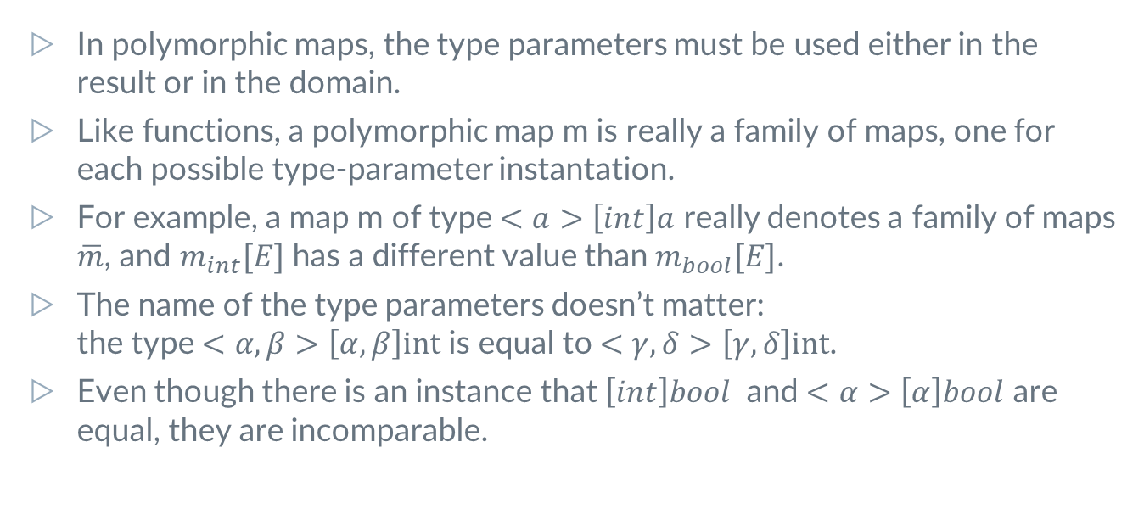
Boogie 2 Expressions
In polymorphic maps, the type parameters must be used either in the result or in the domain.
Like functions, a polymorphic map m is really a family of maps, one for each possible type-parameter instantation.
For example, a map m of type $<a>\left[int\right]a$ really denotes a family of maps $\overline{m}$, and $m_{int}[E]$ has a different value than$m_{bool}[E]$.
The name of the type parameters doesn’t matter:
the type $<α,β>\left[α,β\right]int$ is equal to $<γ,δ>\left[γ,δ\right]int$.
Even though there is an instance that $\left[int\right]bool$ and $<α>\left[α\right]bool$ are equal, they are incomparable.

Slide 17
Boogie 2 Expressions
A common way to specify the affects of a source-language procedure is to use a modify clause that lists the variables that the procedure is allowed to modify.
The modify clause is then encoded into Boogie as a procedure post-condition, that represents the relation between the old memory state and the memory state on return.
For example, if we want to limit a function to edit only a specific Ref p, we can write the following encoded modify clause:

Slide 18
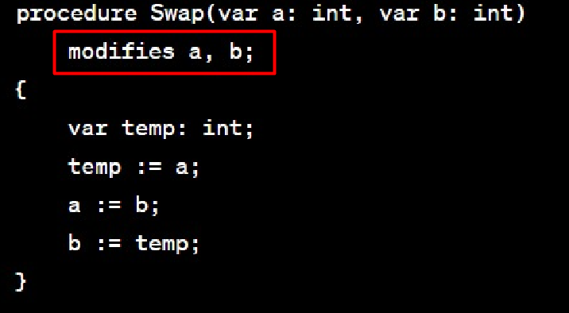
Boogie 2 Expressions
If we want to write a swap procedure that take to variables a, b and swaps them:
This will be encoded into a modify clause.

Slide 19
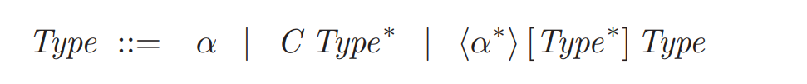
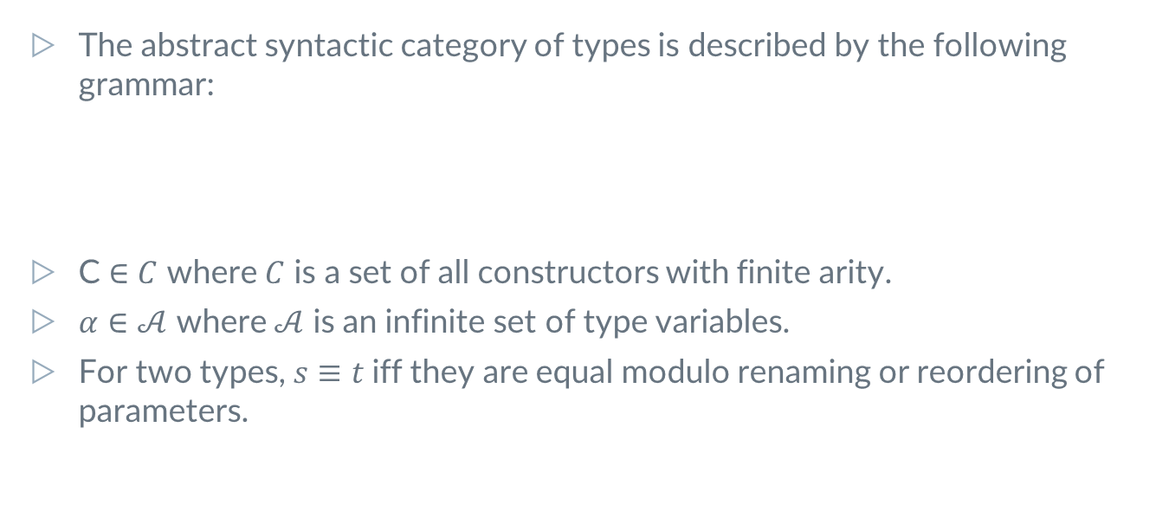
Formalization of the type system and type checking
The abstract syntactic category of types is described by the following grammar:
C $∈C$ where $C$ is a set of all constructors with finite arity.
$α∈𝒜$ where $𝒜$ is an infinite set of type variables.
For two types, $s≡t$iff they are equal modulo renaming or reordering of parameters.

Slide 20
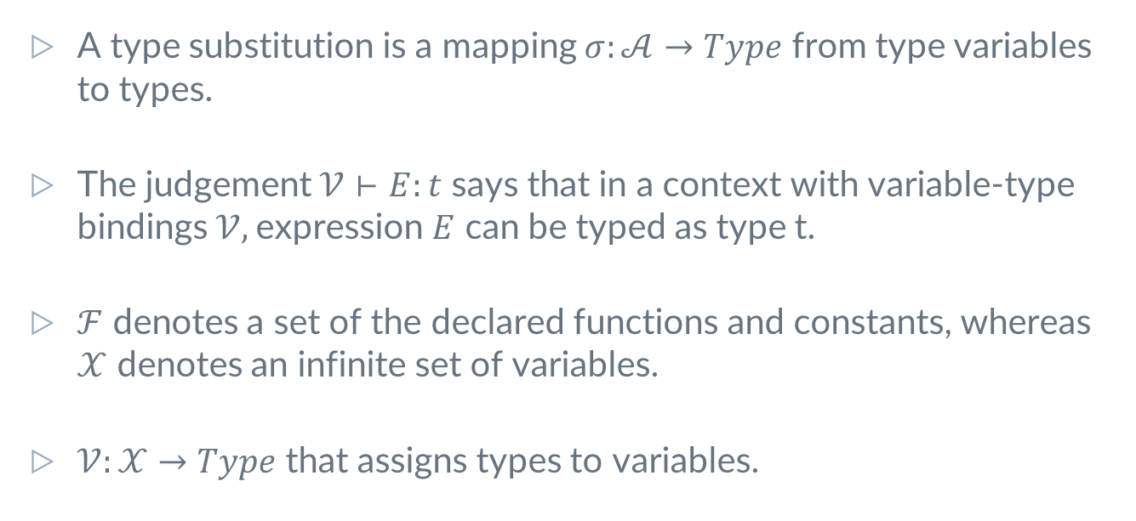
Formalization of the type system and type checking
A type substitution is a mapping $σ:𝒜→Type$ from type variables to types.
The judgement $𝒱⊢E:t$ says that in a context with variable-type bindings $𝒱,$expression $E$ can be typed as type t.
$ℱ$ denotes a set of the declared functions and constants, whereas $𝒳$ denotes an infinite set of variables.
$𝒱:𝒳→Type$ that assigns types to variables.

Slide 21
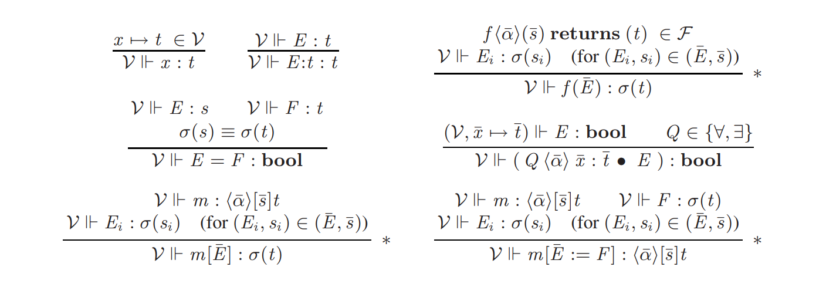
Formalization of the type system and type checking
The typing rules for Boogie expressions.

Slide 22
3.
Representation of types as terms

Slide 23
Representation of types as terms
SMT solvers typically offers untyped or simply-typed logic as their input language.
With such SMT solvers in the verifier back-end, expressions from richer language like Boogie have to be translated into simpler logic.
There are two approaches to do this translation:
  Translation using Type Guards
  Translation using Type arguments
In both cases, it is required to encode Boogie types as terms.

Slide 24
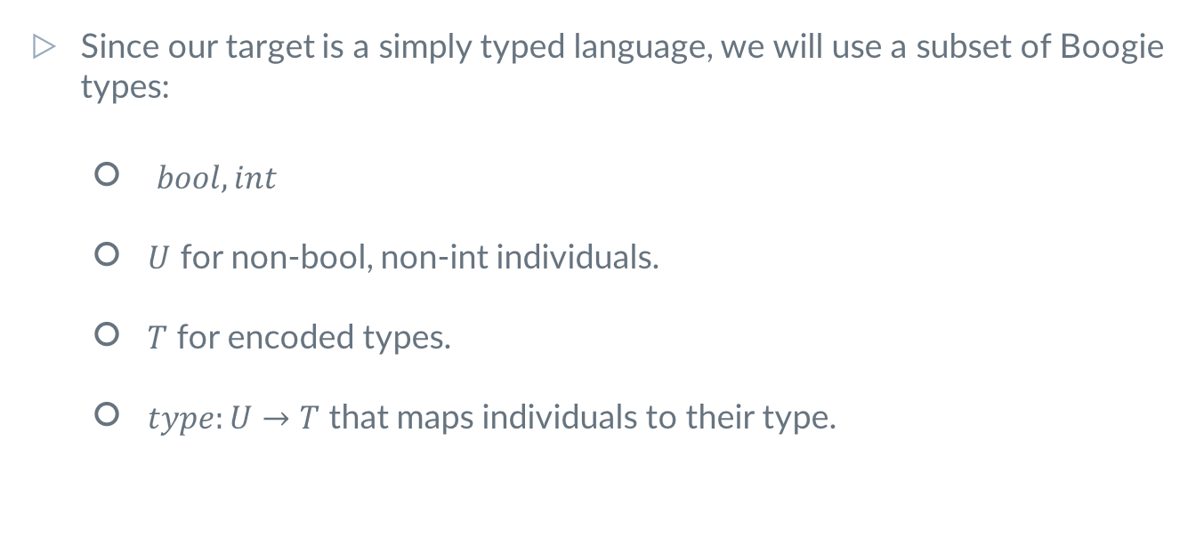
Representation of types as terms
Since our target is a simply typed language, we will use a subset of Boogie types:
  $bool, int$
  $U$ for non-bool, non-int individuals.
  $T$ for encoded types.
  $type:U→T$ that maps individuals to their type.

Slide 25
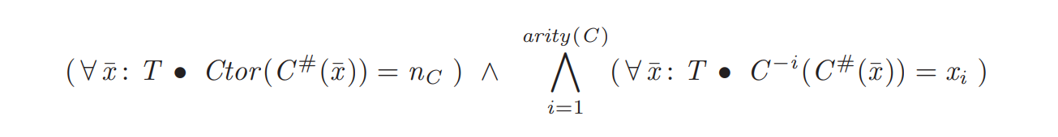
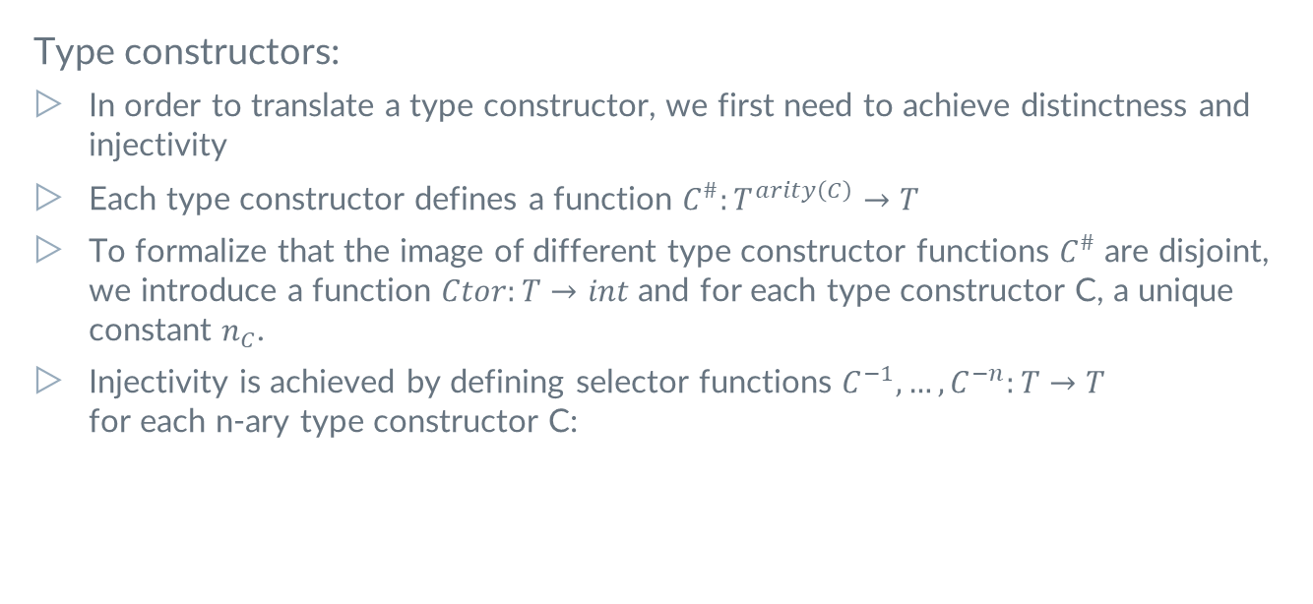
Representation of types as terms
Type constructors:
In order to translate a type constructor, we first need to achieve distinctness and
injectivity
Each type constructor defines a function $C^{\#}:T^{arity\left(C\right)}→T$
To formalize that the image of different type constructor functions $C^{\#}$ are disjoint, we introduce a function $Ctor:T→int$ and for each type constructor C, a unique constant $n_{C}$.
Injectivity is achieved by defining selector functions $C^{−1},…,C^{−n}:T→T$
for each n-ary type constructor C:

Slide 26
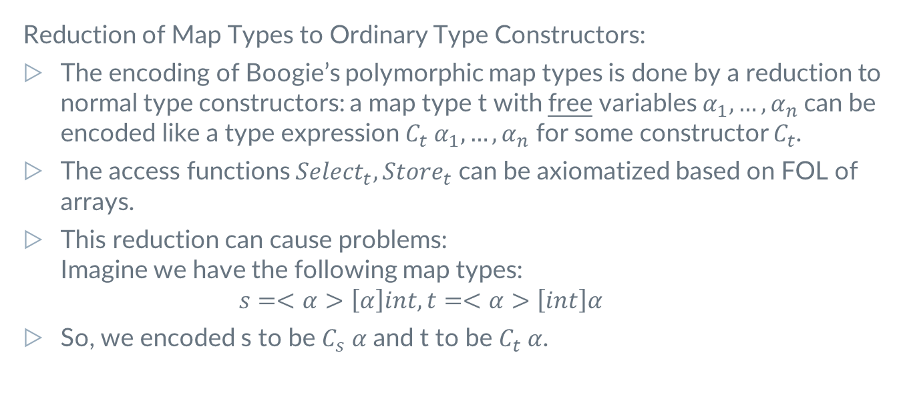
Representation of types as terms
Reduction of Map Types to Ordinary Type Constructors:
The encoding of Boogie’s polymorphic map types is done by a reduction to normal type constructors: a map type t with free variables $α_{1},…,α_{n}$can be encoded like a type expression $C_{t} α_{1},…,α_{n}$ for some constructor $C_{t}$.
The access functions $Select_{t},Store_{t}$ can be axiomatized based on FOL of arrays.
This reduction can cause problems:
Imagine we have the following map types:
$s=<α>\left[α\right]int, t=<α>\left[int\right]α$
So, we encoded s to be $C_{s} α$ and t to be $C_{t} α$.

Slide 27
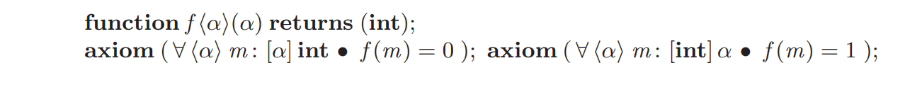
Representation of types as terms
Now, consider we have the following axioms:
As we can see, according to the translation we made, we have inconsistency with the above axioms.
In order to solve this problem, we need to make this translation more “general”.

Slide 28
Representation of types as terms
A small summary:
We wanted to translate Boogie types to terms.
First, we saw how to achieve distinctness and injectivity in type constructors.
We saw how to translate a map to a type constructor(not the full way. There is a small change we need to do in order to avoid the inconsistency we saw earlier).
There is a way to translate all Boogie types to terms, and it’s out of our scope.

Slide 29
4.
Translation of Expressions

Slide 30
Translation of Expressions
As mentioned earlier, there are two ways to translate typed Boogie expressions into equivalent simply-typed expressions:
Logical guards
Type arguments
We will discuss only the Type arguments translation.

Slide 31
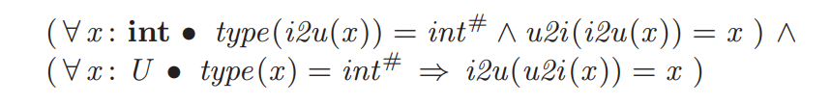
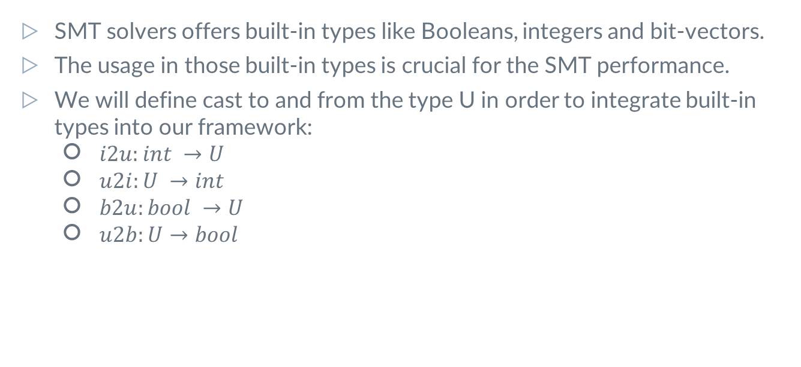
Translation of Expressions
SMT solvers offers built-in types like Booleans, integers and bit-vectors.
The usage in those built-in types is crucial for the SMT performance.
We will define cast to and from the type U in order to integrate built-in types into our framework:
  $i2u:int →U$
  $u2i:U →int$
  $b2u:bool →U$
  $u2b:U→bool$

Slide 32
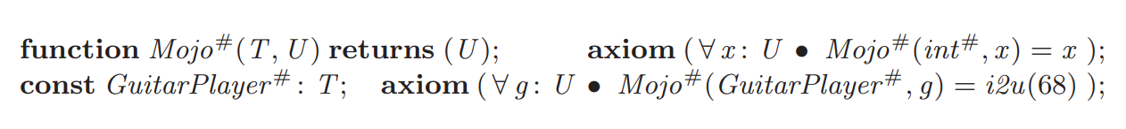
Translation of Expressions
Type argument translation works by explicitly passing the values of type parameters to functions.
Consider the following Boogie program:
With type argument translation, the example getting translated as follows:

Slide 33

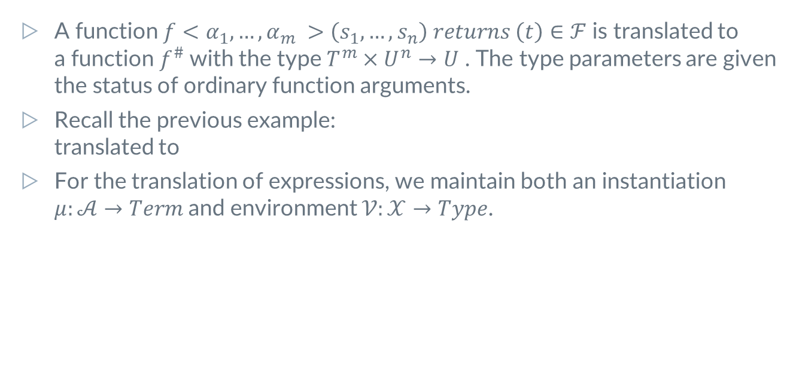
Translation of Expressions
A function $f<α_{1},…,α_{m} >\left(s_{1},…,s_{n}\right) returns \left(t\right)∈ℱ$ is translated to
a function $f^{\#}$with the type $T^{m}×U^{n}→U$ . The type parameters are given the status of ordinary function arguments.
Recall the previous example:
translated to
For the translation of expressions, we maintain both an instantiation
$μ:𝒜→Term$and environment $𝒱:𝒳→Type$.

Slide 34
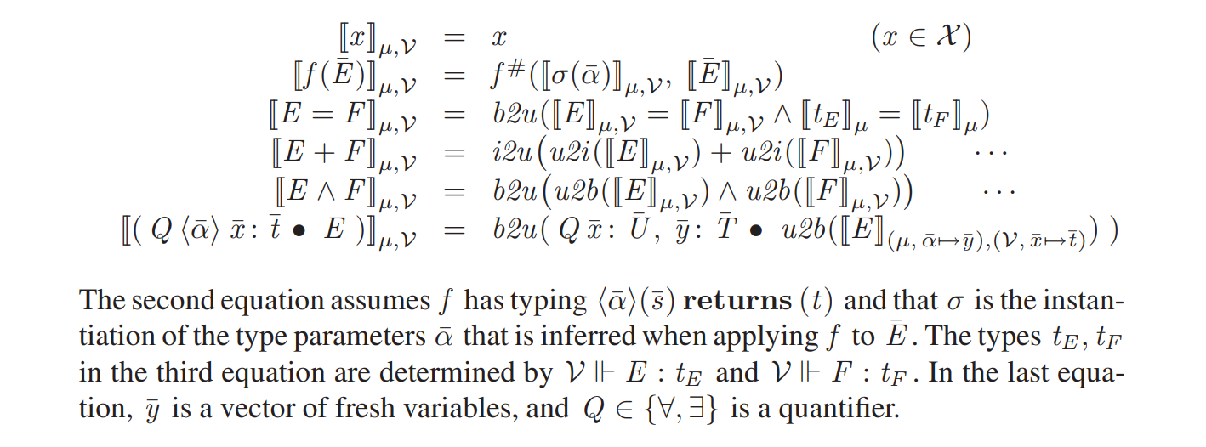
Translation of Expressions

Slide 35
5.
Code Example

Slide 36
6.
Summary

Slide 37
Summary
The program verification procedure is divided into 2 parts:
  Convert a code written in a regular programming language to an IVL(done by the front-end).
  Verify the correctness of the IVL code(done by the back-end).
Boogie 2 is an example for an IVL. Boogie 2 offers basic data types like Integers, Booleans and bit vectors, as well as user defined types and maps.
Boogie 2 is a polymorphic language, so it can take type parameters.
Since Boogie has maps and it’s polymorphic, we can model important things in Boogie, such as the program’s Heap. The conversion from an OOP language to Boogie is intuitive.
We can define function signatures. We can define functions and variables properties with axioms.
We saw Boogie 2 type-inference semantics.
Boogie’s expressivity is too large for SMT solvers. To encounter with this problem, we saw how to convert Boogie types to a smaller subset of types, and how to represent Boogie expressions with this small subset of types, via the Type arguments method.

Slide 38

Thanks!
Any questions?
Ben Levi – benlevi7770528@gmail.com
Eliran Eiluz – eliranfr1@gmail.com

