Slide 1
The Calculus of Computation
IDAn Ziv
Semyon Guretskiy
Based on: “The Calculus of Computation” by A. Bradley and Z. Manna
Some examples taken from the course “Automeated Reasoning” by Yoni Zohar

Slide 2
Lecture OUTLINE
Propositional Logic (PL)
First Order Logic (FOL)
First Order Theories

Slide 3
disclaimer
Not a comprehnsive review on logic.
A survey on key concepts and theories.

Slide 4

WHY we need Logic?

Slide 5
WHY we need logic?
Calculus is a set of symbols and rules to manipulate those symbols. Given a domain they have a certain ‘meaning’ (e.g differential calculus)
In CS, we are interenset in a different domain.
Our chief concern is the computation/behaviour of a program. How should we represent this domain?
Notes:
Ask the crowd

Slide 6

WHY WE NEED LOGIC?
program
transition
state 1
state 2
$$⋯$$
state n

Slide 7
WHY WE NEED LOGIC?
program
transition
state 1
state 2
$$⋯$$
state n
Logic helps us answer question about our programms.

Slide 8
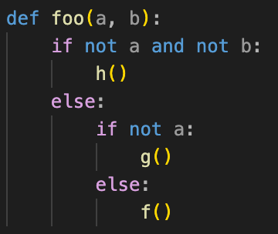
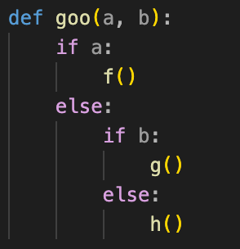
Why we need logic?
Suppose you have two functions in Python:
How can you be sure that they are equivalent? (i.e, they return the same output for the same input)

Slide 9
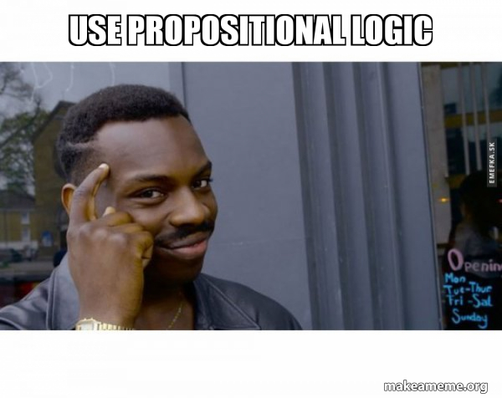

Slide 10
PL
Propositional Logic
Chapters: 1.1 – 1.3
Syntax
Semantics
Satisfiability and Validity
Another Interesting Notes

Slide 11
Syntax Of PL

Slide 12
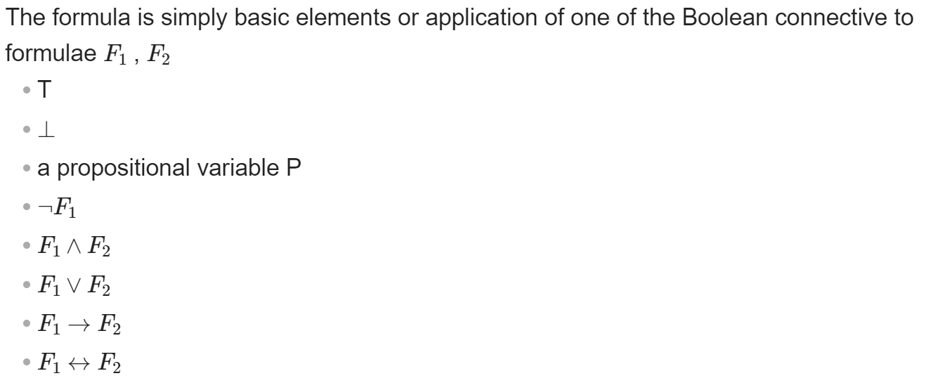
Formula
Basic elements

Slide 13
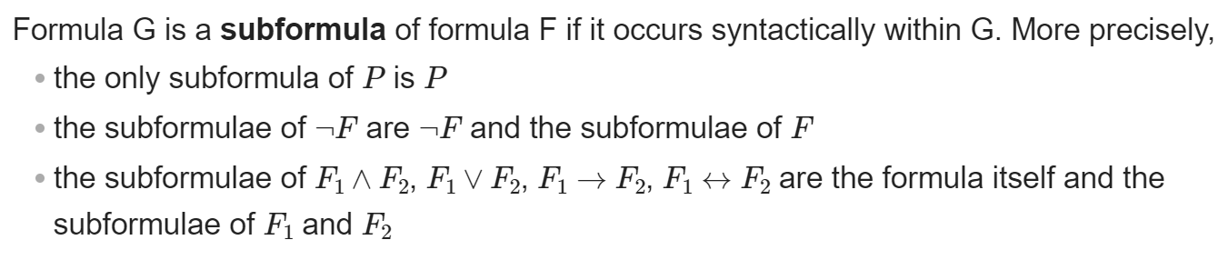
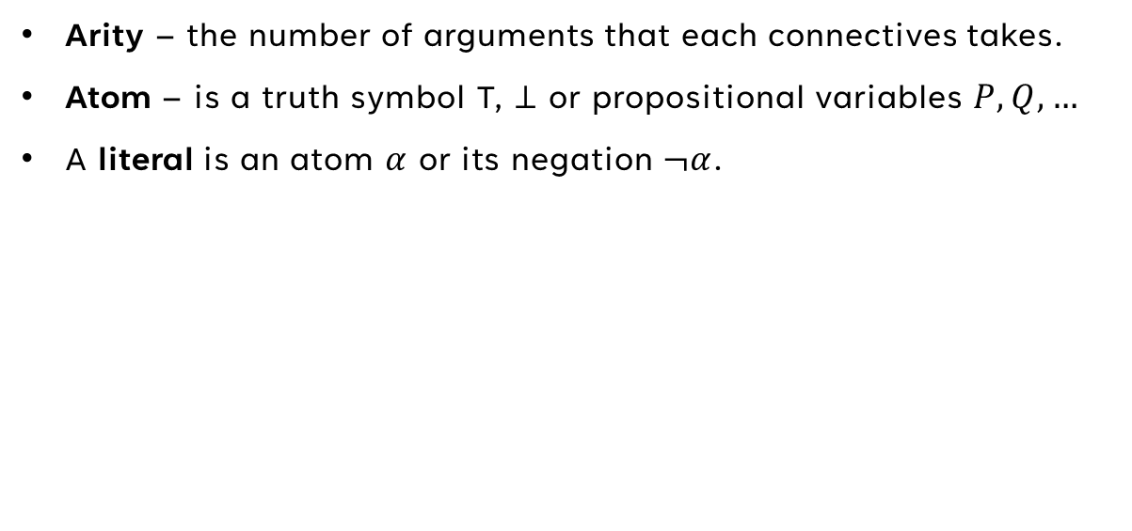
Definitions
  Arity – the number of arguments that each connectives takes.
  Atom – is a truth symbol T, $⊥$ or propositional variables $P,Q, …$
  A literal is an atom $α$ or its negation $¬α$.

Slide 14

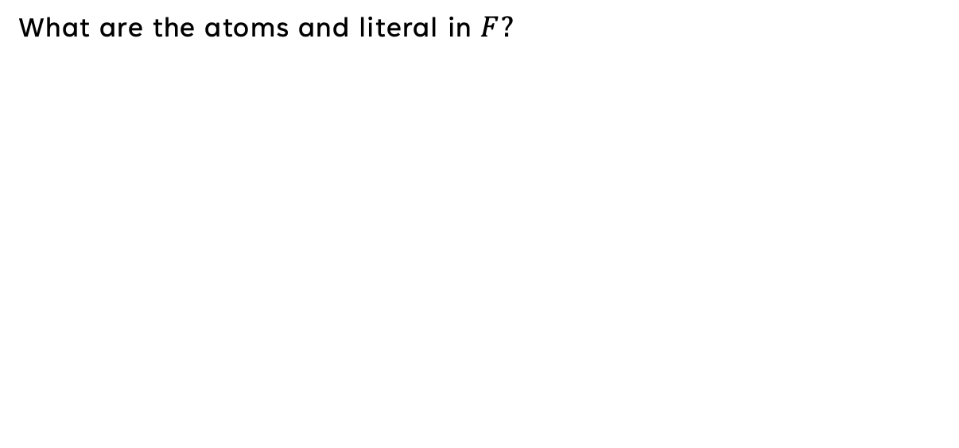
Examples
  What are the atoms and literal in $F?$

Slide 15
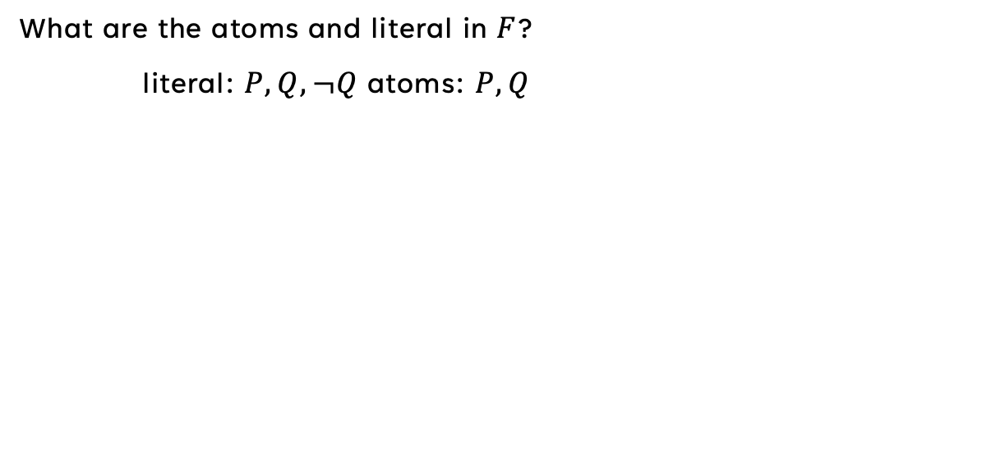
Examples
  What are the atoms and literal in $F$?
    literal: $P,Q,¬Q$ atoms: $P,Q$

Slide 16
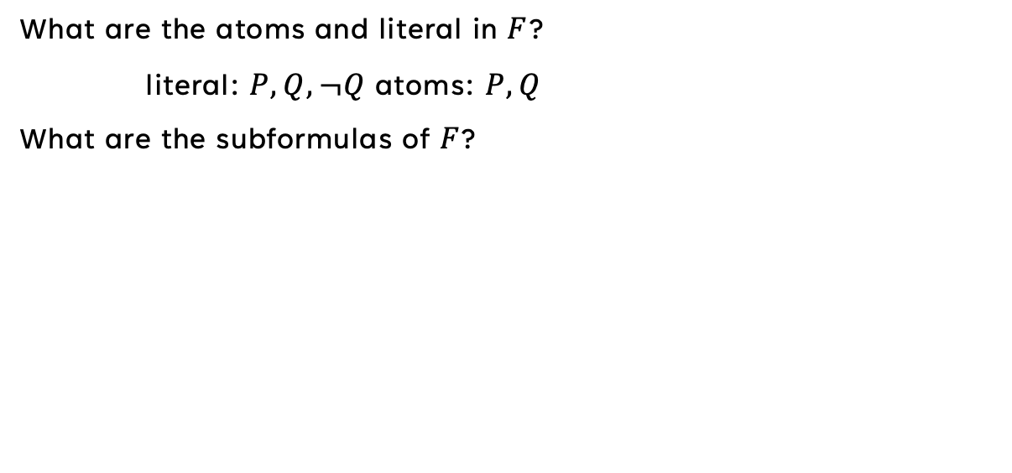
Examples
  What are the atoms and literal in $F$?
    literal: $P,Q,¬Q$ atoms: $P,Q$
  What are the subformulas of $F$?

Slide 17
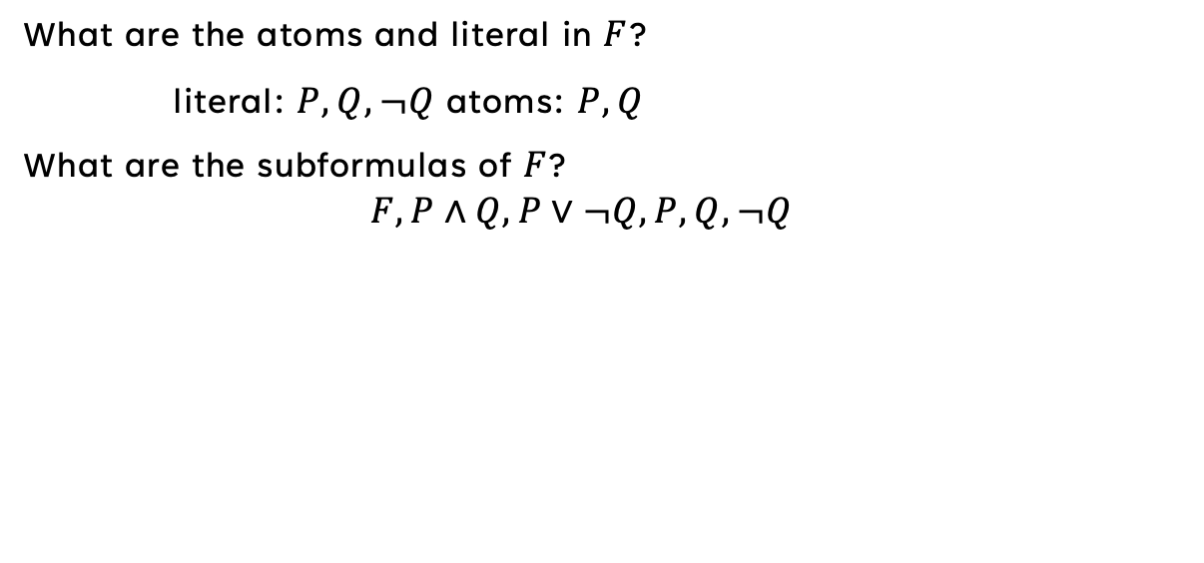
Examples
  What are the atoms and literal in $F$?
    literal: $P,Q,¬Q$ atoms: $P,Q$
  What are the subformulas of $F$?
    $$F, P∧Q,P∨¬Q, P, Q,¬Q$$

Slide 18
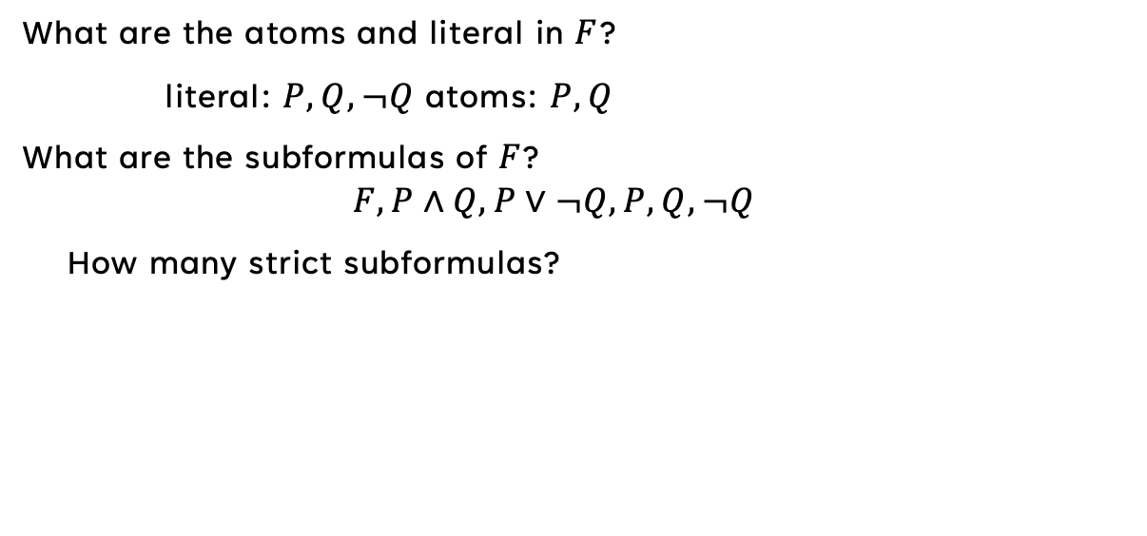
Examples
  What are the atoms and literal in $F$?
    literal: $P,Q,¬Q$ atoms: $P,Q$
  What are the subformulas of $F$?
    $$F, P∧Q,P∨¬Q, P, Q,¬Q$$
    How many strict subformulas?

Slide 19
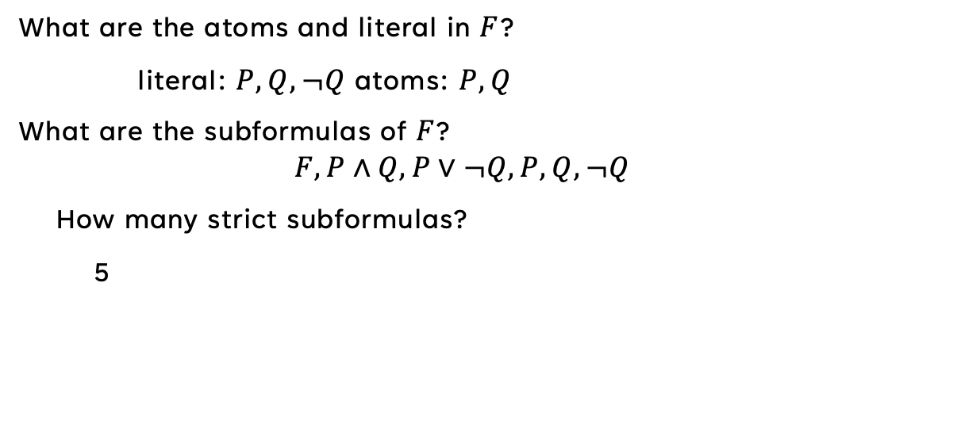
Examples
  What are the atoms and literal in $F$?
    literal: $P,Q,¬Q$ atoms: $P,Q$
  What are the subformulas of $F$?
    $$F, P∧Q,P∨¬Q, P, Q,¬Q$$
    How many strict subformulas?
      5

Slide 20
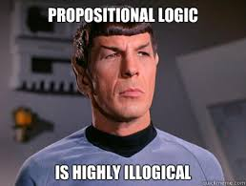
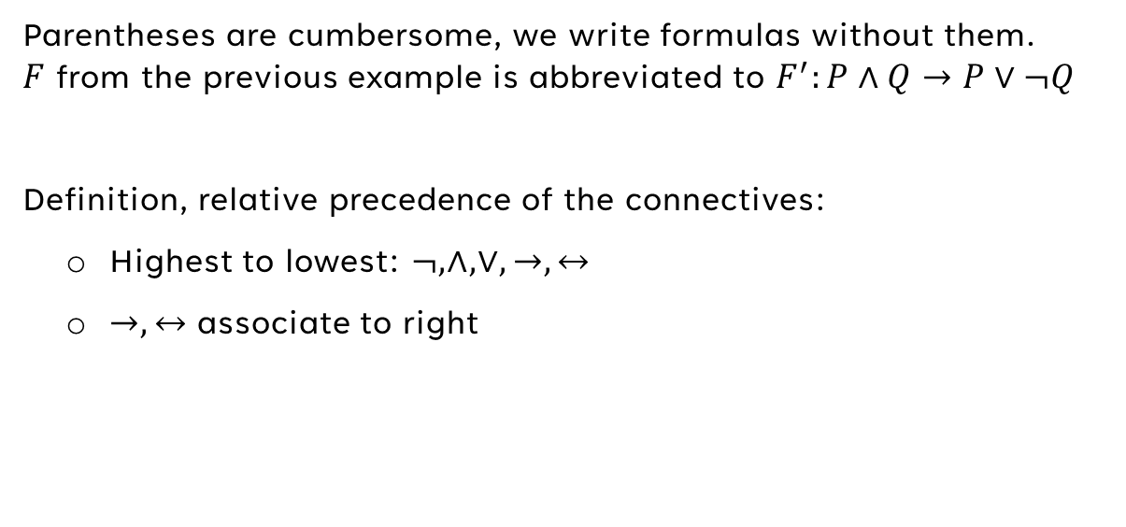
Note – abbreviation of Formulas
  Parentheses are cumbersome, we write formulas without them.
  $F$ from the previous example is abbreviated to $F^{′}:P∧Q→P∨¬Q$
  Definition, relative precedence of the connectives:
    Highest to lowest: $¬,∧,∨,→,↔$
    $→,↔$ associate to right

Slide 21
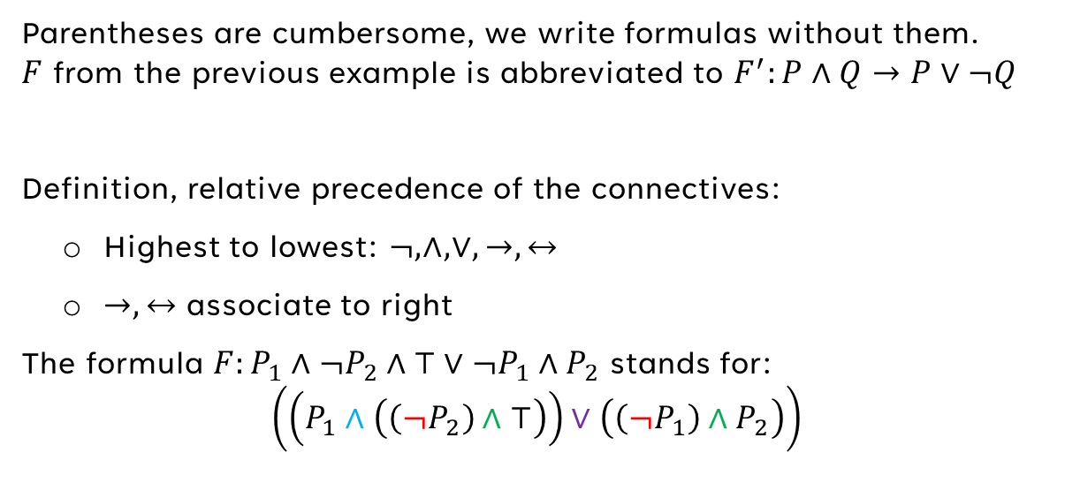
Note – abbreviation of Formulas
  Parentheses are cumbersome, we write formulas without them.
  $F$ from the previous example is abbreviated to $F^{′}:P∧Q→P∨¬Q$
  Definition, relative precedence of the connectives:
    Highest to lowest: $¬,∧,∨,→,↔$
    $→,↔$ associate to right
  The formula $F:P_{1}∧¬P_{2}∧⊤∨¬P_{1}∧P_{2}$ stands for:
  $$\left(\left(P_{1}∧\left(\left(¬P_{2}\right)∧⊤\right)\right)∨\left(\left(¬P_{1}\right)∧P_{2}\right)\right)$$

Slide 22
Semantics Of PL
Notes:
So far, we have considered the syntax of PL. The semantics of a logic provides its meaning. What exactly is meaning? [make a joke in real life, which we know it is 42. Then in PL] In PL, meaning is given by the truth value, true and false (which are ≠), So our objective is to define how, given a formula, we give it a meaning.

Slide 23
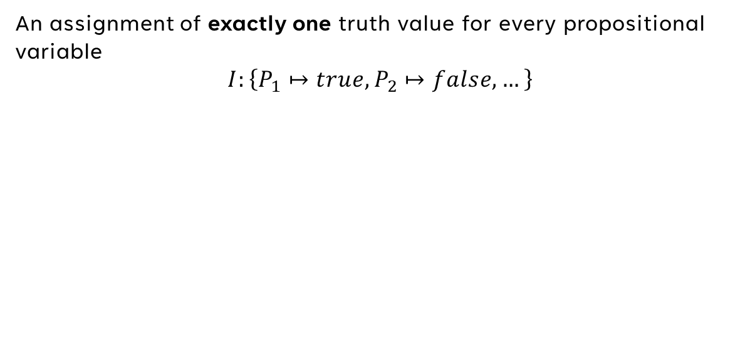
Interpretation
An assignment of exactly one truth value for every propositional variable
$$I:\left\{P_{1}↦true,P_{2}↦false,…\right\}$$
Notes:
In PL we are using propositional variables. The truth value of a formula is determined by the values of its propositonal variable. e.g if we will take the formula x & y – different values to the p.v here will change the entire meaning.
You can look at I as a function that receives a variable and returns its truth value.

Slide 24
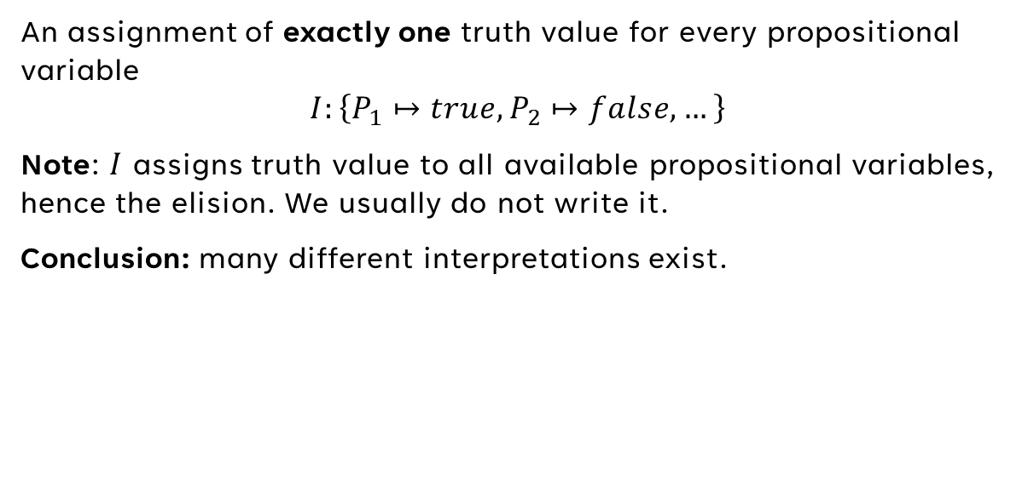
Interpretation
An assignment of exactly one truth value for every propositional variable
$$I:\left\{P_{1}↦true,P_{2}↦false,…\right\}$$
Note: $I$ assigns truth value to all available propositional variables, hence the elision. We usually do not write it.
Conclusion: many different interpretations exist.
Notes:
In PL we are using propositional variables. The truth value of a formula is determined by the values of its propositonal variable. e.g if we will take the formula x & y – different values to the p.v here will change the entire meaning.
You can look at I as a function that receives a variable and returns its truth value.

Slide 25
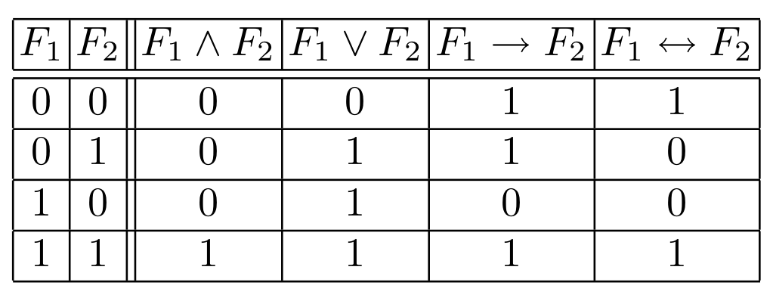
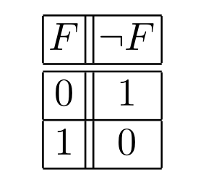
Interpretation – Brief reminder
Note: $F_{1}→F_{2}$ is false iff $F_{1}↦⊤∧F_{2}↦⊥$
Notes:
Given a PL formula and interpretation I, we can compute the truth value of the formula. The simplest manner of computing the truth valure of F is with a truth table.Before we jump into the how to, a brief reminder. Since we use logical connectivies to define our formulas we first need to understand how, given turth values ,they are evaluated. [assume that I asisigned truth values to the v.p of F and now you need to evalute neg and continue.
You can look at the truth tables as function [click to next slide]

Slide 26
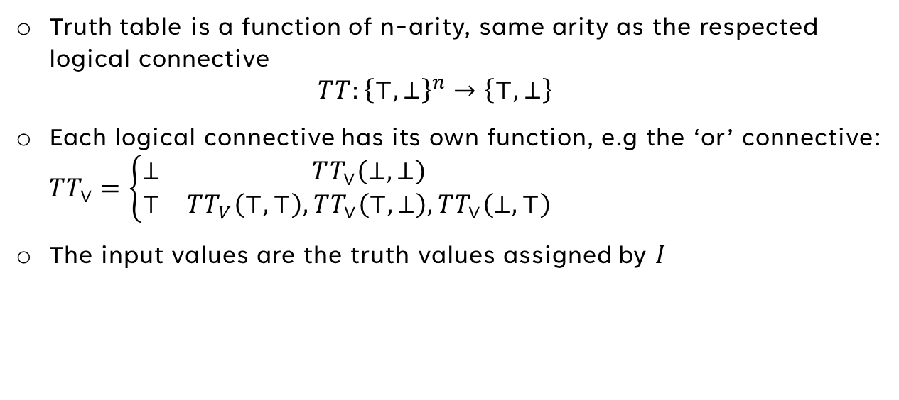
Interpretation – brief reminder
Truth table is a function of n-arity, same arity as the respected logical connective
$TT:{\left\{⊤,⊥\right\}}^{n}→\left\{⊤,⊥\right\}$
Each logical connective has its own function, e.g the ‘or’ connective:
$TT_{∨}=\left\{\begin{matrix}⊥ & TT_{∨}\left(⊥,⊥\right) \\ ⊤ & TT_{V}\left(⊤,⊤\right),TT_{∨}\left(⊤,⊥\right),TT_{∨}\left(⊥,⊤\right)\end{matrix}\right.$
The input values are the truth values assigned by $I$
Notes:
Just explain the stuff breifly

Slide 27
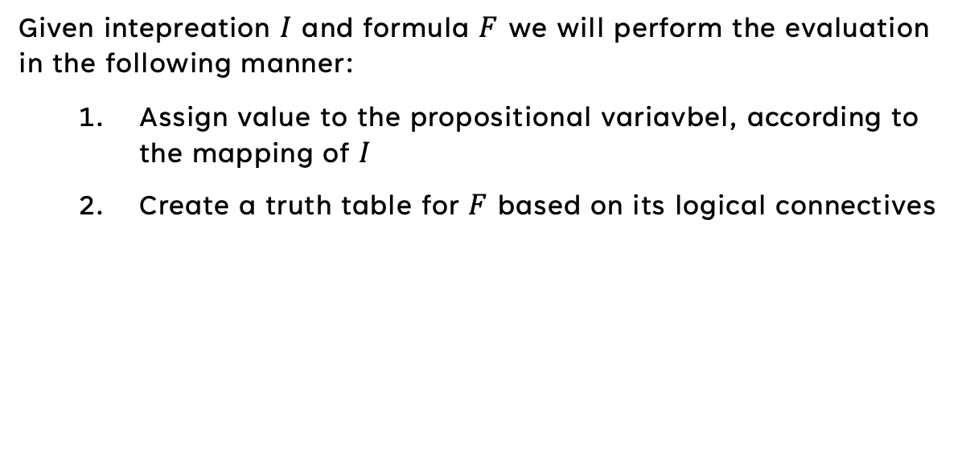
Semantics - truth table evaluation
Given intepreation $I$ and formula $F$ we will perform the evaluation in the following manner:
  Assign value to the propositional variavbel, according to the mapping of $I$
  Create a truth table for $F$ based on its logical connectives

Slide 28
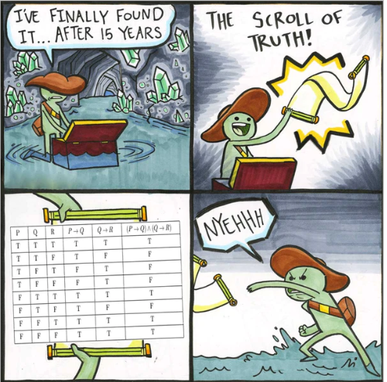

Slide 29
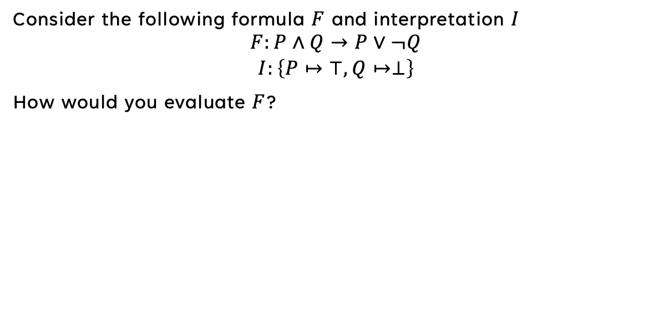
Semantics – Truth tables
EXAMPLe
Consider the following formula $F$ and interpretation $I$
$$\begin{matrix}F:P∧Q→P∨¬Q \\ I:\left\{P↦⊤,Q↦⊥\right\}\end{matrix}$$
How would you evaluate $F$?
Notes:
Simplest manner for computing the truth value of a formula is by using truth tables
Add the end of the proof – did you notice we did not write the elision … of I? and still it is countably infinite.
How would you use the truth table to evaluate F? Do we need all the rows of the table? Will we evalueate each connective? Enage with students.

Slide 30
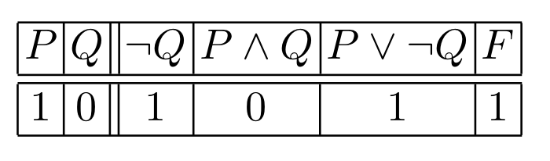
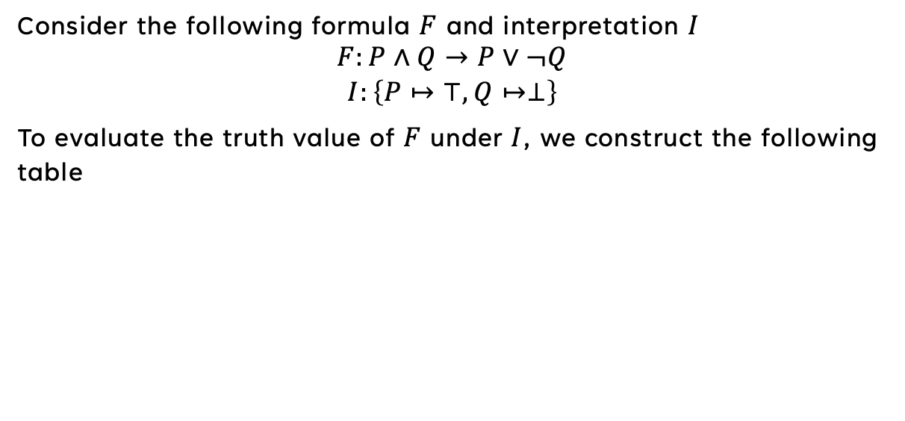
EXAMPLe
Consider the following formula $F$ and interpretation $I$
$$\begin{matrix}F:P∧Q→P∨¬Q \\ I:\left\{P↦⊤,Q↦⊥\right\}\end{matrix}$$
To evaluate the truth value of $F$ under $I$, we construct the following table
Notes:
Note that the table takes into consideration the precedence of the logical connectives. Each column is basically inserting the truth assignment of the variables to the truth value function. Note that we only entered the strict sub formulas as columns in the table, the value of F is determine by the truth function of \to connective

Slide 31
Semantics – truth table
Is truth table a efficient method to evalute formulas in PL?

Slide 32
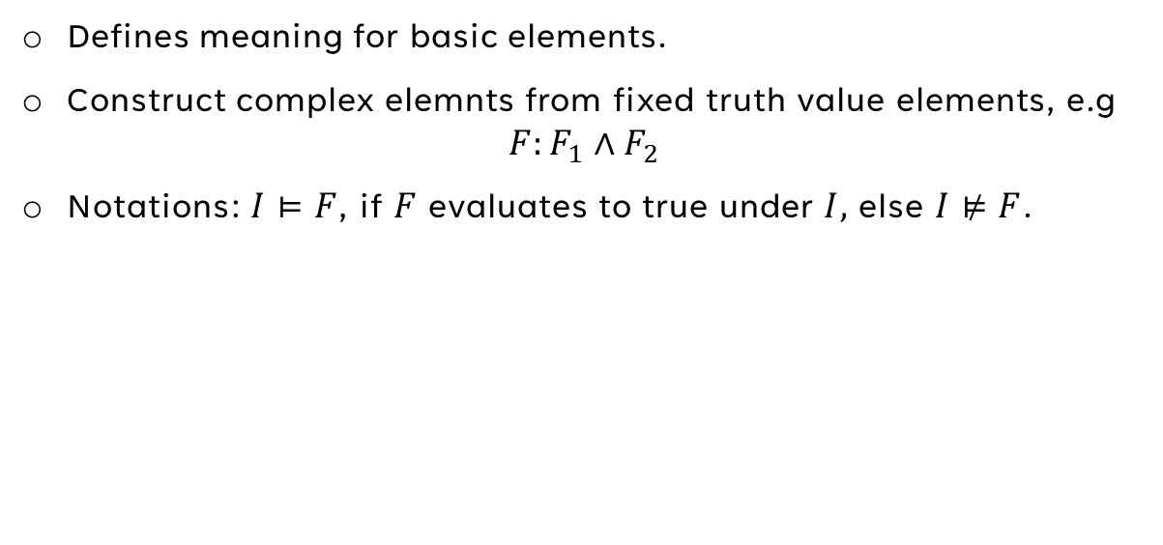
SEMAntics – Inductive DEFINITION
Defines meaning for basic elements.
Construct complex elemnts from fixed truth value elements, e.g
$F:F_{1}∧F_{2}$
Notations: $I⊨F$, if $F$ evaluates to true under $I,$ else $I⊭F$.
Notes:
An inductive definition defiens the meaning of basic elements first, in our case atoms. The nit assumes that the meaning of a set of elements is fixed and defines a more complext elemtn in terms of these elements. Example: F is more complex than F1 or F2

Slide 33
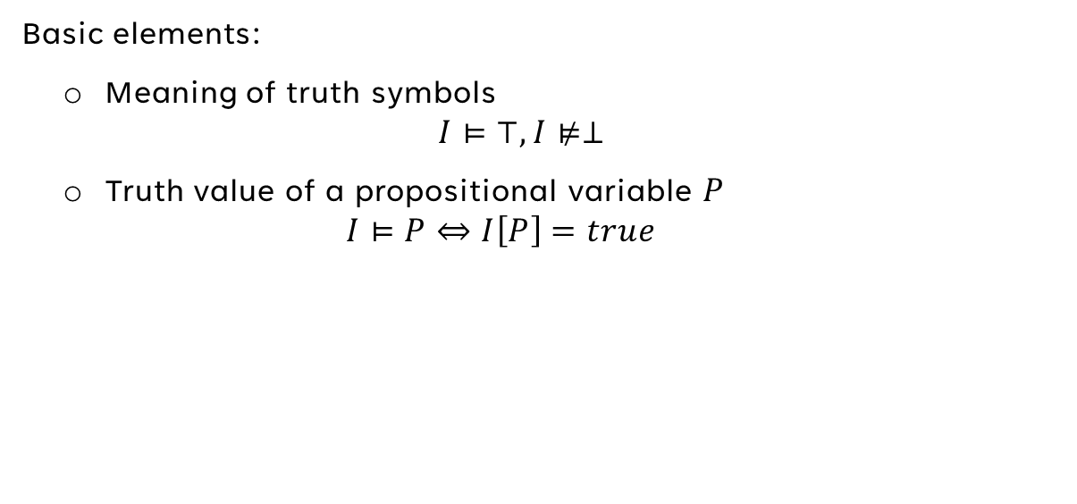
SEMAntics – Inductive DEFINITION
Basic elements:
  Meaning of truth symbols
  $$I⊨⊤,I⊭⊥$$
  Truth value of a propositional variable $P$
    $$I⊨P⇔I\left[P\right]=true$$
Notes:
Under any interpretations the truth symbol and false symbol must be assigned true and false values, respectivley.
The next basic element is a propositional variable. P has value true iff is is assigned this value by the interpretation. Since interpretation assign a truth value to each v..p than we can say that when P is not asisgned true by I it is assigned false, thus we can instead define the truth values of v.p as I doesnot evaluete P iff P is assigned false by I. Note that since true≠false, both definitions yield the same (and unique) truth values.

Slide 34
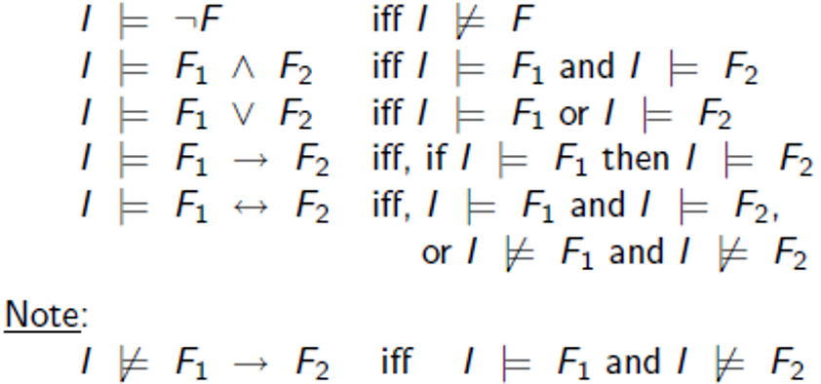
SEMAntics – Inductive DEFINITION
Inductive step:

Slide 35
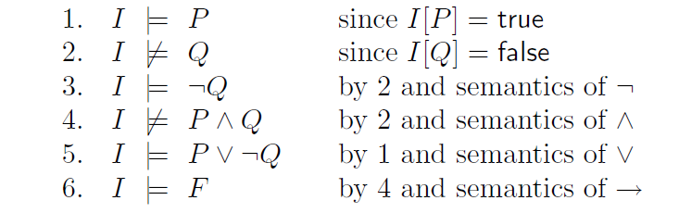
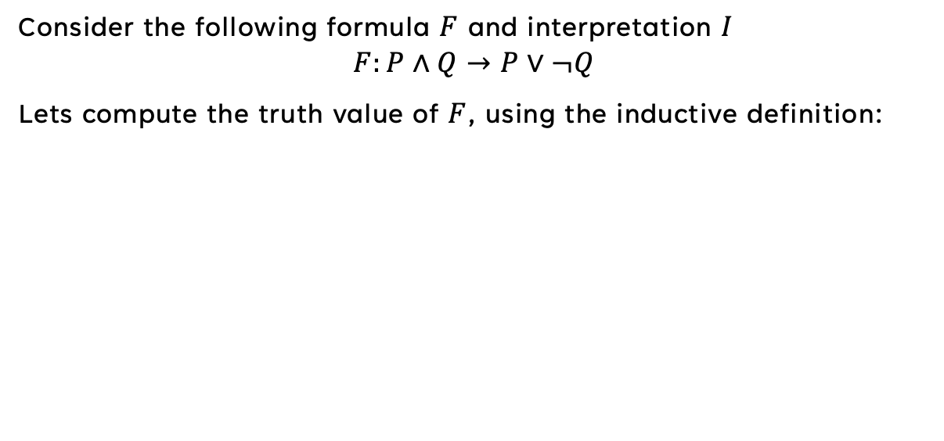
EXAMPLE
Consider the following formula $F$ and interpretation $I$
$$F:P∧Q→P∨¬Q$$
Lets compute the truth value of $F$, using the inductive definition:
Notes:
Note that we first start from assigning the values to the variables as per the interpretation and then moving on according to the precednce we introduced earlier and we priorotize the strict subformulas first. [click to next slide]

Slide 36
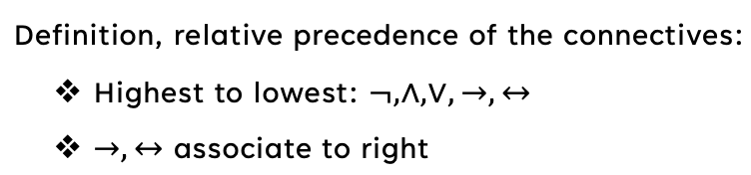
EXAMPLE
Consider the following formula $F$ and interpretation $I$
$$F:P∧Q→P∨¬Q$$
Lets compute the truth value of $F$, using the inductive definition:
Notes:
[Just go through the stages, have in hand the inductive steps so you can reference them]

Slide 37
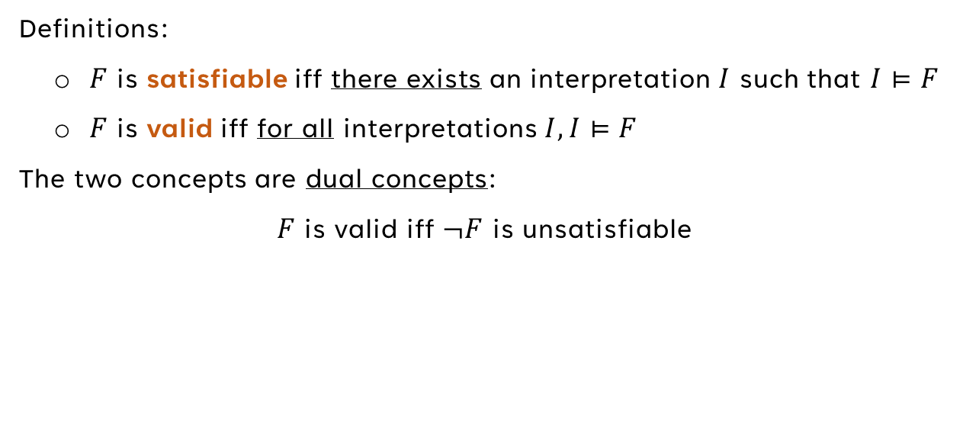
Satisfiability and validity
Definitions:
  $F$ is satisfiable iff there exists an interpretation $I$ such that $I⊨F$
  $F$ is valid iff for all interpretations $I,I⊨F$
The two concepts are dual concepts:
$F$ is valid iff $¬F$ is unsatisfiable
Notes:
One of the most important tasks that we have in logic. A fundemntal characterazation of a PL formula.
[present definitions]
The meaning of duality is that switching from one to the other is easy!

Slide 38
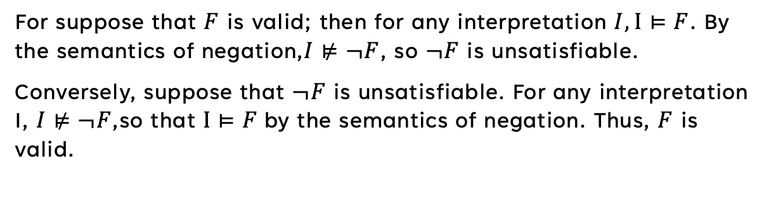
PROOF
For suppose that $F$ is valid; then for any interpretation $I,I⊨F$. By the semantics of negation,$I⊭¬F$, so $¬F$ is unsatisfiable.
Conversely, suppose that $¬F$ is unsatisfiable. For any interpretation I, $I⊭¬F$,so that $I⊨F$by the semantics of negation. Thus, $F$ is valid.
Notes:
Because of this duality, we can focus on either of the concepts, depending which one is more convient for the discussion. Now we will present methods to determine the validity and satisfiability of a PL formula

Slide 39
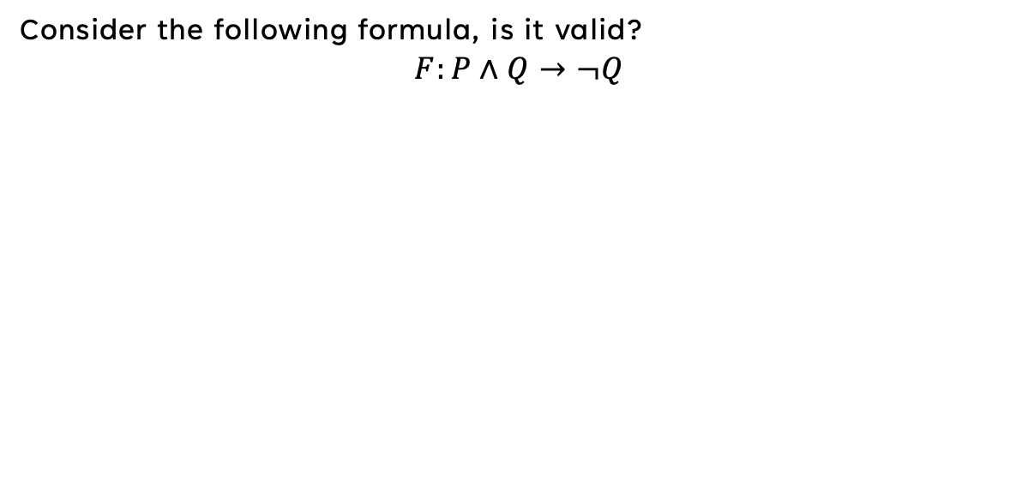
Validity check: Truth Table
Consider the following formula, is it valid?
$$F:P∧Q→¬Q$$
Notes:
Note that we need that all interpretation to evalutate F as true. we are only intetrsted in all the different posible interpretaions for the value of P and Q: we will construct a truth table that will represent all those interpretations.

Slide 40
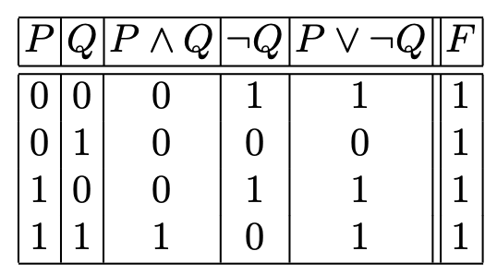
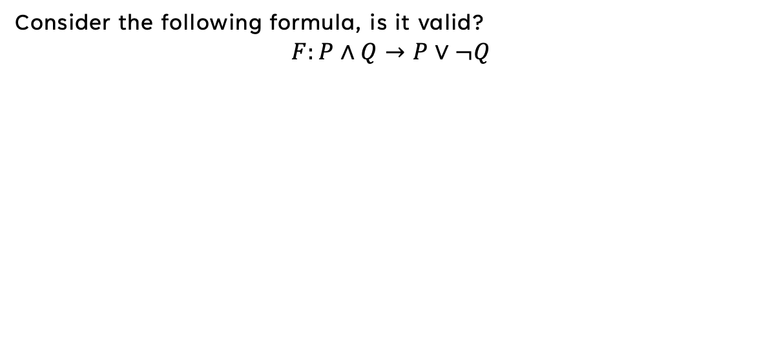
Validity check: Truth Table
Consider the following formula, is it valid?
$$F:P∧Q→P∨¬Q$$
Notes:
We can see that we have a total of 4 different truth value assignment for P and Q hence the 4 rows, remember we need to order the columns according to the pl variables and the order of strict subform and precendnce.
We can see that final column is the truth value of F under each possible interpretation – in our case F is Valid! [click to next presentation]

Slide 41
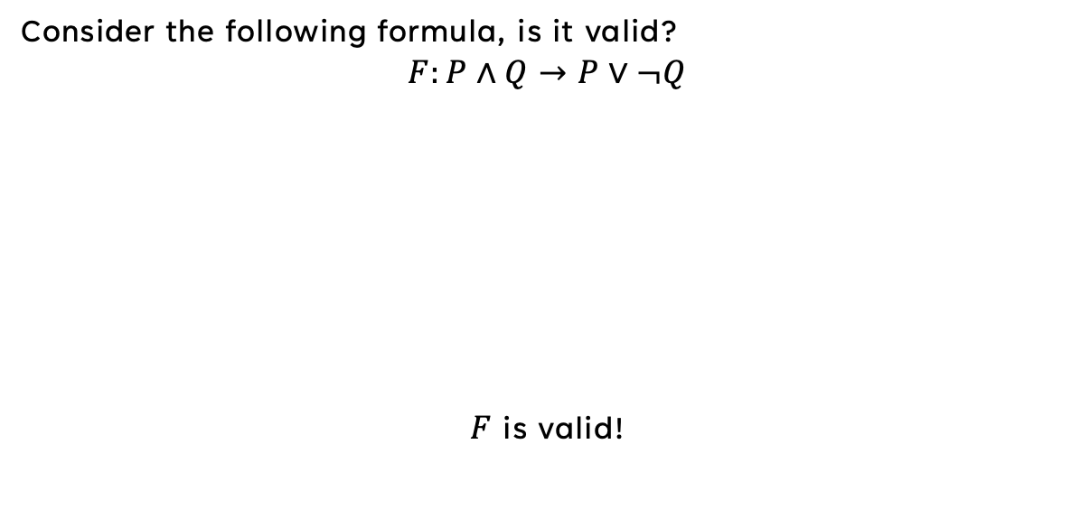
Validity check: Truth Table
Consider the following formula, is it valid?
$$F:P∧Q→P∨¬Q$$
$F$ is valid!
Notes:
[click to next slide

Slide 42
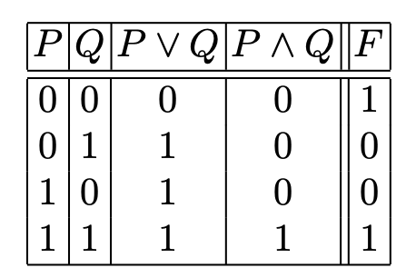
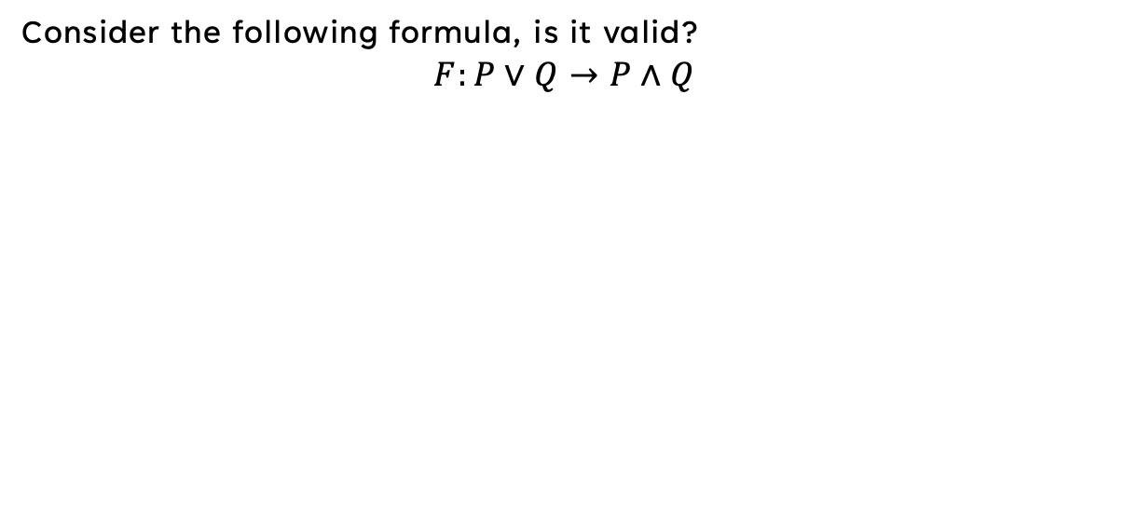
Validity check: Truth Table
Consider the following formula, is it valid?
$$F:P∨Q→P∧Q$$
Notes:
Just go again, note that second and third rows show that F can be false [click]

Slide 43
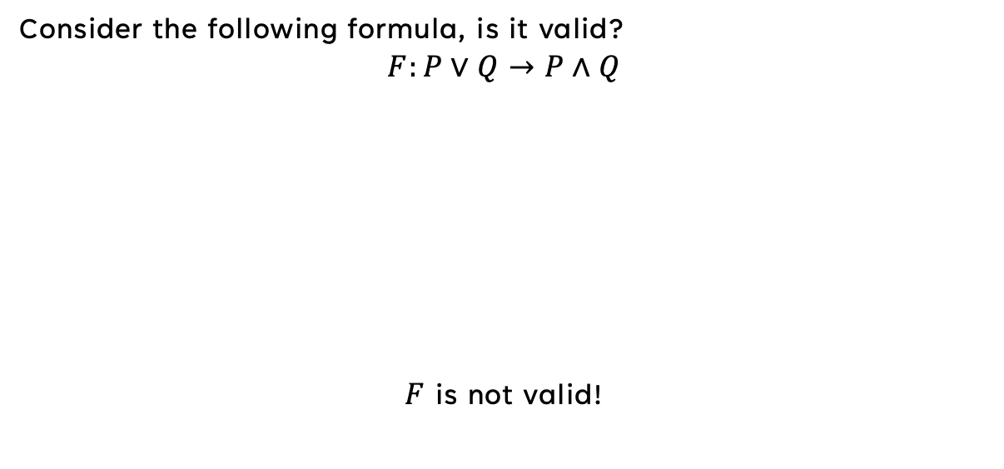
Validity check: Truth Table
Consider the following formula, is it valid?
$$F:P∨Q→P∧Q$$
$F$ is not valid!
Notes:
Just go again, yet it is satisifiable

Slide 44
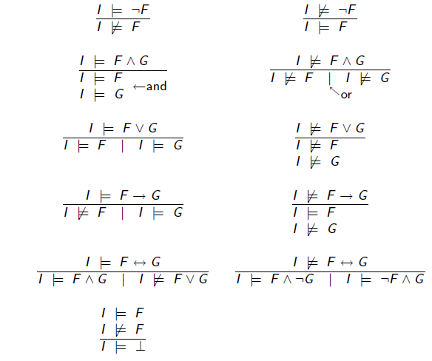
Validity Check: Semantics arguments
Notes:
Note: you can see that the proofs evolve as trees rather than linearity, since we have the or and multiple deductions.

Slide 45
Validity Check: Semantics arguments
Proof rules, each has at least one premise and at least one deduction. In order to invoke/apply a rule, all premises must be matched.
A proof begins with assuming the given formula is invalid
A proof ends when no more rules are applicable or when we reached a contradiction.
Notes:
It is a more complicated method than truth tables, we introduce it here since it is our only method of evaluating the satisfy and valid of the formulas in next type of logic we will see soon. The idea is not strange or new to us. During our studies we have encounter and used proof systems based on rules and this is no exception. Say by heart

Slide 46
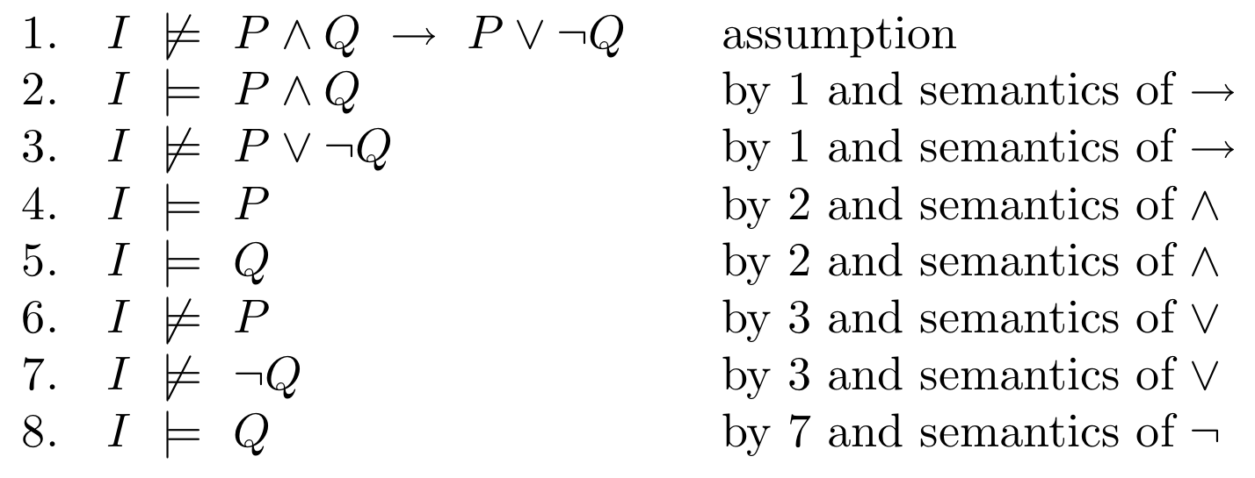
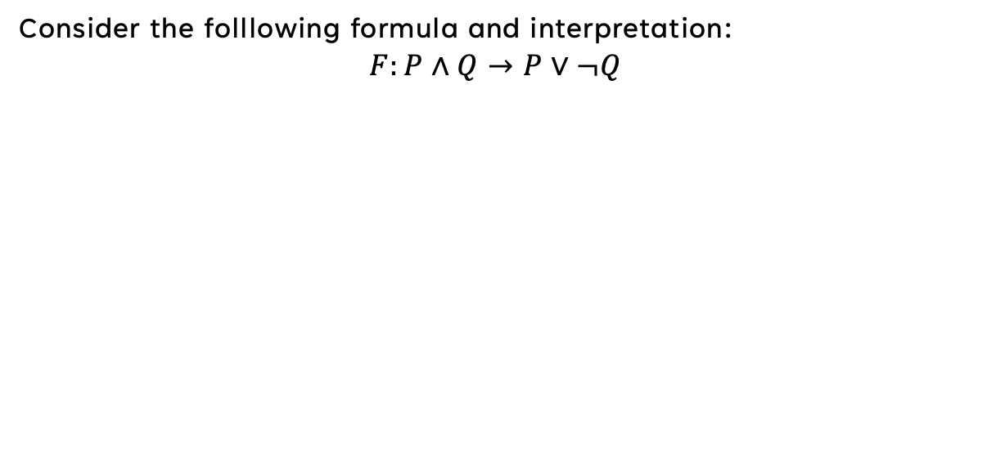
Example – semantics argumetns
Consider the folllowing formula and interpretation:
$$F:P∧Q→P∨¬Q$$

Slide 47
Example – semantics argumetns
Consider the folllowing formula and interpretation:
$$F:P∧Q→P∨¬Q$$

Slide 48
Example – semantics argumetns
Consider the folllowing formula and interpretation:
$$F:P∧Q→P∨¬Q$$
Notes:
Line 4 and 6 contracdit each other, so our assumption must be wrong: F is actually valid.
Note: So we can end the proof as soon as we see the contradiction, so our proof becomes [click]

Slide 49
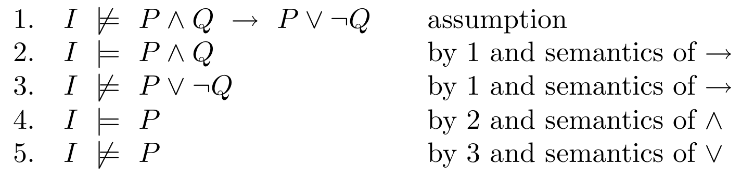
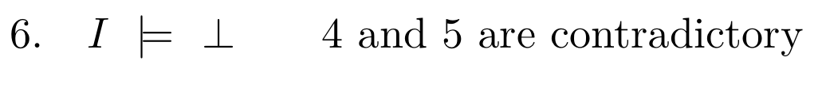
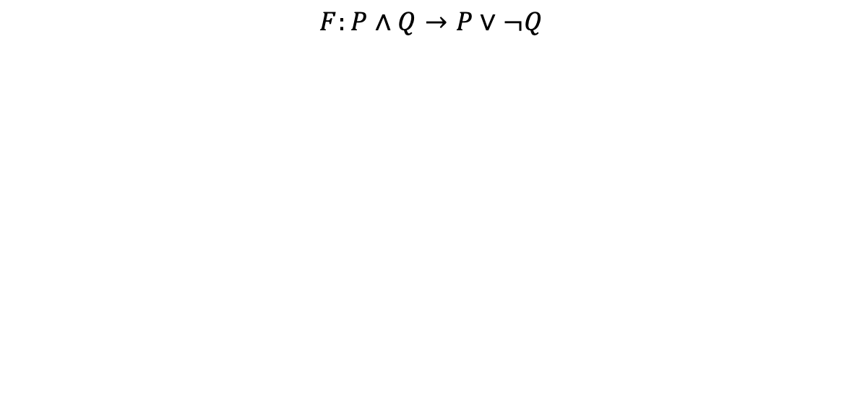
Example – semantics argumetns
$$F:P∧Q→P∨¬Q$$
Notes:
Note: sometimes we note the contradiction explicitly in the proof, as shown in line 6 of the proof.

Slide 50
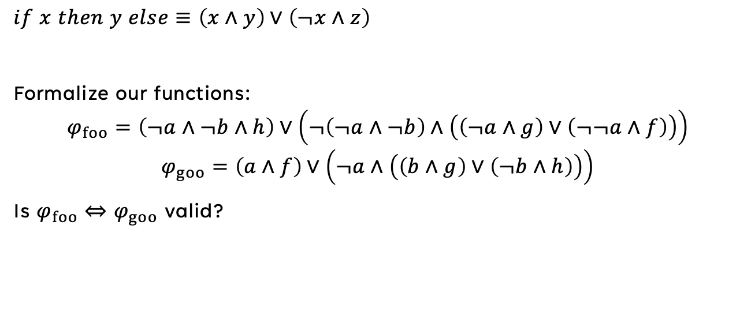
Back to the first example
$$if x then y else≡\left(x∧y\right)∨\left(¬x∧z\right)$$
Formalize our functions:
$$φ_{foo}=\left(¬a∧¬b∧h\right)∨\left(¬\left(¬a∧¬b\right)∧\left(\left(¬a∧g\right)∨\left(¬¬a∧f\right)\right)\right)$$
$$φ_{goo}=\left(a∧f\right)∨\left(¬a∧\left(\left(b∧g\right)∨\left(¬b∧h\right)\right)\right)$$
Is $φ_{foo}⇔φ_{goo}$ valid?

Slide 51
PL – A NP-Complete problem?
Deciding satisfiability of propositional logic formulas is an NP-complete problem
However, practical methods exists (e.g DPLL algorithm, 1962; Chaff algorithm, 2001) that are fast for many useful cases.

Slide 52
FOL
First order
Logic
Chapters: 2.1 – 2.3
Syntax
Semantics
Satisfiability and Validity
Notes:
So far we introducted PL, now we will present an extenstion of PL called first order logic, if pl is called propositional logic – fol is called predicate calculus.
The fol extends pl introducing predicates, function and constasts. We will introdcuce the new syntax and semantics mechanism. We will build on the semantic system of PL of semntics arguments to provide a mtehod of proving FOL validtty

Slide 53
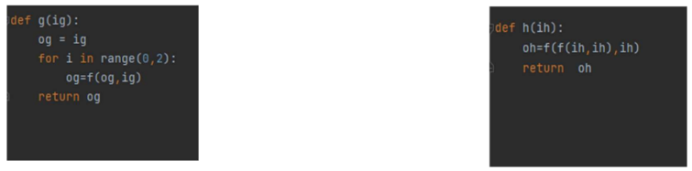

Slide 54
Syntax Of FOL
Notes:
While all formulas of PL are evaluated to a truth table (true or false), FOL is not so simple.
First we will introduces a new syntax. As in PL, the syntax of FOL is indpenent of its meaning.
We will start from the most basic elemnts in FOL syntax

Slide 55
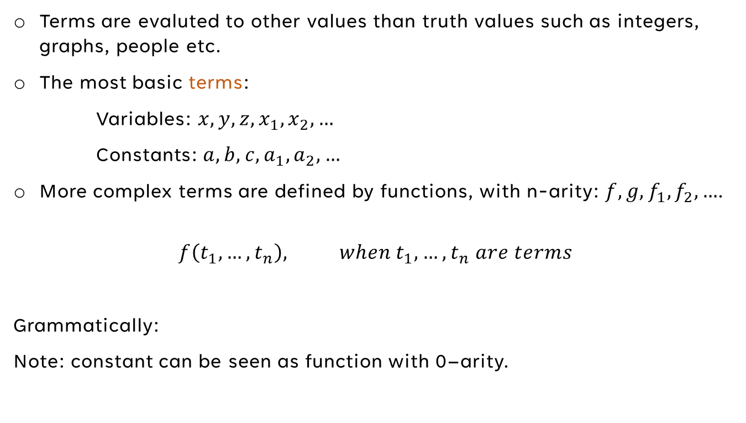
TERMS
Terms are evaluted to other values than truth values such as integers, graphs, people etc.
The most basic terms:
  Variables: $x,y,z,x_{1},x_{2},…$
  Constants: $a,b,c,a_{1},a_{2},…$
More complex terms are defined by functions, with n-arity: $f,g,f_{1},f_{2},…$.
$$f\left(t_{1},…,t_{n}\right), when t_{1},…,t_{n} are terms$$
Grammatically:
Note: constant can be seen as function with 0–arity.

Slide 56
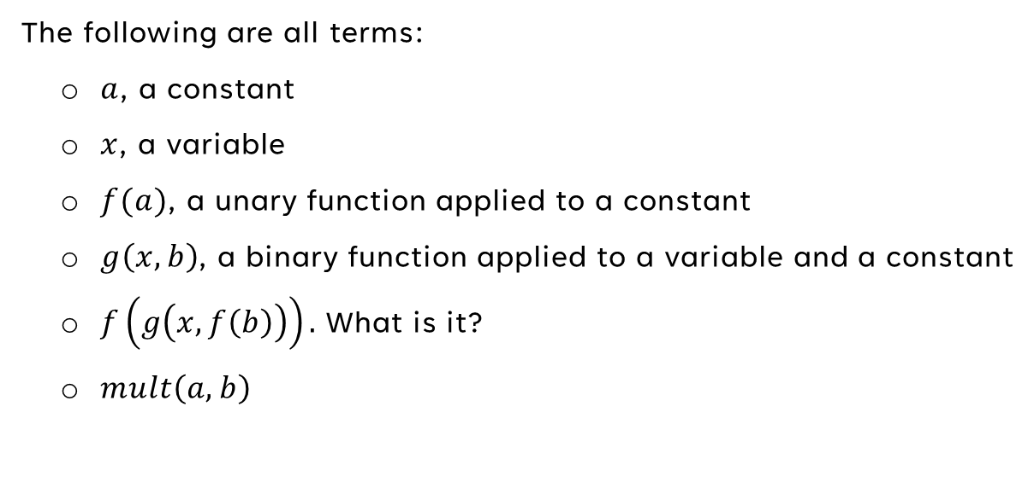
TERMS - EXAMPLES
  The following are all terms:
    $a$, a constant
    $x$, a variable
    $f(a)$, a unary function applied to a constant
    $g\left(x,b\right)$, a binary function applied to a variable and a constant
    $f\left(g\left(x,f\left(b\right)\right)\right).$ What is it?
    $mult\left(a,b\right)$

Slide 57

Syntax – predicates
All propositional variables are generlized to predicates.
$$p,q,r$$
A FOL propositional variables is a 0-ary predicate, which we write
$$P,Q,R$$
$$p\left(t_{1},…,t_{n}\right)$$
where $t_{1},…,t_{n}$ are terms
Countably infinitely many constant, function, and predicate symbols are available.
Notes:
The variables of FOL mentioned before are 0-arity preicates

Slide 58


Syntax – predicates – Example
Example:
$prime\left(a\right): prime\left(3\right), prime(6)$
$cute\left(a\right): cute\left(cat\right), cute(spider)$
Notes:
The variables of FOL mentioned before are 0-arity preicates

Slide 59

Syntax – predicates, atoms and literals
An atom is $⊤,⊥$ or an n-arry predicate applied to $n$ terms
A literal is an atom or its negation
Notes:
The variables of FOL mentioned before are 0-arity preicates

Slide 60

EXAMPLES
The following are all literals:
  $P$, a propositional variable (or –arity predicate)
  $p\left(f\left(x\right),g\left(x,f\left(x\right)\right)\right)$, a binary predicate applied to two terms
  $¬p\left(f\left(x\right),g\left(x,f\left(x\right)\right)\right)$, negation
Notes:
Note: the two first literals are also atoms.

Slide 61
FormulaS
FOL formulas is
a literal,
the application of a logical connective to the formula,
or the application of a quantifier to the formula
Notes:
Some words about scope and an example

Slide 62

QUANTIFIERS
There are two FOL quantifiers
  the existential quantifier $∃x.F[x]$ i.e “there exists an $x$ such that $F\left[x\right]$”
  the universal quantifier $∀x.F\left[x\right]$ i.e “for all $x,F\left[x\right]$”
Notes:
Some words about scope and an example

Slide 63


FREE and bound variables
Given a formula $F$ and variable $x$
  $x$ is bound if it has an occurance in a scope of a quantifier
  $x$ is free if it has no occurance in a scope of a quantifier
$$∀x. x+y=x∧y=0$$
$free(F)$ and $bound\left(F\right)$ denotes the set of free and bounded variables in the formula, respectevly.
Note: it can be that $free\left(F\right)∩bound\left(F\right)≠∅$
A formula is closed if it does not contain any free variables.
Notes:
We mentined a scope of a quantefier and its bounding of

Slide 64

EXAMPLE
Notes:
The scope of x is F and the scope of y is G. This formula reads: “for all x, if p(f(x),x) then there exists a y such that p(f(g(X,y)),g(x,y)) an q(x,f(x))

Slide 65


EXAMPLES
Cosider the following formula, $F$:
What are the free and bound variables?
Is $free\left(F\right)∩bound\left(F\right)=∅$?
Notes:
X only occurs bound, whily y appeas both free and

Slide 66

EXAMPLES
Cosider the following formula, $F$:
What are the free and bound variables?
$$free\left(F\right)=\left\{y\right\}, bound=\{x,y\}$$
Is $free\left(F\right)∩bound\left(F\right)=∅$? No
Notes:
X only occurs bound, whily y appeas both free and

Slide 67

Note
$∀x∀y. F$ we will write as $∀x,y.F$
Notes:
X only occurs bound, whily y appeas both free and

Slide 68

Definition
If $free\left(F\right)=\left\{x_{1},…,x_{n}\right\}$, then its universal closure is
$$∀x_{1.}…∀x_{n}.F$$
and its existential closure is
$$∃x_{1}.…∃x_{n}.F$$
We usually write the universal and existential closures as $∀∗.F$ and $∃∗.F$
Notes:
X only occurs bound, whily y appeas both free and

Slide 69

subformulas
The subforumlae of a FOL formula are defined according to an extension of the PL definition of a subformula:
  the only subformula of $p\left(t_{1},…,t_{n}\right)$, where the terms are $t_{i}$, is $p\left(t_{1},…,t_{n}\right)$
  the subformulae of $¬F$ are $¬F$ and the subformulae $F$
  The subformulae of $F_{1}∧F_{2},F_{1}∨F_{2},F_{1}→F_{2},F_{1}↔F_{2}$ are the formula itself and the subformulae of $F_{1}$ and $F_{2}$
  The subformulae of $∃x.F$ and $∀x.F$ are the formulae itself and the subformulae of $F$
The strict subformulae of a formula excludes the formula itself.

Slide 70

subterms
The subterm of a constant or a variable is the constant or the variable itself, respectevly.
The subterms of $f\left(t_{1},t_{2},…,t_{n}\right)$ are the term itself and the subterms of $t_{1},…,t_{n}$
A strict subterm of a term excludes the term itself
Notes:
We have introduced a new building block in the syntax called terms, we want to define its subterms for later use.

Slide 71

EXAMPLE
Given following formula:
What are the subformulas?
Notes:
[click to next slide]

Slide 72
EXAMPLE
Given following formula:
What are the subformulas?
Notes:
[click to next slide]

Slide 73
EXAMPLE
Given following formula:
What are the subformulas?
What are the strict subfomulas?
Notes:
[click to next slide]

Slide 74
EXAMPLE
Given following formula:
What are the subformulas?
What are the strict subfomulas?
Notes:
[click to next silde]

Slide 75
EXAMPLE
?
Notes:
[click to the next slide]

Slide 76
EXAMPLE
?
Subterms:
Notes:
[click to the next slide]

Slide 77
EXAMPLEs
Some dogs have more days than others?

Slide 78
EXAMPLEs
Some dogs have more days than others?

Slide 79
EXAMPLEs
Some dogs have more days than others?
All cats have more days than dogs.

Slide 80
EXAMPLEs
Some dogs have more days than others?
All cats have more days than dogs.

Slide 81

EXAMPLEs

Slide 82
Semantics
Of FOL
Notes:
We mentioned before that , while PL evalutes to a truth table, a FOL formula and terms are evaluated to a different, changing value. Here we will extend the mechanism of the interpretation to fit a more complex setting and then define the semantics of FOL in terms on interpretaitons

Slide 83

DOMAin
For intepretation $I$, the domain $D_{I}$ is a nonempty set of values or objects. $\left|D_{I}\right|$ denotes the cardinality/size of the domain.
Examples:
  Days of the week
  Integers $ℤ$ and Reals $ℝ$
  Set of shapes
Notes:
Since a fomrula in FOL gets different meaning for different settings we would like to formilze what a setting. A domain of an interpretaion I is a noneempty set of values or objects.
The domain can be integers or a deck of cards or even an abstract object. The set domain can be finite or countably finite, or even infinite (e.g the reals/real numbers).
Note: although we can have a infinite size domain, such as described below the interpretation can be finitie – since it depends on the elements in formula!
About the domain ’set of shapes’:
This domain could encompass various geometric shapes like squares, circles, triangles, etc. While we might draw shapes in the real world, the concept of a perfect circle as an abstract ideal form is what resides in the domain.

Slide 84


Assignment - $α_{I}$
A mapping between the constants, function and predicate symbols to elements, functions and predicates over the domain.
A mapping variables to elements of $D_{I}$:
  Each variable symbol $x$ is assigned a value $x_{I}∈D_{I}$
  Each n-ary function symbol $f$ is assigned an n-ary function
  $f_{I}:D^{n}→D_{I}$
  Each n-ary predicate symbol $p$ is assigned an n-ary predicate
  $p_{I}:D^{n}→\left\{T, ⊥\right\}$
  In particular, each constant is assigned a value from the domain, and each propositional variable is assigned a truth value.
Notes:
Let’s recall that the syntax is just a set of symbols and rules to manipulate thenm into “sentences” - formulas! So the first assignmet is to meaning full symbol under the specific domain. We will see an example to this a long the way.
Note that the function maps every n elements from the domain to an element of the domain – the maping are between the domain’s values. So the semantics should first assign domain values to the symbols.
Note that the predicte maps domain values to the true and false values of the domain!
Note: we can the constant 0 in our syntax and the meaning the zero element can differ between domains, in the domain of integers it is the number, but if we are talking about strings it is the null value (under ASCI)

Slide 85


INTERPRETATION - $I:\left(D_{I},α_{I}\right)$
The interpretation of a FOL formula is a pair constinting of a domain and assignment over that domain.
Lets consider the following formula:
$$F:x+y>z→y>z−x$$
And interpretation $I:\left(D_{I},α_{I}\right)$ where
$$\begin{matrix}D_{I}=ℤ \\ α_{I}:\left\{+↦+_{ℤ}, −↦−_{ℤ},>↦>_{ℤ},x↦13, y↦42,z↦1,…\right\}\end{matrix}$$
After applying the interpretation
$$F^{′}:13+_{ℤ}42>_{ℤ}1→42>_{ℤ}1−_{ℤ}13$$
Notes:
We can see that F contain 2 binary unction symbols +,-. As well as the binary predicate symbol < and the variable x, y, z.
As mentioned before: those symbols names and notation were chosen to provide intuition for the intended meaning of the formulae
We could just as easily have written f_1 and f_2 for the functions and p_1 for the predicate.

Slide 86

INTERPRETATION - $I:\left(D_{I},α_{I}\right)$
Example:
$$F:x+y=z$$
$$D_{I}=\{1,2,3\}$$
$$+ ↦f\left(a,b\right)=1$$
$$x↦1$$
$$y↦2$$
$$z↦3$$
$$= ↦ =_{\left\{ℕ\right\}}$$
Notes:
We can see that F contain 2 binary unction symbols +,-. As well as the binary predicate symbol < and the variable x, y, z.
As mentioned before: those symbols names and notation were chosen to provide intuition for the intended meaning of the formulae
We could just as easily have written f_1 and f_2 for the functions and p_1 for the predicate.

Slide 87


INDUCTIVE DEFENITION
Given a FOL formula $F$ and interpretation $I:(D_{I},α_{I})$we want to compute if $F$ evaluates to true under interpretation $I$.
We define semantics inductively:
Basic elements:
$α_{I}$ gives to the variable $x$, constant $c$ and function $f$ the meaning $α_{I}\left[x\right],α_{I}\left[c\right]$ and $α_{I}\left[f\right]$
Notes:
Given a FOL formula and interpretation we want to compute if F evalutes a true inder the interpretation I, or evalutes false.
We will start to define it inductivley as in PL. Note that we will have similiarities and some additions.

Slide 88

INDUCTIVE DEFENITION
Evaluate arbitrary terms recursively:
$$α_{I}\left[f\left(t_{1},…,t_{n}\right)\right]=α_{I}\left[f\right]\left(α_{I}\left[t_{1}\right],…,α_{I}\left[t_{n}\right]\right)$$
for terms $t_{1},…,t_{n}$
Evaluate arbitrary atoms recursively:
$$α_{I}\left[p\left(t_{1},…,t_{n}\right)\right]=α_{I}\left[p\right]\left(α_{I}\left[t_{1}\right],…,α_{I}\left[t_{n}\right]\right)$$
for terms $t_{1},…,t_{n}$
Notes:
After first eval – Note: That is define the of the term under the assinment by evalute the function meaning with respected arguments’ meaning.
After second eval: basically we can see it as invoking a method with its argument, since after the interpretation we know its meaning under the domain.

Slide 89

INDUCTIVE DEFENITION
$I⊨p\left(t_{1},…,t_{n}\right)$ iff $α_{I}\left[p\left(t_{1},…,t_{n}\right)\right]=$T
Notes:
In the inductive step we assume that f, f1 and f2 have fixed truth values. From these fomulate, evalute the semantics of more complex formulae.
The logical connectives are handled in FOL in percisley the same way as in PL

Slide 90

INDUCTIVE DEFINITION: Quantfiers
Let x be a variable, we define the x-variant of $I:\left(D_{I},α_{I}\right)$ as an interpretation $J:\left(D_{J},α_{J}\right)$ such that
  $D_{I}=D_{J}$
  For all constant, free variable, function and predicte symbol $y:α_{I}\left[y\right]=α_{J}\left[y\right]$, except possibly $x$
Denote by $I:I⊲\left\{x↦v\right\}$

Slide 91


INDUCTIVE DEFINITION: Quantfiers
Let x be a variable, we define the x-variant of $I:\left(D_{I},α_{I}\right)$ as an interpretation $J:\left(D_{J},α_{J}\right)$ such that
  $D_{I}=D_{J}$
  For all constant, free variable, function and predicte symbol $y:α_{I}\left[y\right]=α_{J}\left[y\right]$, except possibly $x$
$$F:∀x.(x≥y∧y=0)$$
$$D_{I}=ℕ$$
$$α_{I}:\{0↦0_{ℕ}, y↦0, ≥−↦≥_{ℕ}, =↦=_{ℕ}x↦2\}$$

Slide 92

INDUCTIVE DEFINITION: Quantfiers
$I⊨∀x.F$ iff $for all v∈D_{I},I⊲\left\{x↦v\right\}⊨F$
$I⊨∃x.F$ iff $there is exists v∈D_{I},I⊲\left\{x↦v\right\}⊨F$
Notes:
In words, I is an interpretation of forall x iff all x-variant of I are interpretations of F
I is an interpretation of exists x iff some x-variant of I is an interpretation of F

Slide 93

INDUCTIVE DEFINITION: Quantfiers example
Consider the following formula
$$F:∃x.f\left(x\right)=g\left(x\right)$$
and the interpretation $I:\left(D:\left\{∘, ⋅\right\},α_{I}\right)$ where
$$α_{I}:\left\{f\left(∘\right)↦∘,f\left(⋅\right)↦⋅, g\left(⋅\right)↦∘,g\left(∘\right)↦⋅\right\}$$
Compute the truth value of $F$ under $I$
Notes:
In the first line, basic reasoning about the interpretation I reveals that f and g always disagree. The second line follows from the first by the semantics of existtential quantification.

Slide 94

Satisfiability and Vailidity
A formula $F$ is said to be satisfiable $⇔$ there exists an interpretation $I$ such that $I⊨F$
A formula $F$ is said to be valid $⇔$ for all interpretations $I,I⊨F$.
Technically, satisfiability and validity only apply to closed FOL formulae, which do not have free variables. However let us agree on a convention:
  if we say that a formula $F$ such $free\left(F\right)≠∅$ is valid, we mean that its universal closure, $∀∗.F$, is valid;
  and if we say that it is satisfiable, we mean the its existential closure, $∃∗.F$ is satisfiable.

Slide 95






Satisfiability and Vailidity
Notes:
The restriction in the latter two rules corresponds to our intuition: if all we know is that exists x such that F then we certainly do not know which value in particular satisife F, Hence we choose a new value v that does not appear previously in the proof: it was never introduced before by a quantifiation rule. Moreover, the assignment of I does not already assign it to some constant or to some function application.
Lastly you have the contracdiction rule: [click to next slide]

Slide 96

Satisfiability and Vailidity
Notes:
A contradiction occurs if two variants of the original interpretation I disagree on the truth value of an n-ary predicate p for a given tuple of domain values

Slide 97

EXample
Consider the following formula
Is it valid?

Slide 98

EXample
Consider the following formula
Notes:
Second CASE: <-
Lines 3 and 6 are contradictory. Line 4 says the exists x that p does not hold for x, under interpretation I.
Thus, by the semantics of existential quantifier, no value w from D_I is such p(w) is true.
In particular line 5 identifies v, introduced in line 3.
As both cases end in contradictions for arbitrary interpretaion I, F is valid.

Slide 99



Slide 100
FIRST ORDER THEORIES
Notes:
So far we introducted PL, now we will present an extenstion of PL called first order logic, if pl is called propositional logic – fol is called predicate calculus.
The fol extends pl introducing predicates, function and constasts. We will introdcuce the new syntax and semantics mechanism. We will build on the semantic system of PL of semntics arguments to provide a mtehod of proving FOL validtty

Slide 101

DEFINITIONS
A first-order theory $T$ is defined by the following components.
  Its signature $Σ$ is a set of constant, function and predicate symbols.
  Its set of axioms $A$ is a set of closed FOL formulae in which only constant, function and predicate symbols of $Σ$ appear
A $Σ$-formula is constructed from:
  constant, function and predicate symbols
  variables, logical connectives and quantifiers.
Notes:
In PL we are using propositional variables. The truth value of a formula is determined by the values of its propositonal variable. e.g if we will take the formula x & y – different values to the p.v here will change the entire meaning.
You can look at I as a function that receives a variable and returns its truth value.

Slide 102

Satisfiability and validity
A $Σ$-formula $F$ is valid in theory $T$, or $T$-valid, if every interpretation $I$ that satisfies the axioms of $T$
$$∀a∈A. I⊨A$$
also satisfies $F:I⊨F$. For this reason we write $T⊨F$ to mean that $F$ is $T$-valid.
Formally, the theory $T$ consists of all (closed) formulae that are $T$-valid

Slide 103

Satisfiability and validity
An interpretation $I. I⊨A$, is called $T$-interpretation
A $Σ$-formula $F$ is satisfiable in $T$, or $T$-satisfiable, if there is a $T$-interpretation $I$ that satisfies $F$.

Slide 104

ANOTHER NOTES
A theory $T$ is complete if for every closed $Σ$-formula $F$
$T⊨F$ or,
$T⊨¬F$
A theory is consistent if there is at least one $T$-interpretation. In particular, in a consitent theory, there does not exists a $Σ$-formula $F$ such that both $I⊨F$ and $I⊨¬F$.
Could you think why?

Slide 105

ANOTHER NOTES
$F_{1},F_{2}$ are equivalent in $T$, or $T$-equivalent, if $T⊨F_{1}↔F_{2}$.
In other words, for every $T$-interpretation $I$, $I⊨F_{1}$ iff $I⊨F_{2}$.
A fragment of a theory is a syntactically-resteicted subset of formulae of the theory.
For example, the quantifier-free fragment of a theory $T$ is the set of formulae without quantifiers that are valid in $T$.

Slide 106

ANOTHER NOTES
A theory $T$ is decidable if $T⊨F$ is decidable for every $Σ$-formula.
A union $T_{1}∪T_{2}$ of two theories, $T_{1},T_{2}$ has signature $Σ_{1}∪Σ_{2}$ and axioms $A_{1}∪A_{2}$

Slide 107
Equality theory
Notes:
While all formulas of PL are evaluated to a truth table (true or false), FOL is not so simple.
First we will introduces a new syntax. As in PL, the syntax of FOL is indpenent of its meaning.
We will start from the most basic elemnts in FOL syntax

Slide 108


Eqaulity theory
The theory of equality $T_{E}$ is the simplest first-order theory.
$$Σ_{E}:\left\{=,a,b,c…, f,g,h…,p,q,r,…\right\}$$
Its signature consits of all constant, function and predicate symbobls and also binray predicate “=“.
Equality = is an interpreted predicate symbol: its meaning is defined via the axioms of $T_{E}$.

Slide 109


Equality theory
The axioms of $T_{E}$ are:
Note: $\overline{x}=x_{1},…,x_{n}$

Slide 110


Equality theory
An axiom schema stands for a set of axioms, each and instantioation of the parameters.
In this case (function congruence) and (predicate congruence) are axiom schemeta, and parameters are $f,p$. For example, for example, for each binary function symbol $f_{2}$, (function congruence) axim instantiates to the following axiom:
$$∀x_{1},x_{2},y_{1},y_{2}. x_{1}=y_{1}∧x_{2}=y_{2}→f_{2}\left(x_{1},x_{2}\right)=f_{2}\left(y_{1},y_{2}\right)$$

Slide 111


Equality theory
Prove the following formula is $T_{E}$-valid:
$$F:a=b∧b=c→g\left(f\left(a\right),b\right)=g\left(f\left(c\right),a\right)$$

Slide 112

NATURAL NUMBERS AND INTEGERS
Notes:
While all formulas of PL are evaluated to a truth table (true or false), FOL is not so simple.
First we will introduces a new syntax. As in PL, the syntax of FOL is indpenent of its meaning.
We will start from the most basic elemnts in FOL syntax

Slide 113


PEANO arithmetic – natural numbers
The theory of Peano arithmetic $T_{PA}$, or first-order aritmetic has signature
$$Σ_{PA}:\left\{0,1,+, ⋅,=\right\}$$
where
$0,1$ are constants
$+$ and $⋅$ are binray functions
and $=$ is a binary predicate, again.
Note that $+,=,⋅$ are interpreted/

Slide 114

Peano arithmetic – natural numbers
Its axioms are the following:
Axiom Schema

Slide 115

Peano arithmetic – natural numbers
The intended interpretations of $T_{PA}$ have domain $ℕ$ and assignments $α_{I}$ defining $0,1,+,⋅$ and $=$ as we understand them in everyday arithmetic.
In particular,
  $α_{I}[0]$ is $0_{ℕ}$: $α_{I}$ maps the symbols “0” to $0_{ℕ}∈ℕ$
  $α_{I}[0]$ is $1_{ℕ}$: $α_{I}$ maps the symbols “1” to $1_{ℕ}∈ℕ$
  $α_{I}\left[+\right]$ is $+_{ℕ},$ addition over $ℕ$
  $α_{I}\left[⋅\right]$ is $⋅_{ℕ},$ mulltiplication over $ℕ$
  $α_{I}\left[=\right]$ is $=_{ℕ},$ equality over $ℕ$

Slide 116

PEANO Arithmetim – natural numbers
Example
Consider the following formula
$$F:∃x,y,z.x≠0∧y≠0∧z≠0∧xx+yy=zz$$
What is the meaning of the formula?
Is it $T_{PA}$-valid or $T_{PA}$-satisfiable?

Slide 117

PEANO Arithmetim – natural numbers
Example
Consider the following formula
$$F:3x+5>2y$$
Is this a legal formula in $T_{PA}$?
Could we transform it into a formula that is legal in $T_{PA}$? How?

Slide 118

PEANO Arithmetim – natural numbers
Example
Consider the following formula
$$F:3x+5>2y$$
Is this a legal formula in $T_{PA}$?
Could we transform it into a formula that is legal in $T_{PA}$? How?
$$F^{′}:∃z. z≠0∧3x+5≠2y+z$$

Slide 119

PEANO Arithmetim – natural numbers
Example
What should we change for
$$F:3x+5≥2y$$

Slide 120

PEANO Arithmetim – natural numbers
Example
What should we change for
$$F:3x+5≥2y$$
we would write it as
$$F^{′′}:∃z.3x+5=2y+z$$

Slide 121

PEANO Arithmetim – natural numbers
Gödel’s first incompleteness theorem implies that Peano arithmetic
$T_{PA}$ does not capture true arithmetic. This means that there exist $Σ_{PA}$-formula representing valid propositions of number theory that are $T_{PA}$-invalid.
Gödel’s proof constructs such formula: it encodes the assertion that the formula itself cannot be proved. Now, either this formula can be proved from the axioms of $T_{PA}$ (contradicting itself so that $T_{PA}$ is inconsistent) or it cannot be proved (so that $T_{PA}$ is incomplete)

Slide 122


PRESBURGER ARITHMETIC – Natural numbers
The theory of Presburger arithmetic $T_{ℕ}$ has signature
$$Σ_{ℕ}:\left\{0,1,+,=\right\}$$
where
  0 and 1 are constants
  + (addition) is a binary function
  and = (equality) is a binary predicate
Note that +,= are interpreted

Slide 123


PRESBURGER ARITHMETIC – Natural numbers
The theory’s axioms are a subset of the axioms $T_{PA}$

Slide 124

PRESBURGER ARITHMETIC – Natural numbers
The intended interpretations of $T_{ℕ}$ have domain $ℕ$ and are such that
  $α_{I}\left[0\right]$ is $0_{ℕ}∈ℕ$
  $α_{I}[1]$ is $1_{ℕ}∈ℕ$
  $α_{I}\left[+\right]$ is $+_{ℕ}$, addition over $ℕ$
  $α_{I}\left[=\right]$ is $=_{ℕ}$, equality over $ℕ$

Slide 125

PRESBURGER ARITHMETIC – INTEGERS?
Let’s say we want to reason about all the integers $ℤ$.
How can we encode such formulae to $Σ_{ℕ}$

Slide 126

PRESBURGER ARITHMETIC – INTEGERS?
Consider the following formula
All variables are intended to range over $ℤ$ and – to be interpreted as standard subtraction.
So, how to encode the following formula to $Σ_{ℕ}$?

Slide 127


PRESBURGER ARITHMETIC – INTEGERS?
First we introduce two variables, $v_{p},v_{n}$, for each variable in $F_{0}$
Then, to deal with substraction, we just move negated elements to the other side of the ineqaulity

Slide 128

PRESBURGER ARITHMETIC – INTEGERS?
Recall that we only have the = predicate, so we use the notation for strict ineqauliity we learned earlier, and the final form of rewriting is

Slide 129

PRESBURGER ARITHMETIC – decidability
Presburger showed in 1929 that the theory is decidable.
This means that the theory of integers, that we loosely constructed earlier, is also decidable. Yet, is is very cumbersome, so we next study a theory of integers.

Slide 130

Theory of integers
The theory of integers $T_{ℤ}$ has signature
$$Σ_{ℤ}:\left\{…,−2,−1,0,1,2,…,−3⋅,−2⋅,2⋅,3⋅,…,+,−,=,>\right\}$$
where
$…,−2,−1,0,1,2,…$ are constants, intended to be assigned the obvious corresponding values in the intended domain $ℤ$
$…,−3⋅,−2⋅,2⋅,3⋅,…$ are unary functions, intended to represent constant coefficients (e.g, $2⋅x$, abbreviates $2x$)
$+,−$ are binary functions, intended to represent obvious corresponding function over $ℤ$
=, > are binary predicates, intended to represent the obvious corresponding predicates over $ℤ$

Slide 131

EXAMPLE

Slide 132

RATIONALS AND REALS
Notes:
While all formulas of PL are evaluated to a truth table (true or false), FOL is not so simple.
First we will introduces a new syntax. As in PL, the syntax of FOL is indpenent of its meaning.
We will start from the most basic elemnts in FOL syntax

Slide 133

REALS
The theory of reals $T_{ℝ}$, or elementry algebra, has signature
$$Σ_{ℝ}:\left\{0,1,+,−,⋅, =,≥\right\}$$
where
0 and 1 are constants
+ (addition) and $⋅$ (multiplication) are binary functions
$−$ (negation) is a unary function
and $=$ (equality) and $≥$ (weak equality) are binary predicates

Slide 134

REALS
Real nubmers are ordered field. What does that mean?
Field axioms

Slide 135

ReALS – Ordered field

Slide 136



REALS
Total order of $≥$
Ordered field

Slide 137

Complexity

Slide 138

RATIONALS
The theory of rationals $T_{ℚ}$ has signature
$$Σ_{ℚ}:\left\{0,1,+,−,=,≥\right\}$$
where
0 and 1 are constatns
$+$ (addition) is a binary function
$−$ (negation) is a unary function
and $=$ (equality) and $≥$ (weak ineqaulity) are binary predicates

Slide 139


RATINOALS
Ordered
Abiliean Group

Slide 140

Rationals - example
Rationals coefficients are simple to express in $T_{ℚ}$. Write
$$\frac{1}{2}x+\frac{2}{3}y≥4$$
as the $Σ_{ℚ}$-formula $3x+4y≥24$

Slide 141

example
Look at these thee forumals and tell if they are $T_{ℤ},T_{ℚ}$ and $T_{ℝ}$ satisfiable?
$$H:∃x.2x=6$$
$$F:∃x. 2x=7$$
$$G:∃x.xx=2$$

Slide 142

RATIONALS - NOTe
As $T_{ℚ}$-interpretations, the rationals and reals are elementarily equivalent: there does not exists a $Σ_{ℚ}$-formula that distinguishes between a real $T_{ℚ}$-interpretation (an interpretation with domain $ℚ$) and a rational $T_{ℚ}$-interpretation (an interpretation with domain $ℝ$).
Why?
This characteristic makes sense, intuitively: no linear expression with only integer coefficients can capture, say, $\sqrt{2}$ without also being satisfied by some rational values.

Slide 143

Complexity
$T_{ℚ}$ is decidable.
Quantifier-free fragment of $T_{ℚ}$ is efficiently decidable.

Slide 144

Recursive data structures
Notes:
While all formulas of PL are evaluated to a truth table (true or false), FOL is not so simple.
First we will introduces a new syntax. As in PL, the syntax of FOL is indpenent of its meaning.
We will start from the most basic elemnts in FOL syntax

Slide 145

Theory of LISTS
We first focus on the theory of LISP-like lists, $T_{cons}$, which has signature
$$Σ_{cons}:\left\{cons, car,cdr,atom, =\right\}$$
where
cons is a binary function, called the constructor: $cons\left(a,b\right)$ represents the list constructed by concatenating $a$ to $b$
car is a unary function, called the left projector: $car\left(cons\left(a,b\right)\right)=a$
cdr is a unary function, called the right projector: $cdr\left(cons\left(a,b\right)\right)=b$
atom is a unary predicate: $atom\left(x\right)$ is true iff $x$ is a single-element list
$=$ (equality) is a binary predicate

Slide 146

Theort of LISTS
For example, $cons\left(a,cons\left(b,c\right)\right)$ is a list of three elements, while $a$ for which $atom\left(a\right)$ holds is an atom.
$car$ and $cdr$ are functions for accessing parts of lists.
For example, $car\left(const\left(a,cons\left(b,c\right)\right)\right)$ returns the head of the list; $cdr\left(cons\left(a,cons\left(b,c\right)\right)\right)$ returns the tail, $const\left(b,c\right)$, of the list; and $cdr\left(cdr\left(cons\left(a, cons\left(b,c\right)\right)\right)\right)$ returns $c$.

Slide 147



Theory of lists

Slide 148


THEORy of lists
The axioms of $T_{cons}$ are the following

Slide 149

Complexity
$T_{cons}$ is undecidable.
Quantifier-free fragment of $T_{cons}$ is efficiently decidable.

Slide 150

Additional theories
Theory of Lists with Specified Atoms
The axioms of $T_{cons}$ leave the behaviour of $car$ and $cdr$ in atoms unspecified. Adding the axiom
$$∀x.atom\left(x\right)→atom\left(car\left(x\right)\right)∧atom\left(cdr\left(x\right)\right)$$
to those of $T_{cons}$ makes decidability of the resulting theory $T_{cons}^{atom}$ $NP$-complete

Slide 151

Additional theories

Slide 152

GENERAL THEORY OF RDS
Each RDS contributes the following to the signature
an $n$-ary constructor $C$
$n$ projection functions $Π_{1}^{C},…,Π_{n}^{C}$
and one atom predicate $atom_{C}$
Note: $T_{cons}$ is an instance of the general theory of recursive data structures $T_{RDS}$

Slide 153


GENERAL THEORY OF RDS
(1)-(3) Associated with each RDS is an instantiation of the following axiom schema: the axioms of (reflexivity), (symmetry) and (transitivity) of $T_{E}$

Slide 154

ARRAY
Because logic is static, modified arrays are represented functionally, as in functional programming.
The theory of arrays $T_{A}$ has signature
$$Σ_{A}:\left\{⋅\left[⋅\right],⋅\left\langle ⋅⊲⋅\right\rangle , =\right\}$$
where
  $⋅\left[⋅\right]$ (read) is a binary function: $a[i]$ represents the valie of array $a$ at position $i$.
  $⋅\left\langle ⋅⊲⋅\right\rangle$ (write) is a ternart function: $a\left\langle i⊲v\right\rangle$ represents the modified array $a$ in which position $i$ has value $v$
  and $=$ (equality) is a binary predicate

Slide 155


ARRAY
Arrays are represented functionally. If $a$ is an array then $a\left\langle i⊲v\right\rangle$ defined as
$$a\left\langle i⊲v\right\rangle \left[j\right]=\left\{\begin{matrix}v & i=j \\ a\left[j\right] & otherwise\end{matrix}\right.$$
So more appropriate way to think of arrays is as a function.
Is we continue to update same array we have will write $a\left\langle i⊲v\right\rangle \left\langle k⊲u\right\rangle$
The axioms of $T_{A}$ are the following

Slide 156



array

Slide 157

Array – note
The equality predicate $=$ is only defined for array ”elements”
For example
$$F:a\left[i\right]→a\left\langle i⊲e\right\rangle =a$$
Is not $T_{A}$-valid, although our intuition suggests that it should be. The problem is that the interaction between $=$ and the read and write functions is not captured in the axioms of $T_{A}$. In other words, equality between arrays, not just between elements, is undefined.
Intsted of $F$, we write
$$F^{′}:a\left[i\right]=e→∀j.a\left\langle i⊲e\right\rangle \left[j\right]=a[j]$$
which is $T_{A}$-valid.

Slide 158



example

Slide 159

Complexity
$T_{A}$ is undecidable.
Quantifier-free fragment of $T_{A}$ is efficiently decidable.

Slide 160


Array with equality
The signature of $T_{A}^{=}$ is the same and we just add one more axiom
$T_{A}^{=}$ is undecidable.
Quantifier-free fragment of $T_{A}^{=}$ is efficiently decidable.

Slide 161

ARRAY with equality - example

Slide 162

Conclusion

Slide 163

Questions?

Slide 164
THANK YOU
Idan Ziv
Semyon Guretskiy

