Slide 1
Move
A Language With Programmable Resources

Slide 2
What will we see today?
The Libra Blockchain
Issues with digital asset representation on the blockchain.
Move's design solutions to these issues.
The programming model and key features of Move
Move’s technical details and it’s virtual machine design
Putting It All Together

Slide 3
What is the Move language?
Programming language designed for the Libra Blockchain
A language with programmable resources
A resource can never be copied or discarded, only moved between program storage locations
The safety and expressivity of Move have enabled us to implement significant parts of the Libra protocol in Move

Slide 4
What is Libra?
Facebook’s trial to create their own blockchain
Renamed to Diem
Aiming to create a stable and globally accessible digital currency
It aims to provide a secure and low-cost way for people to transfer money across borders

Slide 5
An Abstract View of a Blockchain
A blockchain is a replicated state machine
Replicators in the system are known as validators
Users of the system send transactions to validators
Each validator that execute a transaction, transition its internal state machine from the current state to a new state
Validators follow a consensus protocol for collectively defining and maintaining the replicated state

Slide 6
Encoding Digital Assets in an Open System
The Libra Blockchain is an open system
The role of the language is to decide how transitions and states are represented
The state of the Blockchain must be able to encode the owners of digital assets and allow the transfer of assets
The state transition function must be able to recognize if state transition is invalid and reject it

Slide 7
Physical assets properties
There are two properties of physical assets that are difficult to encode in digital assets:
Scarcity
Access control
The goal is to design a system that is expressive enough to allow a money transfer, yet constrained enough to prevent any user from violating the scarcity or access control properties.

Slide 8
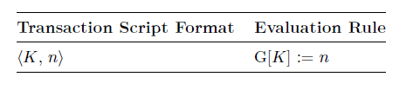
Simplest proposal
Directly encode the update to the state in the transaction script:
The proposal does not enforce scarcity
Scarcity is an important property of valuable physical assets

Slide 9
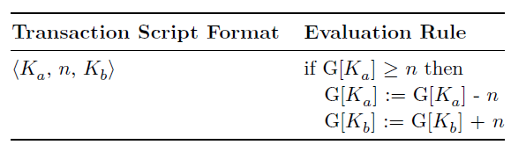
second proposal - scarcity:
Under this scheme, executing a valid transaction script enforces scarcity by conserving the number of coins in the system
Alice can no longer create coins out of thin air

Slide 10
second proposal - scarcity:
We still have a problem:
The proposal does not enforce Access Control
nothing in the evaluation rule will stop Bob from sending the transaction:
⟨Alice, 100, Bob⟩

Slide 11
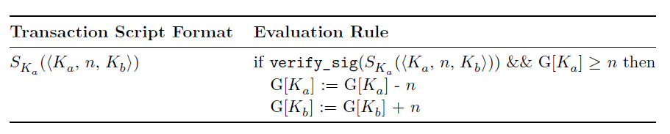
second proposal – scarcity and
Access Control:
We can address this by adding an access control mechanism based on digital signatures:
This new rule solves the problem by using the unforgeability of digital signatures.

Slide 12
Why we need Blockchain Languages
1. Indirect representation of assets
2. Scarcity is not extensible
3. Access control is not flexible

Slide 13
3. Move goal
“The Libra mission is to enable a simple global currency and financial infrastructure that empowers billions of people”
Move’s requitements
Move is designed with four key goals:
First class assets, flexability, safety, verifiable

Slide 14
First class resources
Ability to define custom resource types
Resources are ordinary program values.

Slide 15
First class resources
The Libra coin is implemented as a regular Move resource.
Move must support operations on these resources:
Creating resources.
Modifying resources.
Destroying resources.

Slide 16
First class resources
Move programmers can protect access to these critical operations with modules.
declares resource types and procedures.
A model can use other model resources and procedures.

Slide 17
Flexibility
Flexibility here refers to the ability to write and organize code in a manner that allows for easy changes, reuse, and extension
Move adds flexibility to Libra by transaction scripts.
can perform expressive one-off behaviors or reusable behaviors

Slide 18
Flexibility
Move modules enable a different kind of flexibility
modules/resources/procedures is similar to classes/objects/methods.
Key Differences:
Resource Declaration.
Procedures and Methods.

Slide 19
safty
Must satisfy key properties : resource safety, type safety, and memory safety
High-Level Language with Compiler
Low-Level Assembly with Runtime Checks

Slide 20
safty
Move’s Approach: Typed Bytecode
Typed Bytecode: Higher-level than assembly but lower-level than high level languages.
Bytecode Verifier: Checks for safety properties on-chain before execution.
Bytecode Interpreter: Executes verified bytecode directly.

Slide 21
Verifiability
Ideally: check every safety property of Move programs
Approach to Verifiability:
On-Chain Verification:
  Perform lightweight checks on-chain to ensure key safety properties.
Off-Chain - Static Verification:
  Support advanced off-chain verification tools to analyze programs before execution.

Slide 22
Design Decisions for Static Verification
No dynamic dispatch:
Every function call target is determined at compile time.
Limited mutability:
Every mutation to a Move value occurs through a reference.
Move’s bytecode verifier uses a “borrow checking” scheme.

Slide 23
Design Decisions for Static Verification
Modularity :
Code is organized into modules enforcing data abstraction and encapsulation.
Efficiently check for runtime failures and program-specific properties.
Simplified language design facilitates accurate and efficient analysis.

Slide 24
resource safety
the guarantees that Move resources can never be copied, reused, or lost.

Slide 25
Peer-to-Peer Payment Transaction Script
public main(payee: address, amount: u64) {
let coin: 0x0.Currency.Coin=0x0.Currency.withdraw_from_sender(copy(amount));
0x0.Currency.deposit(copy(payee), move(coin));
}

Slide 26
Copy a coin
public main(payee: address, amount: u64) {
let coin:0x0.Currency.Coin=0x0.Currency.withdraw_from_sender(copy(amount));
0x0.Currency.deposit(copy(payee), copy(coin));
}

Slide 27
Duplicate a coin
public main(payee: address, amount: u64) {
let coin: 0x0.Currency.Coin =0x0.Currency.withdraw_from_sender(copy(amount));
0x0.Currency.deposit(copy(payee), move(coin));
0x0.Currency.deposit(copy(some_other_payee), move(coin));
}

Slide 28
Lose truck of a coin
public main(payee: address, amount: u64) {
let coin: 0x0.Currency.Coin=0x0.Currency.withdraw_from_sender(copy(amount));
}
These guarantees go beyond what is possible for physical assets like paper currency.

Slide 29
Currency Module
Move has two different kinds of programs: transaction scripts and modules.
Transaction scripts are included in each user-submitted transaction and invoke procedures of a module to update the global state.

Slide 30
The global state
The global state is structured as a map from account addresses to accounts.
Each account can contain zero or more modules and one or more resource values.
Accounts can contain at most one resource value of a given type and at most one module with a given name.
Modules can contain a resource type named Coin that is managed by the module.

Slide 31
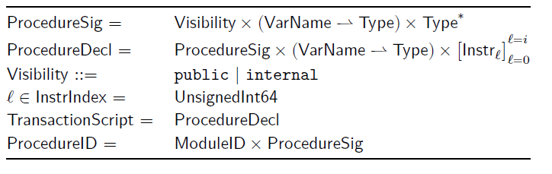
Procedures and transaction scripts
Signature:
visibility, typed formal parameters, return types.
Declaration:
signature, typed local variables, array of bytecode instructions.
Visibility:
Internal Procedures: Invoked only by other procedures within the same module.
Public Procedures: invoked by any module or transaction script

Slide 32
Bytecode Interpreter
The blockchain state is updated by a transaction script that can invoke public procedures of any module that is currently published under an account.
In Move, a procedure is uniquely identified by the module it belongs to and its signature (the name and types of its parameters and return values).

Slide 33
Bytecode Interpreter
The Call bytecode instruction in Move requires a unique procedure ID as input.
Move enforces that modules that were published earlier in the linear transaction history.

Slide 34
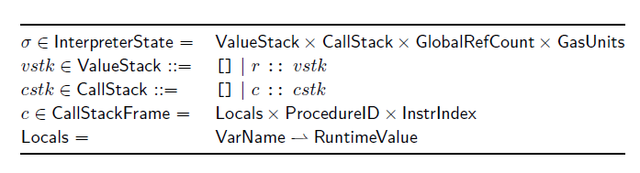
Bytecode Interpreter
Move bytecode instructions are executed by a stack-based interpreter
An instruction consumes operands from the stack and pushes results onto the stack

Slide 35
Bytecode Interpreter
The bytecode interpreter supports procedure calls
Input values passed to the callee and output values returned to the caller are also communicated by the stack

Slide 36
Bytecode Interpreter
The bytecode interpreter executing operations in sequence
unless there is a branch operation that causes a jump
When the callee wishes to return, it pushes the return values onto the stack and invokes the Return instruction.

Slide 37
Bytecode Interpreter
Execution of Move programs similar to the EVM
a stack machine with typed locals is a very natural fit for the resource semantics of Move.
it aligns perfectly with Move's resource management principles. The process of moving values shows how resources are intended to be managed in Move.

Slide 38
Instructions 1
Move supports six broad categories of bytecode instructions:
CopyLoc/MoveLoc:
for copying/moving data from local variables to the stack
StoreLoc:
moving data from the stack to local variables

Slide 39
Instructions 2
Operations on typed stack values
operations on stack operands
Push constants
5
5
5
11
6
6

Slide 40
Instructions 3 : Module builtins
Pack and Unpack:
Creating/destroying the module’s declared types,
MoveToSender/MoveFrom:
For publishing/unpublishing the module’s types
BorrowField:
Acquiring a reference to a field

Slide 41
Instructions 4 - Reference-related
ReleaseRef:
destroying a reference
FreezeRef :
converting a mutable to immutable
ReadRef, WriteRef
Reading, Writing references

Slide 42
Instructions 5&6
Control-flow operations
Blockchain-specific builtin operations

Slide 43
Native
Move provides cryptographic functions as native procedures within standard library modules instead of as direct bytecode instructions.

Slide 44
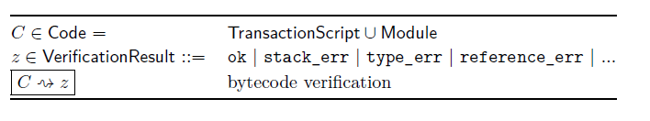
Bytecode Verifier
Goal: enforce safety properties for any module and any transaction script submitted for publication.
The bytecode verifier enforces general safety properties that must hold for any well formed Move program.
The binary format of a Move module or transaction script encodes a collection of tables of entities

Slide 45
Bytecode Verifier
The checks performed by the verifier fall into three categories:
Structural checks:
to ensure that the bytecode tables are well-formed
Semantic checks on procedure bodies.
Linking uses of struct types and procedure signatures against their declaring modules.

Slide 46

Move Virtual Machine: Putting It All Together
The role of the Move virtual machine is to execute a block 𝐵 of transactions from a global state Σ and produce a transaction effect 𝐸 representing modifications to the global state
Transactions in a block are executed sequentially by the VM

