Slide 1
Program Verification
Chapters 12.1 - 12.3 in “Decision Procedures: An Algorithmic Point of View“ by Daniel Kroening and Ofer Strichman.
Safwan Butto and Bar Kirshenboim

Slide 2


Agenda:
Introduction of Software Verification
Bounded Program Analysis
Unbounded Program Analysis

Slide 3
Connection to the Seminar
Verification of smart contracts
Use logic for verification

Slide 4
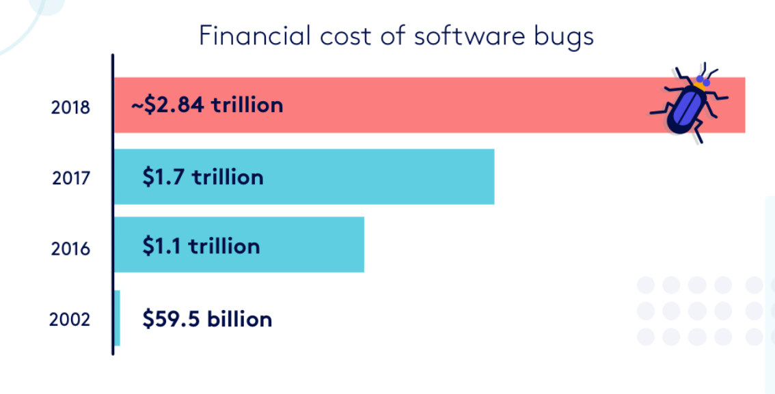
Elimination program errors – Why is it important?
The Cost of Software Bugs: Time is money. Bugs waste both | BugSnag Blog
Israel budget for 2023 was 484.7 billion NIS.
Notes:
Importance of Detecting Program Errors:
Crucial for ensuring software reliability and correctness.
Errors can lead to significant failures, especially in critical systems.

Slide 5

Checking bugs evolution
Testing the program –
Can never guarantee the absence of errors.
Testing can only declare a program as incorrect if a test fails.
Formal verification – ambitious
    check if a given specification is satisfied for all possible inputs
Notes:
The goal is to decide whether for all possible inputs a given specification is satisfied by the program
x < y
no division-by-0
These specifications are an instance of reachability

Slide 6

Reachability Problem
“The problem of checking whether a given state occurs in any execution of the program.”
Undecidable, Why?
* Infinite memory allocation
Software verification – undecidable
Notes:
, the problem of checking whether a given program state occurs in any execution of the program.
What makes this problem undecidable?
unbounded allocation of memory
because it implies that we cannot bound the number of states that the program can reach (note the aside on the topic).

Slide 7
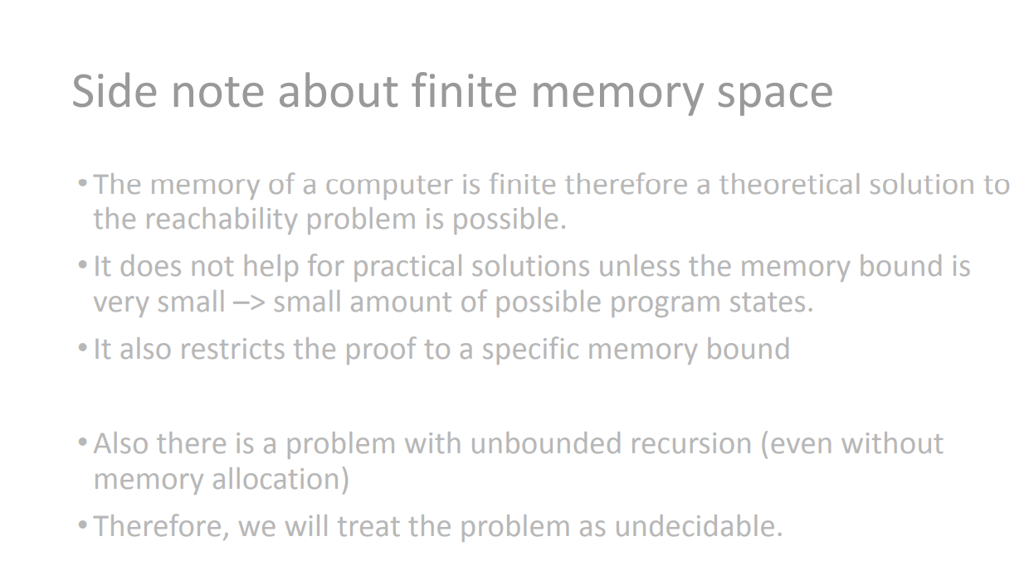

Slide 8
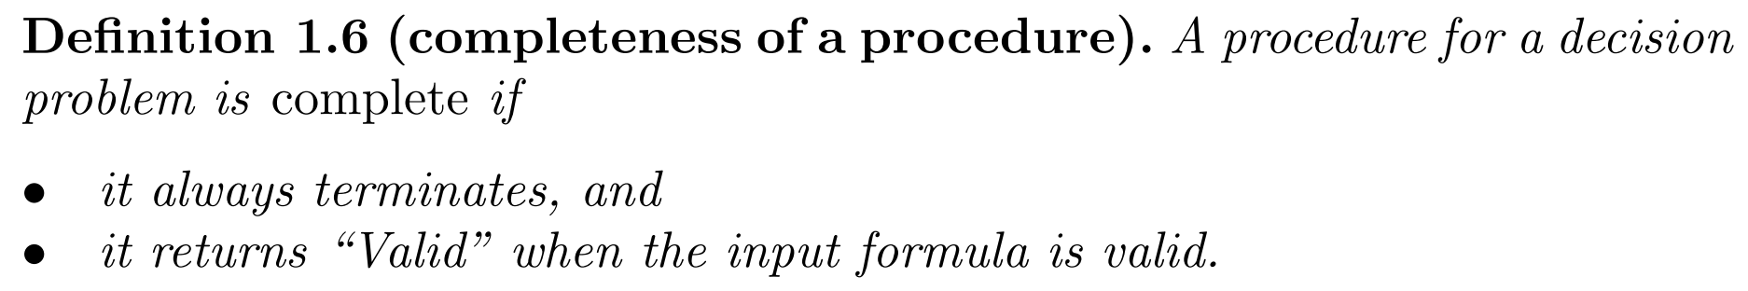
What now? Partial solutions
Many partial solutions have been invented, but for some programs the solution is incomplete.
Notes:
Testing – not declare something is correct
many partial solutions have been invented through the years, and many of them are used on a daily basis.
“partial” we mean that the type of programs that can be handled is restricted; for other programs the solution is incomplete (see Definition 1.6),

Slide 9

Partial Solutions
A key of those solutions is a reasoning engine, and at core of this is a decision procedure.
SMT (Satisfiability modulo theories) - generalizes SAT to more complex formulas involving real numbers, integers, and various data structures.
SMT-solvers - general-purpose logical solvers. Check satisfiability program’s generated logical formula using SMT-solver.
Program connected to Logic???
Program dynamic, reuse variables, memory…
Decision procedures are static, SAT
Avoid undecidability: impose a bound on loops, - underapproximates
Notes:
Programs are dynamic: they execute instructions one at a time, reuse variables, allocate memory, and so on. Decision procedures for quantifier-free first-order theories are static: they can only check whether there exists a simultaneous assignment to the variables that satisfies a given logical formula.
Bridging this gap is one of the topics of this chapter.
. A significant industrial application domain for these solvers is the analysis, verification and testing of programs

Slide 10
SSA
SSA = Static Single Assignment
Create a “time stamped version” of the program variables
Variable is written – a new symbol (=‘time stamp’) is introduced for it.
Values of inputs => 0

Slide 11
Bounded Program Analysis
- Checking Feasibility of a Single Path
- Checking Feasibility of All Paths

Slide 12

Basic definitions for understanding
Execution path is a sequence of program instructions executed during a run of a program.
Execution trace is a sequence of states that are observed along an execution path.
An assertion is a program instruction that takes a condition as argument, and if the condition evaluates to false, it reports an error and aborts
Notes:
For each path we can build a formula that represents it: the satisfying assignments to this formula correspond to traces along this path.
basic building block of many program analyzers: a method to determine whether the program can execute a given path.
The path can be partial, meaning that it does not have to reach an exit point of the program.
There can be many such traces along a single path, corresponding to different inputs.

Slide 13
Technique For Finding An Error
Choosing an execution path
Translating the SSA we got into logic formula
SSA – Static
Single Assignment
Looking for satisfaction

Slide 14
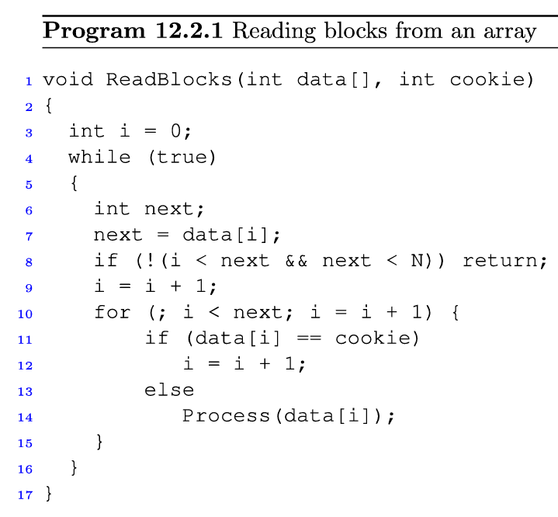
Example 1
* The first element of each block contains the index of the next block
* Skipping data that is equal to the input parameter cookie
14

Slide 15
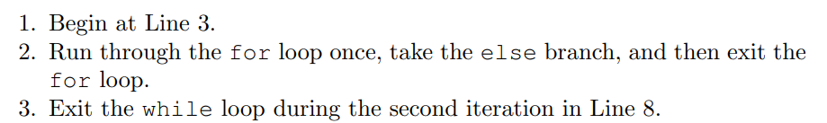
15

Slide 16
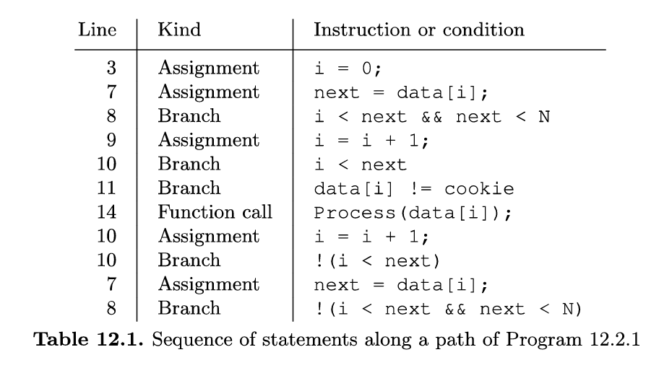


16

Slide 17
SSA
SSA = Static Single Assignment
Create a “time stamped version” of the program variables
Variable is written – a new symbol (=‘time stamp’) is introduced for it.
Values of inputs => 0

Slide 18
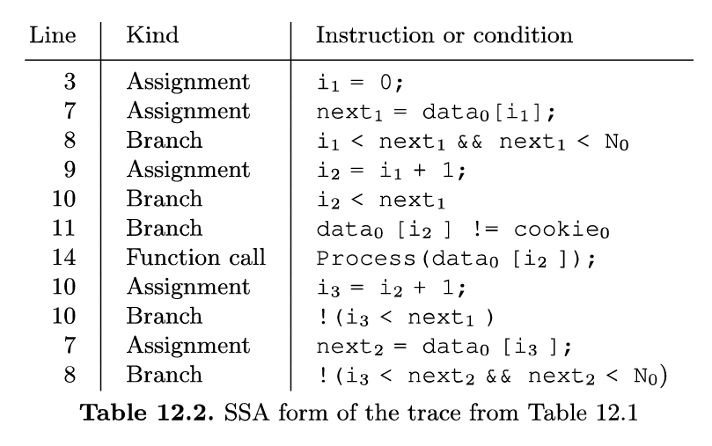
Path to SSA

Slide 19
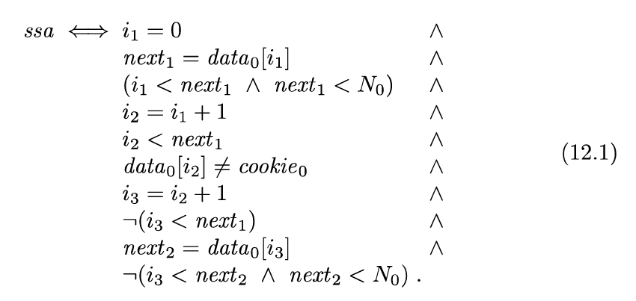
SSA to Formula
Note that the equality symbol in the formula denotes mathematical equality, whereas it denotes an assignment in Table 12.2.
Notes:
then the assertion can be violated

Slide 20

SSA to Formula
Notes:
then the assertion can be violated

Slide 21
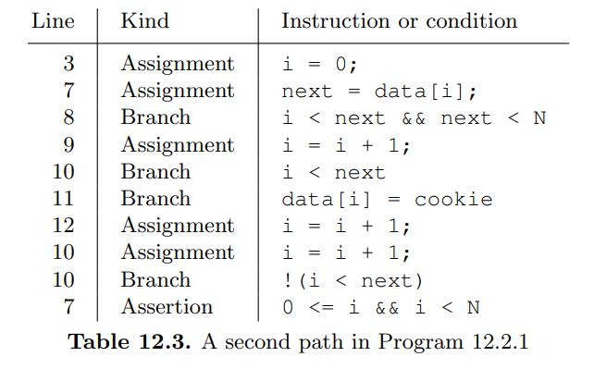
Another Example

Slide 22
Another Example

Slide 23
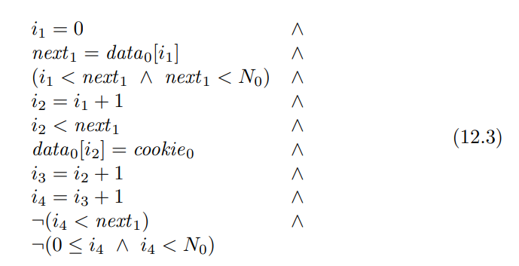
Another Example

Slide 24
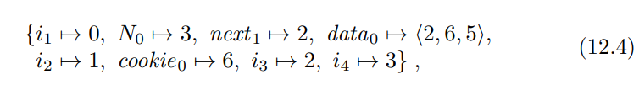
Another Example
Notes:
Such a formula is accordingly called the verification condition (VC) corresponding to our verification problem. The program has an additional, more subtle error.
The path that leads to this violation is given in Table 12.3. We now translate this path into a path constraint, and add the negation of the last assertion on the path:

Slide 25
By now
Verify path of program -> Check if a formula is satisfied

Slide 26
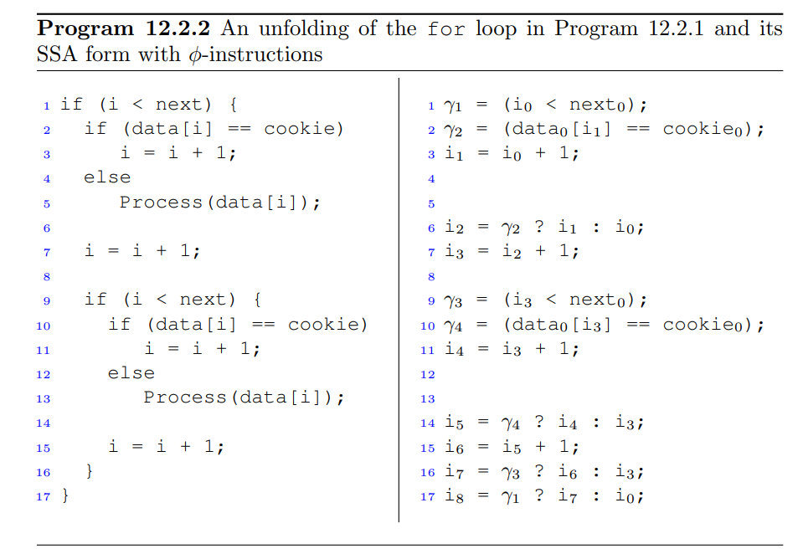
Let’s try now feasibility for All paths
Checking all paths -> Exponential
Instead,
Loops will be unfolded K times
Condition of ‘if’ will be assigned to Gamma
Where program’s flow reconverges, we will add statements that assign the correct value to variables that have been modified.
Notes:
Instead, we can generate SSA for bounded programs that contain branches
(rather than just for a path). The SSA can subsequently be converted into
a single formula that encodes all possible paths.
As a first step, loops are
unfolded k times, where k is specified by the user. The second step is to
assign the condition of each if statement to a new variable; we will use the
variable γ for this purpose. It will serve as a convenient shorthand whenever

Slide 27
Back to 1st Example
Unfold – k=2

Slide 29
Bounded Program Analysis - Summary
Given the SSA form of the (unfolded) program, we can construct a formula that captures exactly all the possible traces that it can execute.
To check an assertion in the program, we need to add its negation to the formula.
The resulting formula is then finally given to a suitable decision procedure. (SMT solver)

