Slide 1
12.3 Unbounded Program Analysis
Unbounded programs are those for which there are no predetermined bounds on certain computational resources, such as:
Memory usage:
  The program might dynamically allocate memory during its execution without a predefined limit.
Execution time:
  The program can perform operations that depend on input conditions and may potentially run indefinitely (e.g., operating systems or servers that are designed to run continuously).
Data structures:
  Use of dynamic data structures like lists, queues, or trees that can grow as needed during the program’s execution.
Notes:
What are unbounded program

Slide 2
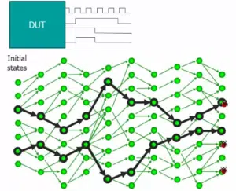
12.3 Unbounded Program Analysis
Challenges:
  Verifying unbounded programs is generally undecidable
  No universal decision procedure exists for all programs
What makes the problem undecidable?
- Infinite Execution Paths:
    The presence of unbounded loops, recursion, and dynamic memory allocation can lead to an infinite number of potential execution paths.
Notes:
We have seen a technique that under-approximates the behavior of the program by limiting the depth of loops.
• We now show a transformation that gets rid of loops but over-approximates the original behavior.
• When Successful, it proves for every possible input. But it might find errors in correct programs.

Slide 3
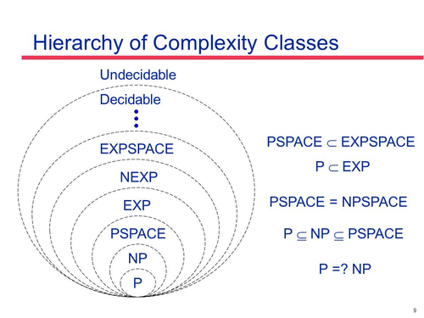
12.3 Unbounded Program Analysis
Undecidability
  Undecidability (Unrecognizable):
    The verification of unbounded programs is undecidable because it is infeasible to exhaustively analyze all potential states.
    This is related to the Halting problem , and we know that its semi-decidable problem
Notes:
What does it mean that the problem is undecidable

Slide 4
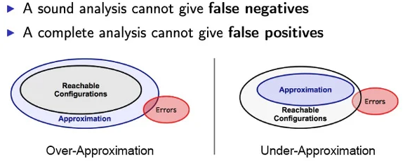
12.3.1Overapproximation with Nondeterministic Assignments
Under-Approximation (Technique from Sect. 12.2.2 )
  Translates program into a formula with bounded loop depth
  Underapproximates program behavior
  Cannot confirm assertions beyond the bound
Over-Approximation a new program transformation
  Converts a program with loops into a loop-free program
  Overapproximates the original program behavior
  Allows claims about executions of arbitrary length
Notes:
In Sect. 12.2.2 we have seen a technique that can translate a program into a formula by limiting the depth of loops to a given bound. This underapproximates the behavior of the program
It is not possible to conclude that the assertion holds for executions that exceed this bound.

Slide 5

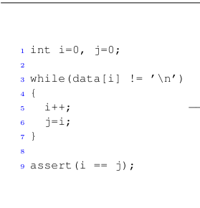
12.3.1 Overapproxaimation with Nondeterministic Assignments
For each loop and each program variable that is modified by the loop, add an assignment at the beginning of the loop that assigns a nondeterministic value to the variable.
After each loop, add an assumption that the negation of the loop condition holds. An assumption is a program statement assume(c) that aborts any path that does not satisfy c.
Replace each while loop with an if statement using the condition of the loop as the condition of the if statement.
Notes:
Overappriximation steps

Slide 6
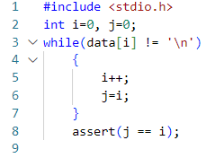
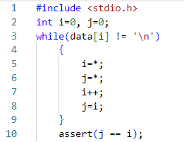
12.3.1 Overapproxaimation with Nondeterministic Assignments
For each loop and each program variable that is modified by the loop, add an assignment at the beginning of the loop that assigns a nondeterministic value to the variable.
After each loop, add an assumption that the negation of the loop condition holds. An assumption is a program statement assume(c) that aborts any path that does not satisfy c.
Replace each while loop with an if statement using the condition of the loop as the condition of the if statement.

Slide 7
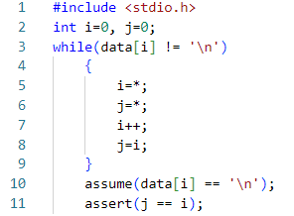
12.3.1 Overapproxaimation with Nondeterministic Assignments
For each loop and each program variable that is modified by the loop, add an assignment at the beginning of the loop that assigns a nondeterministic value to the variable.
After each loop, add an assumption that the negation of the loop condition holds. An assumption is a program statement assume(c) that aborts any path that does not satisfy c.
Replace each while loop with an if statement using the condition of the loop as the condition of the if statement.

Slide 8
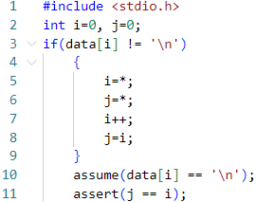
12.3.1 Overapproxaimation with Nondeterministic Assignments
For each loop and each program variable that is modified by the loop, add an assignment at the beginning of the loop that assigns a nondeterministic value to the variable.
After each loop, add an assumption that the negation of the loop condition holds. An assumption is a program statement assume(c) that aborts any path that does not satisfy c.
Replace each while loop with an if statement using the condition of the loop as the condition of the if statement.

Slide 9
12.3.1 Overapproxaimation with Nondeterministic Assignments
For each loop and each program variable that is modified by the loop, add an assignment at the beginning of the loop that assigns a nondeterministic value to the variable.
After each loop, add an assumption that the negation of the loop condition holds. An assumption is a program statement assume(c) that aborts any path that does not satisfy c.
Replace each while loop with an if statement using the condition of the loop as the condition of the if statement.

Slide 10
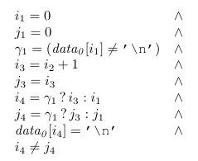
12.3.1 Overapproxaimation with Nondeterministic Assignments
We can now further translate this program into an SSA constraint using the technique that we have seen in Sect. 12.2.2.
Initialize Variables
2 Translate the if Condition
3 introducing new SSA variables for each assignment.
4 merging the different possible values of i and j
5 Translate the assume Statement
6 Translate the assert Statement

Slide 11
12.3.1 Overapproxaimation with Nondeterministic Assignments
We can now further translate this program into an SSA constraint using the technique that we have seen in Sect. 12.2.2.
Initialize Variables
2 Translate the if Condition
3 introducing new SSA variables for each assignment.
4 merging the different possible values of i and j
5 Translate the assume Statement
6 Translate the assert Statement
Notes:
While the technique has successfully proven the assertion in this particular example, this is not possible for arbitrary programs.
It worked because the correctness of the assertion does not depend on the previous iterations of the

Slide 12
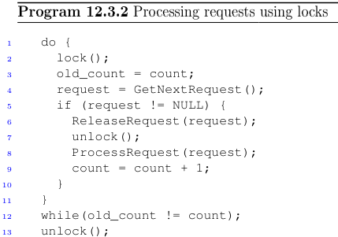
12.3.2 The Overapproximating Can Be Too Coarse
Consider the following program
It is an excerpt of a typical Windows device driver .
We will use it as an example in which the simple overapproximation of Sect. 12.3.1 does not work

Slide 13
12.3.2 The Overapproximating Can Be Too Coarse
Loop Functionality:
  Continuously fetches requests using GetNextRequest()
  Protected by a lock for managing concurrent thread access
  Lock is released after obtaining the request
Concurrency Control
  Multiple threads can access the request queue
  Lock released after dequeuing request
  Lock must be released before processing to avoid deadlocks or multiple locks
Key Requirements
  Must not exit the loop without owning the lock
  Prevents calling unlock() without lock ownership
Cause of Double Unlock
  If the request (req) is NULL, the loop exits Exiting the loop without owning the lock leads to an additional unlock() call
  Results in unlock() being called twice without re-acquiring the lock
Notes:
Lets take a closer look at the program
critical section is protected by a lock

Slide 14
12.3.2 The Overapproximation Can Be Too Coarse
Correct Lock Usage:
It is important that the program does not exit the loop without owning the lock.
If the program exits the loop without owning the lock, the subsequent call to unlock() would release the lock twice.
Releasing the lock twice violates the proper usage of locks: unlock() should only be called by a thread that owns the lock.

Slide 15
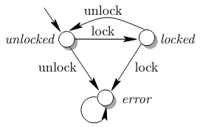
12.3.2 The Overapproximation Can Be Too Coarse
Locking Policy Assurance diagram
Goal:
  Ensure the program never reaches the error state, as illustrated by the state diagram .
  The program should alternate strictly between locking and unlocking.

Slide 16
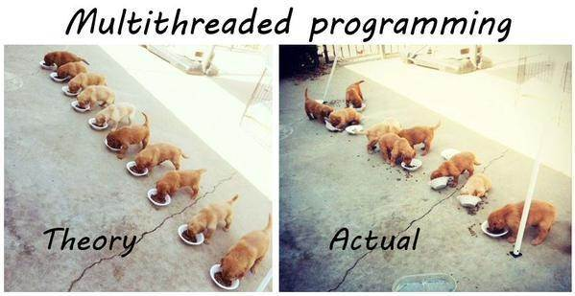
12.3.2 The Overapproximation Can Be Too Coarse
Locking Mechanism:
  Although locking mechanisms are typically used in multi-threaded programs, verification can be conducted on a single-threaded version.
  This single-threaded verification checks that the thread does not lock or unlock twice in a row, as specified by the state diagram.
Notes:
Instead of testing how threads work concurrently
We are going to test how a single thread behave Meaning

Slide 17
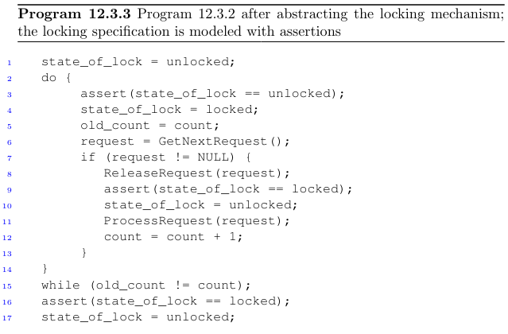
12.3.2 The Overapproximation Can Be Too Coarse
We add a variable state_of_lock, which reflects the state of the state machine. The variable is initialized with the unlocked state.
When the program performs an action that affects the state of the state machine (either locking or unlocking):
Assignments are added to the variable state_of_lock accordingly.
Finally, we add assertions to the program to capture the scenarios where the state machine transitions to the error state.
Notes:
The program after these transformations is shown in Program 12.3.3. Our goal is to check the locking specification, as expressed in the assertions.

Slide 18
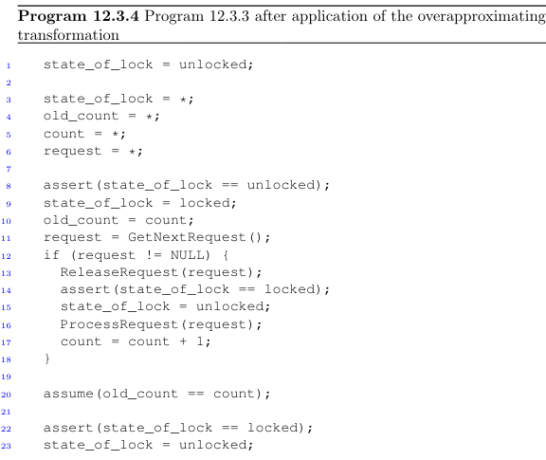
Notes:
Creating undetemenistic assignment for the

Slide 20
Notes:
Adding an assumption to the negation of the loop condition

Slide 21
12.3.2 The Overapproximation Can Be Too Coarse
We will, however, find that the obtained formula is satisfiable.
In particular, there is a trivial counterexample to the first assertion, in which the variable state_of_lock is assigned the value locked in the beginning of the loop, just before Line 3.
Clearly the state cannot be locked in the beginning of the loop in the concrete (real) program; it is an artifact of the abstraction.

Slide 22
12.3.2 The Overapproximation Can Be Too Coarse
This example shows us that beginning the loop with an arbitrary state is too coarse as an abstraction, as it may lead to false alarms.
We need to refine this abstraction, namely make it closer to the concrete program at hand: this will remove such spurious states that fail the proof despite the fact that they do not exist in the concrete program.
Next, we consider a strategy for coping with this problem.
In Sect. 12.3.4 we will show how it solves the verification problem for our program.

Slide 23
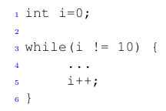
12.3.3 Loop Invariants
A key tool for program analysis is the loop invariant.
A loop invariant is any predicate that holds at the beginning of the body, irrespective of how many times the loop iterates.
Consider, for example, the following fragment of C code:
The following predicate is an invariant of this loop,
0 ≤ i < 10
because it is true in the beginning of the loop’s body regardless of which iteration we are at

Slide 24

12.3.3 Loop Invariants
How can we prove that a given predicate is a loop invariant? The answer is that we can use induction.
Suppose that our program matches the following template:
Both code fragments A and B are required to be free of loops, but may contain branching
The condition C and the candidate invariant I must be free of side-effects.
. We prove that I is an invariant by induction:
  Base case: prove that the loop invariant is satisfied when entering the loop for the first time.
  Step case: prove that, beginning in a state that satisfies the invariant, executing the loop body once brings us to a state that satisfies the invariant as well.

Slide 25


12.3.3 Loop Invariants
How can we prove that a given predicate is a loop invariant? The answer is that we can use induction.
Both parts of the proof must succeed to conclude that the invariant holds.
We will now construct two loop-free programs that check the two conditions above. The program we need to check for the base case is simple
The program for the induction step first restricts the entry state of the loop body to one that satisfies both the loop condition and the loop invariant. It then executes the body once, and asserts that the invariant still holds.

Slide 26
12.3.3 Loop Invariants
The assertion in the base case program passes trivially. We now construct the program for the induction step case:
1 assume(i != 10 && i >= 0 && i < 10);
2 i++;
3 assert(i != 10 =⇒ i >= 0 && i < 10);
The program above can again be checked by means of a suitable decision procedure. We will find in this case that the formula is unsatisfiable (i.e., the assertion passes). Thus, we have established our invariant. We leave it for the reader to adapt this procedure for Do-While and For loops (see Problem 12.1).

Slide 27
12.3.4 Refining the Abstraction with Loop Invariants
Let us now improve the precision of the program abstraction procedure explained in Sect.12.3.1 with loop invariants,we will add 3 further steps to the transformation for section 12.3.1
For each loop and each program variable that is modified by the loop, add an assignment at the beginning of the loop that assigns a nondeterministic value to the variable.
After each loop, add an assumption that the negation of the loop condition holds. An assumption is a program statement assume(c) that aborts any path that does not satisfy c.
Replace each while loop with an if statement using the condition of the loop as the condition of the if statement.
Add an assertion that I` holds before the nondeterministic assignments to the loop variables. This establishes the base case.
Add an assumption that I` holds after the nondeterministic assignments to the loop variables. This is the induction hypothesis.
Add an assertion that C =⇒ I` holds at the end of the loop body. This proves the induction step.

Slide 28
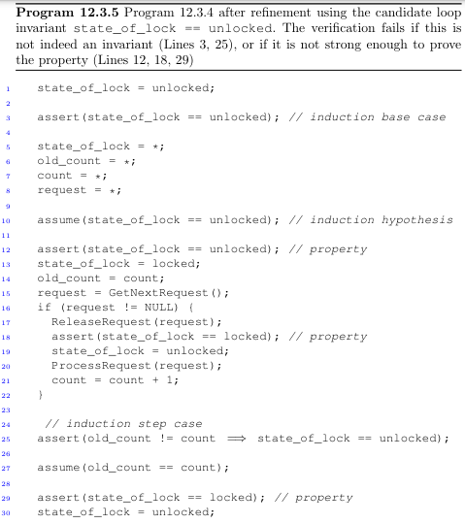
12.3.4 Refining the Abstraction with Loop Invariants
It is time to apply this for verifying the Windows driver excerpt from Sect. 12.3.2.
Recall that our abstraction suffered from the fact that the assertion state_of_lock == unlocked failed when entering the loop.
We therefore guess that this predicate is a potential invariant of the loop.
We then construct a new abstraction using the new steps.
This results in Program 12.3.5.

Slide 29
12.3.4 Refining the Abstraction with Loop Invariants
The assertions in lines 3, 12, and 18 pass trivially.
It is more difficult to see why the two assertions in Lines 25 and 29 pass.
Splitting the analysis into two cases can help:
If request != NULL, the program executes the “then” branch of the if statement in Line 16. As a result, the variable state has the value unlocked. Thus, the assertion for the induction step case (Line 25) passes. Furthermore, since count is equal to old_count plus one, old_count is different from count, which means that the assertion in Line 29 is not even executed owing to the assumption in Line 27.

Slide 30
12.3.4 Refining the Abstraction with Loop Invariants
The assertions in lines 3, 12, and 18 pass trivially.
It is more difficult to see why the two assertions in Lines 25 and 29 pass.
Splitting the analysis into two cases can help:
    • If request != NULL, the program executes the “then” branch of the if statement in Line 16. As a result, the variable state has the value unlocked. Thus, the assertion for the induction step case (Line 25) passes. Furthermore, since count is equal to old_count plus one, old_count is different from count, which means that the
    assertion in Line 29 is not even executed owing to the assumption in Line 27.
    • If request == NULL, then the execution skips over the “then”-branch. The variable old_count is equal to count and state is equal to locked. As a consequence, both assertions pass trivially.

Slide 31
12.3.4 Refining the Abstraction with Loop Invariants
Summary
The challenge is to find an invariant that is strong enough to prove the property as in the example above (recall that there the invariant was simply guessed).
As an extreme example, the constant “true” is also an invariant, but it is not helpful for verification: it does not restrict the states that are explored by the verification engine.
Finding suitable loop invariants is an area of active research.
Simple options include choosing predicates that appear in the program text, or constructing new predicates from the program variables and the usual relational operators.
A heuristic selects candidates and then uses the decision procedure as described above in an attempt to confirm the invariant and the properties.
In general there is no algorithm that always finds an invariant that is strong enough to prove a given property.

Slide 32
Q & A

