Slide 1
Securify
Ishay Asulin and Alon Dahan

Slide 2
What are smart contracts?
Definition:
A smart contract is a self-executing contract with the terms of the agreement directly written into lines of code.
Key Features:
Automation: Executes transactions automatically when predetermined conditions are met.
Trustless Transactions: Removes the need for intermediaries, relying on the code.
Transparency: All parties can see the terms and conditions of the contract.

Slide 3
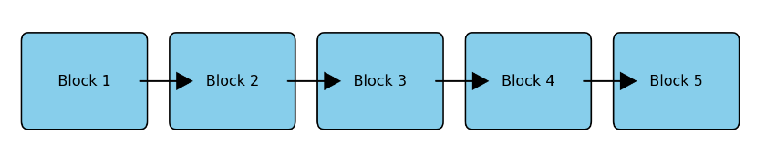
Blockchain
Definition:
A blockchain is a decentralized, distributed ledger that records transactions across many computers so that the record cannot be altered retroactively without altering all subsequent blocks and the consensus of the network.
Key Characteristics:
Decentralization: No single point of control or failure.
Immutability: Once data is written, it cannot be changed or deleted.
Transparency: All transactions are visible to participants in the network.

Slide 4
Benefits of Blockchain
Security: Uses cryptographic algorithms to ensure data integrity and security.
Efficiency: Reduces the need for intermediaries, speeding up transaction times and reducing costs.
Transparency: Enhances trust among participants through transparent and verifiable records, all participants share the same ledge

Slide 5
EVM
Defenition:
The EVM is a decentralized computing environment that executes smart contracts on the Ethereum blockchain.
It serves as the runtime environment for all Ethereum smart contracts, ensuring their execution and state management.
Key Features:
Turing-Complete: The EVM can execute any computational task, given enough resources.
Isolation: Smart contracts run in an isolated environment, ensuring that the blockchain's overall state remains secure even if a smart contract fails or behaves maliciously.
Bytecode Execution: Smart contracts written in high-level languages like Solidity are compiled into EVM bytecode, which the EVM turns into opcode (elaboration later) ,and executes it.

Slide 6
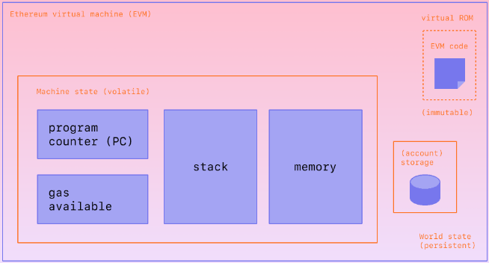
EVM storage
sstore vs mstore
sload vs mload

Slide 7

What is securify?
Securify is a static analysis tool for the security assessment of Ethereum smart contracts.
Designed to automatically detect vulnerabilities and ensure compliance with security best practices.
Won’t change your code, but help you understand what should be modified.
Analyzed over 18k contracts until August 2018.

Slide 8
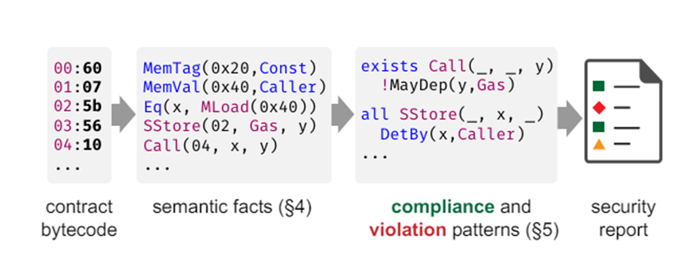
How Does It Work?
Securify’s approach is based on automatic inference of semantic program facts followed by checking of compliance and violation security patterns over these facts.
The contract is analyzed based of it’s dependency graph.
Patterns are expressed in a designated domain-specific language (DSL).

Slide 9
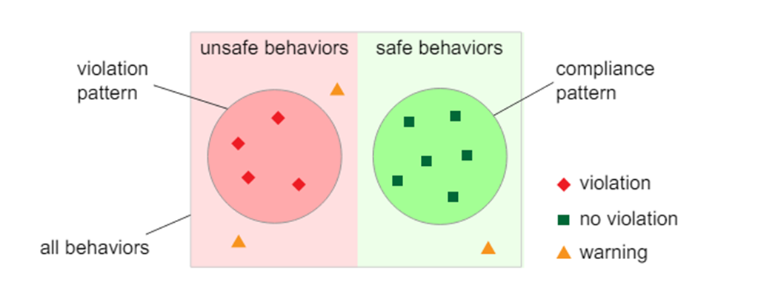
A list of compliance and violations patterns is provided as an input (which means new patterns can be added through time).
If there’s a match between the semantic facts to the patterns, it’s being added to the final report, either as a compliance/violation/warning.
Warnings are behaviors that wasn’t matched by any pattern.

Slide 10
Almost Automatic
Unlike other smart contract analyzers, in securify, the user needs to classify manually only the warnings, while the violations are classified automatically by the tool.
the approach of using both violation and compliance patterns reduces the warnings a user needs to inspect manually by 65.9%, and even up to 99.4% for some properties.

Slide 11
Motivation Stories
In 2017, a vulnerability was found on the Parity Multi-signature Wallet version 1.5+, that allowed an attacker to steal over 150,000 ETH (~30M USD).
Later that year, 280M USD were frozen due to the removal of a wallet library from the blockchain.
How did it happen?

Slide 12
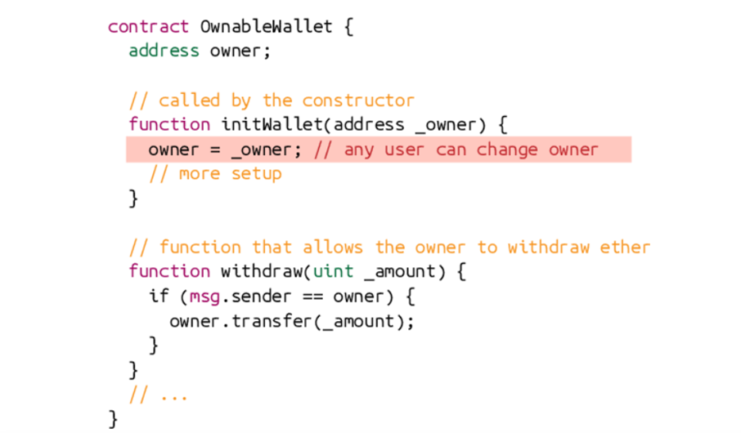
The parity’s attack
Here’s a simplified version of the multi-signature wallet’s code.
initWallet was supposed to be called only by the constructor, and only once.
It was assumed not to be accessible by others.

Slide 13
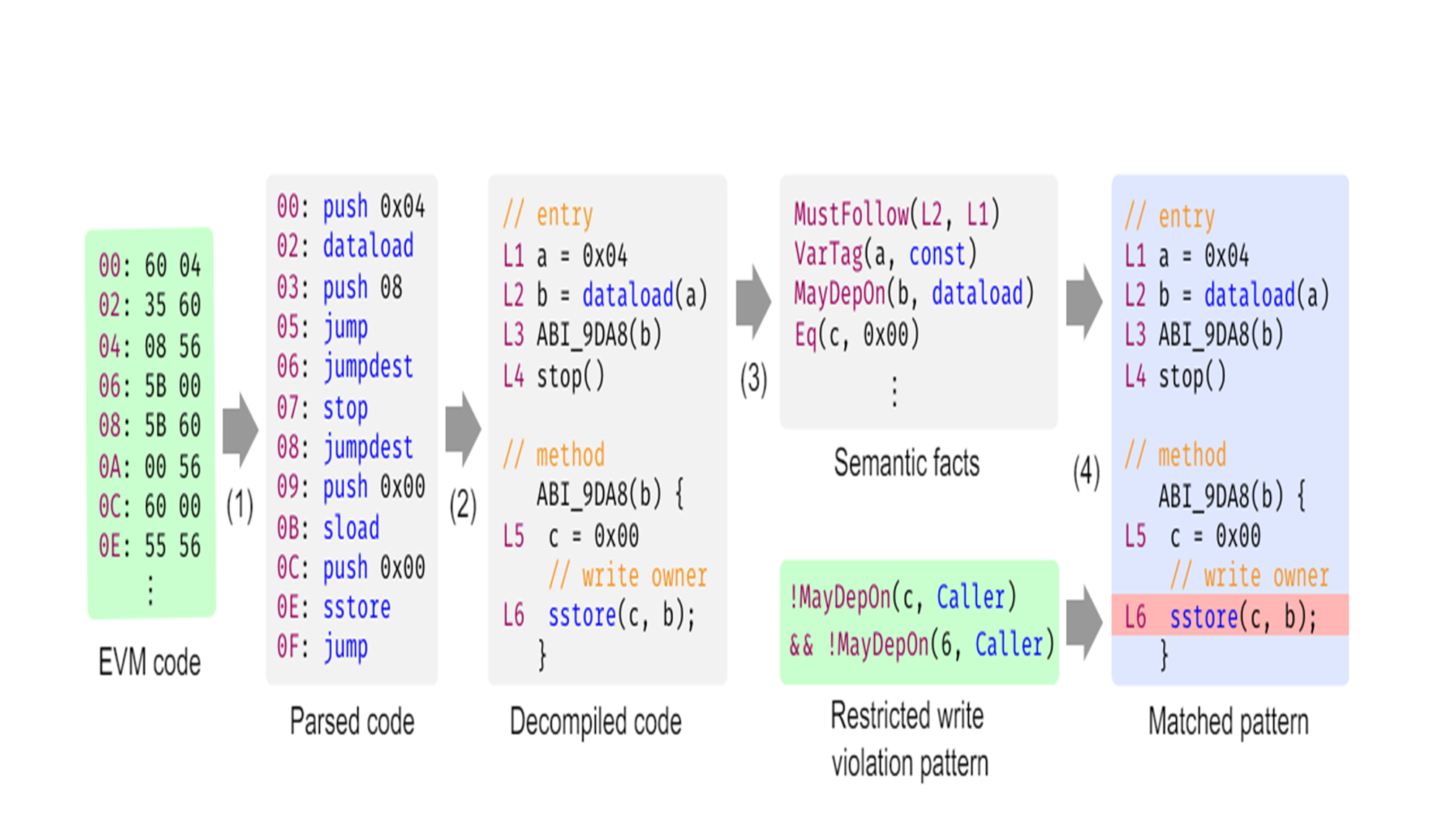
Detection

Slide 14
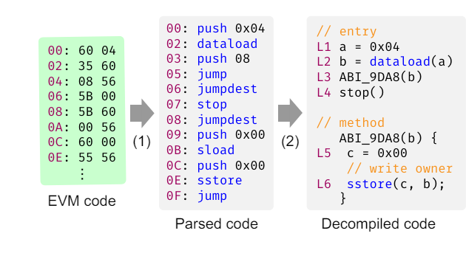
Step 1: Decompiling EVM Bytecode
Transforming the EVM bytecode into a stackless representation.
For example, push turned into the local variable a.
Methods are identified.
There is an evaluation of memory and storage offsets, jump destinations, in order to analyze the code precisely.

Slide 15
Optimizations
Eliminating instructions whose results are not used.
Partial evaluation - improves the precision of storage and memory analysis.
Method inlining - improves the precision of static analysis.

Slide 16
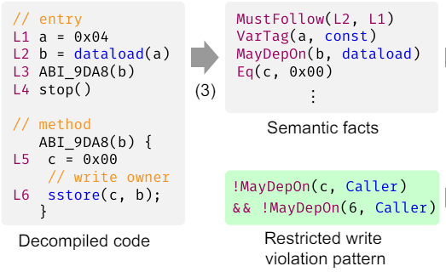
Step 2: Inferring Semantic Facts
Understanding data and control-flow dependencies.
In here, b depends on dataload, c equals 0.
The semantic facts are specified in datalog, and their derivation is fully automated.

Slide 17
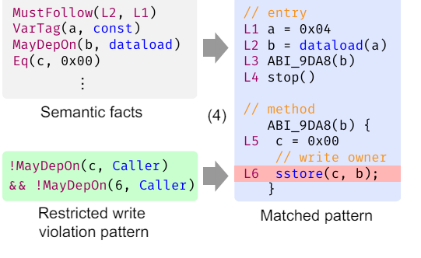
Step 3: Checking Security Patterns
Checking the set of compliance and violation patterns that was given as an input.
The DSL is a fragment of logical formulas over the semantic facts.
Enabling the addition of new and customized patterns by security experts at any time.

Slide 18

Example
sstore(c,b) matched a violation pattern.
c is the storage offset to the owner field, b is the value to store.
“caller” is address of the transaction sender.
The execution of the instruction (L) and the storage offset (X) doesn’t depend on the caller, that's a violation.

Slide 19
Step 4: Output
Securify will output the instruction that caused the violation, in this example, sstore(c,b)
Since the offset is known, if the source code is provided it’s easy to return the instruction in its source form.
Warnings are shown as well.

Slide 20
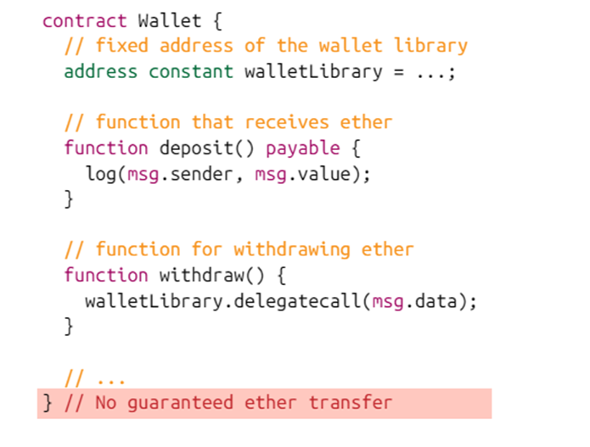
Frozen Funds
In this case we can see the use of wallet libraries.
Can get ether through deposit.
Can withdraw ether only by delegating the calls to the wallet library.

Slide 21
Detection
Two requirements are needed to be proven:
Users can deposit ether.
The contract has no ether transfer instruction by its own.
Both requirements can be detected by the analysis of Securify.

Slide 22
Semantic Facts - Background (EVM)
EVM - the EVM instruction set supports a few dozen opcodes.
Many are eliminated in Securify’s decompilation (due to the stackless representation.)
Some important instruction to know are:
balance, caller, callvalue.
add, mul, lt, eq (arithmetic operations)
number, timestamp, gaslimit (related to the block).
mload, mstore, sload, sstore.
call (transfers ether).
goto

Slide 23
Base Facts
The base facts take the form of inst(L,Y,X1,....,Xn).
L is the instruction label.
Y is the variable storing the result.
X1,...,Xn are the arguments to the instruction.
Examples:
l1: a=4 is encoded to assign(l1,a,4)
l6: sstore(c,b) where c equals 0 is encoded to sstore(l6,0,b), if c can’t be determined at compile time we have sstore(l6,T,b).

Slide 24
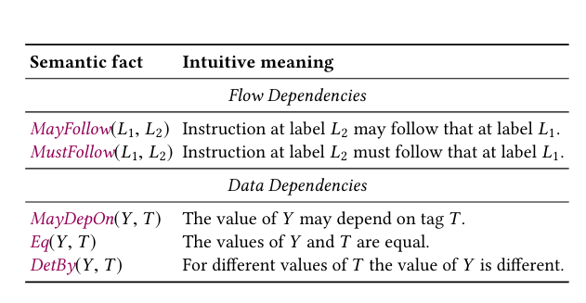
The base facts are expressed by a predicate defined over labels called Follow.
If L2 appears immediately after L1 in the dependency graph then it means Follow(L1,L2).
Securify computes two kinds of semantic facts:
Flow-dependency predicates (instruction dependencies).
Data-dependency predicates.

Slide 25

Flow-Dependency Predicates
Based on the control flow graph (CFG).
MayFollow(L1, L2) holds for L1 and L2 if both are in the same basic block and L2 follows L1, or there is a path from the basic block of L1 to the basic block of L2.
MustFollow(L1, L2) holds if both are in the same basic block and L2 follows L1, or any path to the basic block of L2 passes through the basic block of L1.
Inferring MayFollow:

Slide 26
Data-Dependency Predicates
The dependency predicates we consider are MayDepOn, Eq, and DetBy.
Eq(Y,T ) indicates that the values of Y and T are identical.
MayDepOn(Y,T ) is derived if the value of variable Y depends on the tag T, the change of T may change Y.
DetBy(Y,T ) indicates that a different value of T guarantees that the value of Y changes.

Slide 27
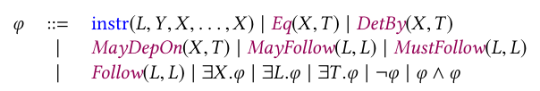

Securify Language
Has the following syntax by BNF:
Can convert “all”, “or” to “exists”, “and” using negations.

Slide 28
Security Properties and Patterns
We now define some security properties with respect to the EVM semantics.
Checking these properties precisely is impossible since EVM is Turing-complete.
We use the patterns.

Slide 29
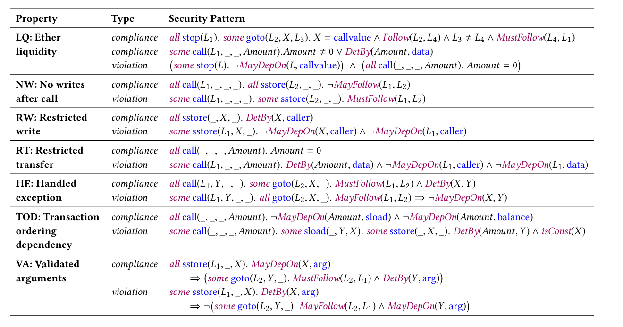

Slide 30
Ether Liquidity
The frozen funds problem.
Compliance - either 1 or 2:
All traces t do not change the contract’s balance.
There exists a trace t that decreases the contract’s balance.
Violation - both conditions are false: the contract can receive ether, but cannot transfer ether.

Slide 31
No Writes After Calls
The attack - In July 2016, a bug in the DAO contract enabled an attacker to steal 60M USD.
The attacker exploited the combination of two factors:
First, a call instruction which upon its execution enabled the recipient of that call to execute her own code before returning to the contract.
Second, the amount transferred by this call depended on a storage value, which was updated after this call

Slide 32
Compliance - there are no writes to the storage after any ‘call’ instruction.
For all traces t, the storage does not change in the interval that starts just before any call instruction and ends when the trace completes.

Slide 33
Restricted Writes
The multi signature wallet attack.
Compliance - for every storage offset x (e.g., a field in the contract), there is a user a that cannot write at offset x of the storage.
Violation - there is an sstore instruction whose execution and offset are independent of ‘caller’.

Slide 34
Restricted Transfer
Guaranteeing that ether transfers (via call) cannot be invoked by any user ‘a’.
Compliance - for all users, invocations of that call instruction do not transfer ether.
Violation: The call instruction transfers non-zero amount of ether and its execution is independent of the sender.

Slide 35
Handled Exception
In February 2016, a contract by the name “King of Ether” had an issue due to mishandled exceptions.
The issue was that the return value of a ‘call’, which indicated if the instruction completed successfully, was not checked.
Could lead to undefined and unexpected behaviors.

Slide 36
Compliance - call instructions are followed by a goto instruction whose condition is determined by the return code of call.
Violation - the call instruction is not followed by a goto instruction which may depend on the return value.

Slide 37
Transaction Ordering Dependency
No guarantee on the execution order of transactions.
Compliance - the amount of ether send by a call instruction is independent of the state of the storage and contract’s balance.
Violation - the amount of the call instruction is determined by a value read from the storage, whose offset in the storage is known, and that this value can be updated.

Slide 38
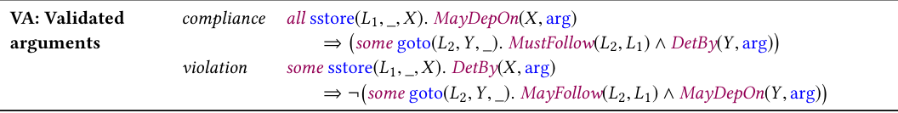
Validated Arguments
Method arguments should be validated before usage, because unexpected arguments may result in insecure contract behaviors.
Compliance - before storing in the persistent memory a variable that may depend on a method argument, there exists a check of the argument value.
Violation - sstore instructions that write to memory a method argument without previously checking its value.

Slide 39
Limitations
Securify lacks handling numerical properties, but made a huge progress there.
Securify does not reason about reachability, which means it assumes that every instruction in the contract could be executed.
Securify might flag something as a potential vulnerability, but that doesn't necessarily mean it's exploitable or poses a significant risk in practice.
Doesn’t capture contract-specific requirements.

Slide 40

Running Example

Slide 41
Evaluation
Goals:
evaluate Securify’s effectiveness in proving the correctness of and discovering violations in real world contracts
manually inspect Securify’s results (i.e reported violations and warnings) on smart contracts whose source code had been uploaded to Securify’s public interface
compare Securify to Oyente and Mythril (smart contract checkers)
measure the success of Securify’s decompiler in resolving memory and storage offsets
measure Securify’s time and memory consumption.

Slide 42
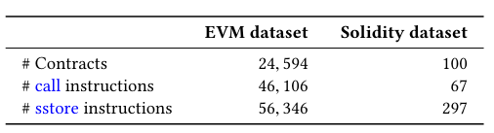
Dataset

Slide 43
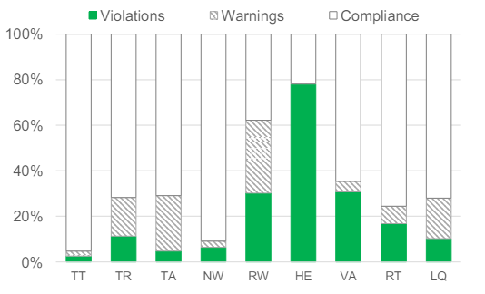
Security Analysis of Real-World Smart Contracts
Overall statistics:
55.5% safe
29.3% violations
15.2% warnings
65.9% of instructions that s that failed to match a compliance pattern, are proved to be violations.

Slide 44
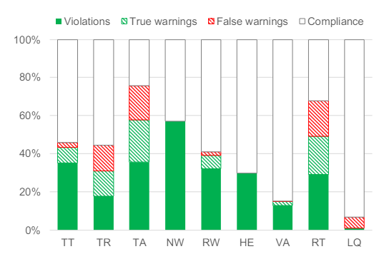
Manual Inspection of Results
Interesting points:
In HE, 29.9% of call instructions have returned unexpected return value.
Number of security issues discovered in the Solidity dataset is higher relative to those found in the EVM dataset (different distribution, finished vs unfinished, used potentially problematic contracts to check).
One exception is in HE which solitidy has less security issues(probably because of the transfer function that handles errors by default used recently).

Slide 45
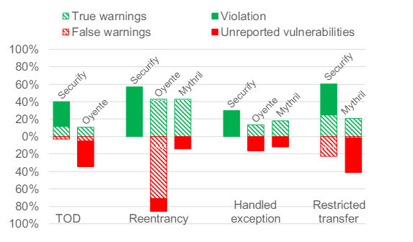
Comparing Securify to Symbolic Security Checkers
Oyente fails to report 72.9% of TOD violations.
Mythril fails to report 65.6% of the restricted transfer violations.

Slide 46
Partial evaluation - offsets
Definition: the distance (in bytes) of a variable, label, or instruction from its base segment.
Example: arr, arr[8].
Our goal: predict where the data will be stored in memory/storage.

Slide 47
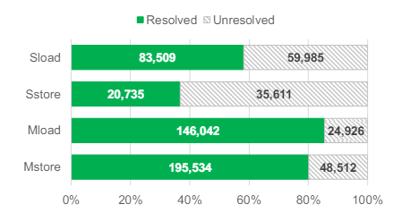
Resolving Storage/Memory Offsets
Partial evaluation correctly resolves 72.6% of the offsets
Storage depends on other users on the network, so it's harder to predict.
Memory is local so it's easier to predict

Slide 48
Time and Memory Consumption.
Average time: 30 sec per contract.
Oyente and Mythril have similar running times on default settings, on advanced settings its longer.
in 95% of the cases, Securify require less then 10MB consumption.
in the rest it's less than 1GB.

Slide 49
Conclusion
Securify benefits:
  Safety
  Error checking
  Best compared to competitors
  Quick response

Slide 50
