Slide 1
Demystifying Loops in Smart Contracts
Written by:Benjamin Mariano, Yanju Chen, Yu Feng
Presenting: shachaf yosef, Sally al khoury

Slide 2
Presentation:
Short recap on previous lectures topics that are relevant.
Goals and motivation
Introduction
Study of loops in smart contracts
DSL for loop summarizing
Synthesis of loop summaries
Evaluation
Conclusion and future work

Slide 3
goals
How loops are used in smart contracts
Research and analyze of loops used in solidity contracts deployed on Ethereum
See a DSL language used to summarize loops
Evaluate how much of those loops can be summerised

Slide 4
motivation
Why analyzing loops in smart contracts is crucial?
The research evaluation shows that at least 56% of the analyzed loops can be summarized in our DSL, and 81% of these summaries are exactly equivalent to the original loop

Slide 5

motivation

Slide 6
A short review on previous lectures
Overview of smart contracts
Solidity
Gas costs and vulnerabilities

Slide 7
Smart contracts
As programs that run on a blockchain, smart contracts enable multiparty transactions that involve the transfer of funds or other commodities
Due to their obvious security-critical nature, there has been interest —both in the security, software engineering, and formal verification communities — in developing techniques for automatically checking that smart contracts behave as expected

Slide 8
introduction
In this lectuere we will fucus specifically on loops in smart contracts.
What are loops?
Why do we need to study them?
In this article, we study various of syntactic and semantic characteristics of loops used in over 20,000 solidity contracts of etheriom blockchain.
propose a small dsl(domain-specific language) – consul.
We will evaluate how much our dsl summarize.

Slide 9
introduction
What will we get from analyzing loops:
Improved Analysis and Verification
Optimization Opportunities
Enhanced Security

Slide 10
A STUDY OF LOOPS IN SMART CONTRACTS
We will study of over 20,000 solidity smart contracts.
We will look at various features of them.
Nature of Loops, Syntactically, Semantically.
Clustering Loops by Semantic Properties

Slide 11
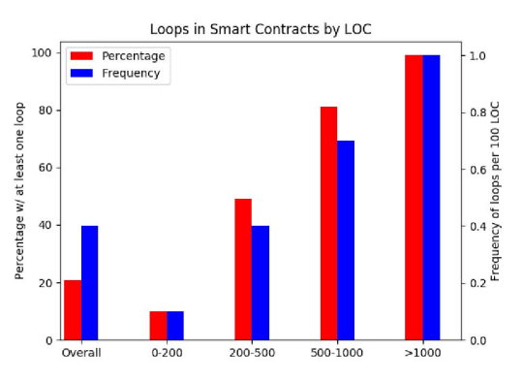
A STUDY OF LOOPS IN SMART CONTRACTS

Slide 12
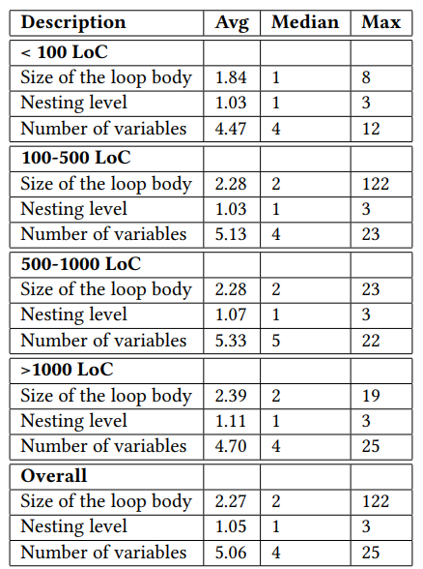
Nature of Loops, Syntactically

Slide 13
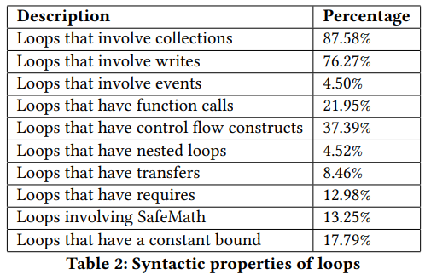
Nature of Loops, Syntactically

Slide 14
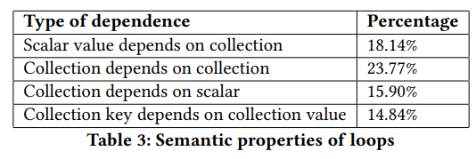
Nature of Loops, semantically

Slide 15
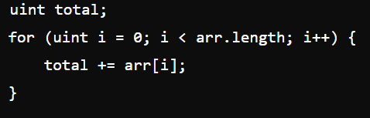
Nature of Loops, semantically
1. Scalar Value Depends on Collection
Percentage: 18.14%

Slide 16
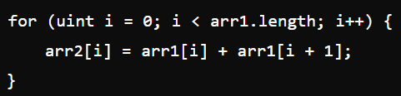
Nature of Loops, semantically
2. Collection Depends on Collection
Percentage: 23.77%

Slide 17
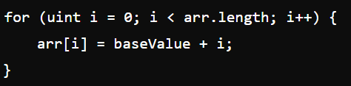
Nature of Loops, semantically
3. Collection Depends on Scalar
Percentage: 15.90%

Slide 18
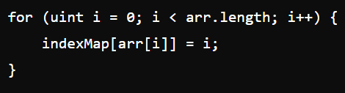
Nature of Loops, semantically
4. Collection Key Depends on Collection Value
Percentage: 14.84%

Slide 19
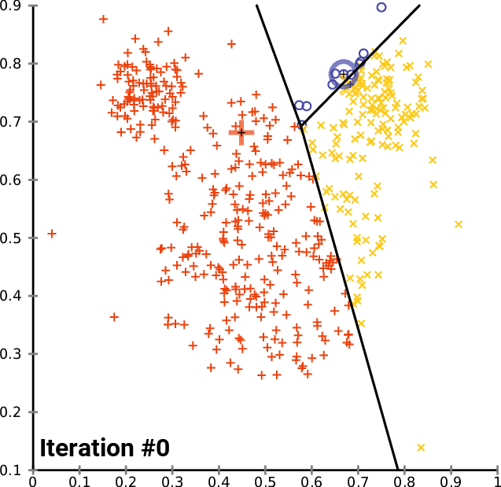
2.4 Clustering Loops by Semantic Properties
K-means

Slide 20
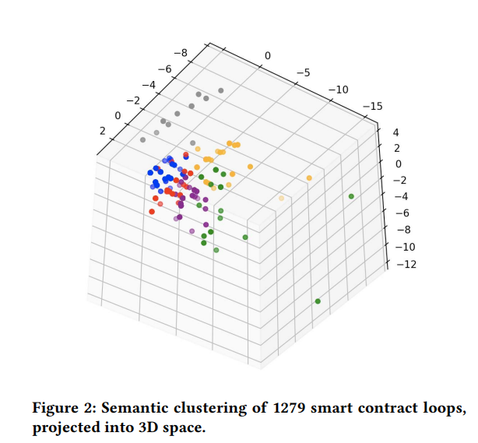
2.4 Clustering Loops by Semantic Properties
Both cluster 0 (pictured in red in Figure 2) and cluster 1 (in green) contain loops that perform an accumulating computation similar to a fold operation
Clusters 2 (in blue), 3 (in orange), and 4 (in purple) contain loops that map values onto a global array/map
the loops sampled from cluster 5 (in grey) all contain complex arithmetic computations

Slide 21
A DSL FOR LOOP SUMMARIZATION
What is DSL?
Consul

Slide 22
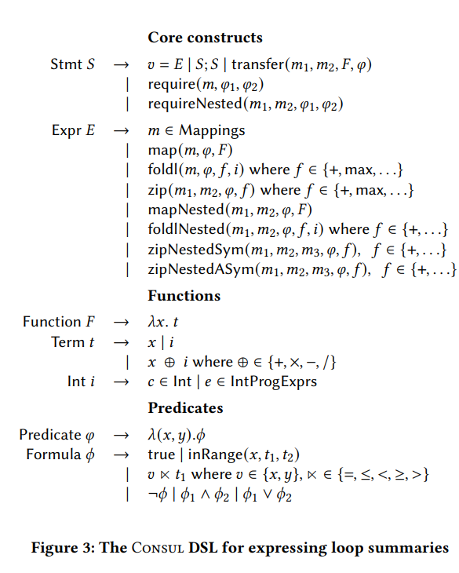
A DSL FOR LOOP SUMMARIZATION
Examples:

Slide 23
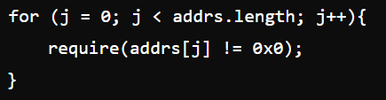

A DSL FOR LOOP SUMMARIZATION
Requirements:

Slide 24
A DSL FOR LOOP SUMMARIZATION
Requirements:
Improves gas efficiency by stopping execution early if conditions are not met.
Enhances security by preventing invalid operations and ensuring proper conditions are met before proceeding.
Increases readability by clearly defining preconditions and providing informative error messages.

Slide 25
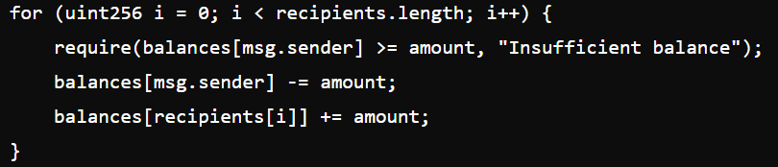
A DSL FOR LOOP SUMMARIZATION
transfer:
Conciseness: Summarizing loops with Consul constructs reduces boilerplate code, focusing on the logic rather than implementation details.
Safety and Efficiency: Encapsulating checks and operations within Consul constructs ensures consistency and reduces the risk of errors.
Abstract Representation: Consul abstracts the loop and transfer operations, making it easier to reason about the code.

Slide 26
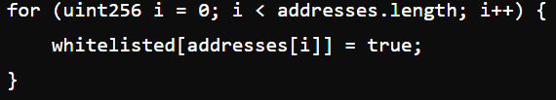
A DSL FOR LOOP SUMMARIZATION
map:

Slide 27
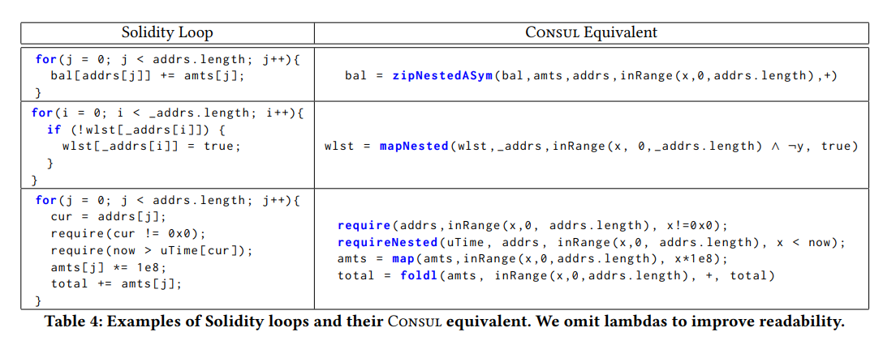
A DSL FOR LOOP SUMMARIZATION

Slide 28
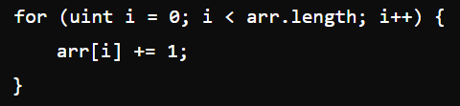
questions

Slide 29
questions

Slide 30
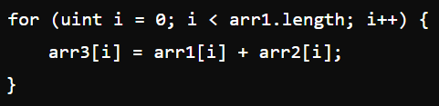
questions

Slide 31
questions

Slide 32
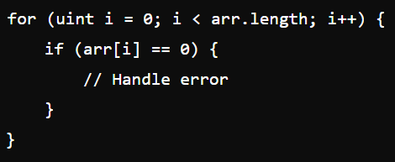
questions

Slide 33
questions

Slide 34
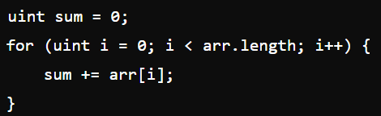
questions

Slide 35

questions

Slide 36
Any questions?

Slide 37
SOLIS
Solis is a tool that helps us to synthesizing loop summaries
Based on syntax guided synthesis paradigm that take advantage from
1- search engine
2- equivalence checker

Slide 38
Search engine
the search engine enumerates candidate Consul summaries for the given loop until we exhaust all candidate
Consul programs for the given loop or until we generate an equivalent summary.

Slide 39
search engine depends on two type of informations to purne large parts of search space
Variable types: Given a variable 𝑣, we write 𝜏 (𝑣) = 𝜏1 to indicate that the type of variable 𝑣 is 𝜏1. If 𝜏1 = Map, the notation 𝜏2 ⇒ 𝜏3 indicates that the key type of the map is 𝜏2 and value type is 𝜏3.
• Read-write sets: For each loop 𝐿 in the original contract, we compute the set of variables it reads from and the set of variables it writes to. We use the notation 𝑣 ∈ Reads(𝐿) (resp. 𝑣 ∈ Writes(𝐿)) to indicate that 𝑣 is read from (resp. written to) in loop 𝐿.

Slide 40
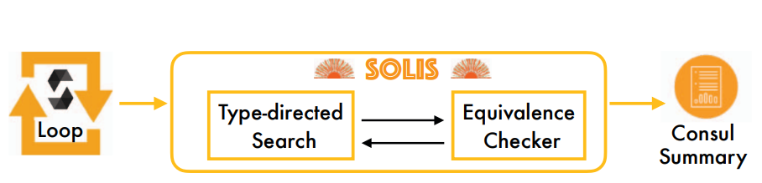
Notes:
We have loop code we want to convert it to loop free code the first step is to use search engine and check the pre condition and execute the right statements after that check if the summary is equivalent to the original loop by equivalence checker if they are equals then we got the consul summary

Slide 41
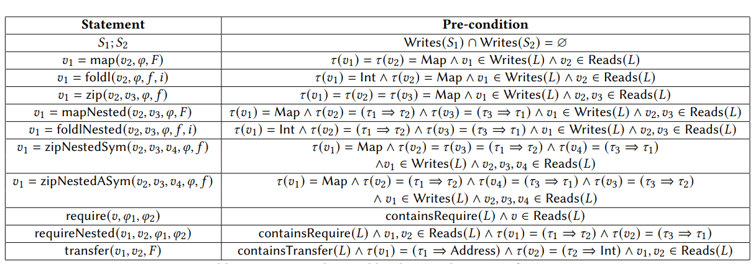
The table lists different statements and indicates the conditions under which they will be executed

Slide 42
Example :
• map: According to the second row of Table 5, Solis only enumerates the statement 𝑣1 = map(𝑣2,𝜑, 𝐹 ) if both 𝑣1 and 𝑣2 have type mapping and 𝑣1 is written to by the input loop whereas 𝑣2 is read from.
• foldlNested: For an input loop 𝐿, the summary should only contain the statement 𝑣1 = foldlNested(𝑣2, 𝑣3, 𝑓,𝑖) if 𝑣1 has type Int and the value type of 𝑣3 is the same as the key type of 𝑣2. In addition, 𝑣1 must be written to and 𝑣2, 𝑣3 must be read from.
• Composition: According to the first row of Table 5, different statements in the summary should not write to the same variable. This rule prevents Solis from enumerating useless
Notes:
summaries where the effect of one summary statement is overridden by a subsequent one. For a given Solidity loop 𝐿, there are typically not too many Consul statements that meet the pre-conditions from Table 5; thus, our pre-conditions are effective at pruning a large part of the search space during enumeration.
In addition to the rules shown in Table 5, Solis uses several other type-directed rules to prune the space of functions it needs to consider. For example, consider again the statement: 𝑣1 = map(𝑣2, 𝜑, 𝜆𝑥.𝑡) Clearly, for this program to type-check, the type of 𝑡 must be the same as the value type of 𝑣1. Thus, Solis can also use type-based reasoning when filling in lambda expressions used in Consul constructs.

Slide 43
Equivalence Checker
-1 convert the consul summary s to solididity code s’ by using syntax-directed translation
2- there is no checker that check Equivalence between two solidity code so we imlplemnt the verifier
Notes:
To check if summary is equivalent to the original loop

Slide 44
Example
the checker takes as input two Solidity programs fun1 and fun2 as well as a symbolic input called input and verification bound 𝐾 that controls how many times the loops are unrolled. Then, we symbolically evaluate both fun1 and fun2 on the symbolic input state to obtain a pair of symbolic output states o1 and o2. If the resulting output states are equal, this constitutes a proof (up to bound 𝐾) that the Consul summary is equivalent to the original loop
Notes:
How Equivalence checker works

Slide 45
compositional synthesis
synthesis of complex summaries by synthesizing their constituent parts and then composing them together
If there is variable v2 that depends on variable v1 this algorithm will not be able to synthesize a Consul the program that have this variable
Notes:
the search space increase with number of statements
In particular, compositional synthesis works by independently synthesizing partial summaries for each variable written in the loop, and then composing them together with Consul’s sequencing operator. Consider the following loop,

Slide 46
EVALUATION
RQ1 What percentage of loops can be precisely (or at least partially) summarized in the Consul language?
RQ2 What is the relative frequency of Consul constructs that are used in Solidity loop summaries?
RQ3 What types of loops cannot be summarized using Solis?
Notes:
To evaluate what percentage of Solidity loops can be summarized in our proposed Consul language, we used Solis to synthesize summaries for real-world Solidity loops. The main goal of our evaluation is to answer the following research questions

Slide 47
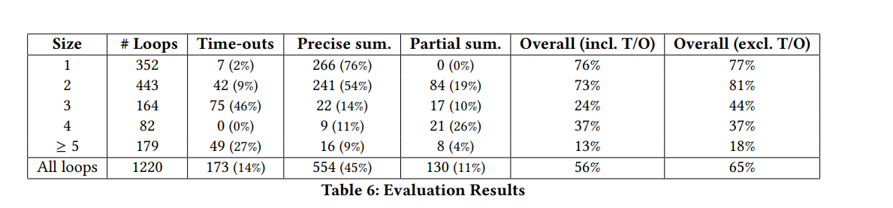
RQ1 What percentage of loops can be precisely (or at least partially) summarized in the Consul language?
At least 56% of the loops in Solidity contracts have a summary that is expressible in the Consul loop summarization DSL, and 81% of these summaries are equivalent to the original loop.
Notes:
As we can also see from Table 6, the percentage of loops that can be summarized by Solis is smaller for larger loops. However, upon manual inspection, we find that this is often due to the incomplete decomposition strategy described

Slide 48
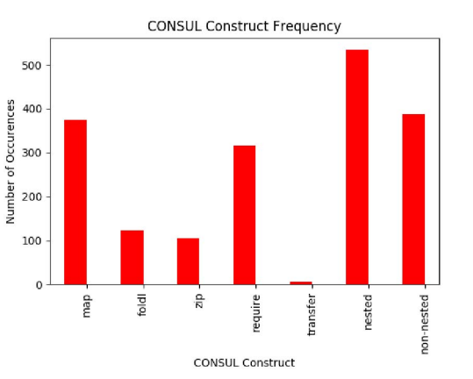
RQ2 What is the relative frequency of Consul constructs that are used in Solidity loop summaries?
The most commonly occurring Consul construct in the synthesized summaries is map. Furthermore, the nested variants of Consul operators occur more commonly than their non-nested variants
Notes:
the relative frequency of each Consul construct in the generated summaries For each DSL operator (map, fold etc), we group together its nested and non-nested version

Slide 49
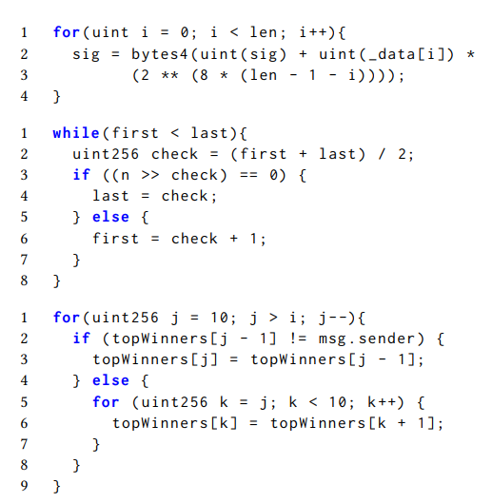
What types of loops cannot be summarized using Solis
There are two reasons why Solis may fail to generate a useful loop summary. One reason is due to the incomplete decomposition heuristic described in Section 4.3. Another reason is the presence of complex arithmetic or nested loops that result in behavior that is not easily expressible in the Consul DSL
Notes:
1- there is no way to summarize this loop because of the iterator I
2-a : it’s a rare state b:there is a big amount of research and information available that discusses this arithmetic variable first and last in detail.
3- the behavior of the outer loop seem to be not expressible in consul although the nested loop has summary that expressible in consul

Slide 50
Threats to validity
We are sure not about the accuracy of the results we got from the experiments

Slide 51
Benchmark Selection
We can evaluate solis in 1200 from 22,685 loops because of the
limitations of our implementation and time restrictions
Notes:
Benchmark Selection. As mentioned earlier, we were able to evaluate Solis on 1220 of the 22,685 loops considered in Section 2 due to limitations of our implementation and time restrictions. However, we believe that our benchmarks are representative enough in terms of both complexity and diversity.

Slide 52
Validity of Summaries:
Solies use bounded number of verification to check if two solidity code are equivlance . based on our manual inspection of randomly sampled summaries, we find that the loops synthesized by Solis are indeed equivalent to the original loop
Notes:
In theory, this means that some of the summaries synthesized by Solis may not actually be equivalent to the original loop. However, based on our manual inspection of randomly sampled summaries, we find that the loops synthesized by Solis are indeed equivalent to the original loop

Slide 53
DSL Construction:
We build our consul so may not be representative enough to represent all the common loop found in in solidity code.
To mitigate this concern, our DSL design was guided by static analysis, semantic clustering, and random sampling as detailed in Section 2
Notes:
To mitigate this concern, our DSL design was guided by static analysis, semantic clustering, and random sampling as detailed in Section 2

Slide 54
Conclusion
There is many tools that vetting smart contract but None of the existing techniques aim to determine exact loop invariants that describe how a loop affects the state of a contract.

Slide 55
Loop summarization
Defination is to convert loop l to loop free code.
Benfits:
1- very helpful in program analysis, both in the context of verification as well as symbolic execution .
2- has also been shown to be effective for program optimization.

Slide 56
Equivalence checking
Have two approaches
1-One approach is to construct a so-called product program 𝑃 such that two programs 𝑃1 and 𝑃2 are equivalent if and only if 𝑃 does not have failing assertions [5, 6, 32].
2- An alternative approach is to utilize program logics, such as relational Hoare logic, that can be used to directly prove equivalence

Slide 57
We follow the first approach and construct a simple program this simple approach is sufficient because we have equivlance checker that based on bounded verification

Slide 58
Program synthesis
While program synthesis is a highly active research field with numerous techniques and applications
our work is most similar to inductive synthesizers that rely on explicit search.
Notes:
More concretely, similar to prior efforts in this space [16, 17, 41], our synthesis technique uses type-based reasoning to significantly prune the search space but also utilizes basic static analysis of the original loop to further reduce the space of candidate summaries

Slide 59
CONCLUSION AND FUTURE WORK
In the first section we talked about the study of loops in smart contracts, saw statistics about frequency of loops and syntactic, semantic properties of smart contract loops.
we have also saw a DSL for loop summarizing and examples of this DSL in use.

Slide 60
CONCLUSION AND FUTURE WORK
In this section we talked about the tool solis that summariez loop by search engine and equivalence checker
Our experiments indicate that at least 56% of loops can be summarized using our proposed DSL and 81% of these summaries are equivalent to the original loop.

Slide 61
There are several directions for future work.
1- although we have made initial progress in loop summarization for smart contracts, our tool chain prefer scalability over completeness, resulting in an inability to generate summaries for larger loops despite the existence of equivalent Consul summaries. besides, we aim to explore more effective loop summarization techniques in the future. Secondly, we plan to combine our loop summarization method with existing verification tools like VeriSol [30] to further automate the verification of functional correctness in smart contracts.
FUTURE WORK
Notes:
VeriSol is a formal verification tool developed by Microsoft for verifying smart contracts written in Solidity.

