Slide 1


OVERAPPROXIMATION OF NON-LINEAR INTEGER ARITHMETIC FOR SMART CONTRACT VERIFICATION
MOHAMMED IBRAHIM
&
SONDOS ZOABI

Slide 2

  Motivation
  Background
    Terminology and Notions
  OverApproximation Methods
    LIA Overapproximation
    NRA Overapproximation
    Example
  Experimental Evaluation
  Main Contribution
  Related papers
  Conclusion
AGENDA

Slide 3

MOTIVATION
Smart Contracts Are Critical
Verification is Essential
Challenge: NIA is Hard
Need for a Practical Approach

Slide 4

WHY VERIFY SMART CONTRACTS?
  Smart contracts automate financial and legal processes.
  Bugs can lead to huge financial losses.
  Formal verification ensures correctness of smart contracts.
  SMT solvers are widely used, but struggle with non-linear integer arithmetic (QF_NIA).

Slide 5

NIA is Hard
UNDECIDABILITY
  The satisfiability problem for NIA is undecidable in general.
  This means no algorithm can always determine whether arbitrary NIA formulas are satisfiable.

Slide 6
Challenge
  Verifying smart contracts is difficult due to non-linear arithmetic constraints.
  The need to solve non-linear arithmetic constraints

Slide 7

PROBLEM STATEMENT
How to efficiently verify smart contracts involving NIA?

Slide 8
OVERAPPROXIMATION
  A technique where we replace a hard problem with a simpler one
  The overapproximated formula may have more solutions than the original, but:
    If the simpler formula is unsatisfiable, the original is also unsatisfiable.
    If it’s satisfiable → might be a false positive.

Slide 9
OverApproximation
two overapproximation:
- 1:Overapproximation using Linear Integer Arithmetic – 2:Overapproximation using Non-linear Real Arithmetic
Can approximations replace exact reasoning while keeping results sound and useful?

Slide 10
BACKGROUND

Slide 11

NIA — NON-LINEAR INTEGER ARITHMETIC
NIA refers to arithmetic formulas over integers that may include non-linear operations, such as multiplication between variables, exponentiation, or other non-linear functions.
Example: x⋅y<10

Slide 12
LIA — LINEAR INTEGER ARITHMETIC
LIA is the fragment of integer arithmetic in which all arithmetic expressions are linear—i.e., variables are only multiplied by constants and combined using addition, subtraction, and inequalities/equalities.
Example: 3x+5y−2z≤10

Slide 13
NRA — NON-LINEAR REAL ARITHMETIC
NRA refers to arithmetic formulas over the real numbers involving non-linear operations, such as x⋅y, x^2, or transcendental functions like sin(x), exp(x), etc.
Example: x^2+sin(y)≥1.5

Slide 14


SATISFIABLE / UNSATISFIABLE
Satisfiable: There is an assignment of variables that makes the formula true.
Unsatisfiable: There is no way to assign values to make the formula true.
Important for verification:
  Unsatisfiable often means the property holds .
  Satisfiable may mean there’s a bug or a counterexample.

Slide 15
VC — VERIFICATION CONDITION
is a logical formula generated from a program (or smart contract) and its specification.
It expresses the correctness criteria that must hold for the program to be considered correct with respect to its specification.
If the VC is valid (i.e., always true under all executions satisfying the preconditions), then the program satisfies its specification.
PURPOSE
they are used in formal verification to reduce program correctness to logical reasoning. By generating VCs, we can use automated tools (like SMT solvers) to prove that the program behaves as intended.

Slide 16

CERTORA PROVER
  is a formal verification tool used to automatically check the correctness of smart contracts, especially those written in Solidity (used on Ethereum).
  It allows developers to write logical rules (called specifications) about how the smart contract should behave, and then it mathematically proves whether the contract follows those rules in all possible execution paths—not just specific test cases.

Slide 17
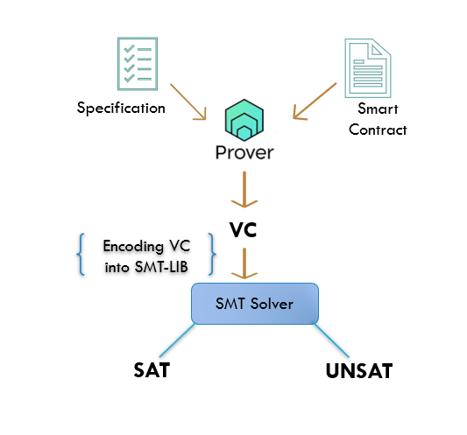
HOW DOES IT WORK ?

Slide 18
QUANTIFIER-FREE LOGIC (QF)
refers to logical formulas that do not use quantifiers such as ∀ (for all) or ∃ (there exists).
In other words, QF formulas are built using logical connectives (like AND, OR, NOT), variables, constants, and operators, but do not contain universal or existential quantification.

Slide 19
QF_NIA
QF_NIA = QUANTIFIER-FREE NON-LINEAR INTEGER ARITHMETIC
  The domain is integers.
  Arithmetic expressions can include non-linear operations, such as multiplication of variables (x⋅y), powers (x^2), etc.
  The formulas are quantifier-free, meaning no use of ∀ (for all) or ∃ (there exists).

Slide 20
PREDICATE AND FUNCTION SYMBOLS
INTEGERS:
REALS:

Slide 21

NOTATION & SYNTAX
  SMT Variables: Represented as a, b
  First-order variables: x, y, z
  Terms: t, u, s (e.g., a + 1)
  t⇝s means replacing term t by s in the formula.
  Formulas: f, Boolean expressions
  Comparison shortcuts:

Slide 22
NOTATION & SYNTAX
±Position in formula: Represented as a sequence (e.g., 1.2.3) to locate a subterm or subformula.
±Polarity: Whether a subformula appears under negation or not (important for approximation/refinement).

Slide 23
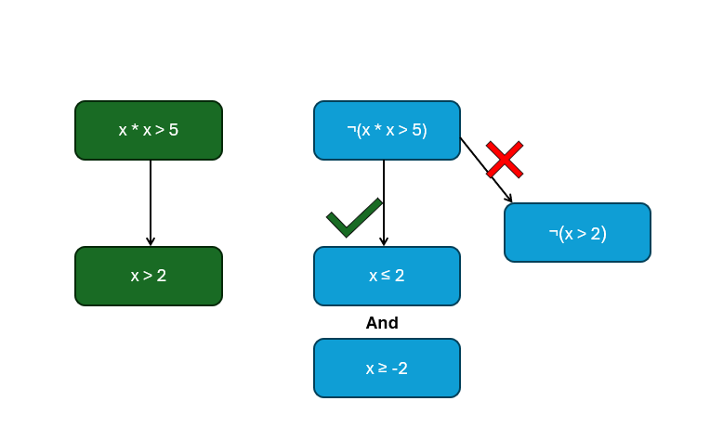
EXAMPLE- POLARITY:

Slide 24
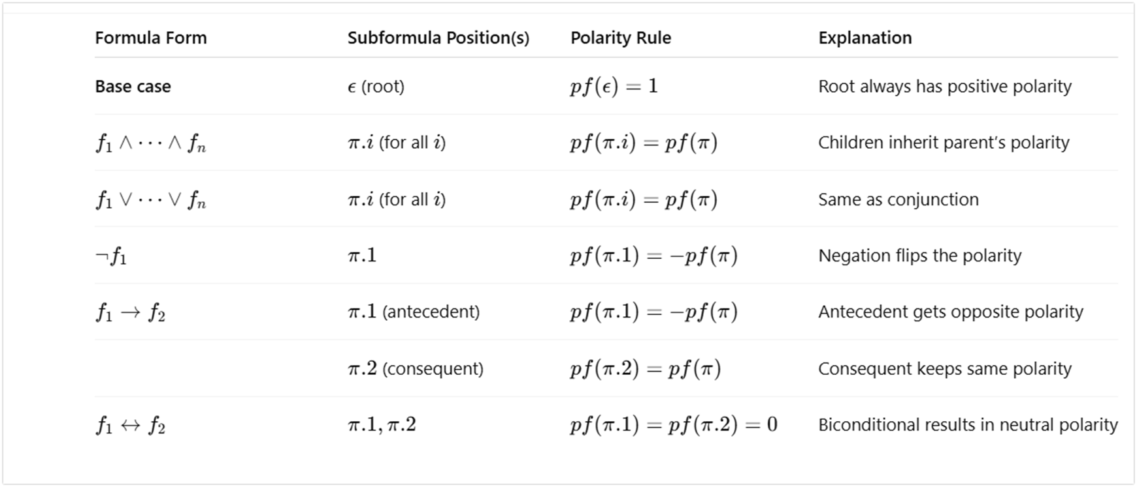
POLARITY
LET F BE A FORMULA . THEN, FOR EACH (SUB)FORMULA F ′ AT POSITION Π OF F: IF F ′ HAS THE FORM:

Slide 25
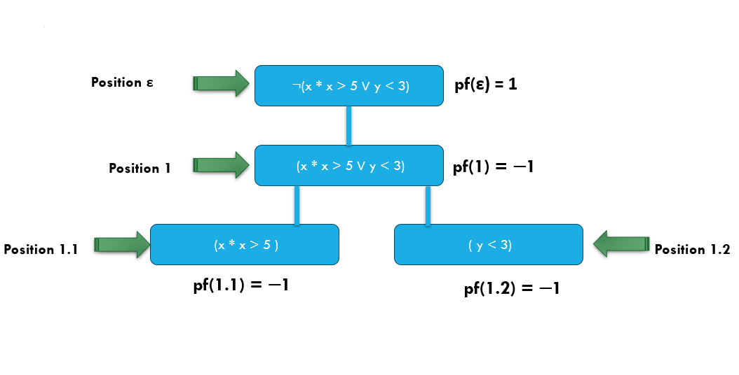
POSITION & POLARITY

Slide 26

OVERAPPROXIMATION METHODS

Slide 27
  The goal is to build overapproximations of a QF_NIA formula f_NI using LIA and NRA, resulting in f_LI and f_NR.
  An overapproximation f is valid if its unsatisfiability implies that f_NI is also unsatisfiable.
  A tighter overapproximation has fewer models, making it more accurate but often more complex to solve.

Slide 28

LIA
OVERAPPROXIMATION

Slide 29
FIRST:
  - Replace non-linear operations (NIA) with uninterpreted functions (UF):
SECOND:
to tighten the overapproximation, the transformation adds axioms constraining umul, udiv, umod to the formula ->

Slide 30
AXIOM ADDITION:
  Arithmetic properties (commutativity, identities, result ranges)
  Conditional link to linear multiplication when constants are used
  Overflow-sensitive properties
  Modular identities from two's complement arithmetic
  •Relations like monotonicity and distributivity between multiplications

Slide 31
Example of aximos
  Arithmetic properties (commutativity, identities, result ranges)
  Commutativity: umul(x, y) = umul(y, x)
  Identities:
  umul(x, 1) = x
  udiv(x, 1) = x
  umul(x, 0) = 0
  Result Ranges:
  0 ≤ udiv(x, y) ≤ x
  0 ≤ umod(x, y) < y
  Conditional linking to linear multiplication:
  * If y is a constant: umul(x, 3) = x + x + x
  Distributivity:
  umul(x, y + z) = umul(x, y) + umul(x, z)

Slide 32
Axomis
  Applied only to original terms
  Not applied recursively
  Final formula: fᴸᴵ
    Easier for SMT solvers

Slide 33


NRA OVERAPPROXIMATION

Slide 34

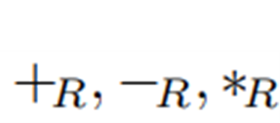
  All variables and operations are switched from integer to real types.
  replace by
  Integer division and modulo are approximated using new uninterpreted functions:
FIRST:

Slide 35
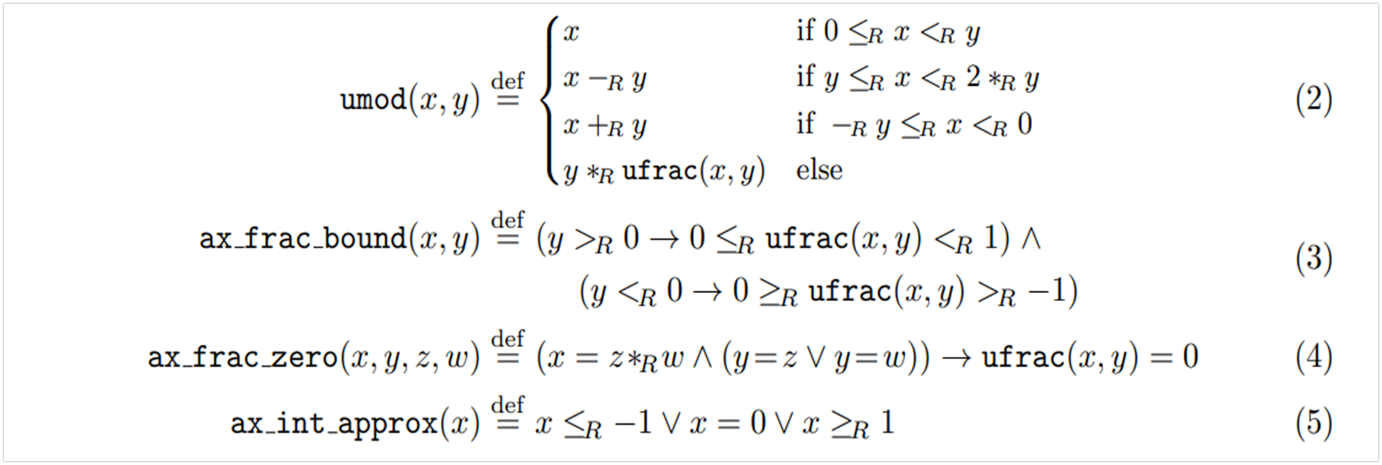
SECOND:
WE AXIOMATIZE THE NEW FUNCTION SYMBOLS:

Slide 36
THIRD:
  Convert inequalities with positive polarity to use negated counterparts:
  Relax inequalities with negative polarity:

Slide 37

EXAMPLE

Slide 38
We verify a simplified Ethereum smart contract
• Tracks assets: Shares and Money
• All variables are modeled as non-negative integers
• Total supply of shares (tS) and total monetary value (tM) are non-zero
If we withdrew wS shares, these shares would be sold and we would obtain the monetary value wM = (wS ∗ tM) div tS.

Slide 39
• nS new shares are added to the total supply tS
• New shares have the same per-share value as old shares (approx. via div)
• New total supply: t′S = tS + nS
• New total monetary value: t′M = tM + ((nS ∗ tM) div tS)

Slide 40
• wS shares are withdrawn from the new supply t′S
• Withdrawn monetary value:
w′M = (wS ∗ t′M) div t′S
w ′ M = (wS ∗ t ′ M) div t′ S
WE WANT TO PROVE THAT
WM ≥ W′M

Slide 41
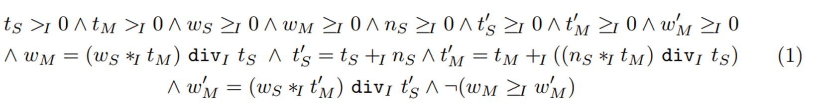
We encode this example in QF_NIA. We construct the verification condition for the example as a conjunction of all the assumptions and a negation of the conjecture:

Slide 42
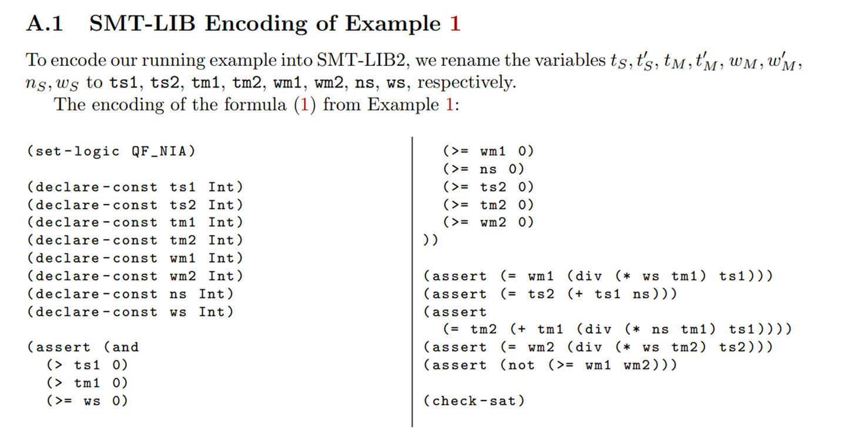

Slide 43
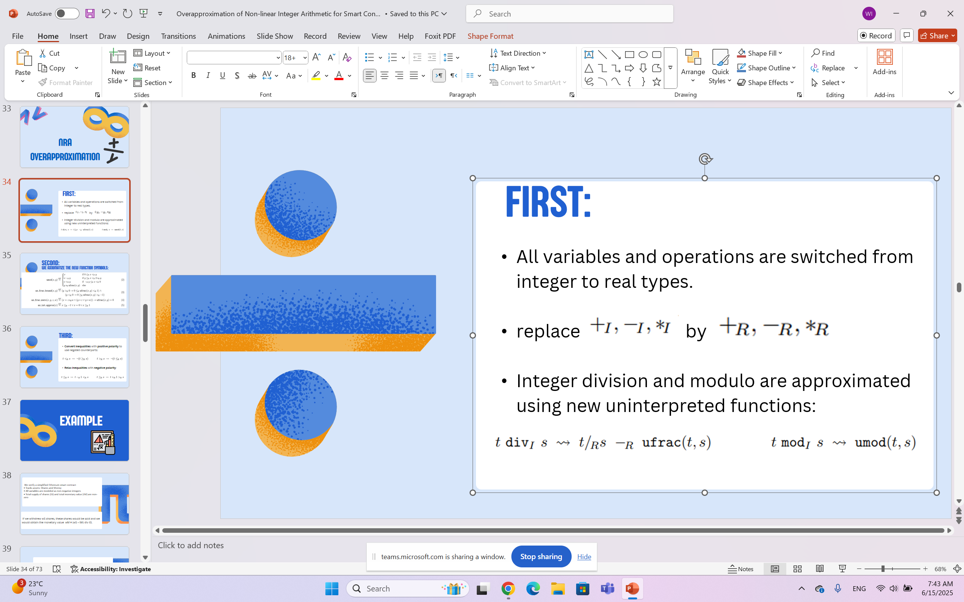

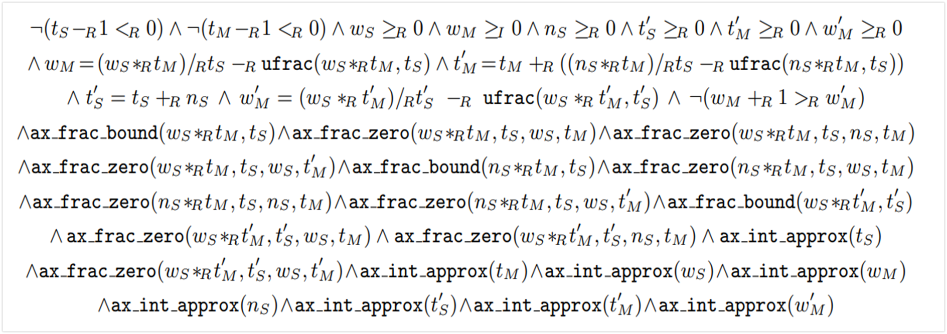

USING THE NRA OVERAPPROXIMATION METHOD:

Slide 44

AXIOMATIZE
for every variable x apply: ax.int.approx(x)
For example:

Slide 45

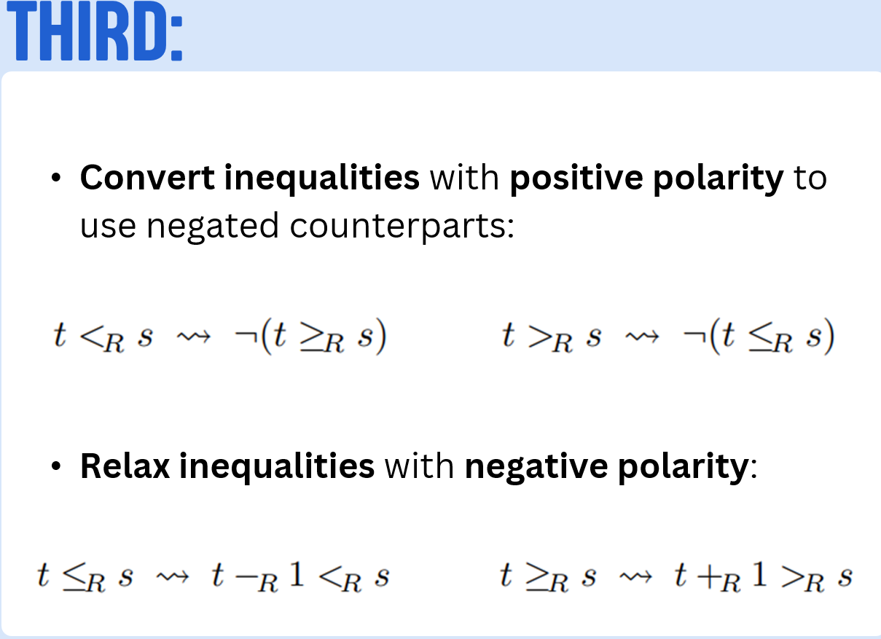
inequalities:

Slide 46
USING THE NRA OVERAPPROXIMATION METHOD, WE GET THIS FORMULA:

Slide 47
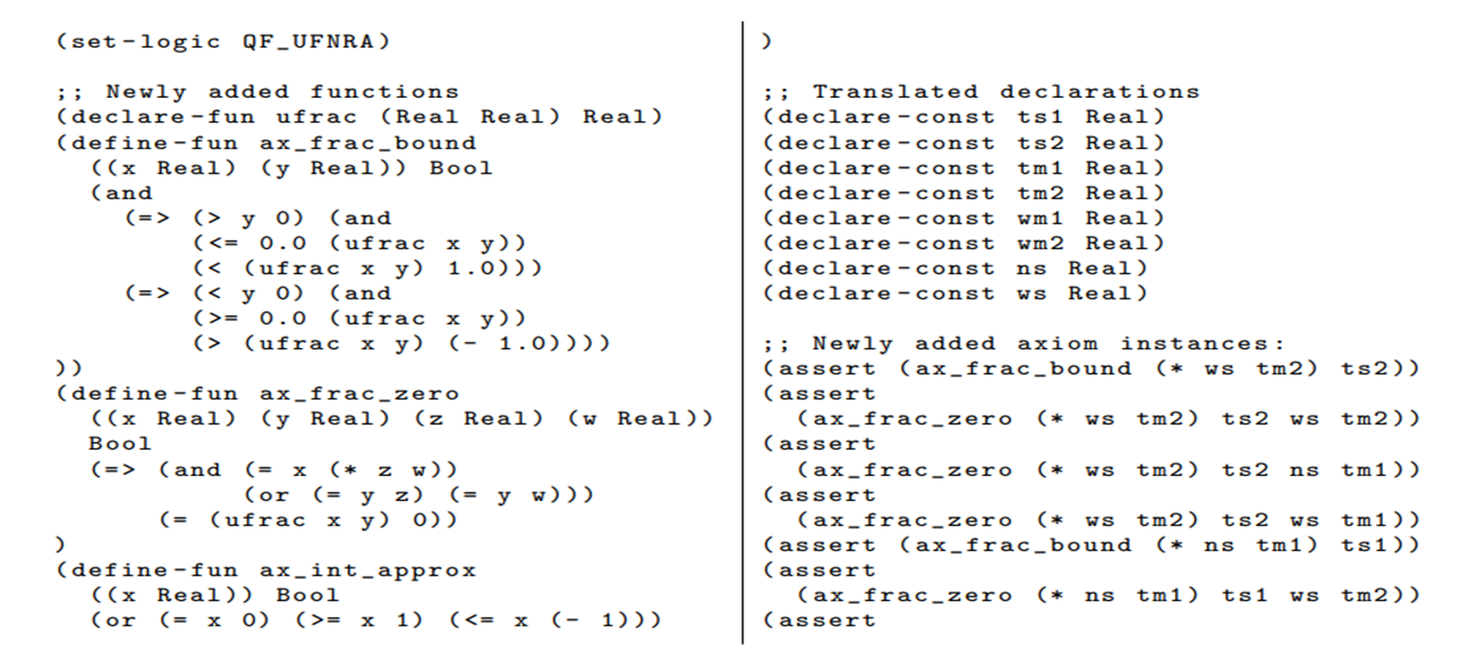
WHEN ENCODED IN THE SMT-LIB2 SYNTAX, THIS FORMULA IS PROVED UNSATISFIABLE BY THE SMT SOLVERS YICES2 AND CVC5. ITS SMT-LIB2 ENCODING IS:

Slide 48
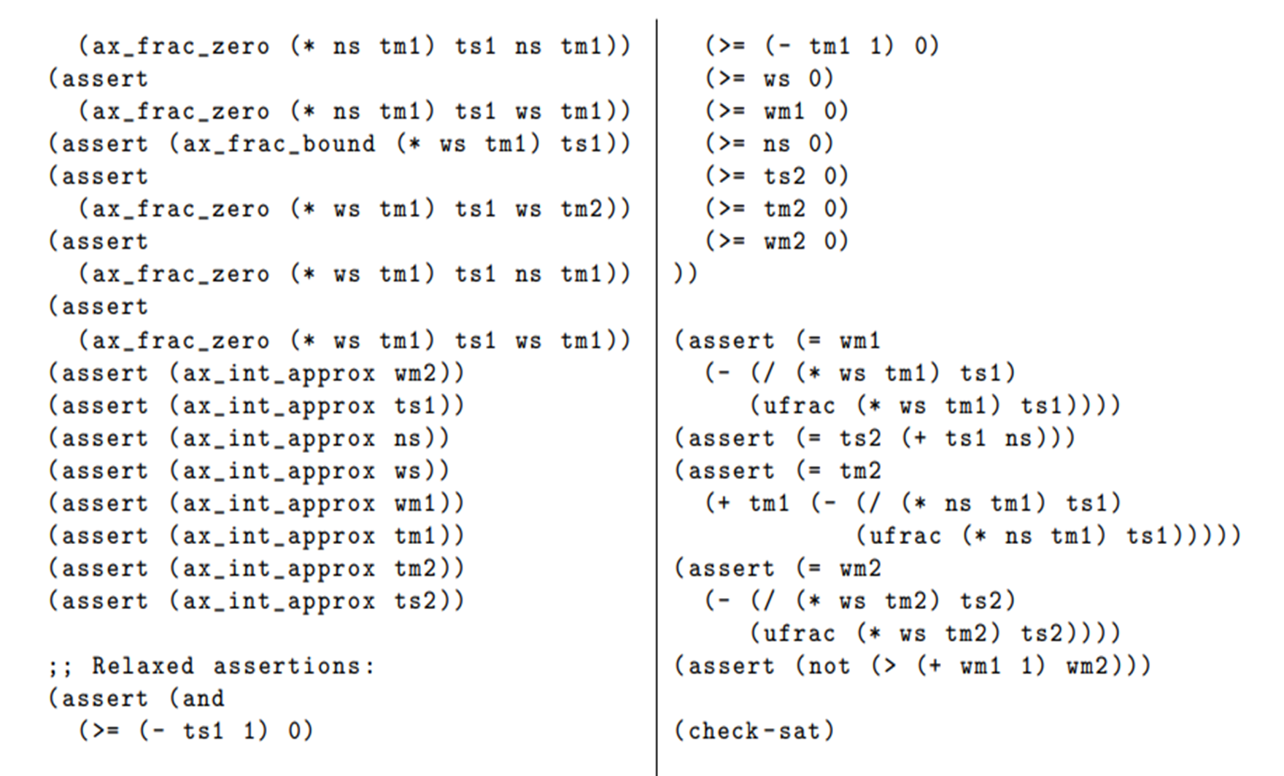

Slide 49
EXPERIMENTAL EVALUATION

Slide 50
EXPERIMENTAL SETUP
The researchers evaluated 792 verification problems derived from customer smart contracts using the Certora Prover. These problems were encoded using non-linear integer arithmetic (NIA) and compared with their overapproximated versions using both techniques:
  LIA overapproximation was integrated directly into the Certora Prover.
  NRA overapproximation was prototyped using Python and PySMT.

Slide 51
EXPERIMENTAL SETUP
The benchmarks consist of two encodings (QF UFNIA and QF UFDTNIA) of 396 problems, differing by how they model hash functions.
300 satisfiable benchmarks were excluded, leaving 246 in each encoding.
Overapproximated sets (e.g., QF UFLIA, QF UFNRA) were generated accordingly.

Slide 52
EXPERIMENTAL SETUP
The solvers cvc5, MathSAT, Yices2, and Z3 were tested on both original and approximated benchmarks. All experiments were executed on a machine with 32 cores and 1 TB RAM, aligning with SMT-COMP 2022 standards.

Slide 53
VBS — VIRTUAL BEST SOLVER
  It is a virtual baseline that picks the best result from all available solvers for each benchmark.
  Used to measure the maximum possible performance.
  Not a real solver!

Slide 54
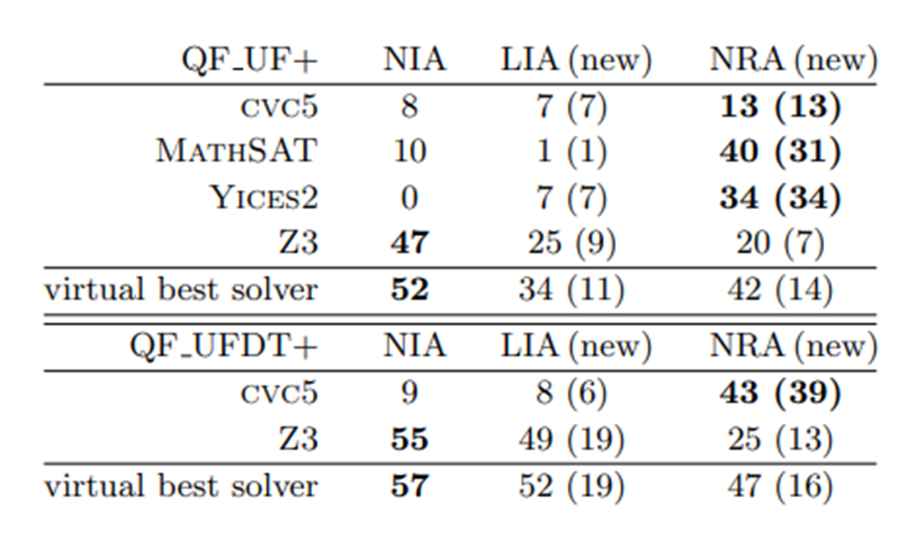
EXPERIMENTAL RESULTS

Slide 55
EXPERIMENTAL RESULTS
  From 492 benchmarks:
    LIA and NRA overapproximations each solved 30 new problems that could not be solved in the original NIA form.
    This is a 28% increase over NIA-only solving.
  When combining both overapproximations:
    The Virtual Best Solver (VBS) solved 50 new problems in QF_UF+ and 59 new problems in QF_UFDT+.
    Resulting in a 39% overall improvement in verification success.

Slide 56
EXPERIMENTAL RESULTS
  NRA overapproximation notably improved performance of:
    cvc5, MathSAT, and Yices2
    Z3 performed best on NIA but did not benefit as much from NRA.
  Virtual best solver results:
    QF_UF+: 52 (NIA), 34 (LIA), 42 (NRA)
    QF_UFDT+: 57 (NIA), 52 (LIA), 47 (NRA)

Slide 57
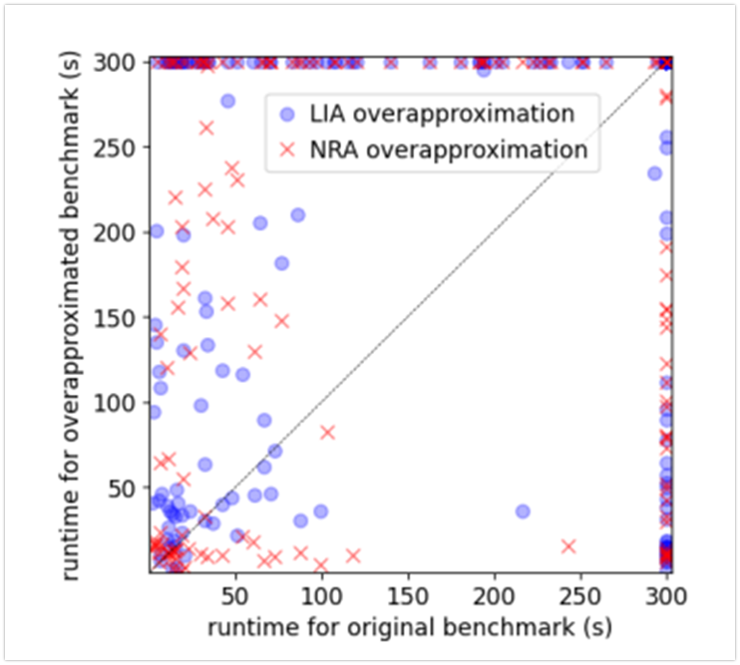
RUNTIME COMPARISON:

Slide 58
RUNTIME COMPARISON:
  Most benchmarks were solved faster or at comparable speed with the overapproximations.
  LIA overapproximation is generally more consistent and less prone to timeouts.
  Around 40 problems were solved faster in original (vs. LIA), and 35 in original (vs. NRA).

Slide 59
TIGHTNESS OF APPROXIMATIONS:
  LIA: Very tight.
    Of 109 problems originally UNSAT in NIA:
      0 became SAT in LIA
      53 were not solved in LIA
  NRA: Less tight.
    24 originally UNSAT problems became SAT
    26 were not solved at all
    Suggests that NRA might be too loose and could benefit from refinement.

Slide 60
BENCHMARK COMPLEXITY
  Average usage per problem:
    Multiplication: 83 times
    Division: 37 times
    Modulo: 47 times
  Overapproximations increased file size:
    LIA: +70%
    NRA: +243%
  Each problem averaged 1361 variables, affecting solver performance.

Slide 61
GENERAL SMT BENCHMARKS
The authors tested whether their NRA overapproximation tool would help beyond smart contracts, specifically on general SMT benchmarks from the SMT-LIB library.
Tested Benchmark Sets
  QF_NIA: Quantifier-Free Non-Linear Integer Arithmetic.
  QF_UFNIA: Quantifier-Free Uninterpreted Functions with NIA

Slide 62
FINDINGS:
  QF_NIA: Very few problems used division or modulo, which are the focus of the overapproximation.
  QF_UFNIA: Non-linear operations appeared only inside function definitions, so the overapproximation tool did not add any useful axioms.

Slide 63
FINDINGS:
One Notable Exception
  Yices Solver on QF_NIA:
    Solved 5243 problems in the original set.
    Solved 5992 problems in the overapproximated set.
⇒ Improvement of 749 problems, which is significant.

Slide 64
CONCLUSION
  Overapproximation (especially LIA) can significantly increase smart contract verification success.
  NRA is promising but needs tightening to reduce false SAT results.
  Overapproximation methods must be tailored to the target domain for best performance.

Slide 65
MAIN CONTRIBUTION

Slide 66
The overapproximations enabled the verification of 39% more real-world examples that could not be verified with the original NIA encoding.
These examples are not synthetic—they come from real customer smart contracts and are publicly available.
Proving more properties—even with some overapproximation—can make smart contract verification more practical and scalable in real-world tools like the Certora Prover.

Slide 67
RELATED
PAPERS

Slide 68
“A SURVEY OF ATTACKS ON ETHEREUM SMART CONTRACTS”
• The survey identifies integer overflow and underflow as serious vulnerabilities.
• This paper directly addresses this class of bugs, especially when it involves non-linear arithmetic, which SMT solvers struggle with.

Slide 69
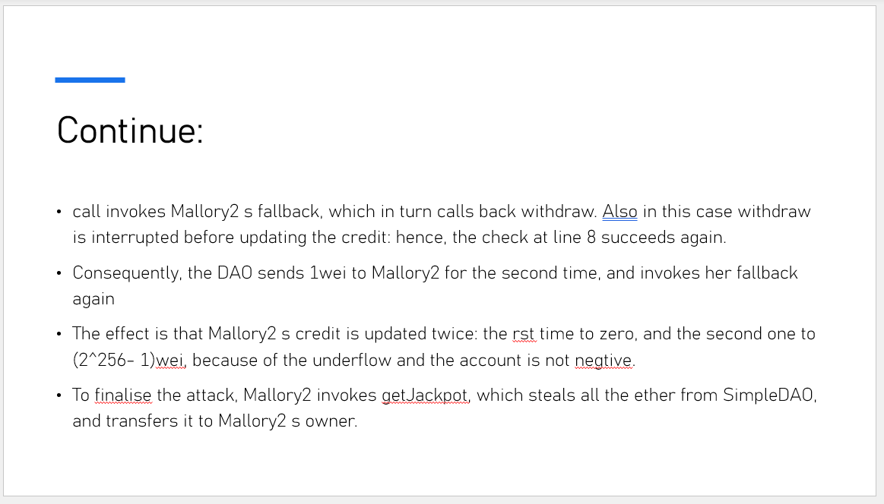
REMINDER...
CREDIT: GUY & OZ

Slide 70
CONCLUSIONS

Slide 71
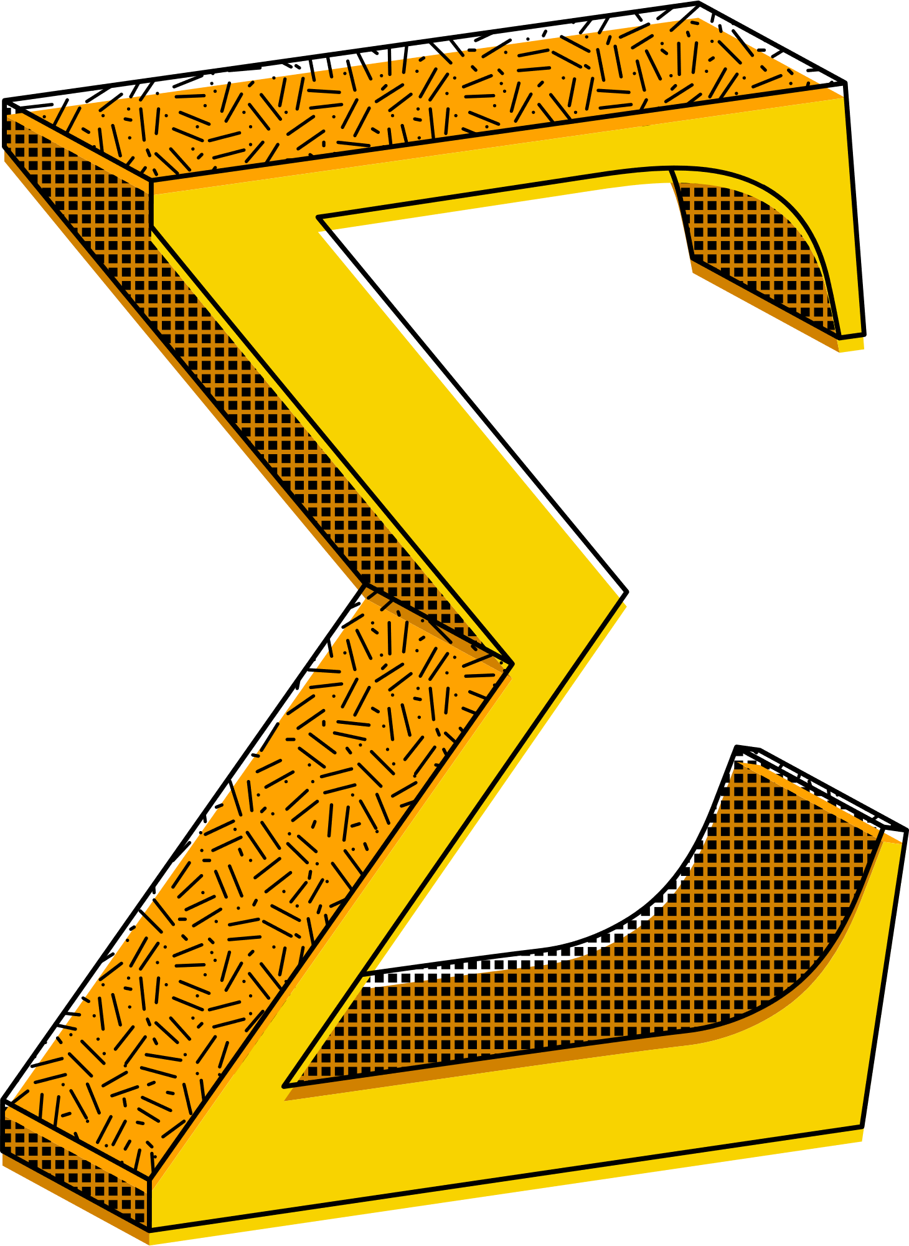
Both methods significantly improved the solvability of many industry benchmarks that were previously unsolved in their native NIA form.
The NRA-based method still has room for improvement and refinement.
This demonstrates the value of domain-specific overapproximation techniques for smart contract verification.

Slide 72
