Slide 1

Formal Verification of Workflow Policies for Smart Contracts in Azure Blockchain
Presented by Shaked Gitta & Bar Wanunu

Slide 2
Lecture Highlights
🌐 The motivation behind verifying smart contracts
🧩 What is semantic conformance and why it matters
🛠️ The proposed solution: VeriSol – a formal verifier for Solidity
🔁 How VeriSol translates Solidity into the Boogie verification language
📊 Evaluation on real Azure Blockchain contracts
🐞 Bugs discovered through formal analysis
🔍 Comparison to existing tools and future directions

Slide 3
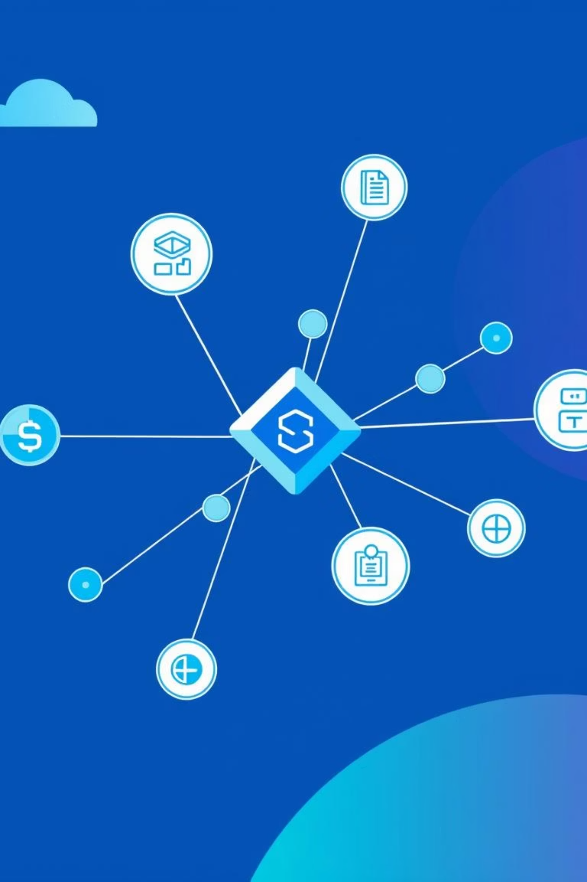
Key Terminology & Background
Smart Contracts
Self-executing contracts with terms directly written into code.
Solidity
A popular programming language for writing smart contracts.
Blockchain-as-a-Service (BaaS)
Cloud-based platforms for deploying and managing blockchain applications.
Azure Blockchain Workbench
Microsoft's enterprise tool for deploying smart contracts with workflows.

Slide 4
Motivation for Formal Verification
Financial Loss
Smart contract bugs cause massive financial losses. Examples: The DAO hack ($60M), Parity Wallet bug ($169M).
As mentioned in the first lecture of the semester. A survey of attacks on Ethereum smart contracts.
Enterprise Need
Strong correctness guarantees are crucial for enterprise blockchain environments (BaaS).

Slide 5
The DAO Attack (2016)
A vulnerability in the withdrawal logic allowed an attacker to re-enter the contract recursively, withdrawing funds multiple times before the balance was updated.
function withdraw(uint amount) public { if (credit[msg.sender] >= amount) { msg.sender.call.value(amount)(); credit[msg.sender] -= amount; } }
The problem here was that the state change (reducing the amount from whom called the function) took action after the external call.
The attacker used recursive fallback functions to re-enter the function before the balance was reduced.
After this attack, the awareness for formal verification of smart contracts rose up tremendously.
VeriSol aims to formally verify correctness and prevent logic bugs like this by checking conformance with intended policy logic and control flow.

Slide 6
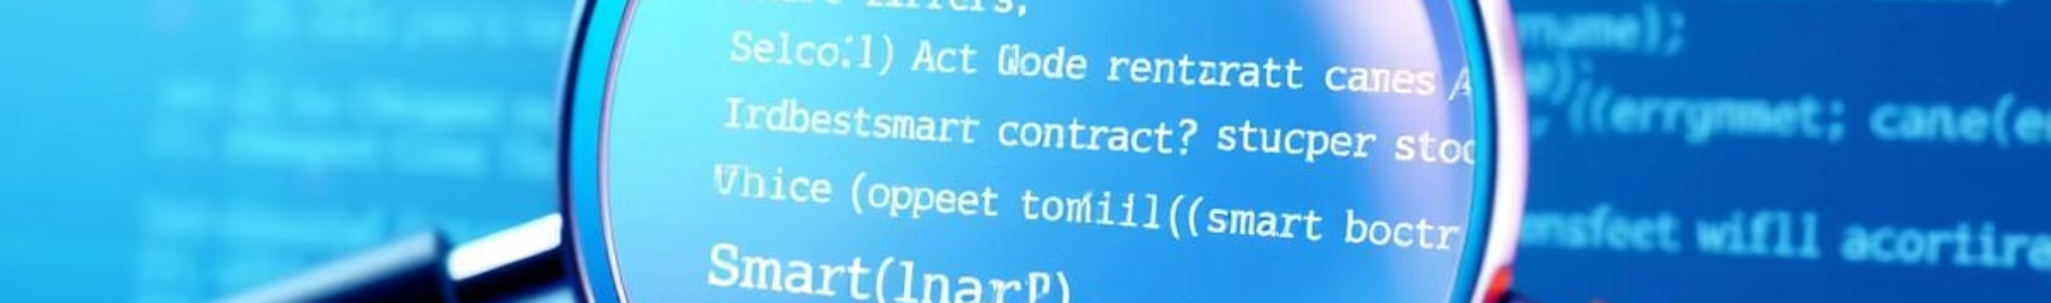




Main Contributions
Semantic Conformance
Formalization of semantic conformance between contract and workflow policy.
VeriSol
Introduction of VeriSol, an automatic verifier using Boogie for smart contracts.
Optimization
Discovering bugs in the contracts before running the environment.
Bug Discovery
Discovery of real bugs in official Azure contracts.

Slide 7
What is a Policy?
A policy defines the allowed behavior of a smart contract.
It specifies:
  Contract states
  User roles
  Allowed actions per role and state
What is an FSM?
A formal model with:
  A list of all valid states
  Transitions between states triggered by actions
  The contract behaves like a state machine, moving between states via approved actions.
  The FSM enforces the rules defined by the policy, allowing the contract to move between states in a controlled and secure manner.

Slide 8
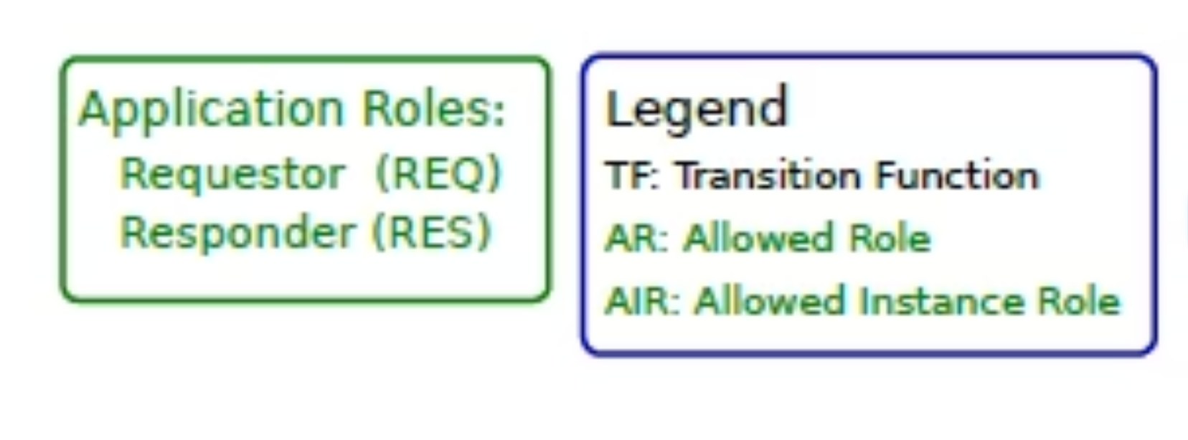
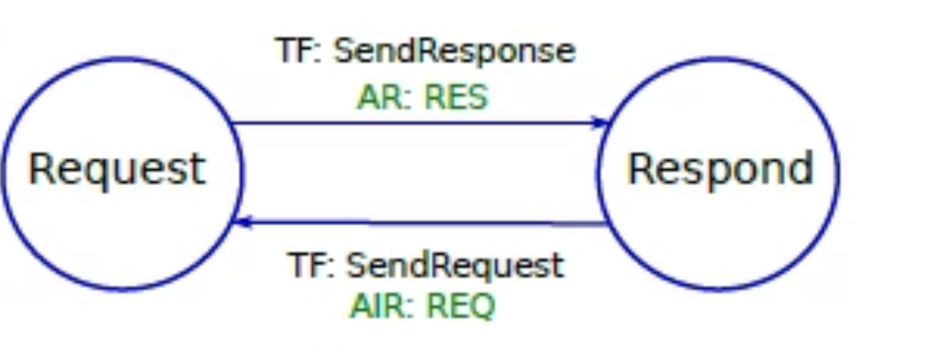
Application Example: HelloBlockchain
Roles: Requestor (REQ) and Responder (RES)
States: Request and Respond
Actions:
  SendRequest() by Requestor → goes to Request
  SendResponse() by Responder → goes to Respond
Workflow Diagram
Visual FSM showing:
  Which role can do which action
  How each action transitions the contract to the next state
This diagram is the policy model the smart contract must follow.

Slide 9
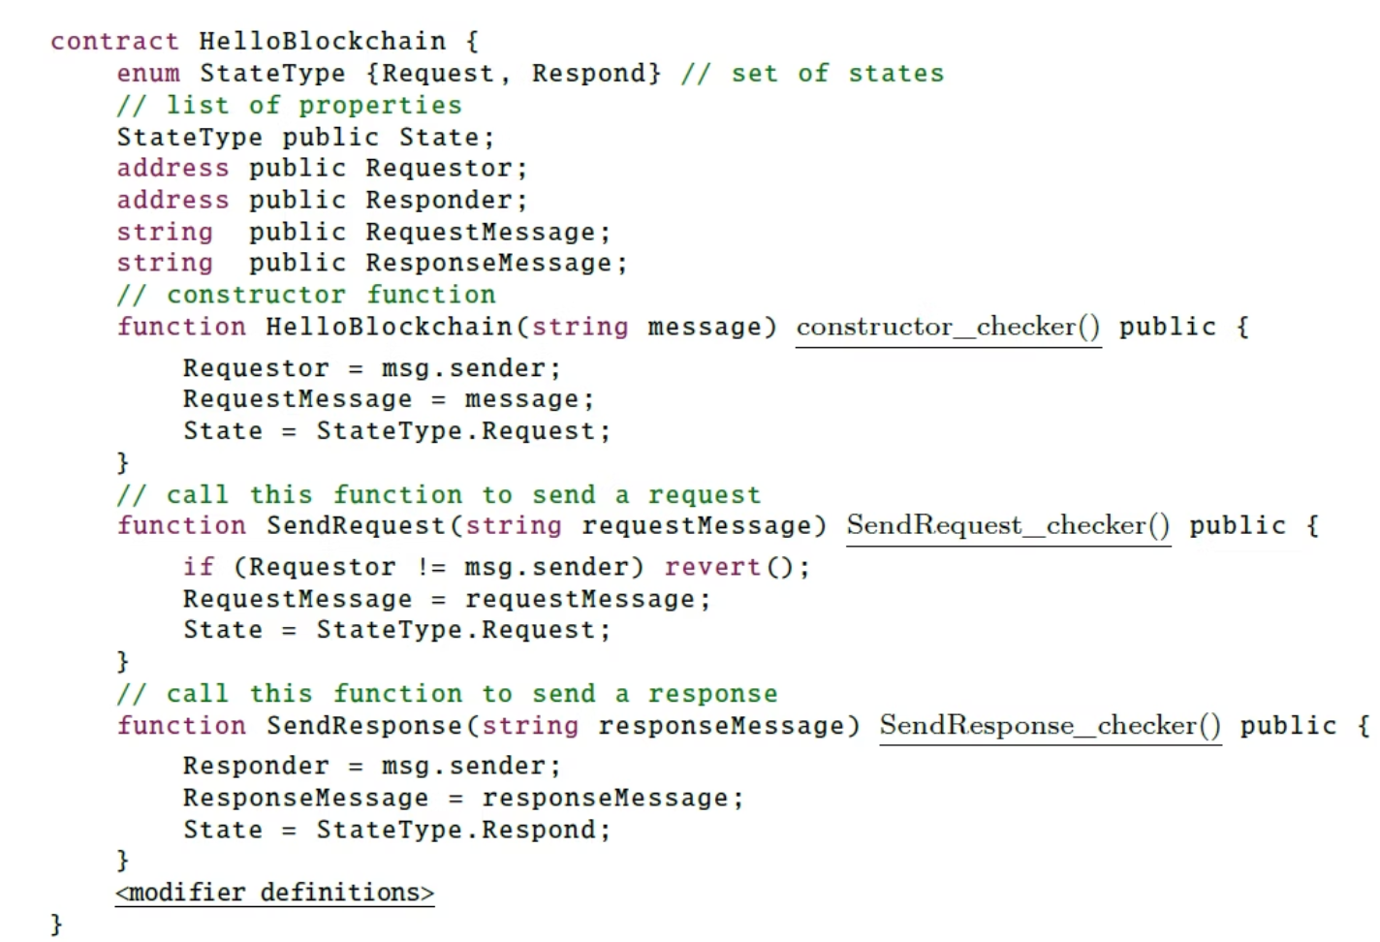
Implementing the Policy in Solidity
Constructor:
  Initializes the contract with the sender as Requestor and sets the state to Request.
State-changing Functions:
  Two public functions: SendRequest() and SendResponse()
  Each function updates the state and relevant variables
These functions mirror the transitions defined in the FSM policy from Figure 1.

Slide 10

What is Semantic Conformance
How can we be sure that the smart contract truly follows the policy (FSM)?
Semantic Conformance means:
The contract starts in the correct initial state
Each function:
  Is called in the right state
  By the right role
  Causes a valid state transition (as allowed by the policy)
Manual checking is not enough
→ Errors can still happen unless verified formally and automatically

Slide 11
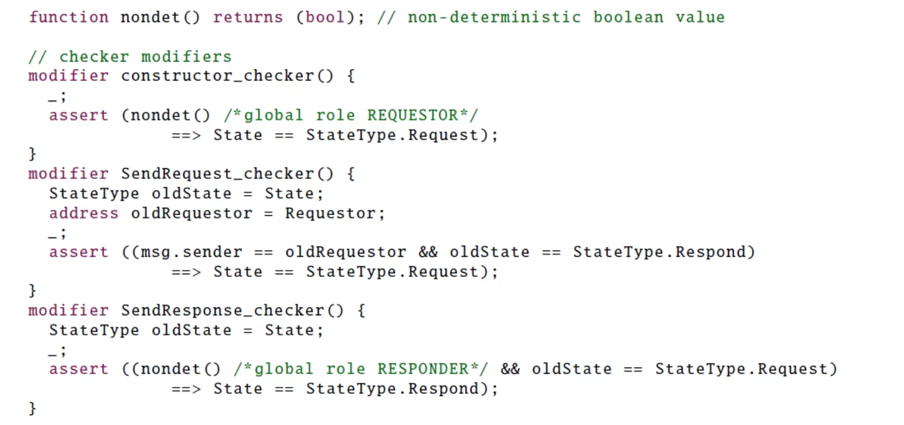
How Do We Check Semantic Conformance
The Goal:
Make sure each function:
Is called by the correct user role
In the correct state
Causes the correct state change (as defined in the FSM policy)
The Solution: Use Solidity modifiers
We add a modifier to each function that checks correctness using assert
  If we were in Respond
  And Requestor called SendRequest()
  Then the new state must be Request

Slide 12
VeriSol
VeriSol = Verifier for Solidity
A tool developed by Microsoft to formally verify smart contracts.
What It Does:
Why It Matters:
Translates the contract into Boogie Analyzes the code without running it
Fully automatic and scalable
Catches errors before deployment
Checks that all transitions and conditions match the FSM policy
Verified all Azure Blockchain sample apps (after fixes)
Finds bugs or proves full correctness

Slide 13
Formal Definition of a Policy in Azure Blockchain Workbench.
A policy = a pair (R, W)
R: global roles (Requestor, Responder)
W: workflows (each defined as a Finite State Machine)
Each workflow is a tuple: ⟨S, s₀, Rw, F, F₀, ac₀, γ⟩
s₀: initial state
Rw: instance roles (Responder)
F: contract functions (actions)
F₀: constructor
ac₀: who can create a new instance
γ: transitions of the form (startState, function, allowedRole, targetStates)

Slide 14
Semantic Conformance
Semantic Conformance is the contract’s behavior matches the policy in every possible case.
Based on Hoare Logic:
For every contract function, we define a triple:
{Pre-condition} → [Action] → {Post-condition}
Purpose:
Ensure only the right user roles can perform actions
Only in the correct states
Resulting in valid state transitions
This allows formal verification of behavior using logical rule

Slide 15
Formal Triples for Conformance
Two main types of checks:
Initiation (Contract Creation): {sender ∈ ac₀} constructor(...) {state = s₀}
– The contract must start in the initial state when created by an authorized user.
Consecution (Transitions): {sender ∈ role ∧ state = s1} f(...) {state ∈ S₂}
– A user with the right role can trigger function f only from state s1 and it must lead to one of the allowed target states in S₂.
VeriSol checks these conditions statically.
If all hold — the contract semantically conforms.If not — it finds a counterexample.

Slide 16
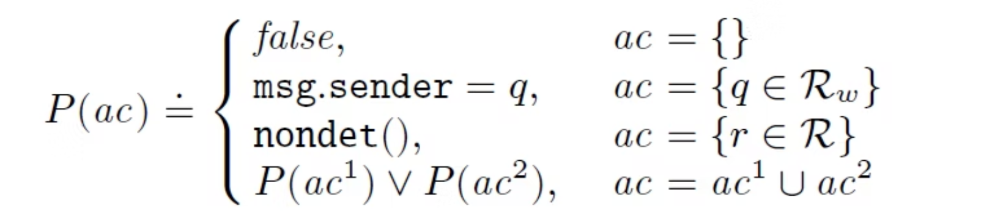
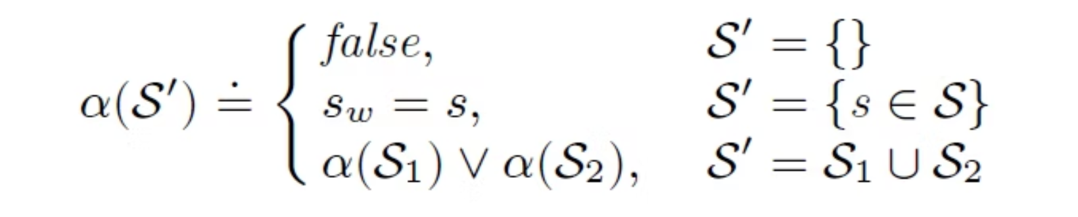

Logical Predicates for Verification
P(ac) – Checks if the sender is allowed to act
α(S') – Checks if the current state is valid
nondet() is a placeholder function that returns a random True/False
It models global roles when exact verification is impossible at compile time.
This allows VeriSol to analyze the contract conservatively and safely.

Slide 17
Using the Predicates in Code
VeriSol uses P(ac) and α(S') to verify access control and state transitions.
These predicates appear in autogenerated modifiers that wrap contract functions.
Example: Constructor Modifier
Ensures that the constructor is only called:
  By an authorized role (P(ac₀))
  And initializes to the correct state (s₀)

Slide 18
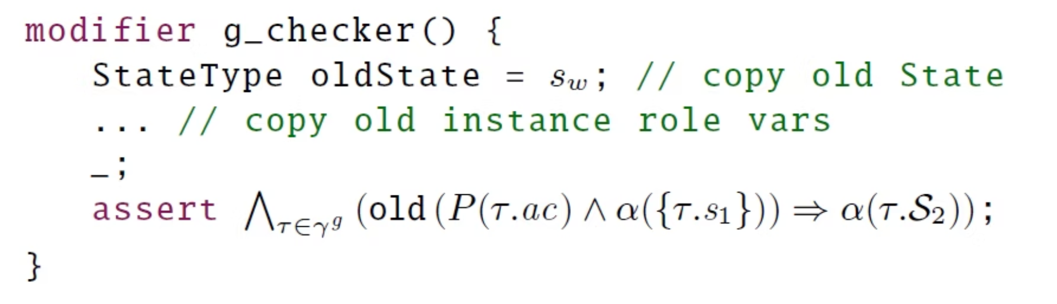
Using the Predicates in Code
Example: Function Modifier
Let \gamma^g ​be the set of transitions for function g.
Each transition τ ∈ \gamma^g ​is a tuple: τ = (s₁, g, ac, S₂)
s₁ = source state
g = function name
ac = access control roles allowed to call this function in state s₁
S₂ = valid next states (can be more than one - a group of states)
For all transitions τ in \gamma^g ​ if sender is allowed (P(τ.ac)) AND current state is τ.s1 → then after function, the new state must be in τ.S₂

Slide 19
Formal Verification using VeriSol
VeriSol’s General Verification Method
Goal: Formally prove that all assert statements in a smart contract are never violated.
Based on generating a contract invariant I such that
{true} f₀ {I} — The constructor establishes I
{I} fᵢ {I}⁣ — Every public function preserves I
This ensures that if the constructor sets I, and every function maintains ⁣I, then I holds throughout any execution of the contract.

Slide 20
So What Is the Invariant I?
I is a logical property (or predicate) that must hold true in every legal state of the contract.
Think of I as a global safety rule:
Example: "The balance of any account is never negative"
Example: "Only registered voters can vote"
VeriSol checks that:
I is initialized correctly by the constructor
I is preserved by every public function
If both hold ⇒ All asserts are guaranteed to succeed

Slide 21

General Methodology
C = \{\lambda\vec{x}_0.f_0,\ \lambda\vec{x}_1.f_1,\ \dots,\ \lambda\vec{x}_n.f_n\}
\lambda\vec{x}_0.f_0​: Constructor function
\lambda\vec{x}_1.f_1,\ \dots,\ \lambda\vec{x}_n.f_n: Public contract functions
\vec{x}_i​: Input parameters to each function
What is C?
C is a vector that lists all possible externally invoked functions in the smart contract—these are the key points where state can change.

Slide 22
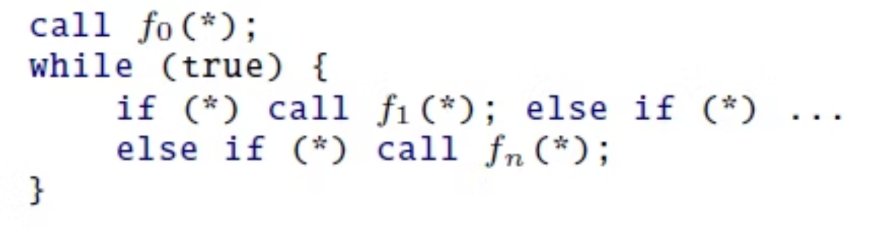
VeriSol’s Contract Harness
This "harness" simulates all possible usages of the contract:
* represents a nondeterministic (random) decision -if (*) means the program non-deterministically decides whether to call f1 or not.
The loop models an unbounded sequence of public function calls.
If we prove I holds after any number of calls in this loop, we can trust the contract under any usage pattern.
The harness works by creating an instance of the contract by calling the constructor, and then repeatedly and non-deterministically calls one of the public functions of C.
VeriSol checks both (1 - {true} f₀ {I}) and (2 - {I} fᵢ {I}) conditions we mentioned before, where the state I is the preserved state after every action.
Then, the contract will be formally verified.

Slide 23
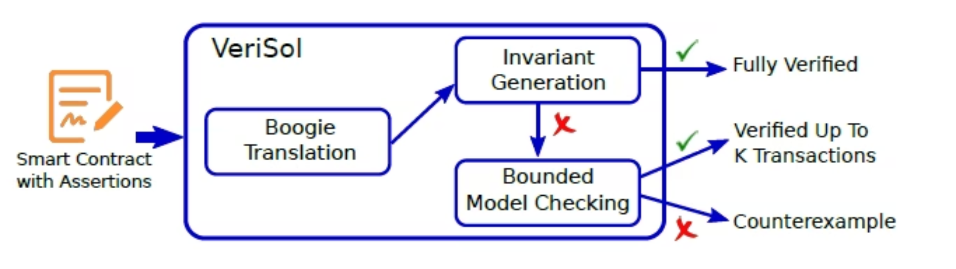
System Architecture
VeriSol has 3 main components:
Input: Solidity contract with assertionsOutput: One of three results:
Boogie TranslationTranslates Solidity → Boogie (formal IR)
Fully Verified – no assertion can ever fail
Invariant GenerationFinds I: a formula that must always be true(established by constructor and preserved by all functions)
Partially Verified – safe only up to k function calls
Refuted – at least one assertion fails in some scenario
Bounded Model CheckingUnrolls the harness loop k times and checks all paths for assertion failures

Slide 24


Why Translate Solidity to Boogie?
Goal: VeriSol translates Solidity code into Boogie code
Why? Boogie is an intermediate verification language used by static analyzers.
Solidity has high-level syntax (e.g., msg.sender, state variables)
Boogie is simpler, logic-based, and easier to analyze formally
📥 Solidity → 🛠 Boogie → 🧪 Verification

Slide 25
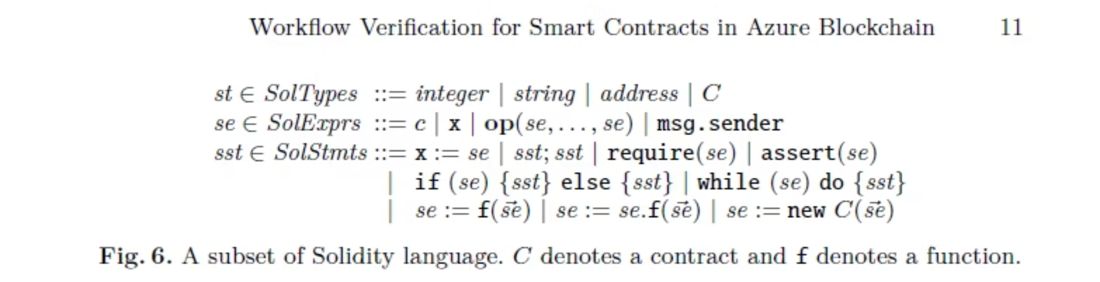
Solidity Language – Overview
Solidity is a contract-oriented, high-level language designed for writing smart contracts on the Ethereum blockchain.
• Types (SolTypes)
• Statements (SolStmts)
→ Solidity supports integer, string, address, and contracts (C).
Assignments (x := se)
• Expressions (SolExprs) → Expressions include constants (c), variables (x), operations (op), and msg.sender.
Sequencing (sst; sst)
Preconditions (require(se))
Assertions (assert(se))
Conditionals (if-else)
msg.sender⁣- The address of the person who calls the function in the smart contract.
Loops (while)
Function calls (f(se))
External calls (se.f(se))
Contract creation (new C(se))

Slide 26
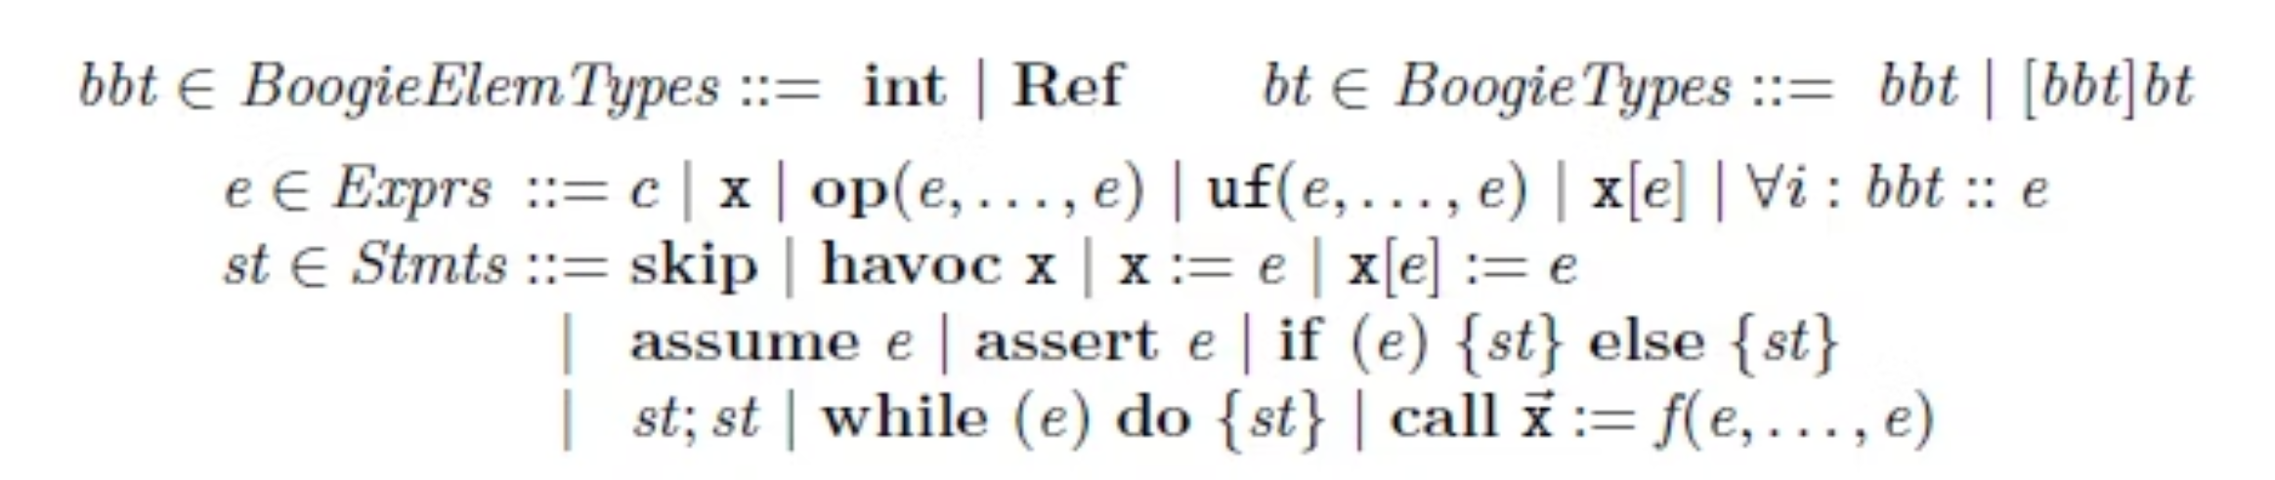
Boogie Overview
• Types (BoogieTypes)→Boogie supports⁣ int, Ref, and maps (arrays) as types.
• Expressions (Exprs)→ Expressions include constants, variables, operations, uninterpreted functions, map lookups, and quantified expressions.
Statements (Stmts) Statements include:
skip: do nothing
Conditionals (if-else)
havoc x: assign an arbitrary value to x
Sequencing
Assignments and map updates
Loops (while)
assume and assert
Procedure calls

Slide 27
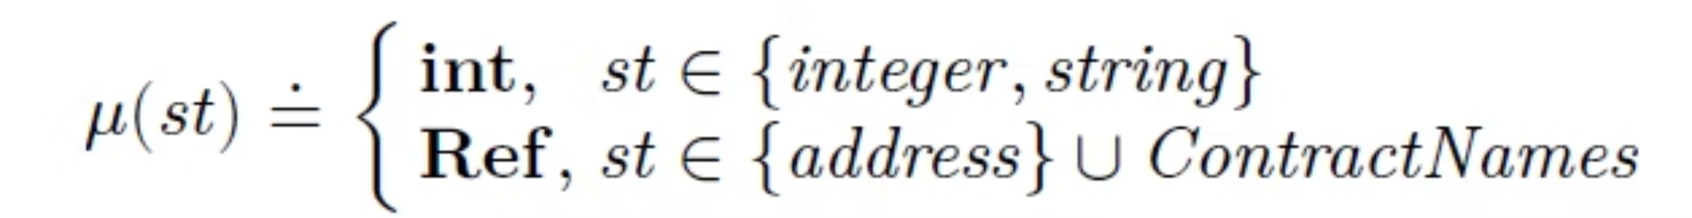

Mapping Solidity Types → Boogie Types
Solidity types are mapped using function μ:
Solidity
Boogie
int, string
int
address, contract name
Ref
Solidity strings = just equality → stored as integers (via StrToInt(hash))

Slide 28
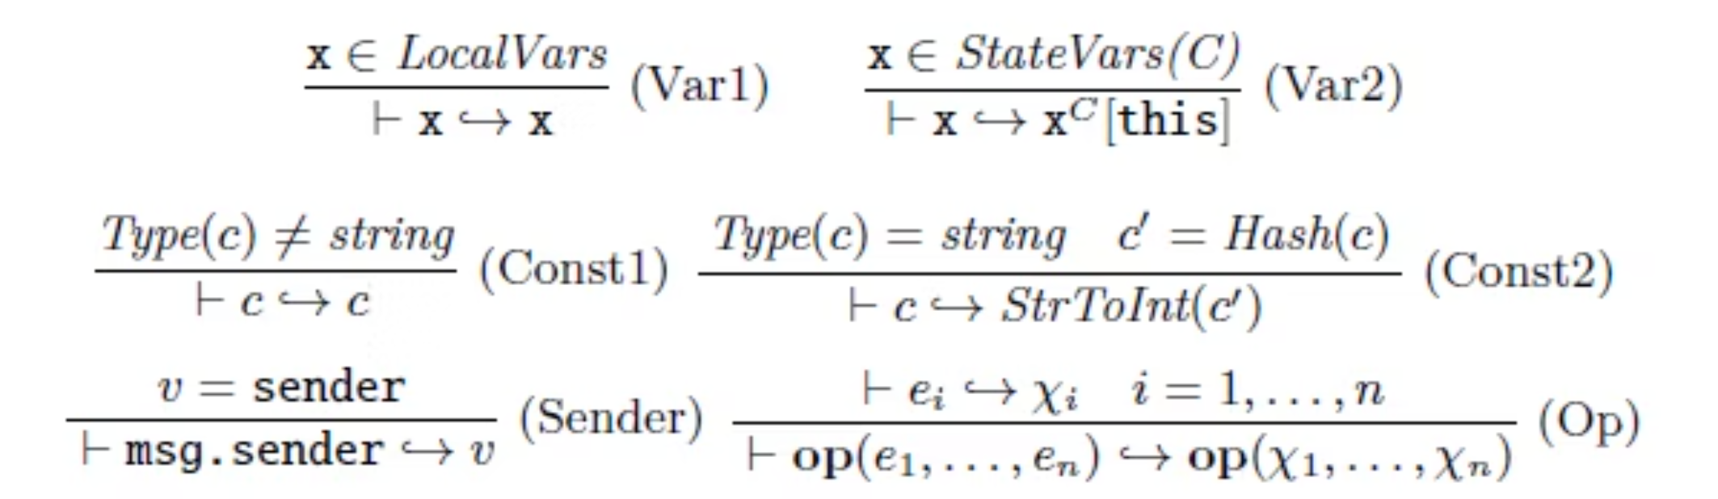
Translating Solidity Expressions to Boogie
Local Variablex ∈ LocalVars ⟹ x ↦ x➤ Local variables map directly to Boogie variables.
Sender Expressionmsg.sender ↦ sender➤ msg.sender becomes the sender value in Boogie.
State Variablex ∈ StateVars(C) ⟹ x ↦ xᴄ[this]➤ State variables map to contract-instance maps.
Operationsop(e₁,...,eₙ) ↦ op(x₁,...,xₙ)➤ Each subexpression is translated, then the full operation is reconstructed.
Constants
Type(c) ≠ string ⟹ c ↦ c➤ Numeric/boolean constants stay unchanged.
Type(c) = string,c′ = Hash(c) ⟹ c ↦ StrToInt(c′)➤ Strings are converted to integers via StrToInt.

Slide 29
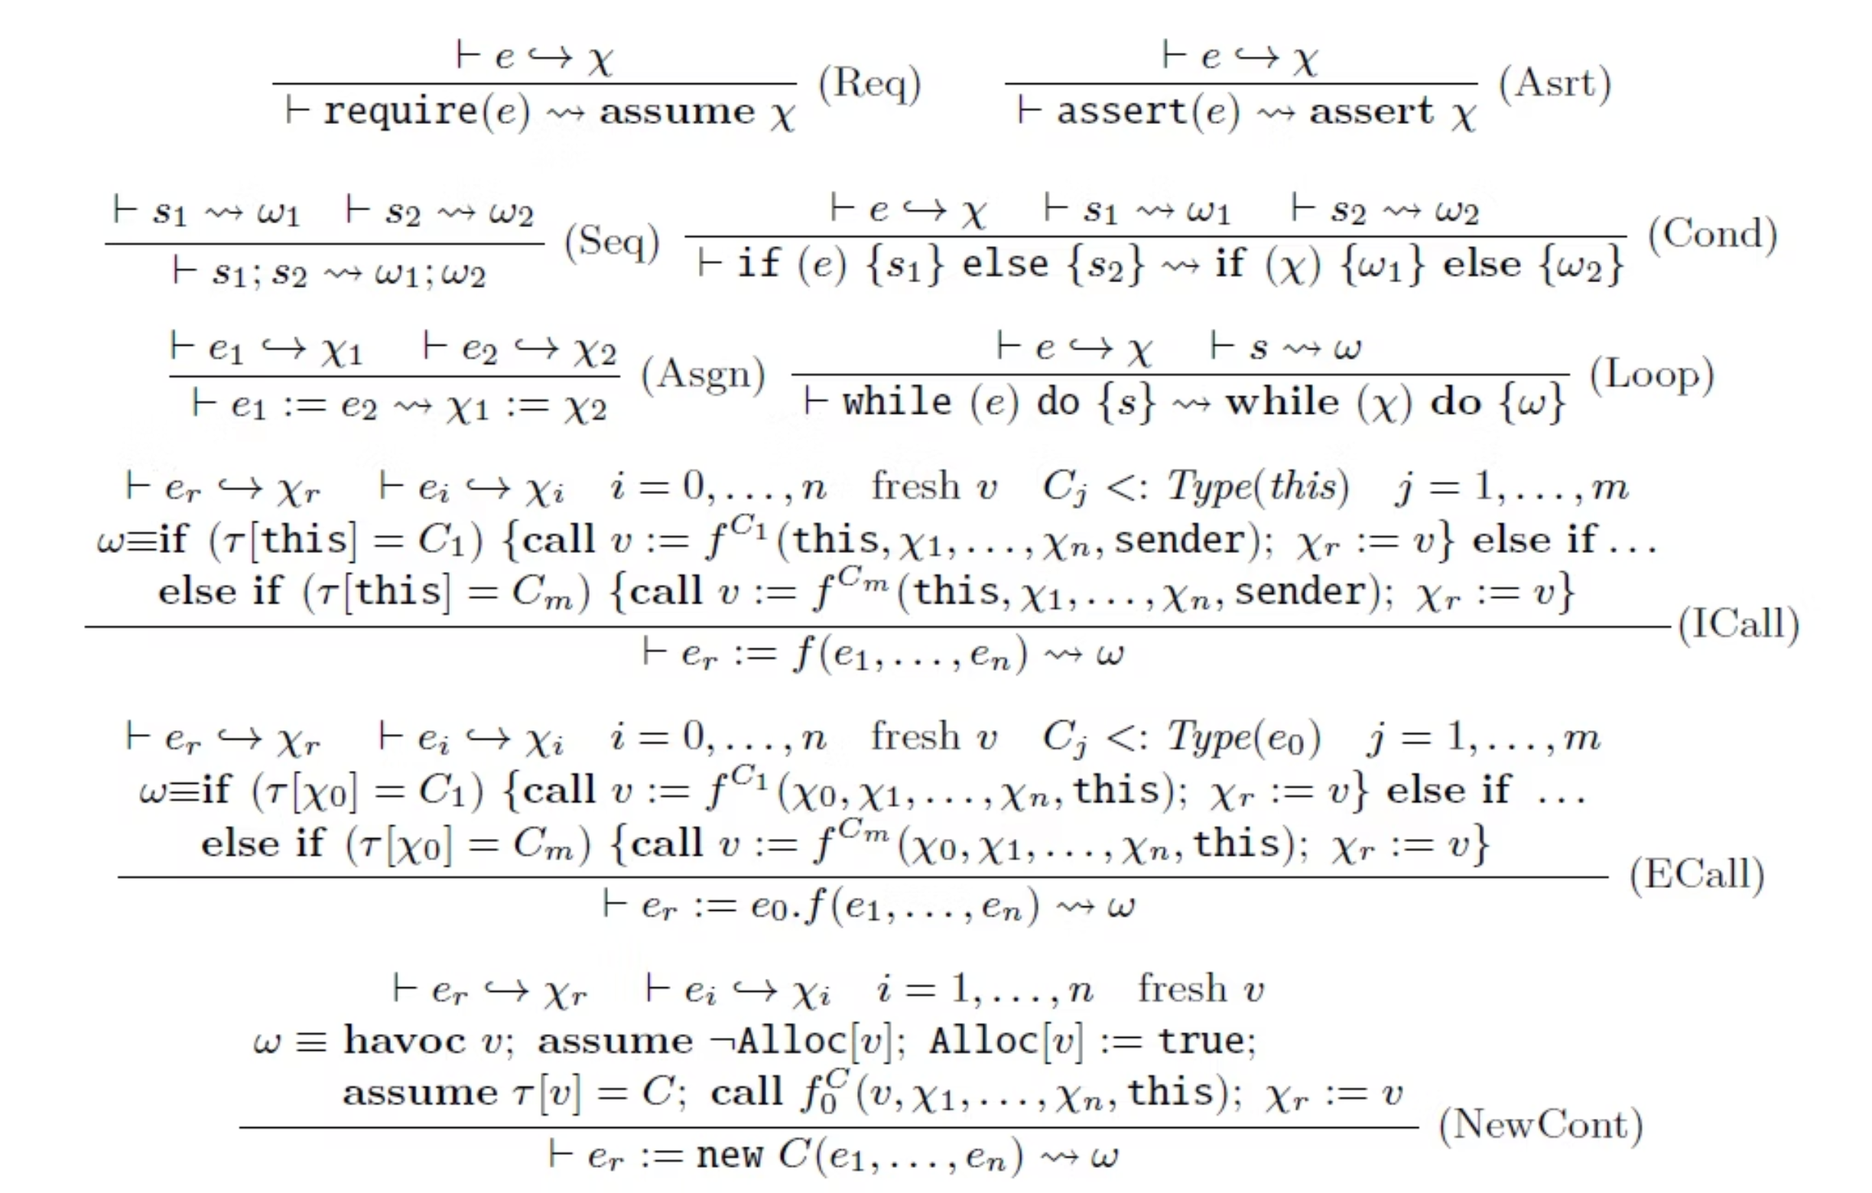
Translating Solidity Statements to Boogie
This translation ensures Solidity code can be formally verified in Boogie, enabling VeriSol to check correctness automatically.

Slide 30
Translating Solidity Statements to Boogie
• require(e) ↦ assume(χ)
• x := e ↦ x := χ
Preconditions in Solidity (require) become assume in Boogie.
Assignments are directly translated.
• assert(e) ↦ assert(χ)
• while (e) do { s } ↦ while (χ) do { ω }
Assertions in Solidity are kept as assert in Boogie.
Loops are translated by mapping the condition and body.
• s1; s2 ↦ ω1; ω2
• Internal Function Calls
Sequencing in Solidity directly translates to sequencing in Boogie.
If τ[this] = C1, call f in C1, else check other types dynamically.
• if (e) { s1 } else { s2 } ↦ if (χ) { ω1 } else { ω2 }
• External Function Calls
Conditional statements are translated while preserving structure.
Similar to internal calls but pass this as msg.sender and handle dynamic dispatch.
• new C(e1,...,en)
Creates a new contract:
havoc v (allocate fresh reference)
Set type mapping τ[v] = C
Call the constructor fC0
Assign reference v back.

Slide 31
Invariant Generation in VeriSol
1
What is it?
VeriSol automatically infers contract invariants, which are logical conditions that must always hold during any execution of the smart contract
2
How does it work?
Uses Monomial Predicate Abstraction:
  Starts with a set of candidate predicates (e.g., e1 == e2, e1 ≠ e2).
  Candidates are built from roles, states, and constants in the contract.
  Assumes all candidates as an invariant and progressively weakens if a candidate fails to hold.
3
Why is it important?
If VeriSol finds an invariant:
  Confirms the contract is fully verified under any execution.
  Ensures all assertions will hold during any function call sequence.
Fast and scalable, even for large contracts.
4
Summary:Invariant Generation is the core step that enables VeriSol to automatically verify smart contracts and guarantee correctness before deployment.

Slide 32
Bounded Model Checking in VeriSol
When is it used?
If Invariant Generation fails to fully verify the contract, VeriSol switches to Bounded Model Checking (BMC) using Corral.
Why does it happen?
Not all the contracts can be proven to be fully verified using an existing invariant, especially where there are complex structures or recursive calls. (We will see an example later.)
What does it do?
Analyzes the contract harness by unrolling the execution loop k times.
Searches for counterexamples (assertion failures) within those k transactions.
Uses abstraction refinement to focus only on relevant execution paths for efficiency.
Possible outcomes:
Counterexample found:VeriSol identifies a specific sequence of transactions that causes an assertion failure in the contract.
Verified up to k transactions:No counterexample was found in k executions, providing bounded confidence in the contract’s correctness.
Summary:
Bounded Model Checking allows VeriSol to catch deep bugs that Invariant Generation could not prove, ensuring robust verification before deployment.

Slide 33
Comparing Invariant Generation vs. Bounded Model Checking
Aspect
Invariant Generation
Bounded Model Checking (BMC)
What it checks
A logical rule that always holds (Invariant)
Simulates actual function calls up to k steps
Method
Uses abstraction to prove correctness
Unrolls function call sequences
Outcome
Fully Verified if invariant holds
Verified up to k or finds a counterexample
Weaknesses
May fail if no suitable invariant exists
Cannot find bugs beyond k steps
Usage
First step in VeriSol verification
Used when invariant generation fails
Together, these methods provide strong, automated verification of smart contracts before deployment.

Slide 34
Evaluation Results
Goal:
To test VeriSol’s effectiveness and efficiency in verifying semantic conformance between Azure Blockchain Workbench smart contracts and their defined policies.
What was tested?
All 11 official Workbench sample contracts from GitHub.
Included various real-world workflows using:
  Arrays
  Nested contract creation
  External calls
  Enum types
  Mutual recursion
How?
Instrumented each contract with assertions based on the FSM policy.
Ran VeriSol to check for assertion violations.
Purpose:
To automate correctness checks for smart contracts before deployment in enterprise blockchain environments.

Slide 35
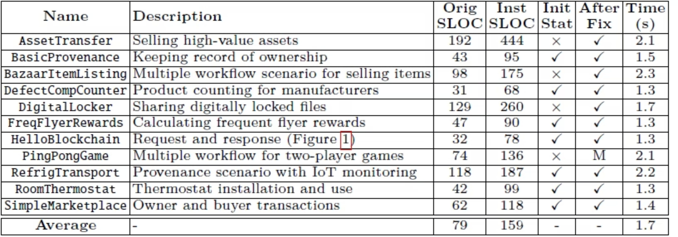
Evaluation – Summary Table
Orig SLOC - Number of source lines of code in the original contract before adding instrumentation.
Inst SLOC - Number of source lines of code in the contract after adding the instrumentation.
The instrumentation of the modifiers and assertions needed for the testing of the contracts.

Slide 36



Lessons Learned from Evaluation
VeriSol is effective
Found 4 real bugs in well-tested contracts.
Clearly showed the exact transaction sequence causing the issue.
In three of the contracts, the bugs were found, minor changes in the policy of the contract were enough to fully verify the contract with invariant generation.
Full verification achieved
After fixing the bugs, all 11 contracts were fully verified using VeriSol.
Invariant Generation sufficed in most cases
In 10 out of 11 contracts, automatic invariant generation was enough for full push-button verification.
Manual effort for complex cases
For PingPongGame, manual summaries for recursive functions were needed due to mutual recursion.
Conclusion:
VeriSol automates correctness checking of smart contracts effectively, helping developers catch deep bugs early before deployment.

Slide 37

Case Study: PingPongGame
What happened?
The contract uses mutual recursion between two contracts.
VeriSol could not automatically generate a sufficient invariant due to this complexity.
What was needed?
Added a manual function summary to assist VeriSol.
This summary stated:
“If the sender calls a recursive function, the sender’s state sw[msg.sender] will be in s1 or s2.”
Result:
After adding the summary:
VeriSol successfully verified the contract.
Demonstrated VeriSol’s ability to handle non-trivial contracts with minimal manual effort.
Key Takeaway:
PingPongGame required manual assistance, but once provided, VeriSol completed the formal verification successfully.

Slide 38


🐞 Bug Analysis
Two main bug types identified:
Incorrect State Transition
Incorrect Initial State
Occurs when a function changes the contract’s state in a way that violates the policy’s FSM.
Examples:
In DigitalLocker, the initial state was incorrectly set to DocumentReview instead of Requested.
Example:
In AssetTransfer, the Accept() function transitioned to Accepted instead of SellerAccepted as required by policy.
In BazaarItemListing, the developer did not set the initial state at all, violating policy.
Key Takeaway:
VeriSol effectively pinpointed deep bugs in state handling and initialization, enabling precise fixes before deployment.

Slide 39
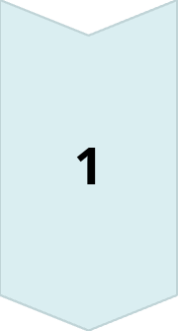


Related Work
Three main approaches to smart contract security:
Static Analysis
Uses data-flow analysis or symbolic execution to find known vulnerability patterns (e.g., reentrancy, transaction ordering).
Tools: Oyente, MAIAN, Manticore, Mythril++, Securify, Slither, MadMax.Do not check semantic conformance or verify assertions.
Formal Verification
Translates Solidity to formal languages (F*, LLVM) and uses SMT solvers for correctness proofs.
Tools: F*, Zeus.
Limitations:
  Supports only a subset of Solidity.
  Requires significant manual guidance.
  Zeus does not check semantic conformance.
Other Approaches
Runtime safety enforcement (e.g., safe reentrancy patterns).
FSolidM: FSM-based contract modeling but lacks:
  Access control checks.
  Support for loops/nested calls.
  Static or dynamic verification.
Key Takeaway:
VeriSol is unique in providing automated semantic conformance checking with formal verification, ensuring smart contracts match FSM policies before deployment.

Slide 40




Our Recommendations for Future Work
Obtain access to Zeus to compare VeriSol’s verification capabilities and limitations more thoroughly.
Expand invariant templates to handle even more complex recursive contracts automatically.
Integrate VeriSol with developer pipelines for real-time smart contract verification during development.
Publish more real-world case studies to check VeriSol performances on more smart contracts.

Slide 41
Conclusion
The paper presents VeriSol, an automated formal verification tool for smart contracts in Azure Blockchain Workbench.
🔹 Objective:To ensure that smart contracts conform semantically to their workflow policies before deployment.
🔹 How it works:
Uses program instrumentation to insert assertions reflecting the workflow policy into the smart contract.
Translates the contract into the Boogie intermediate verification language.
Applies invariant generation to prove correctness under all possible executions.
If invariant generation is insufficient, it applies bounded model checking (BMC) to explore transaction sequences up to a certain depth (k) for potential bugs.
🔹 Key Capabilities:
Detects incorrect state transitions and initialization errors in smart contracts.
Provides precise counterexamples when violations are found, helping developers fix issues.
Successfully verified a range of real-world contracts, demonstrating efficiency and scalability.
In essence:
VeriSol enables automated, formal, and scalable verification of smart contracts, ensuring they adhere to workflow policies and reducing the risk of critical bugs in enterprise blockchain environments.

