Slide 1

Proof-Carrying Smart Contracts
Thomas Dickerson , Paul Gazzillo , Maurice Herlihy ,Vikram Saraph , and Eric Koskinen
Or Levy
Shira Goshen

Slide 2
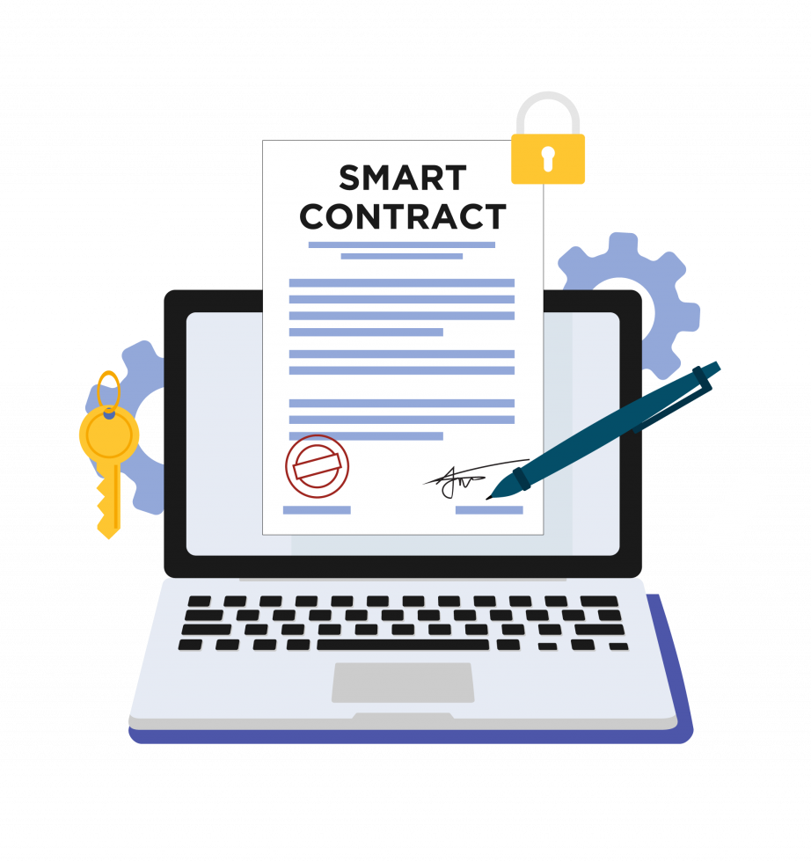
Introduction

Slide 3
Agenda
Background
Proof - Carrying Code
Modification to blockchain
PCSC Architecture
Examples

Slide 4
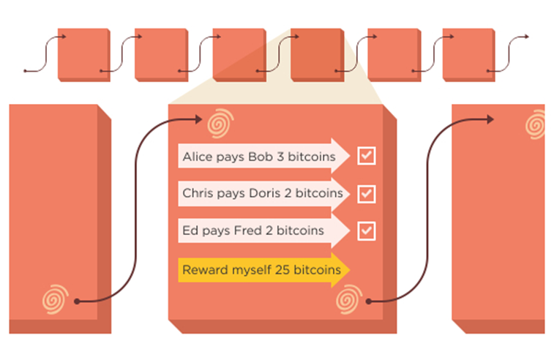
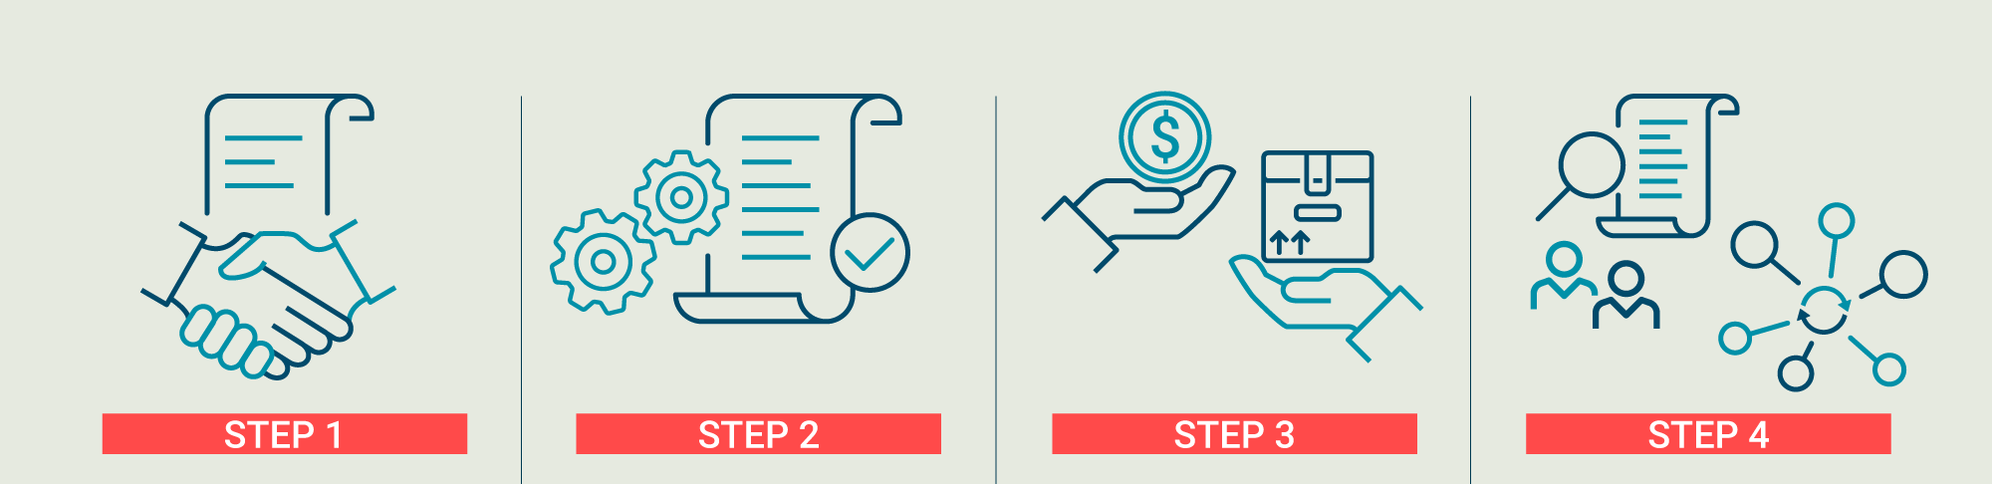
Background
Blockchain
Smart Contracts

Slide 5
Verifying Smart Contracts
Security Assurance
Error Detection
Regulatory Compliance
Cost Efficiency
Notes:
לדבר על הסירטון

Slide 6

How do we verify smart contracts
Combining code and formal proof
Proof-Carrying Code (PCC) model

Slide 7

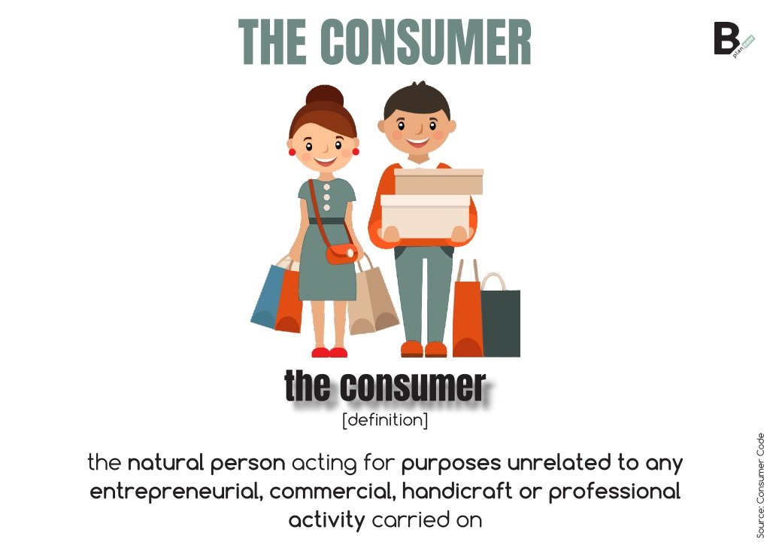

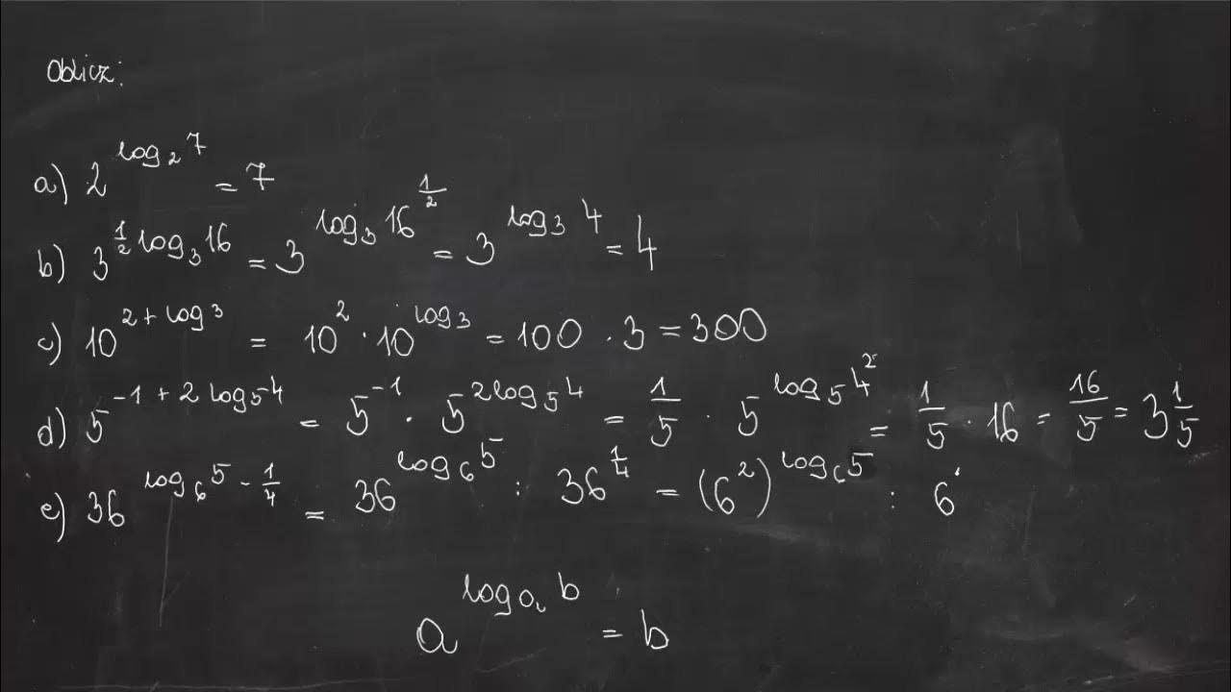

Introduction to PCC
Producer
Consumer
Safety policy
Safety proof
Validation
creating the code and the formal proof
defines the safety policy and checks the proof
Contains safety rules and interface
The code respects the safety rules
Validation of the safety proof

Slide 8
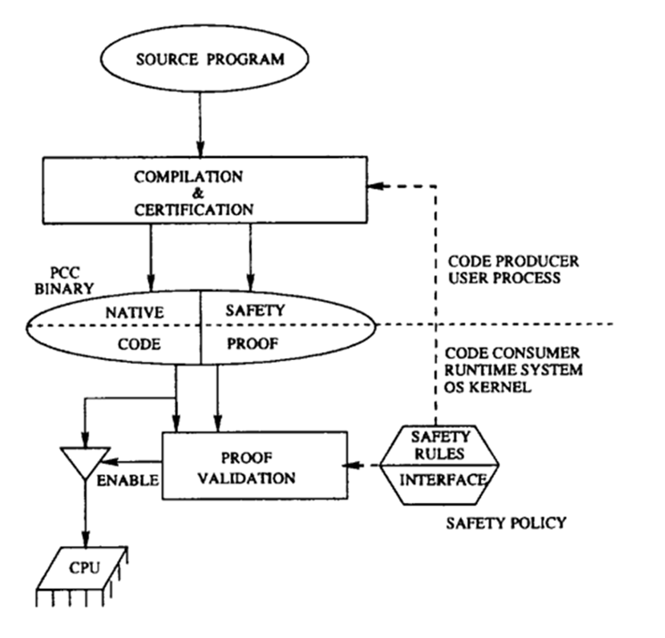
PCC Diagram

Slide 9





Proof-Carrying Code
Maintenance and Updates
Requires Formal Safety Proof
Simple Validation Process
Independent of Cryptography
Focus on Code Safety

Slide 10

The Challenges to Modify PCC for Blockchains
Where are these specifications stored ?
Who generates the proofs ?
Which code needs to be verified ?
How do miners repeatedly validate the proofs ?
What format is needed for contracts specifications ?

Slide 11
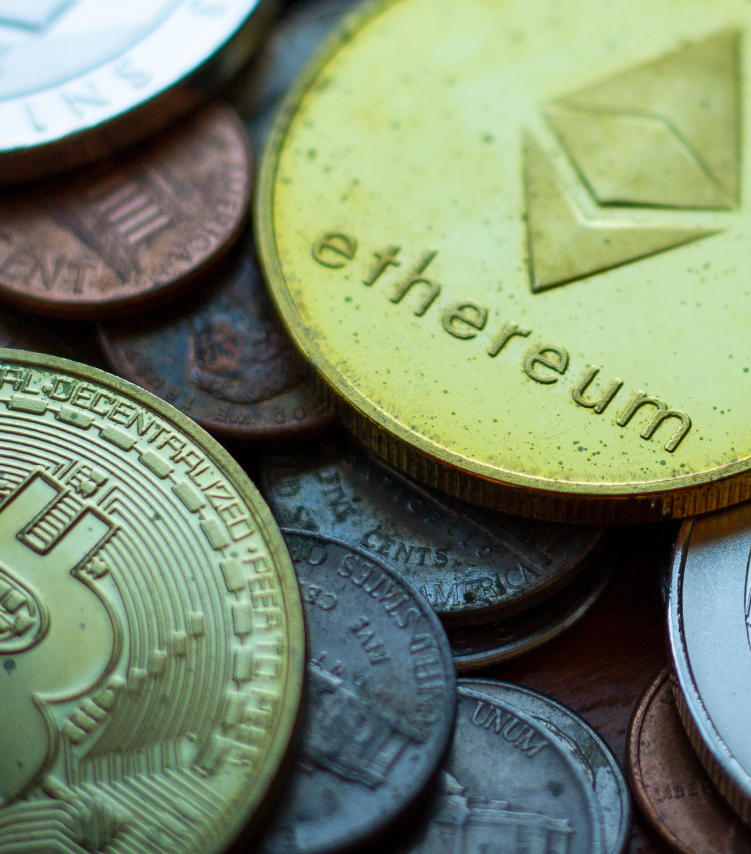
Proof-Carrying Smart Contracts
Updates
New Producer & Consumer
Lowering the overhead when needed to update something in the contract.
We divide it to 2 categories small change and big change.
Producer – write the code, proof and decide the specification
Consumer – check the specification of the contract and decide if he wants to activate it
Proof-Carrying Smart Contracts

Slide 12

Miners
Role Of Miners
How to Become a Miner
Transaction Validation
Network Security
Creation of New Blocks
Rewards
Energy and Resources
Join a Mining Pool

Slide 13
Modification
Safety Rules
Specification
Verification
SAFEUPDATE
Consumer
Validator
Proof Validators
Miners
Producer
Code + Specification
Notes:
להוס יף פרודוסר

Slide 14

PCSC Architecture
Parent Contract
Child Contract
API Methods
Formal Specifications
Childs Address
DELEGATECALL function
Precondition
Post condition
Source code
Proof that the implementation satisfies the specification
SAFRUPDATE function
Proof-Carrying Smart Contracts

Slide 15




Blockchain
Child Contract
Parent Contract

Slide 16

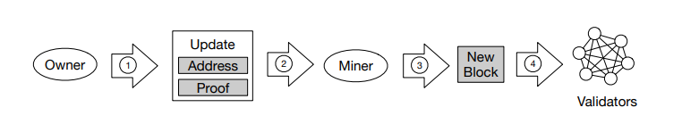
New Blook
Step 1
Step 2
Step 3
Step 4
Producer creates the code and specifications
Proof packed in the block and ready for mining
Miner validate the proof and mine a new block
Validators validate the proof by SAFEUPDATE and decide if they want to activate the contract

Slide 17
Updating Contract
Why to update
Challenges
Solution
Bugs
Specification not safe
Irrelevant functions
Immutable
Irrevocable
Overhead
Minor Upgrade
Major Upgrade

Slide 18
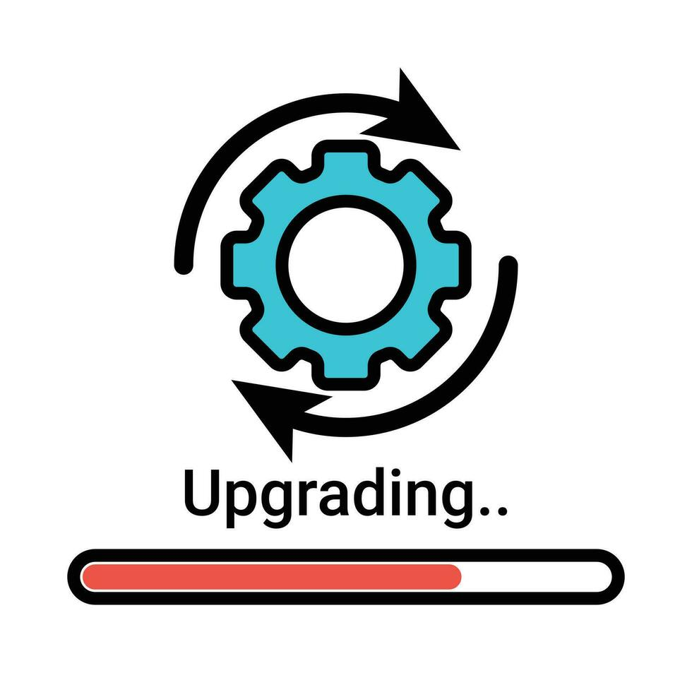
Minor Upgrade
Updating the child contract while preserving the parent contract.
Verify the child contract with the same SAFEUPDATE function.
Use for minor changes like optimization and unnecessary functions.
Reduces the need to trust developers completely.
No additional proof necessary.

Slide 19
Major Upgrade
Altering the existing specifications of the parent contract.
Needs the approval of all the participants.
Verify the new child contact against the new parent specifications.
Updating the contract to include new security invariants.
Parent Contract Modifications Trigger the Creation of a New Block
Proof-Carrying Smart Contracts
19

Slide 20
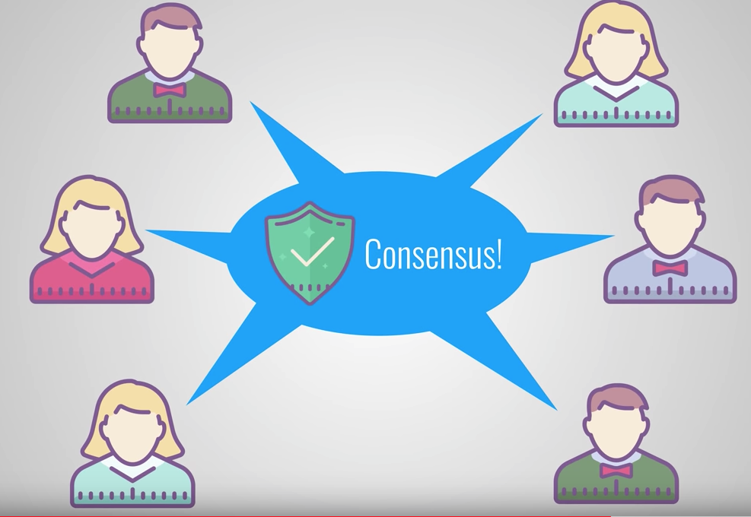
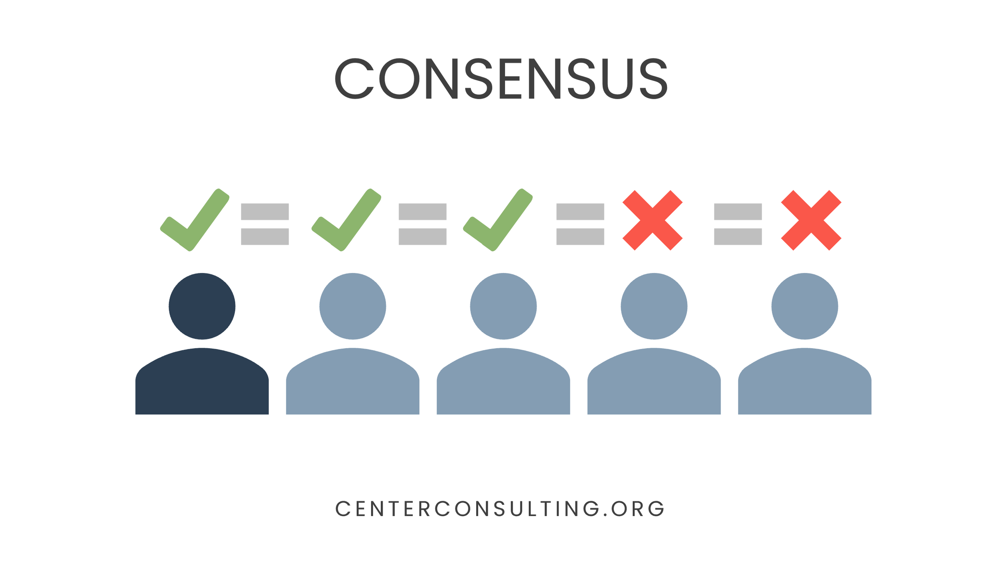
More Then Two Participants
Multi-Party Contracts
Role of Participants
Consensus on Updates
Multiple child contracts
Proof-Carrying Smart Contracts
20

Slide 21
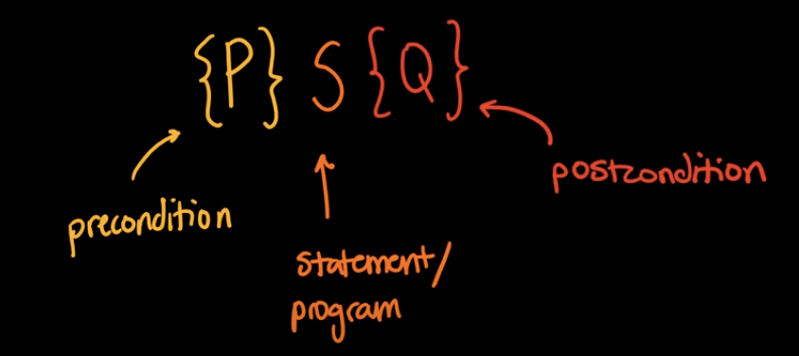
Hoare Logic
What is Hoare Logic?
A formal system used to reason about the correctness of computer programs.
Uses triples {P} C {Q} to represent program correctness.
Notes:
What is Hoare Logic?
A formal system used to reason about the correctness of computer programs.
Uses triples {P} C {Q} to represent program correctness.
Components of Hoare Logic:
Precondition (P): The condition that must be true before executing the command C.
Command (C): The sequence of program commands or operations being analyzed.
Postcondition (Q): The condition that must be true after the command C is executed, assuming the precondition was met.
Purpose of Hoare Logic:
Provides a methodological framework to ensure that programs perform as expected.
Helps in verifying program properties without executing the program.
Significance in Software Development:
Essential for developing reliable and secure software systems.

Slide 22
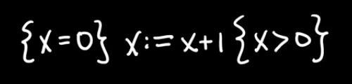

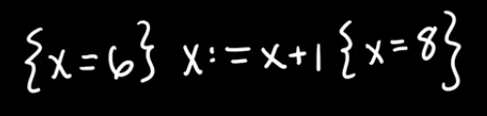

Simple Hoare Triple Examples

Slide 23
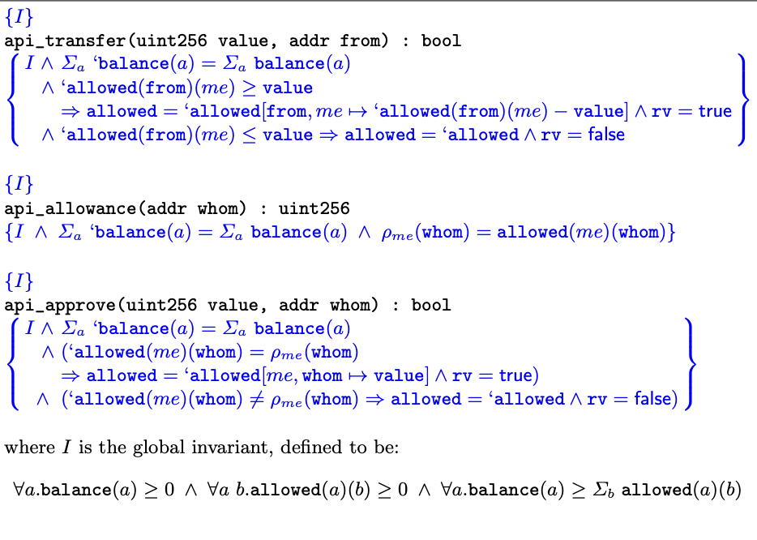
Applying Hoare Logic in PCSC
Formal Specification: Ensures behavior matches expectations
Parent Part of PCSC: guiding the implementation of contract methods
Notes:
Parent part – specification
I – באלנס תמיד אי שלילי, מגבלה אי שלילית, באלנס גדול מהמגבלות
אחרי הפעולה
* סכום כל הכף לא משתנה
* אם העברה אושרה-היה מספיק כסף להעביר ונוריד את הכסף מהיתרה
* העברה לא אושרה – במקרה שלא היה מספיק יתרה, ולכן אין שינוי בבאלנס

Slide 24
Ensuring Safe TRANSFER Operations
What conditions need to be true before we can run the transfer function?
Pre-condition
What conditions need to be true after we run the transfer function?
post-condition
Notes:
Parent part – specification
I – באלנס תמיד אי שלילי, מגבלה אי שלילית, באלנס גדול מהמגבלות
אחרי הפעולה
* סכום כל הכף לא משתנה
* אם העברה אושרה-היה מספיק כסף להעביר ונוריד את הכסף מהיתרה
* העברה לא אושרה – במקרה שלא היה מספיק יתרה, ולכן אין שינוי בבאלנס

Slide 25
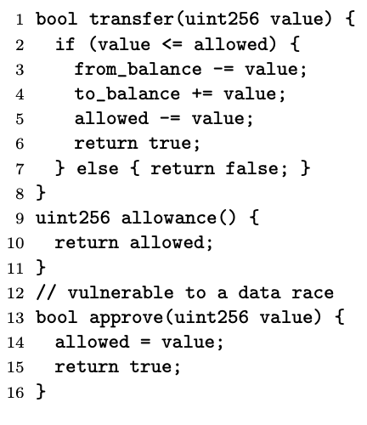
Does This Code Fulfill the Contract Requirements?
Child’s implementation:
No ! Double spending problem

Slide 26
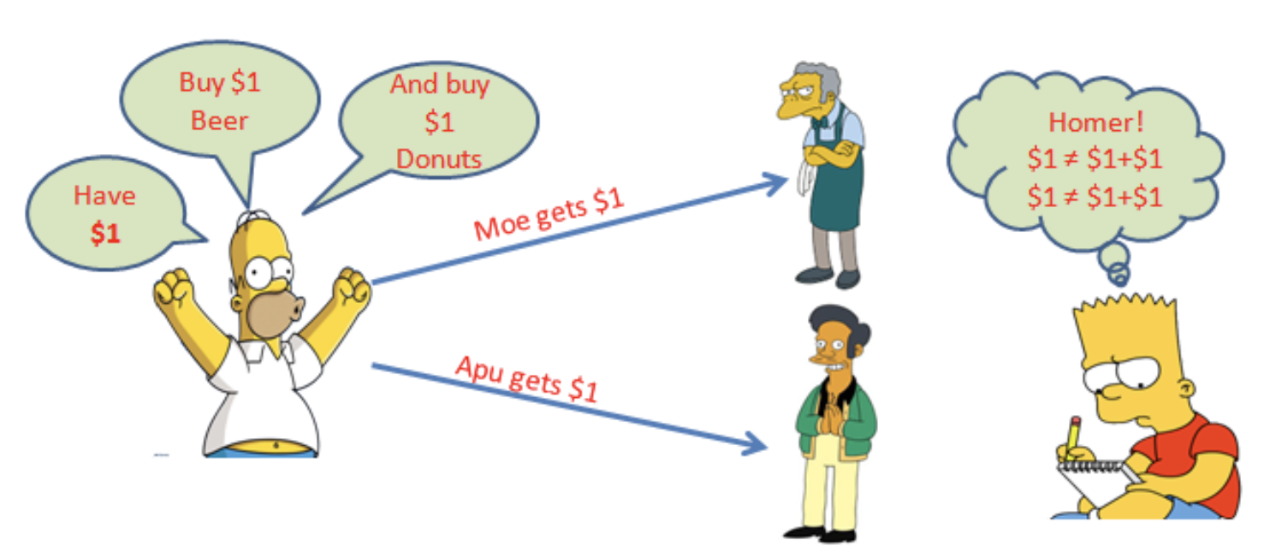
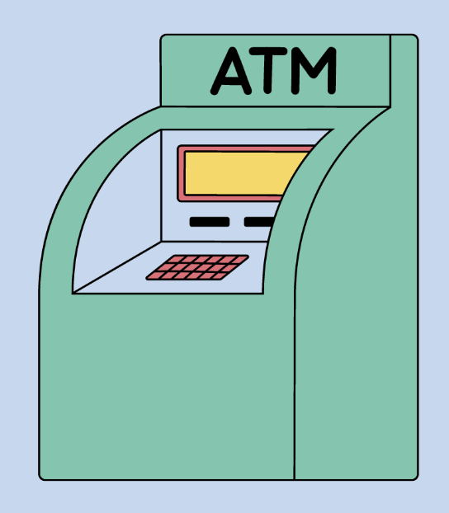
Example- Double Spending
What is Double Spending ?
Allows an attacker to spend more tokens than originally approved
Exploits weaknesses in token contract's transfer and approval logic

Slide 27
Remix
Web-Based IDE
Smart Contract Development: writing, compiling, and deploying Solidity smart contracts.
Testing Tools
Plugins Support: Contract Management, User Simulation, Wallet Integration, Transaction Management
link
Proof-Carrying Smart Contracts

Slide 28
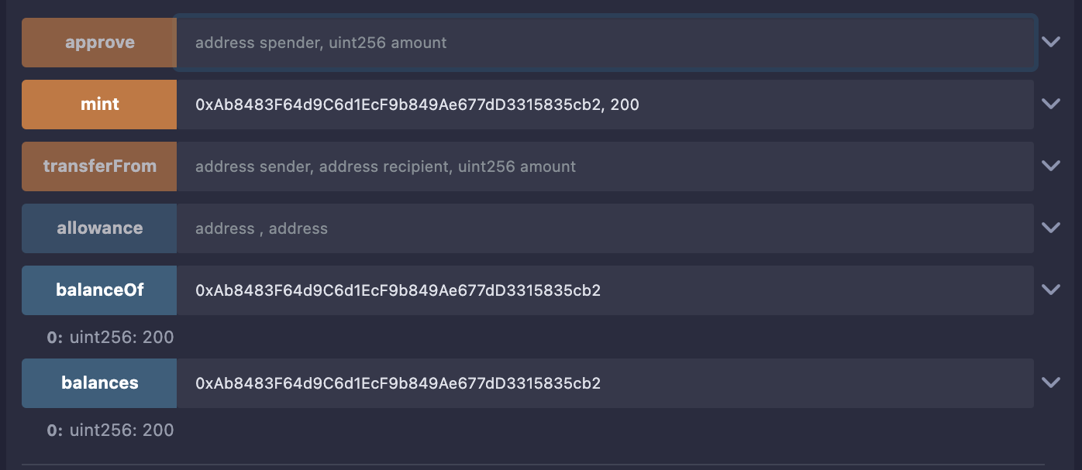
Attack Scenario
Alice has 200 tokens
Proof-Carrying Smart Contracts

Slide 29
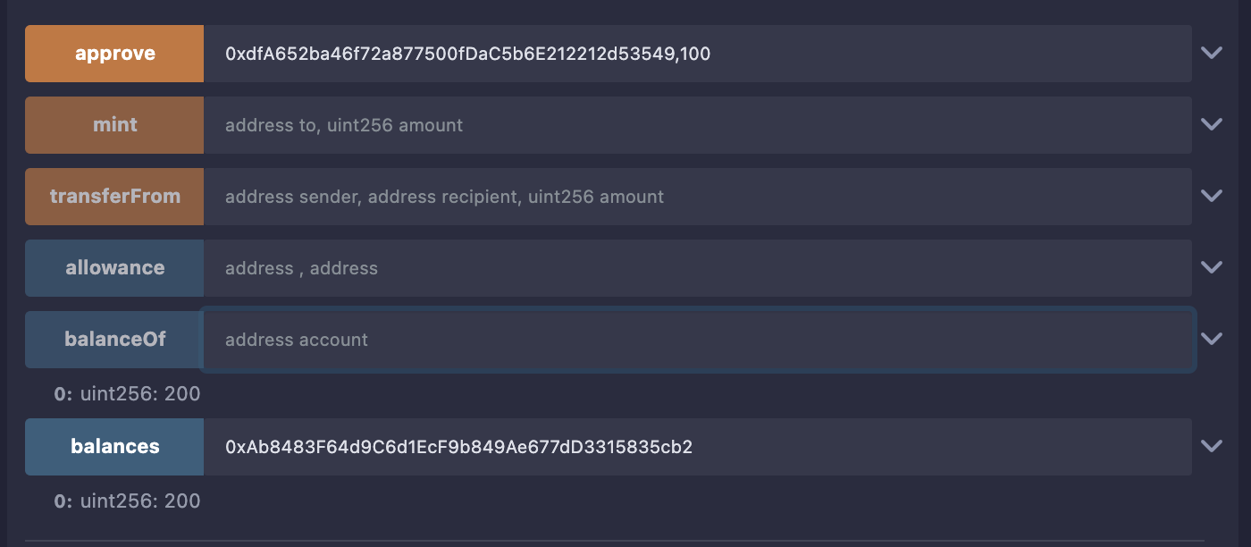
Attack Scenario
Alice approves Bob’s contract 100 tokens
Proof-Carrying Smart Contracts

Slide 30
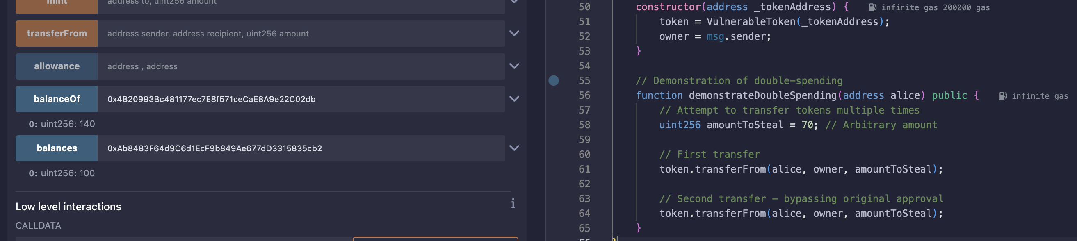
Attack Scenario
Bob bypass approval limits
200 < 140 + 100
Proof-Carrying Smart Contracts

Slide 31


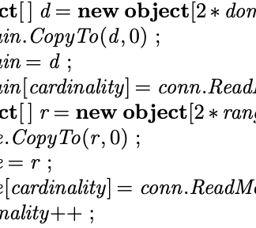

How Can We Know if the Code Complies with the Contract?
Why3
Dafny
Spec#
A verification platform that uses deductive methods to verify program correctness
A programming language with built-in features for automatic verification
Integrates formal specifications directly into C#
Boogie
verification of high-level specifications
Notes:
Spec#: Explain its use in integrating formal specifications within the C# programming language. Boogie: Describe how it acts as an intermediate verification language to aid in the formal verification process. Dafny: Introduce Dafny as a language designed to handle automatic program verification. Why3: Mention Why3 as a platform for deductive program verification that supports various prover backends.

Slide 32

Future Goal
Formally model and implement proof-carrying smart contracts as extensions of existing blockchain technologies
Proof-Carrying Smart Contracts

Slide 33

Summary
Separate Specifications and Implementation
Reconciling Immutability with Flexibility
The research is at an early stage
proof-aware consensus
Notes:
Addressing the challenge of immutable smart contracts versus the need for updates to correct bugs.
Proposed solution: Abstracting contracts to guarantee an invariant rather than a fixed implementation.
Integration of Proof-Carrying Code with Blockchain:
Utilizing proof-carrying code and proof-aware consensus to allow updates that ensure the invariant is not violated.

Slide 34


Thank you !

